Slide 1
Project Clara
Sprint 4
Foxcorp
Team Members:
Abeer Syed
Abraham Abebe
Douglas Borovina
Hayat Dahraj
Jacob Gallagher

Slide 2
Problem Statement
Currently, Parents have no good way of knowing what their child is doing at school, which contributes to several problems in both the families' lives and the teachers'.
Parent anxiety about child's whereabouts throughout the day
No information on child's wellbeing throughout the day
Lack of parental engagement in child's education
No efficient channels to communicate concerns to teachers
Burden on teacher to manage several fragmented communication channels

Slide 3
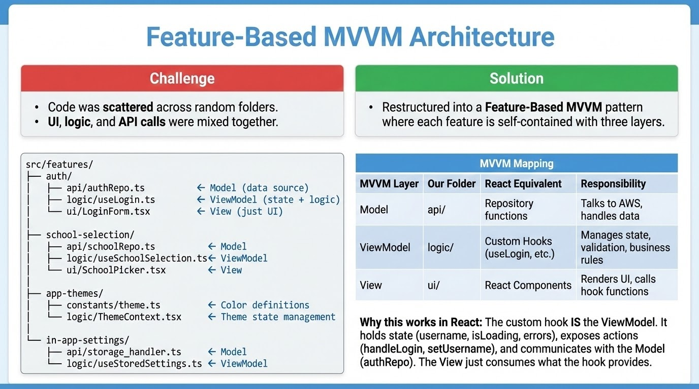
Reorganized File Structure

Slide 4
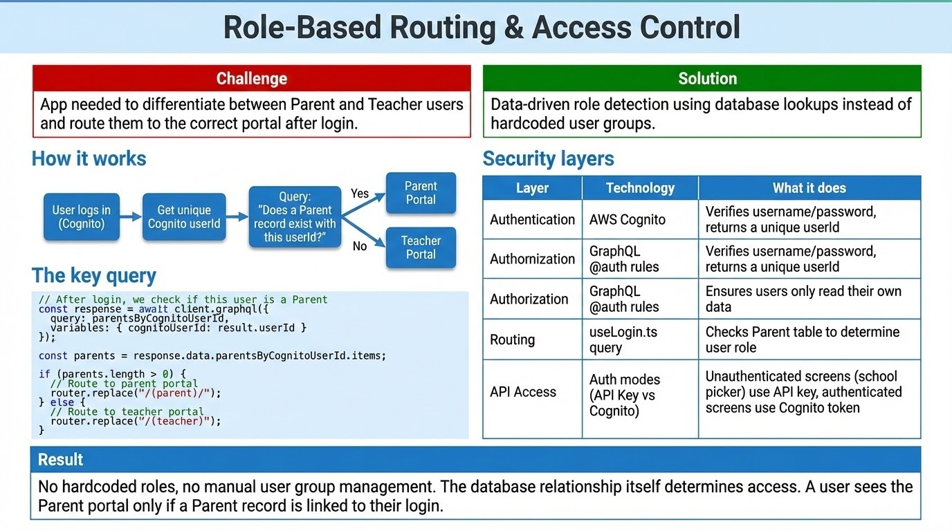

Slide 5
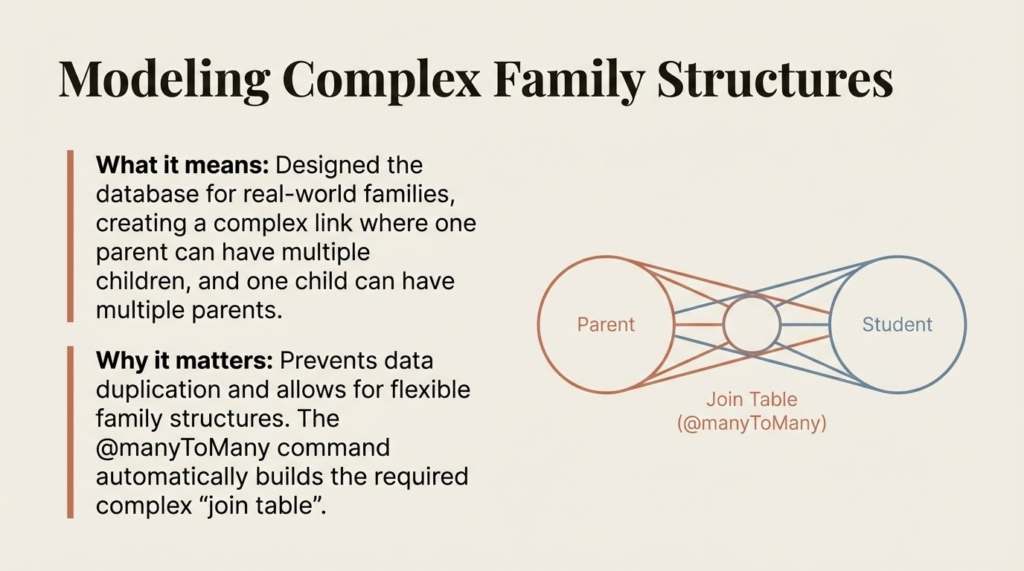
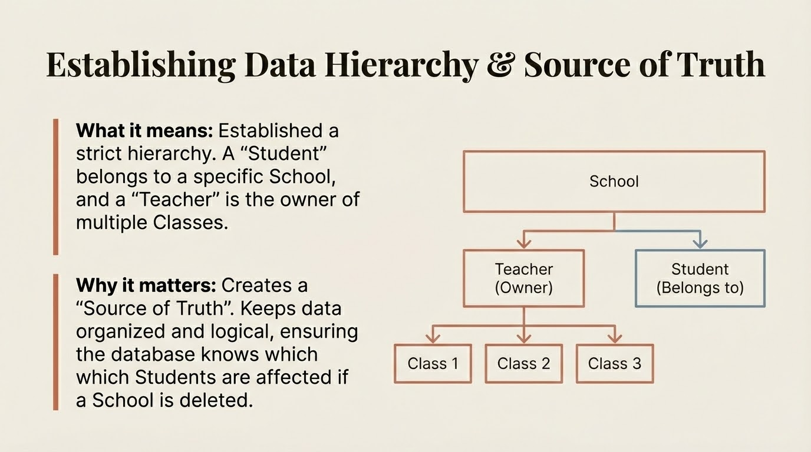

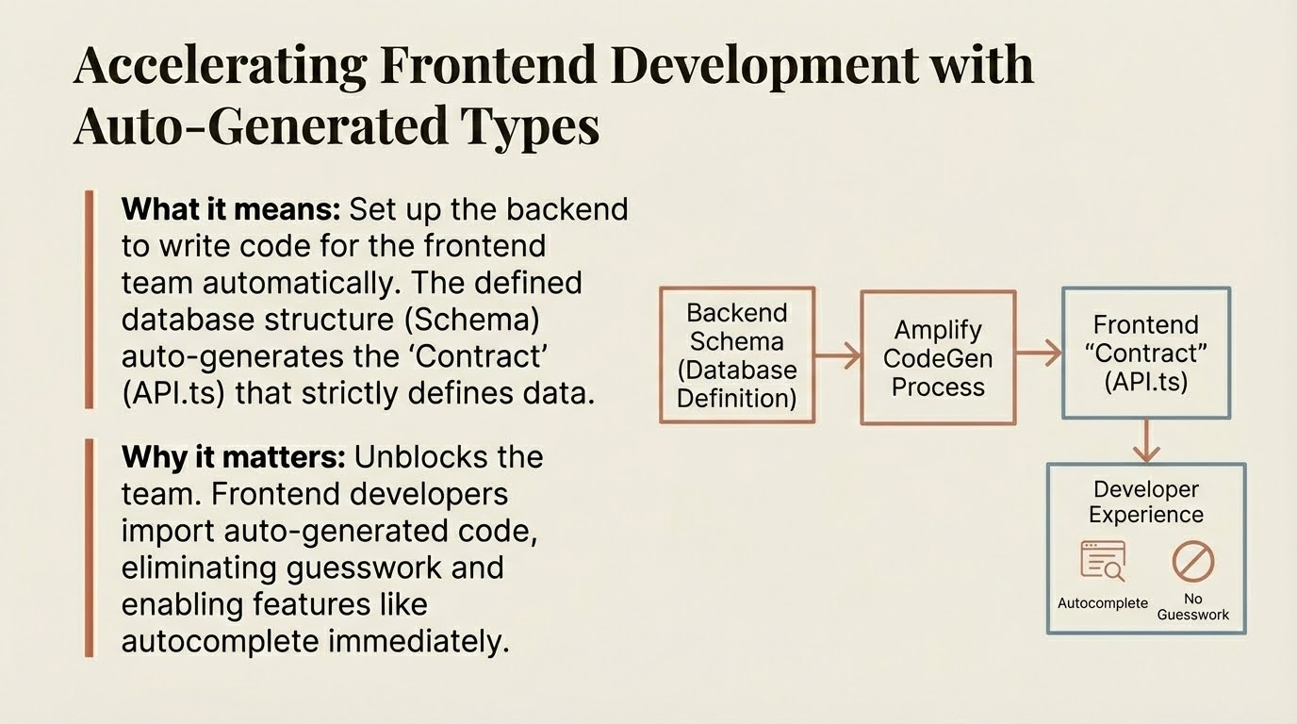
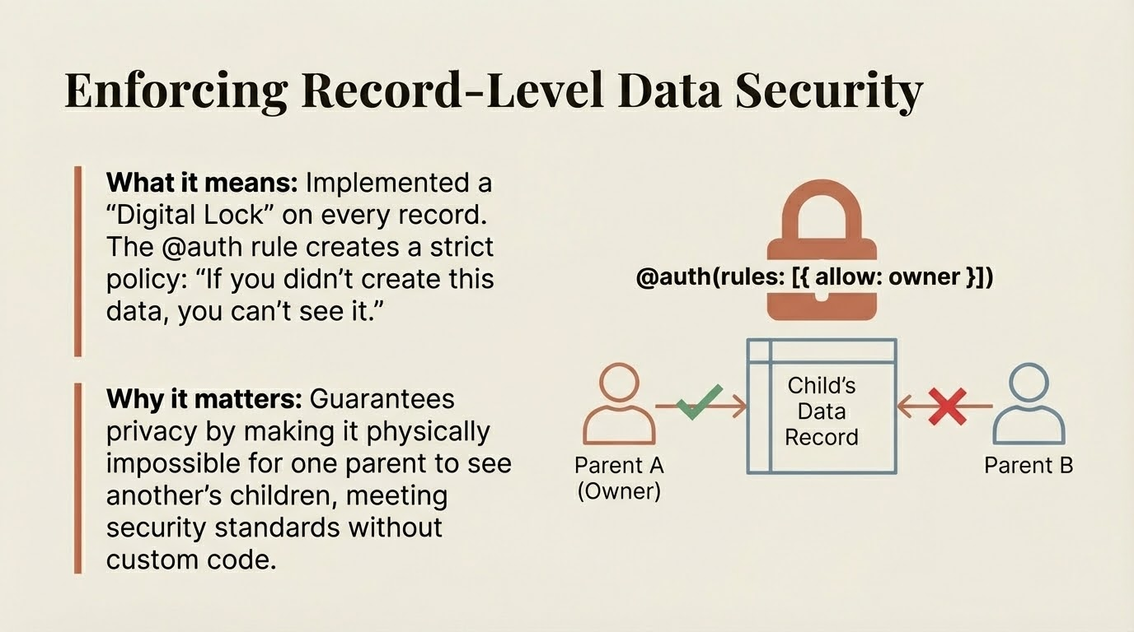

Slide 6
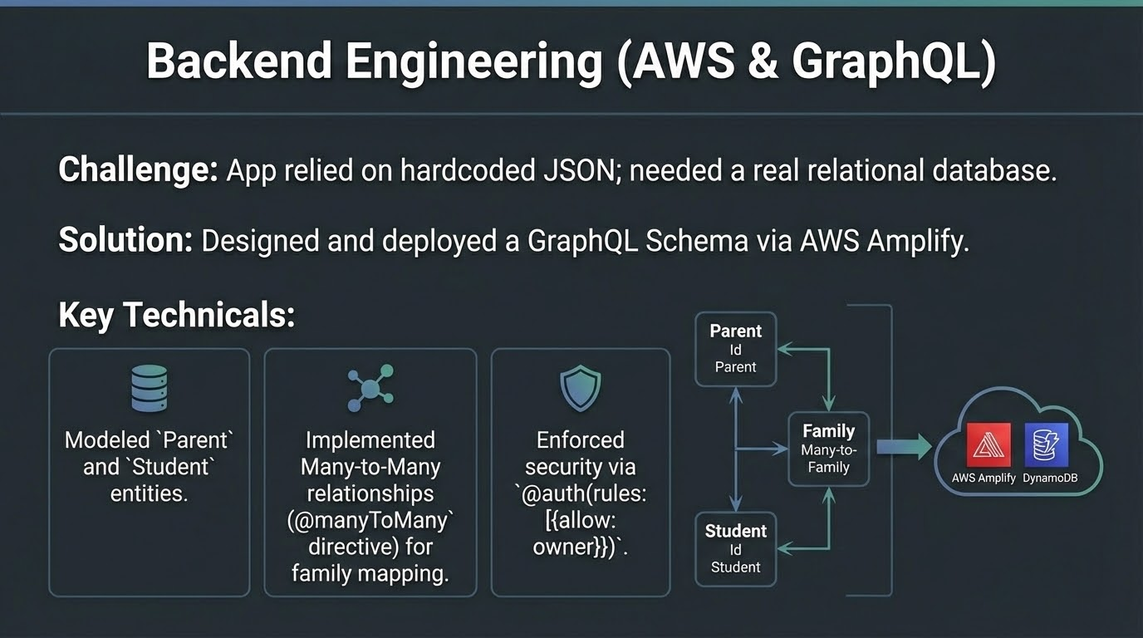
Backend – 1
Backend Data Architecture

Slide 7
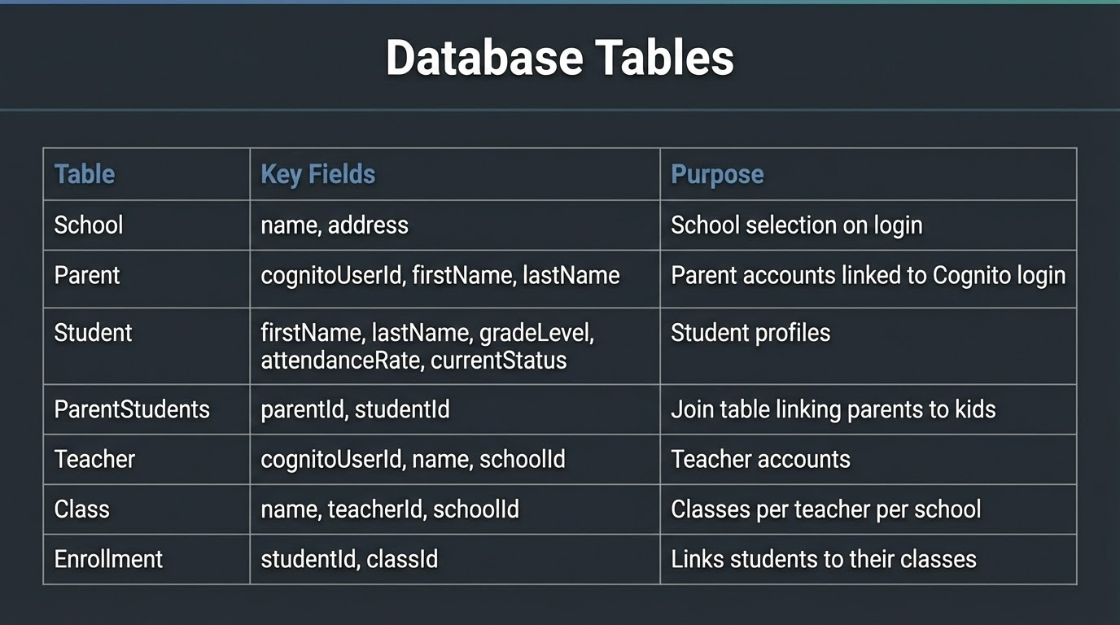
Database: Tables Created

Slide 8
Backend: Additional Tables
Incidents: Records incidents reported by teachers involving specific students.
- Incidents are linked to Teacher, Student, Class and School(one-to-many).
- Lets the teachers report issues.
- Stores Date, Description, Severity of incldent, studentId, classId, schoolId
Examples: Injury, Classroom Disruption, Nurse visit
MedicalRecord: Stores student medical information such as allergies and medication.
- Medical Records are linked one to one with each student.
- Helps teachers and staff respond safely.
- Stores studentId, allergies, medications, notes/emergency info
Examples: Peanut Allergy, Asthma inhaler, EpiPen required, Insulin
Queries Available:
IncidentsByStudentId- gets all incidents for a student
IncidentByTeacherId – gets all the incidents reported by a teacher
MedicalRecordsByStudentId – gets a student's medical record

Slide 9
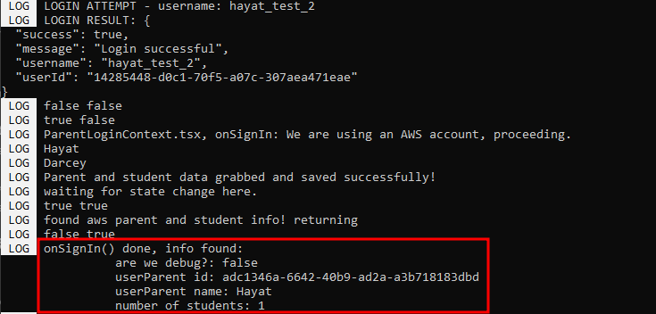
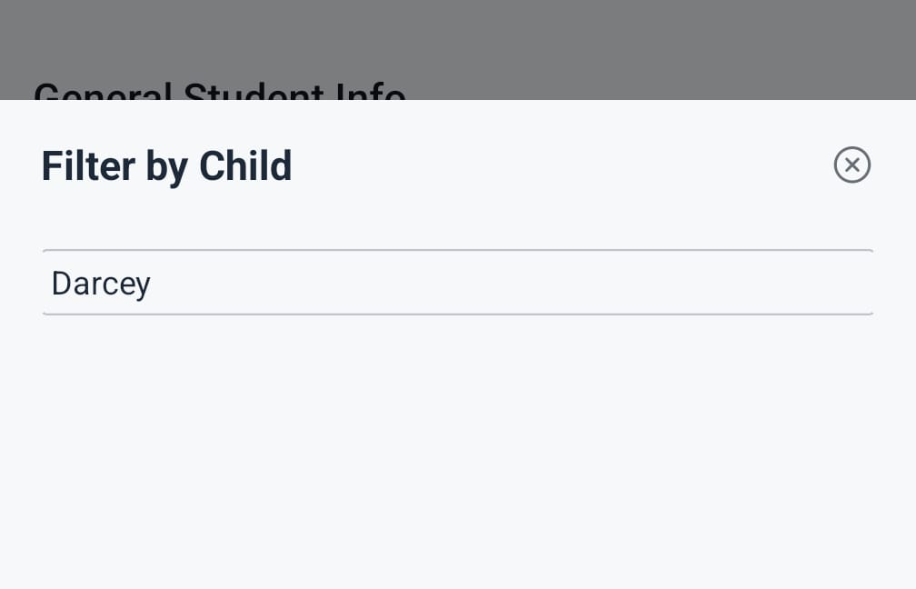
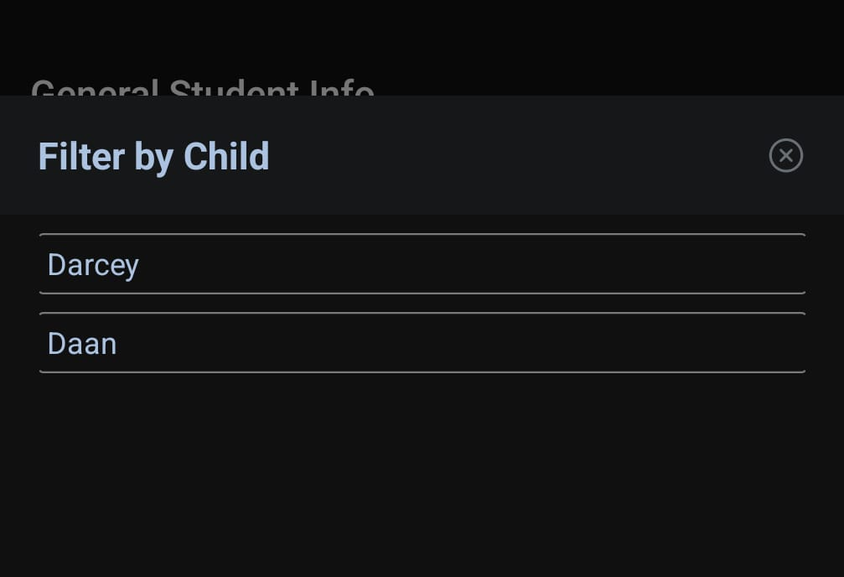
Parent's Views Backend Integration
Grabbing Parent and Student Data from AWS
Upon login, the app now queries AWS for data related to the User
For Parents, it queries AWS for its Parent data table and the tables of Students it has access to
This data is stored in a Context layer above the Parent views
This data is accessible from anywhere after it has been loaded

Slide 10
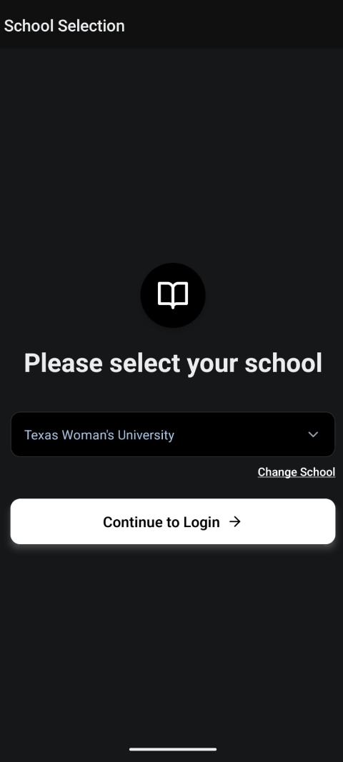
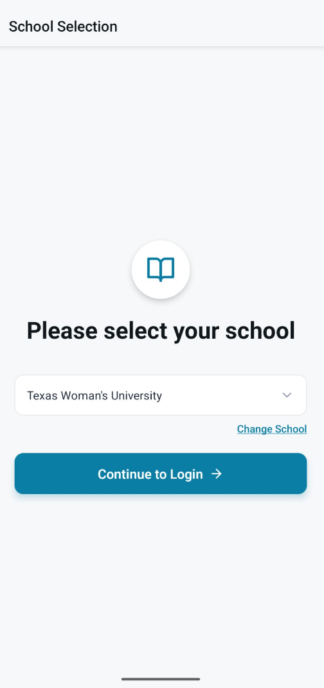
Globalizing the UI Themes
Every screen in the whole app pulls colors from the same file
The whole app reflects a chosen "dark" or "light" mode
Allow users to switch between "dark" or "light" mode as they wish
Allows us to quickly iterate on app-wide color schemes

Slide 11
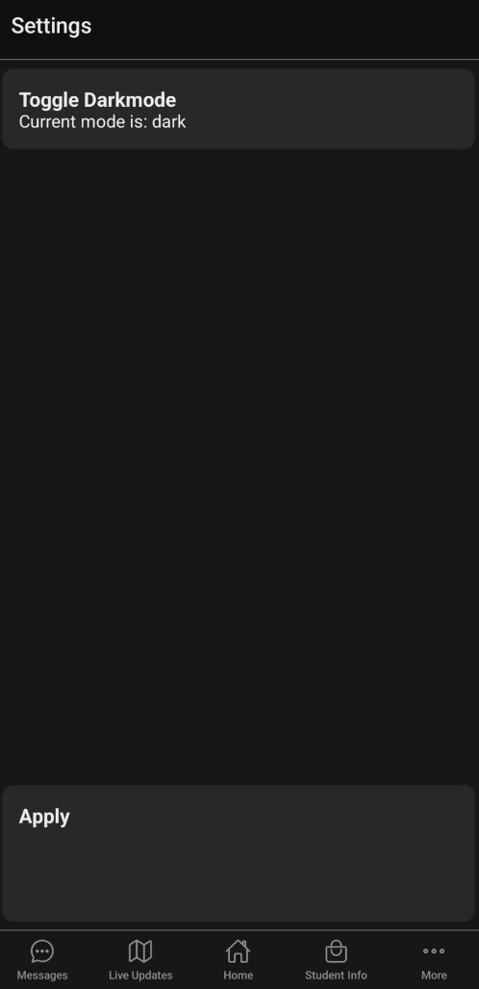

Locally-Saved Settings
Allow Users to Customize the App
Create a unique table of settings for every User who logs in to the app
Upon login, check storage for User settings
Allow Users to change settings, having the settings save to storage
Easily expandable to further settings, like Font Size and Button Size

Slide 12
Test Cases
Test Case ID | Description | Requirement Trace | Directions | Expected Output | Pass/fail
TCB-006 | Verify correct account data fetched and used by Frontend from AWS | R31, R32, R36 | Login with a Parent Cognito account Go to “General Info” screen Tap the Student Picker dropdown Check Student names against what’s expected Select a student Verify information in screen reflects Student information accurately Repeat steps 5-6 for all Students available | The Students connected to the parent’s account should all be loaded in and shown successfully. Each Student should have accurate information provided by the backend. | Pass
TCB-701 | Verify app appearance global variable reflects OS theme by default | R16 | Wipe app cache, ensuring app has no saved settings Change OS theme to “light” mode Open app to login screen Observe color theme Repeat steps 1-4 with “dark” mode OS theme | The app will reflect the color scheme of the OS’s ui. Console will log ui as “dark” or “light”, matching the scheme of the OS. | Pass
TCB-702 | App appearance changes when changing UI theme in settings | R16 | Login to the app and navigate to the “Settings” screen Tap the UI theme toggle Hit “Apply” to apply the settings. | The app will change UI colors to reflect the newly chosen theme instantly. Console will log both the changing of theme aswell as saving the new settings to local storage. Both should be logged with no errors. | Pass

Slide 13
Improvements to Documents
Requirements Document:
Added R37, a functional about app theming
Design Document:
Updated all Screenshots to reflect changes
Test Document:
Added black-box test cases for testing the global UI theme feature
Added black-box test cases for testing the Local Settings feature
Added black-box test cases for the AWS Graphql data integration to Frontend

Slide 14
Before the Sprint is Over
Write up Sprint Submission Report

Slide 15
Focus of Next Sprint
Expanding the AWS backend to include more data for Announcements, Student Documentation, Classes, Teacher-Class data, etc.
Having every piece of relevant data in-app be provided by the Backend
Direct Messaging!
Have automated seeding of data with respect to the correct ORM of tables.

