Slide 1
Project Clara
A Unified School Communication Platform for Denton K-12
Hayat Dahraj | Computer Science | University of North Texas
April 12, 2026
Notes:
Welcome. My name is Hayat Dahraj, and today I will be presenting Project Clara, a proposed mobile application designed to consolidate school communication into a single platform for Denton K-12 public schools. This presentation summarizes my formal research report prepared for TECM 4180.

Slide 2
THE PROBLEM
School communication is fragmented
42%
10-15
3-4
of parents rate app
satisfaction at 5/10
or lower (Skinner)
separate apps used
by most schools
(Skinner)
communication tools
per school in
Denton area (Dahraj)
Notes:
The core problem is fragmentation. A national study found 42% of parents rated their satisfaction with managing multiple school apps at 5 out of 10 or lower. Most schools use between 10 and 15 separate educational apps. My own survey of Denton-area respondents confirmed that families here juggle 3 to 4 different communication platforms just to stay informed about their child's day.

Slide 3
RESEARCH QUESTION
Can a unified, mobile-first communication platform address the documented fragmentation in school communication tools while meeting federal privacy requirements?
Notes:
The central research question guiding this study is: can a unified, mobile-first communication platform address the documented fragmentation in school communication tools while meeting federal privacy requirements and the practical constraints of a student-led development team?

Slide 4
METHODOLOGY
Three complementary research methods
1
Expert Interview
Email interview with Indira Devi Siripurapu, Ph.D. Candidate at UNT, covering architecture, security, and scope
2
Secondary Research
5 scholarly and industry sources on fragmentation, cross-platform dev, digital equity, and FERPA compliance
3
Qualtrics eSurvey
33 Denton-area respondents on communication satisfaction, feature priorities, and data security concerns
Notes:
I used three research methods. First, an email interview with our technical advisor, Indira Devi Siripurapu, a Ph.D. candidate at UNT, who assessed the feasibility of our React Native and AWS architecture. Second, I reviewed five scholarly and industry sources covering communication fragmentation, cross-platform development, digital equity, and FERPA compliance. Third, I distributed a Qualtrics survey to 33 Denton-area respondents to capture community attitudes toward school communication.

Slide 5
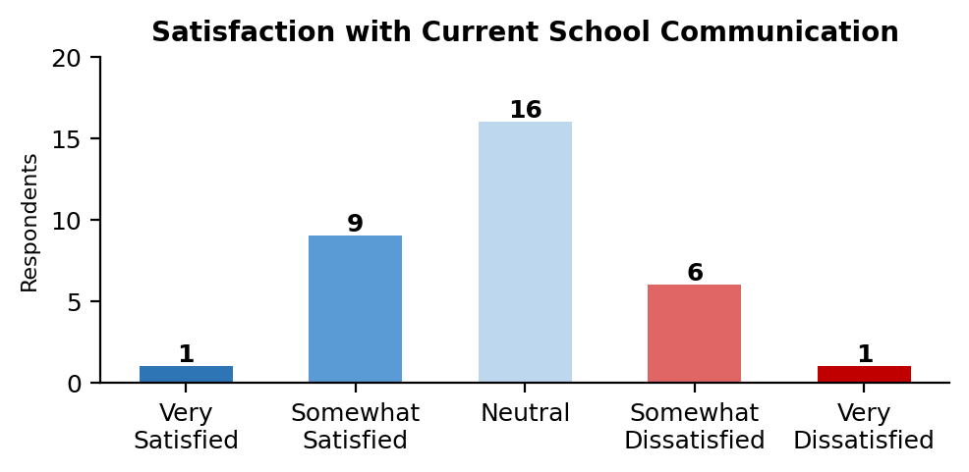
RESULTS: COMMUNICATION FRAGMENTATION
Key Findings
Only 10 of 33 respondents expressed any satisfaction
Email (29), phone (23), and social media (20) dominate
Only 10 noted a dedicated school app
14 of 33 juggle multiple tools daily
Figure 1: Satisfaction with current school communication (n=33)
Notes:
The first major finding is that school communication is fragmented and inadequate. Only 10 of 33 respondents expressed any satisfaction with current methods. Schools rely on email, phone calls, and social media rather than dedicated apps. Only 10 respondents even noted using a school-specific app like ClassDojo or Remind. Respondents described struggling with multiple communication modes and confusion across platforms.

Slide 6
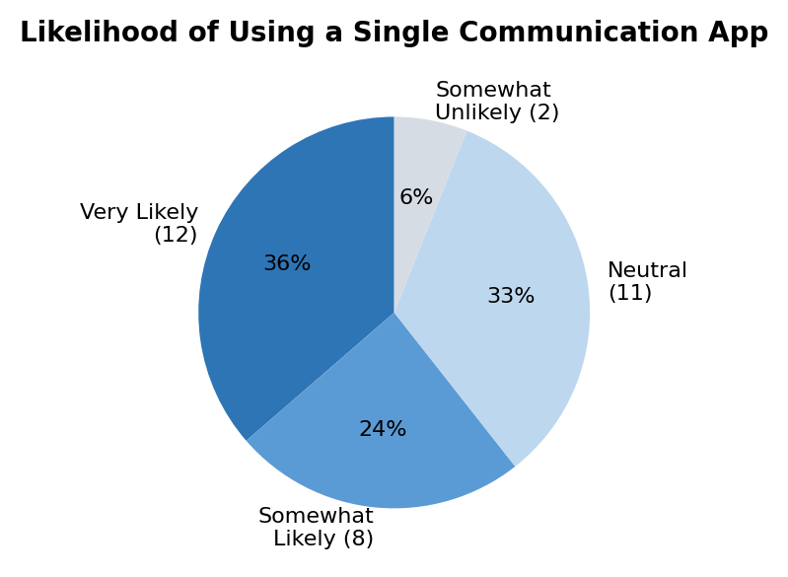
RESULTS: ADOPTION INTEREST
60%+
willing to adopt a single app
Top-rated features:
Emergency notifications
Absence reporting
Student records access
Teacher messaging
Figure 2: Likelihood of adopting a single app (n=33)
Notes:
Over 60% of respondents said they would be likely or very likely to use a single consolidated app. No respondent selected Very Unlikely. The features rated most important were emergency notifications, absence reporting, student records access, and direct messaging with teachers. These priorities map directly onto Project Clara's proposed feature set.

Slide 7
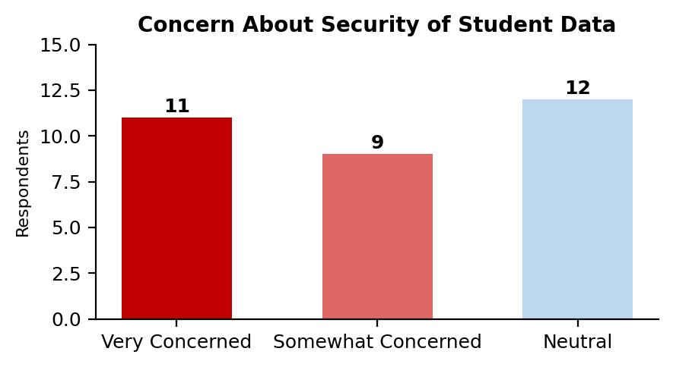
RESULTS: DATA SECURITY CONCERNS
~63% expressed concern
Project Clara addresses this through:
AWS-based encryption (transit + at rest)
Role-based access control
Audit logging for all data access
Full FERPA compliance via AWS
Figure 3: Concern about student data security (n=32)
Notes:
Nearly two-thirds of respondents expressed concern about the security of student data in school apps. No respondent said they were unconcerned. Project Clara's architecture directly addresses this through AWS-based encryption, role-based access control so parents only see their child and staff only see what they need, audit logging, and full FERPA compliance through AWS's Shared Responsibility Model.

Slide 8
RESULTS: TECHNICAL FEASIBILITY
React Native
Near-native performance, one codebase for iOS and Android (Biorn-Hansen et al.)
AWS Infrastructure
FERPA-compliant through Shared Responsibility Model (Amazon Web Services)
Phased MVP
Start with login, roles, roster, attendance; defer GPS and integrations (Siripurapu)
Academic Impact
Consistent parent-teacher messaging improves homework completion (Kraft & Rogers)
Notes:
The expert interview and secondary sources confirmed that React Native offers near-native performance for cross-platform development. AWS provides FERPA-compliant infrastructure. Our advisor recommended a phased MVP approach, saying she'd rather we build a smaller version that works well than a big version that's unreliable. And research by Kraft and Rogers showed that improved parent-teacher communication directly improves student academic outcomes.

Slide 9
DISCUSSION
National fragmentation patterns confirmed locally in Denton
60%+ adoption interest aligns directly with Project Clara’s feature set
Security concerns are both a challenge and an opportunity
Mobile-first design is an equity imperative, not a luxury
Limitation: eSurvey skews toward college-aged respondents
Notes:
The results from all three methods converge. National fragmentation patterns were confirmed locally. The community's adoption interest aligns directly with Clara's feature set. Security concerns mean any platform must earn trust through visible practices. The mobile-first design is essential for equity since many families rely solely on smartphones. One limitation is that the survey skewed toward college-aged respondents, though many had direct family experience with K-12 communication.

Slide 10
RECOMMENDATIONS
Pilot Project Clara at one Denton ISD elementary school
1
Assign a district liaison from the Technology Division
2
Conduct a follow-up parent survey at the pilot school
3
Adopt a phased implementation timeline (MVP first)
4
Notes:
Based on the findings, I recommend four actions. First, approve a pilot deployment at one Denton ISD elementary school in partnership with UNT's Computer Science department. Second, assign a liaison from the Technology Division under Robert Pierce to collaborate on integration and security. Third, conduct a follow-up survey specifically targeting parents at the pilot school. And fourth, adopt a phased timeline starting with core features before adding advanced capabilities.

Slide 11
The need is real.
The solution is feasible.
The community is ready.
PROJECT CLARA
Hayat Dahraj | HayatDahraj@my.unt.edu
Notes:
In conclusion, the research demonstrates that school communication in Denton is fragmented, the community wants a unified solution, and the technology exists to build one securely and affordably. Project Clara represents an opportunity for Denton ISD to lead in family communication technology while directly supporting student academic outcomes. Thank you for your time. I welcome any questions at HayatDahraj@my.unt.edu.

