Slide 1
REAL ESTATE
HOUSING MARKET ANALYSIS
An End-to-End Data Analytics Project · Denmark (1992 – 2024)
Python (Pandas · Matplotlib · Seaborn)
MySQL (18 Business Queries)
Power BI (3-Page Dashboard)
100K
DKK 193Bn
DKK 1.93M
32 Years
Transactions
Total Market Value
Avg Property Price
Data Coverage
Notes:
Title slide. Introduce the project: 100K Danish property transactions analyzed end-to-end using Python, SQL, and Power BI.

Slide 2





PROJECT OVERVIEW
End-to-End Analytics Pipeline
Business Question: "How can real estate transaction and economic data be leveraged to identify market trends, evaluate investment opportunities, optimize pricing strategies, and support data-driven decision-making?"
Business
Problem
▶
Python
EDA
▶
SQL
Analysis
▶
Power BI
Dashboard
▶
Project
Report
KEY OBJECTIVES
Identify top-performing cities, regions, and property types by value
Analyze impact of property characteristics (type, size, era) on prices
Examine how macroeconomic factors (inflation, interest rates) drive market cycles
Evaluate buyer negotiation patterns and emerging investment opportunities
2 / 14
Notes:
Walk through the 5-step pipeline. Emphasize this is a full end-to-end project covering everything from problem scoping to a live dashboard.

Slide 3
DATASET
Dataset Overview — Danish Property Transactions
100,000
19
1992–2024
50+
4
Total Rows
Columns
Time Span
Cities
Regions
Transaction Info
Property Details
Geographic
purchase_price · sqm_price · date · quarter · sales_type
house_type · year_build · no_rooms · sqm · house_id
city · area · region · zip_code · address
Macroeconomic
Buyer Behavior
Engineered Features
nom_interest_rate% · dk_ann_infl_rate% · yield_on_mortgage%
%_change_offer_to_purchase · [engineered] negotiation_gap
price_segment · build_era · real_interest_rate · distressed_sale
3 / 14
Notes:
Highlight that this is a rich dataset with 100K rows across 32 years, covering everything from property characteristics to macroeconomic indicators. Feature engineering added 7 new analytical columns.

Slide 4
DATA PREPARATION
Data Cleaning & Feature Engineering (Python)
🧹 DATA CLEANING STEPS
⚙️ ENGINEERED FEATURES
Loaded data with Pandas · reviewed with df.info() & df.describe()
Fixed date inconsistency: 'MM/DD/YY' & 'MM-DD-YY' → standardized DD/MM/YY
Dropped 11 rows with null City values (<0.02% of data)
Imputed dk_ann_infl_rate% & yield% nulls (77 each) with quarterly median of same year
Verified zero duplicate house_id entries after cleaning
Exported clean dataset to MySQL via SQLAlchemy for SQL analysis
price_segment
Budget / Mid / Premium / Luxury / Ultra-Luxury
build_era
Pre-1900 → 1900s → Mid-century → 70s → 80-90s → 2000s → Modern
sales_season
Winter / Spring / Summer / Autumn from date
offer_price
Back-calculated from purchase_price + %_change
negotiation_gap
Absolute DKK difference: purchase – offer
real_interest_rate
Nominal rate − Annual inflation rate
distressed_sale
Flag: %_change < −15% (severe price cut)
Tools: Python 3 · Pandas · NumPy · SQLAlchemy → MySQL export
4 / 14
Notes:
Explain the data quality issues and how they were resolved. Emphasize the feature engineering — these derived columns were critical for deeper analysis.

Slide 5
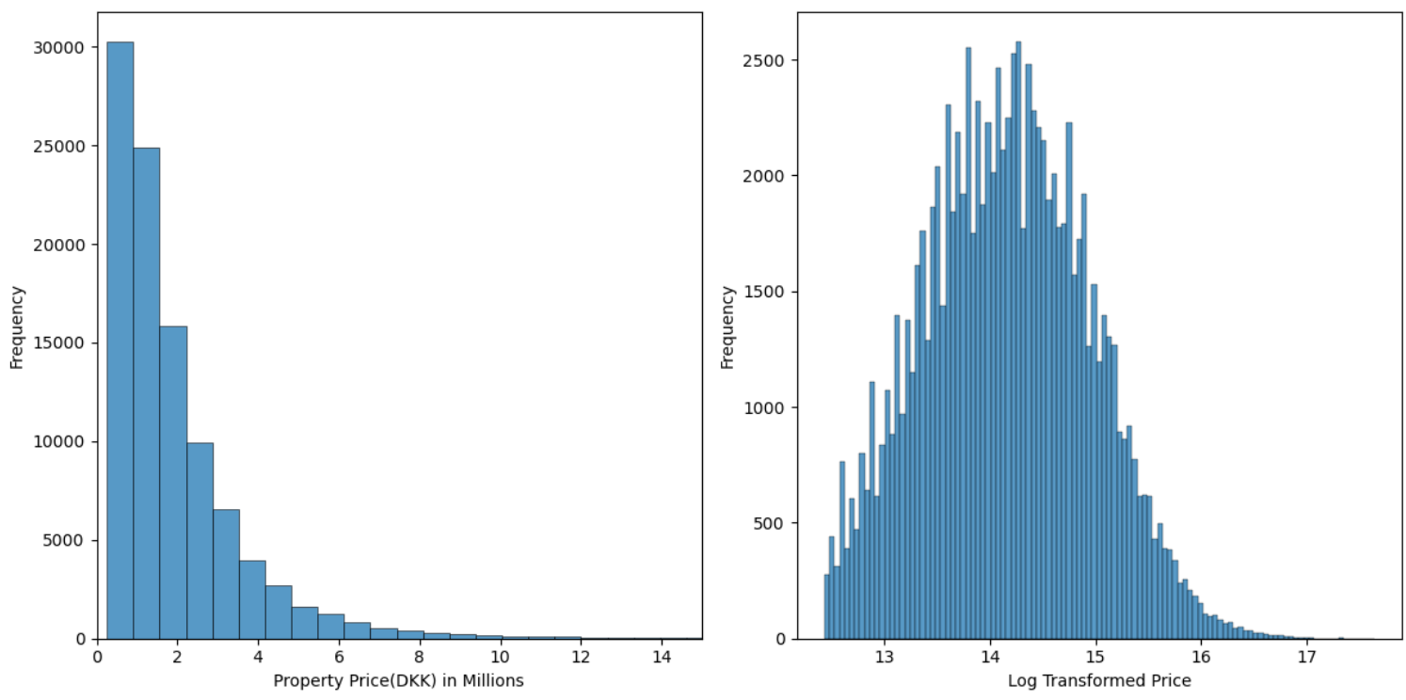
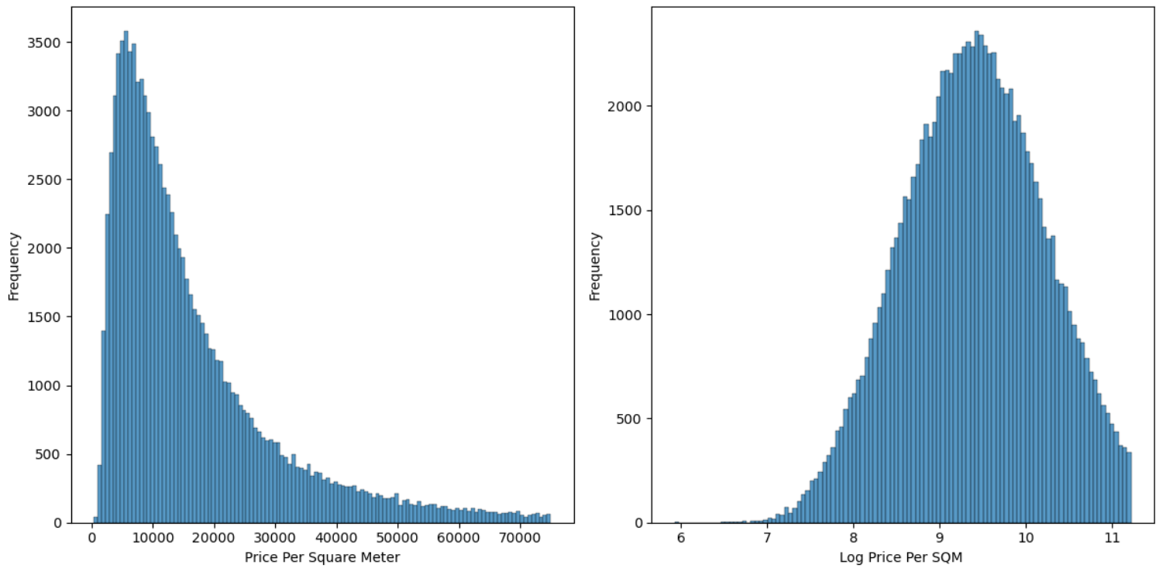
EDA — PYTHON
Exploratory Data Analysis: Price Distributions
KEY FINDINGS
Strong right-skew: most properties priced DKK 0.5M–2M; luxury tail extends to 46M
Log-transformed price shows near-normal distribution — confirms multiplicative pricing structure
SQM price is more consistent (lower variation) than total price — better for cross-property comparisons
Median is the preferred measure; mean is distorted by luxury outliers
Price per m² ranges from DKK ~2,000 to 75,000+ reflecting massive location premiums
5 / 14
Notes:
Note the log-normal distribution. This is a key insight: housing prices follow a multiplicative pattern, not additive — percentage changes matter more than absolute changes.

Slide 6
EDA — PYTHON
House Types & Regional Analysis
Market Share by
House Type
Median SQM Price (DKK) by House Type
🏠 Villas = 54% of market
🏢 Apartments = highest SQM price (DKK 25,437/m²)
🌾 Farms = cheapest per m² but largest by size
🌊 Summerhouses = most negotiated segment
6 / 14
Notes:
Apartments command the highest SQM price but are the smallest in size — pure location premium. Farms are the opposite: large land area but low per-m² value.

Slide 7
EDA — PYTHON
Build Era Trends & Buyer Negotiation Behaviour
Modern era premium
64% zero-negotiation
Farm deepest discounts
Summerhouse = most negotiated
DKK 17,348/m² vs 70s era DKK 10,986/m² — 58% gap
Most buyers accept offer price outright
DKK −237K avg when negotiation occurs
40% of sales see a price reduction
7 / 14
Notes:
Two big takeaways: (1) Modern properties command a ~58% SQM premium over 70s builds — era matters hugely for valuation. (2) Most transactions are non-negotiated, but when they are, the discounts can be massive especially for farms.

Slide 8
SQL ANALYSIS
Business Analysis — 18 SQL Queries (MySQL)
Geographic & Pricing
Temporal Trends
Property Characteristics
Q1: Top 10 cities by avg purchase price
Q2: Avg SQM price by region
Q8: Largest villa city by SQM
Q3: Avg price by quarter each year
Q4: Highest volume quarters
Q10: Nominal interest rate vs price
Q5: House type with highest avg price
Q6: Room count vs avg price
Q7 & Q9: Build era × house type SQM price
Macro Indicators
Negotiation Analysis
Investment Screening
Q11: Real interest rate vs SQM price
Q12: Inflation regime vs price levels
Q13: Offer-to-purchase % by region
Q14: Cities with highest negotiation gap
Q15: Negotiation gap by price segment
Q16: YOY city price growth (window fn)
Q17: Properties 20%+ above city avg SQM
Q18: Best value house type composite
8 / 14
Notes:
18 queries grouped into 6 analytical themes. Highlight the advanced SQL used: window functions (LEAD, OVER PARTITION BY) in Q16 and Q17, subqueries in Q12, and CTEs in Q18.

Slide 9
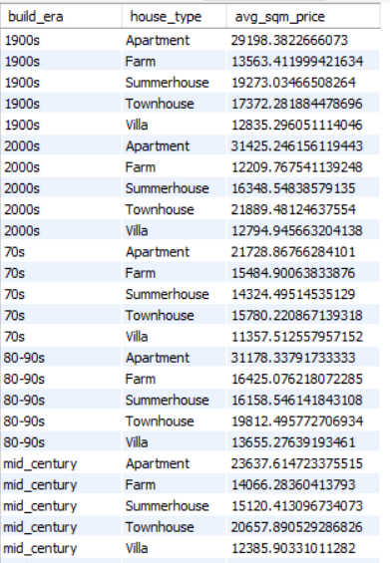
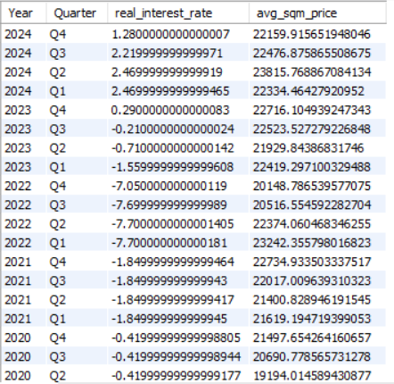
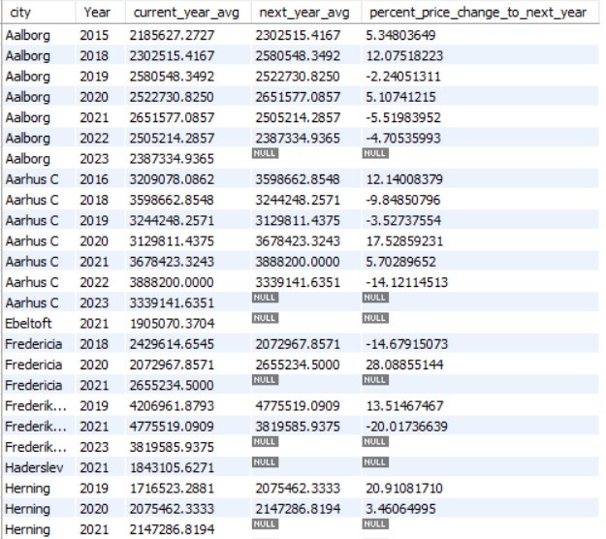
SQL ANALYSIS — KEY RESULTS
Selected SQL Results & Insights
Real Interest Rate vs Avg SQM Price (recent quarters)
Build Era × House Type SQM Price
Apartments command highest SQM across ALL build eras
Negative real rates (2021-22) drove peak SQM prices
Aarhus C shows 12–17% YOY growth — top secondary market
YOY City Price Growth (Aalborg, Aarhus C shown)
9 / 14
Notes:
Three of the most insightful SQL outputs: (1) Apartments are consistently premium across every era, (2) Real interest rates are the strongest macro driver, (3) Aarhus C is the top growth city outside Copenhagen.

Slide 10
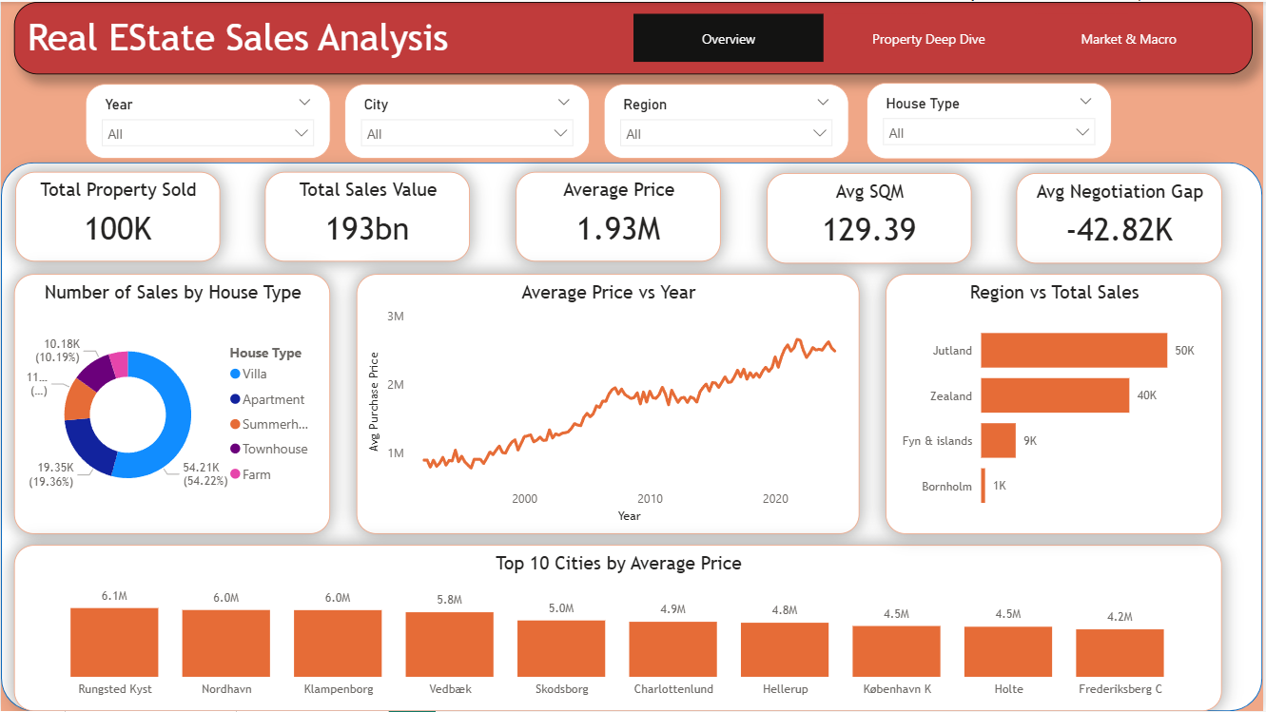
POWER BI DASHBOARD — PAGE 1
Market Overview Dashboard
PAGE FINDINGS
100K transactions · DKK 193Bn total value
Villas = 54.2% of all deals
Avg price grew from ~DKK 800K (1992) to ~2.8M (2024)
Jutland leads in volume (50K); Zealand leads in price premium
Rungsted Kyst tops at DKK 6.1M avg — North Shore dominance
Avg negotiation gap: −DKK 42.82K across all transactions
✦ Interactive slicers: Year · City · Region · House Type
10 / 14
Notes:
Walk through the KPI row first: 100K, 193Bn, 1.93M avg. Then the price trend chart showing 30-year growth. Finish with the Top 10 cities bar chart — note all top cities are in North Zealand near Copenhagen.

Slide 11
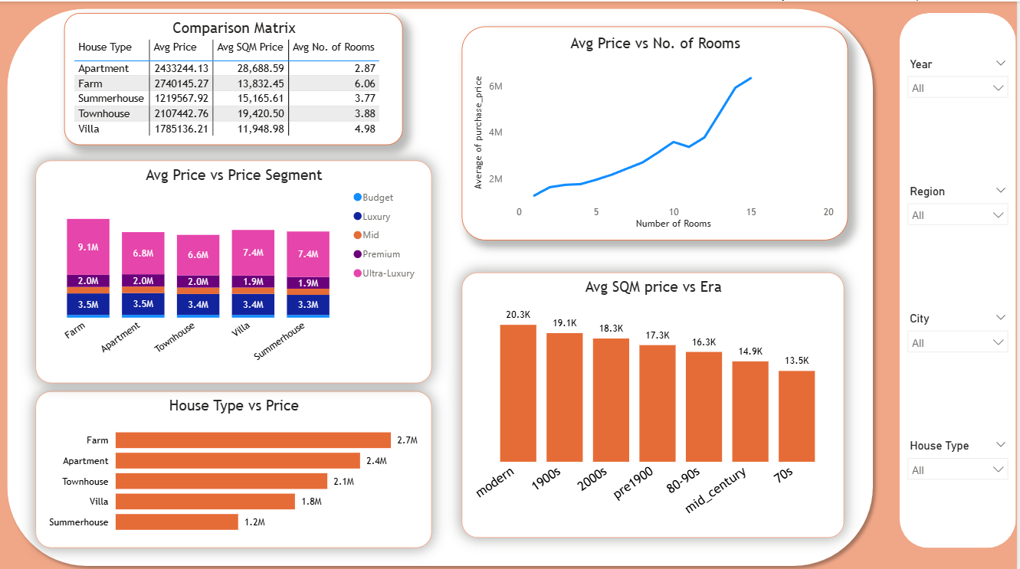
POWER BI DASHBOARD — PAGE 2
Property Deep Dive Dashboard
PAGE FINDINGS
Farms: highest avg price (DKK 2.74M) but lowest SQM price (DKK 13.8K)
Apartments: highest SQM (DKK 28.7K) with fewest rooms (2.87 avg)
Modern builds: DKK 20.3K/m² vs 70s: DKK 13.5K/m² — 50% premium
Rooms-to-price is near-linear; 15+ rooms average DKK 6M+
Ultra-luxury tier exists across all property types
✦ Interactive slicers: Year · Region · City · House Type
11 / 14
Notes:
Focus on the Comparison Matrix table top-left — shows all 5 house types side by side. Then the SQM by Era chart confirms modern properties are the most valuable per square meter.

Slide 12
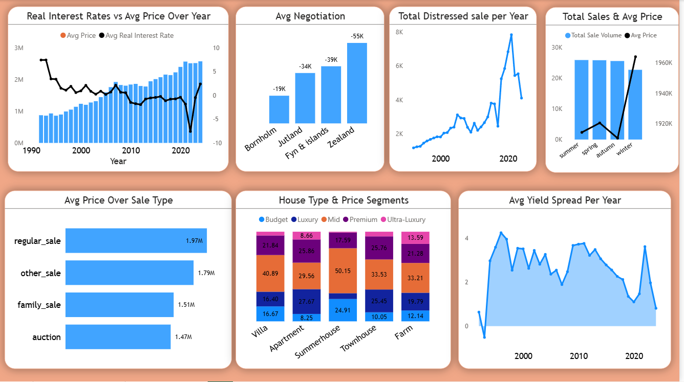
POWER BI DASHBOARD — PAGE 3
Market & Macro Dashboard
PAGE FINDINGS
Real rate inversely tracks price: neg. rates (2021-22) → price peak
Zealand buyers face −DKK 55K avg gap; Bornholm −DKK 19K
Distressed sales spiked in 2008-09 (GFC) and again post-2020
Winter sales = highest avg price; Summer = lowest volume
Auction properties: DKK 1.47M avg vs regular sale DKK 1.97M (−25%)
Mortgage yield trended near zero (2020) — now rising again
✦ Interactive slicers: Year · Region · City · House Type
12 / 14
Notes:
The macro dashboard is the most analytically interesting. Lead with the real interest rate vs price chart — 30 years of inverse correlation. The auction discount (25%) is a great talking point for investors.

Slide 13
KEY FINDINGS
12 Key Findings from the Analysis
📈 240% price growth
🏠 Villa market dominance
🏢 Apartment SQM premium
Danish avg property price grew from DKK ~820K (1992) to ~DKK 2.8M (2024)
54.2% of all 100K transactions are villas — the backbone of Danish housing
Apartments command DKK 25,437/m² — highest of all types driven by urban location
🌊 North Zealand leads
🏗️ Modern build premium
📉 Real rates drive prices
Rungsted Kyst, Klampenborg, Nordhavn avg DKK 5.8–6.1M — Copenhagen coast premium
Post-2010 properties are 50%+ more expensive per m² than 70s-era builds
Negative real interest rates (2020–22) directly caused the last price surge
🚀 2021 Q1 peak activity
🤝 64% zero-negotiation
🗺️ Zealand most stable
2,263 transactions totalling DKK 5.9Bn — highest single quarter in dataset
Majority accept asking price; Farm discounts avg −DKK 237K when they occur
Lowest distressed sale rate (2.10%) — most liquid and demand-healthy region
⚖️ Auction = 25% discount
📊 Aarhus C top growth
🏖️ Summerhouse negotiation
Auction sales avg DKK 1.47M vs DKK 1.97M regular — systematic value entry
12–17% YOY price growth in multiple years — strongest secondary market
Most negotiated segment (40.4% see a price gap) — buyers of vacation homes haggle more
13 / 14
Notes:
This is the synthesis slide — all 12 findings in one view. Pick 3-4 to highlight verbally. Suggested: finding 1 (growth), 6 (real rates), 10 (auctions), 11 (Aarhus C growth).

Slide 14
BUSINESS RECOMMENDATIONS
Strategic Recommendations
💎 Investment
💰 Pricing Strategy
📡 Macro Timing
Prioritize Zealand for core portfolio — lowest distress (2.1%), highest liquidity
Target Aarhus C & Aalborg for growth-oriented plays (12–17% YOY)
Use auction pipeline as a 25% discount entry strategy
Modern & 2000s-era properties offer best SQM appreciation trajectory
Use SQM price (not total price) as primary cross-property comparator
8+ room properties are underrepresented — target for premium segment
Negotiate on Villas & Summerhouses (39–40% see negotiation gaps)
Apartments in urban cores: price firmness high, negotiate sparingly
Monitor real interest rate as #1 market timing signal
Accelerate acquisition when real rate < 0% (historical price boost)
Reduce exposure when real rate > 2–3% (expect price moderation)
Avoid Bornholm as core allocation — highest distress (3.97%), low liquidity
14 / 14
Notes:
Close with the three recommendation themes: where to invest, how to price, and when to move based on macro signals. The real interest rate timing signal is the most actionable insight from this project.

Slide 15
THANK YOU
Real Estate Housing Market Analysis — Denmark
Python
Pandas
Matplotlib
MySQL
Window Functions
Power BI
DAX
Data Storytelling
100K
18
3
12
7
32 Yrs
Rows Analyzed
SQL Queries
Dashboard Pages
Business Recs
Engineered Features
Time Coverage
github.com/HayatTXT/real-estate-housing-analysis · Open to Data Analyst roles
Notes:
Close slide. Update github link with your real username. Mention: this project showcases Python cleaning, SQL with advanced window functions, Power BI dashboard design, and data storytelling skills.

