Slide 1
Docutor
Agents are getting capable.
Enterprise knowledge is not.
The missing layer is a human review layer for messy documents, diagrams, and business rules.
Make the knowledge trustworthy before agents act.
01

Slide 2
The blocker is not the agent.
It is the knowledge the agent has to work with.
AGENTS
ENTERPRISE CONTEXT
RESULT
They can plan and execute.
It still lives in messy files.
Agents stall or guess.
Modern agents can call tools, coordinate steps, and move work forward.
Specifications, business rules, approvals, and exceptions are scattered across PowerPoint, Word, PDF, and diagrams.
If the source knowledge is not structured, the agent cannot safely decide what matters.
02

Slide 3
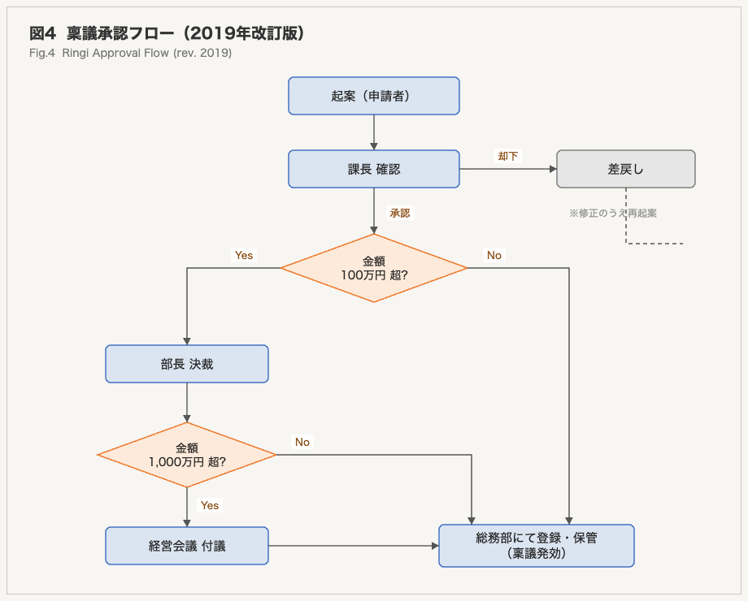
Complex diagrams break first.
A single wrong arrow can change the business rule.
The model may capture text, but the risk is in the relationships: branching, grouping, approval paths, exceptions, and hierarchy.
This is exactly where human review should be fast, visual, and easy to correct.
03

Slide 4
Do we wait for better models?
No.
Use today's models.
Review risky meaning.
HITL
by design
That is the product gap: make uncertainty visible and correction easy.
04

Slide 5
Docutor: convert automatically, review visually, export trusted knowledge.
01
02
03
Convert
Review
Export
Extract text, tables, images, and diagram candidates.
Compare original evidence with generated Markdown and diagrams.
Send approved knowledge to agents and the Company Brain.
05

Slide 6
Demo
Messy enterprise document -> reviewed knowledge asset
>
Insert demo video here
Show the correction moment: original diagram beside generated output, then a human fixes the meaning.
06

Slide 7
Docutor is the intake layer for the Company Brain.
Fragmented internal knowledge becomes structured, reviewed, and ready for AI execution.
Fragmented knowledge
>
Docutor review layer
>
AI execution layer
PPT, Word, PDF, tables, diagrams, approvals
Convert, compare, correct, approve, refresh
Hermes Agents, internal copilots, workflow agents
This is how Docutor picks up the Company Brain idea: structure knowledge first, then let agents act.
07

Slide 8
Do not wait for the perfect model.
Make today's models useful with the right review layer.
Docutor creates the missing bridge:
fragmented enterprise knowledge -> reviewed Company Brain -> safer agentic work
Build the knowledge layer before scaling the agents
08

