Slide 1
Unlocking the Power of LLMs with Retrieval Augmented Generation (RAG)
By
Dr. Haytham Mohamed
Principal Solutions Architect
IBM

Slide 2
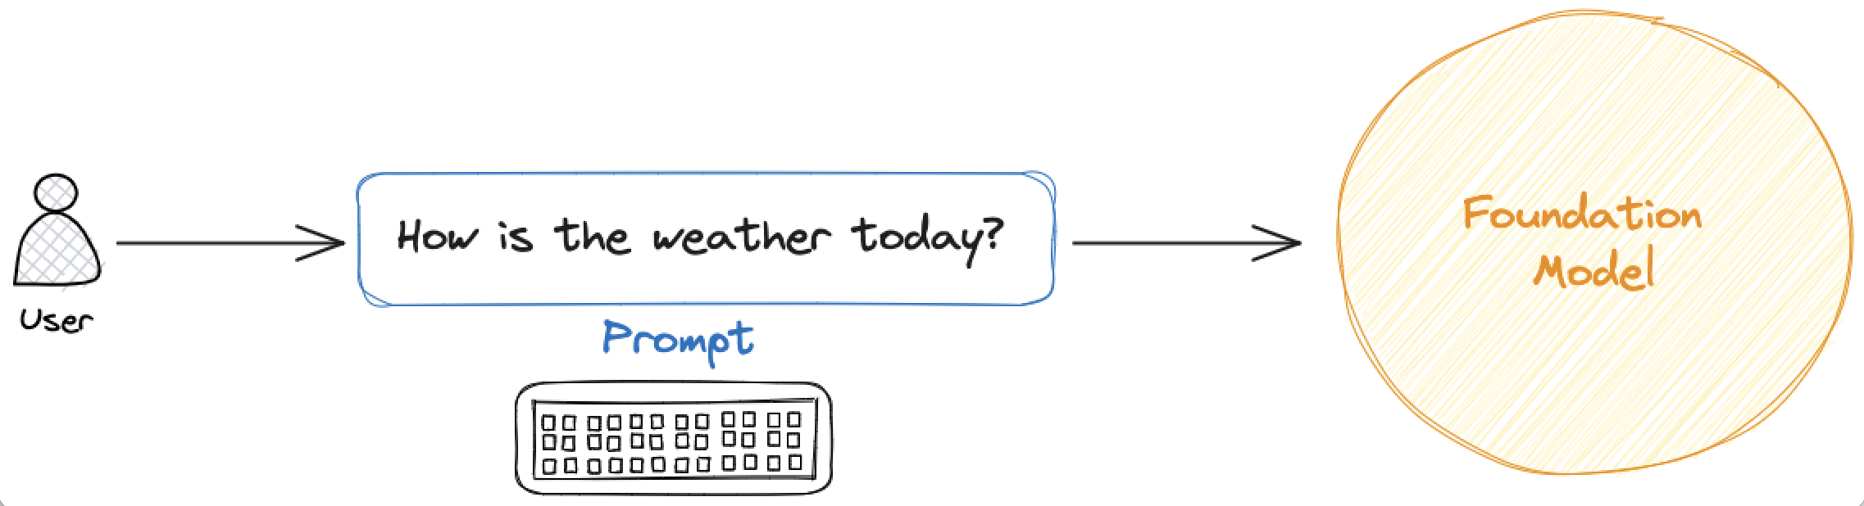
LLM Limitation
LLMs can reason about wide-ranging topics, but their knowledge is limited to the public data up to a specific point in time that they were trained on. (i.e., GTP-4 Turbo – 4/2023)
A large language model (LLM) takes a user’s prompt and generates a response.
Risk of incorrect or fabricated responses, also known as hallucinations.

Slide 3
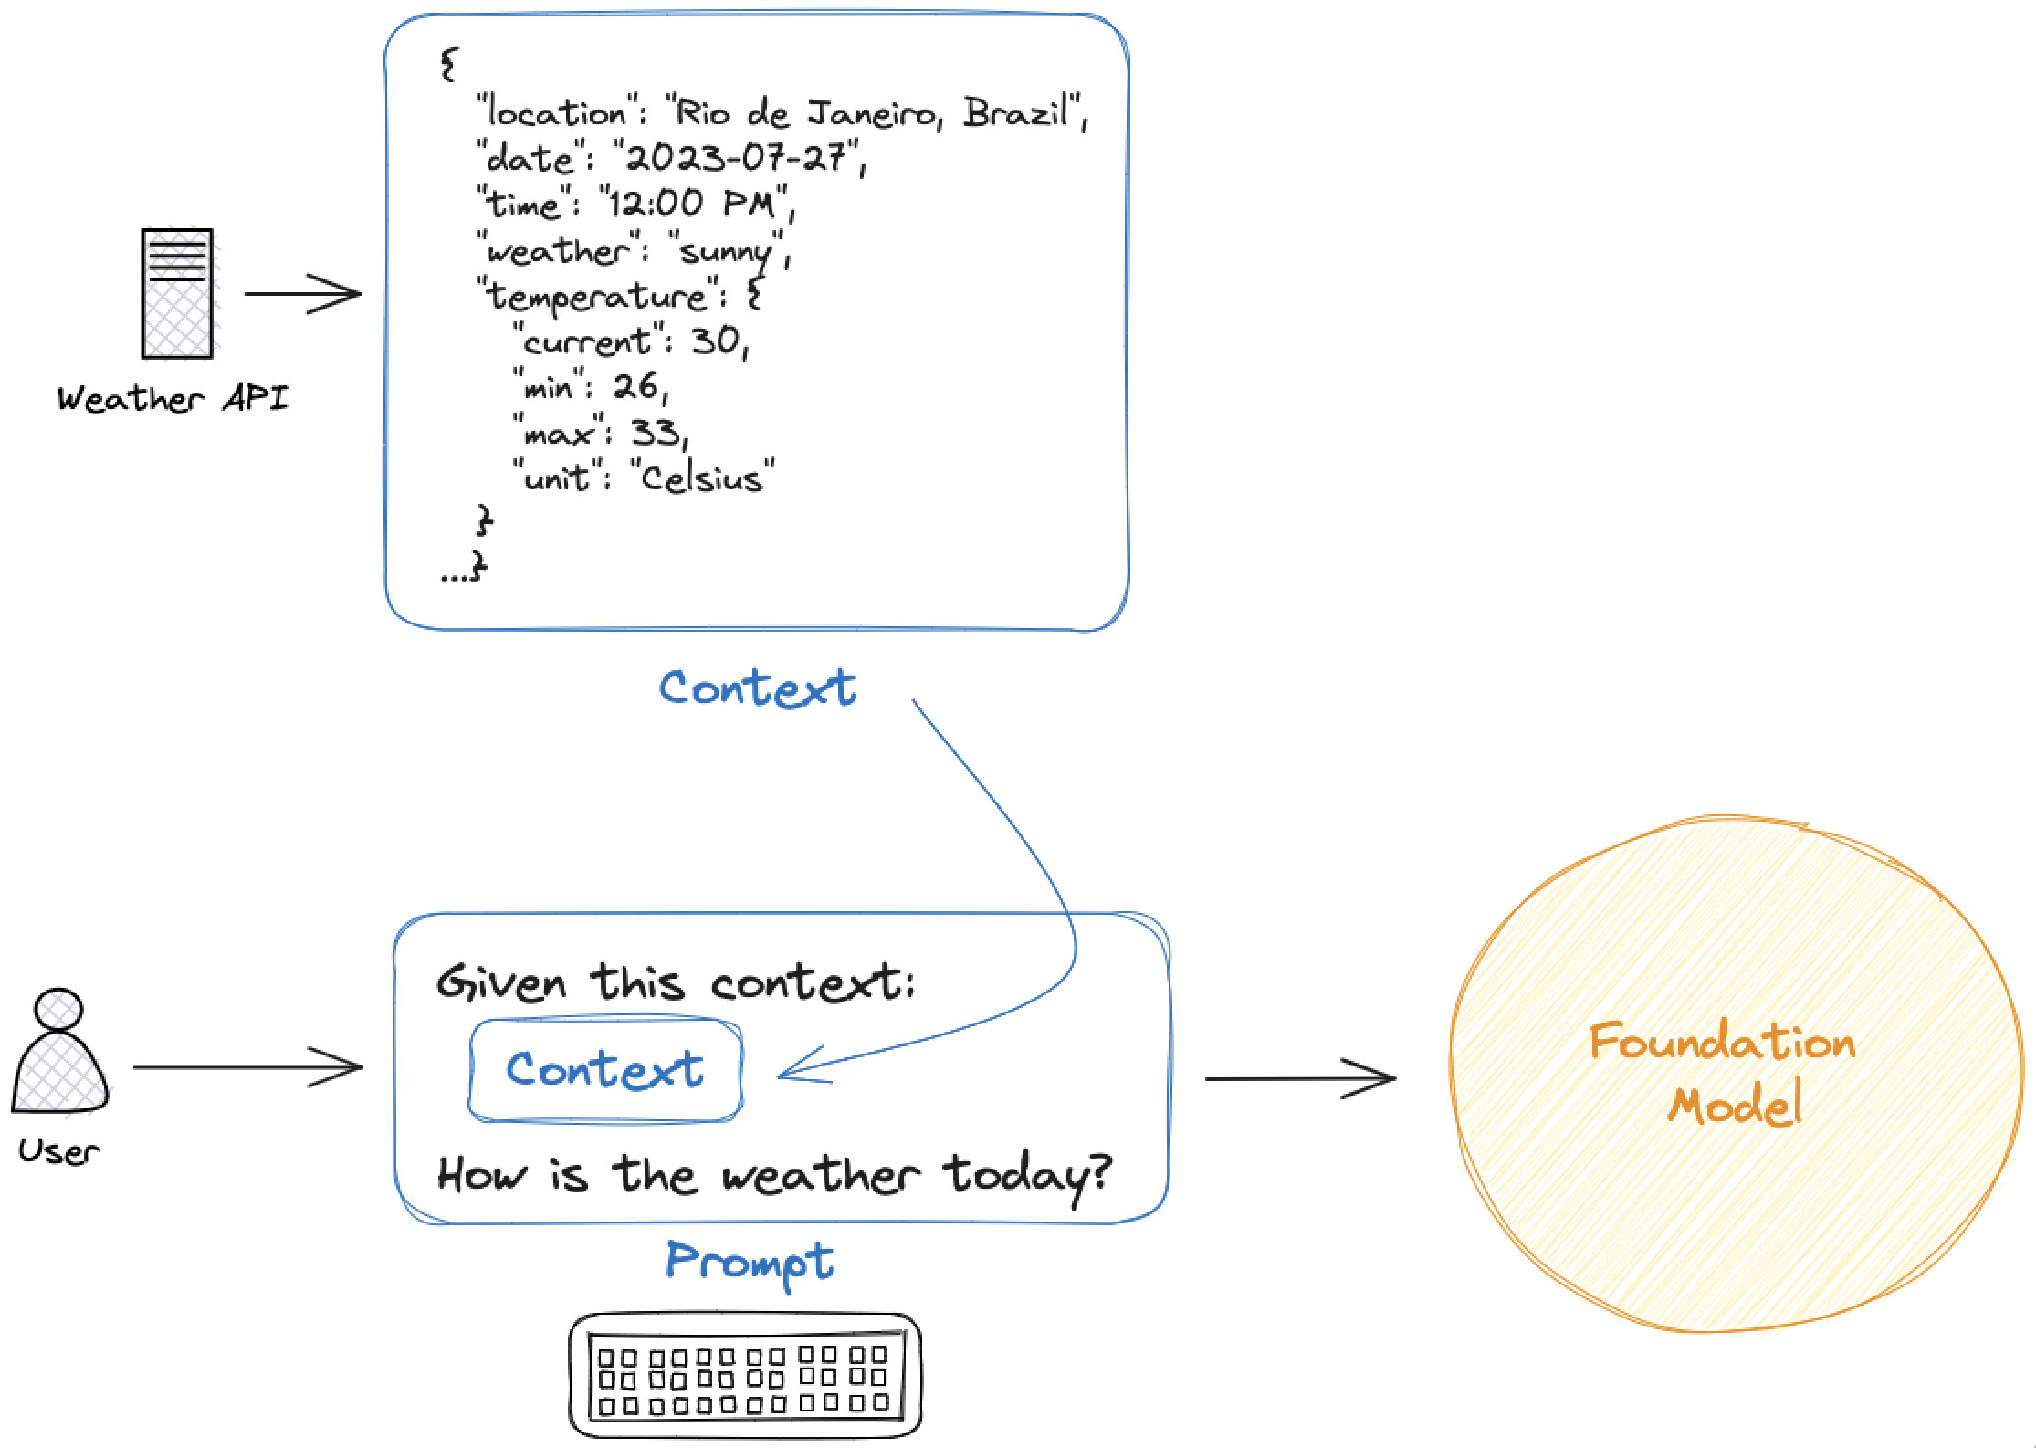
In-Context Learning LLM
If you want to build AI applications that can reason about private data or data introduced after a model's cutoff date, you need to augment the knowledge of the model with the specific information it needs.
“In-context learning” is a technique for augmenting LLM knowledge with additional data.
Guiding a large language model with a provided fact / information / context would help generating more relevant and truthful answers.

Slide 4
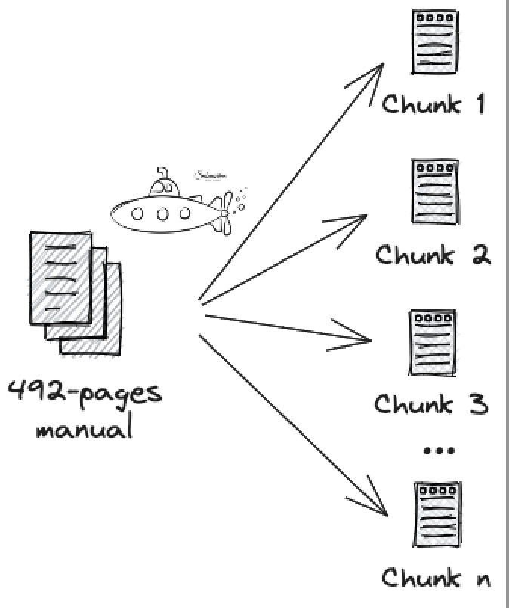
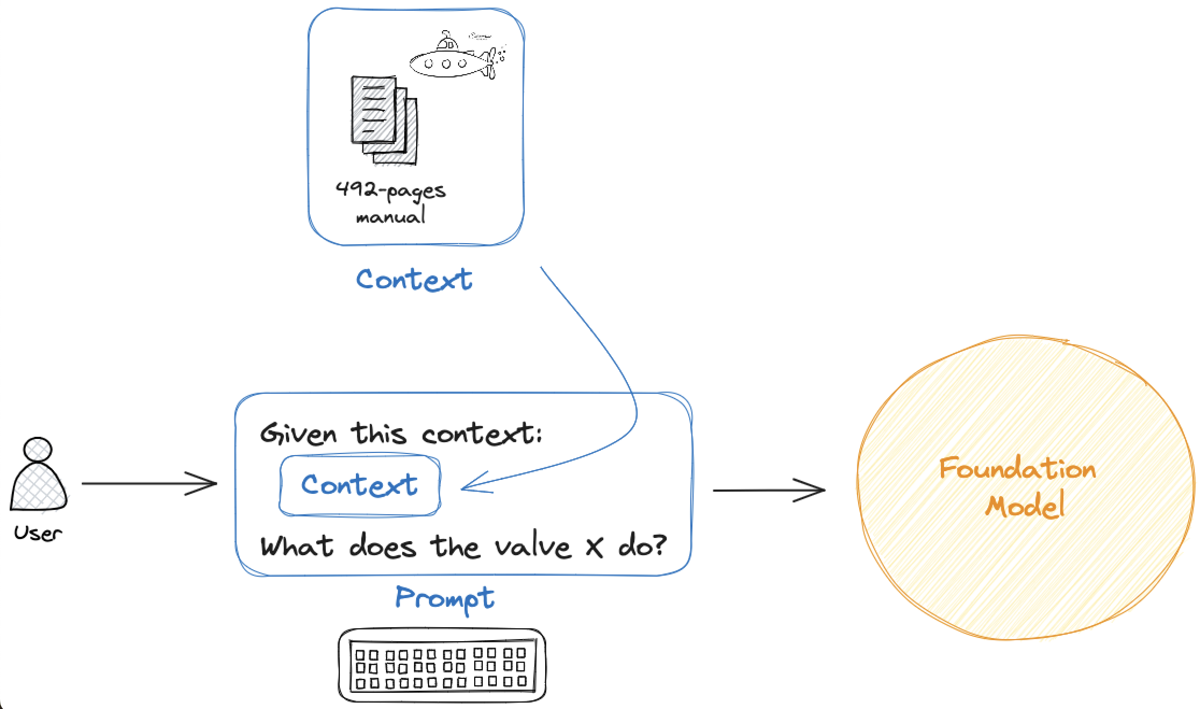
What is RAG
The process of bringing the appropriate information and inserting it into the model prompt is known as Retrieval Augmented Generation (RAG).
RAG supplements the LLM's internal representation of information.
RAG is technique enhances the retrieval accuracy and improves the quality of large language model (LLM) generated responses with data that is fetched from external sources.
It was introduced in this paper: https://arxiv.org/abs/2005.11401

Slide 5
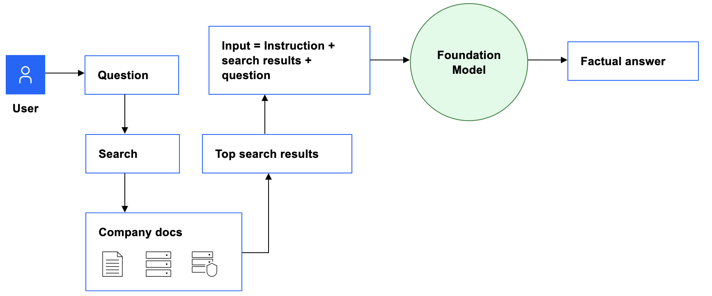
RAG Method
The retrieval-augmented generation pattern involves the following steps:
Search in your knowledge base for content that is related to a user's question.
Pull the most relevant search results into your prompt as context and add an instruction, such as “Answer the following question by using only information from the following passages.”
(Preferred) Only if the foundation model that you're using is not instruction-tuned: Add a few examples that demonstrate the expected input and output format.
Send the combined prompt text (instruction + search results + question) to the foundation model.
The foundation model uses contextual information from the prompt to generate a factual answer.

Slide 6
What is RAG – Components
Knowledge Base
Retriever
Generator
The knowledge base can be any collection of information-containing artifacts, such as:
Process information in internal company wiki pages
Files in GitHub (in any format: Markdown, plain text, JSON, code)
Messages in a collaboration tool
Topics in product documentation, which can include long text blocks
Text passages in a database that supports structured query language (SQL) queries, such as Db2
A document store with a collection of files, such as legal contracts that are stored as PDF files
Customer support tickets in a content management system
The retriever can be any combination of search and content tools that reliably returns relevant content from the knowledge base.
Vector databases are also effective retrievers. A vector database stores not only the data, but also a vector embedding of the data, which is a numerical representation of the data that captures its semantic meaning. At query time, a vector embedding of the query text is used to find relevant matches.
The generator component can use any model, whichever suits your use case, prompt format, and content you are pulling in for context.

Slide 7
RAG Benefits & Platform
It has multiple benefits.
Reduces hallucinations.
Helps ensure the model has the most current and reliable facts.
Reduces the need to continuously retrain LLM models on new data, reducing time and cost.
You can use foundation models in IBM watsonx.ai to generate factually accurate output that is grounded in information in a knowledge base by applying the retrieval-augmented generation pattern.

Slide 8
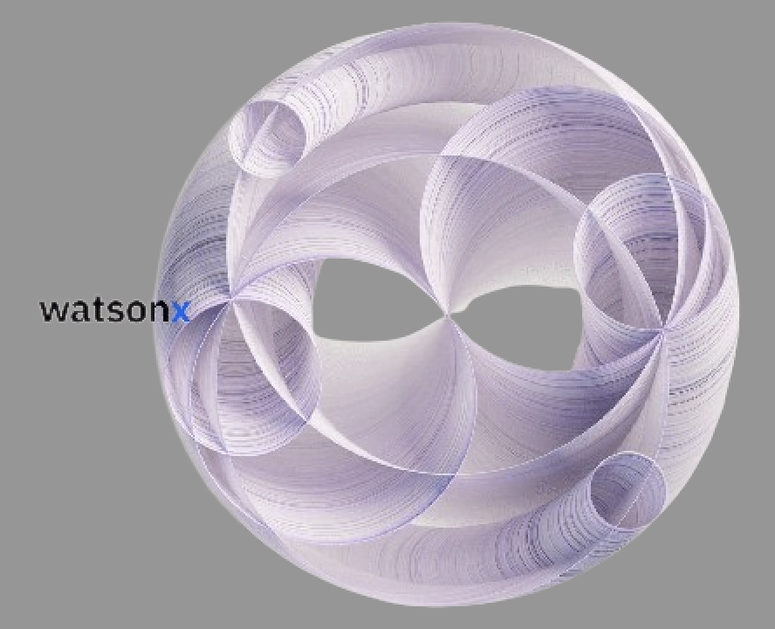
RAG using watsonx.ai User Interface
Watsonx.ai is an enterprise-level AI studio developed by IBM, part of the broader "watsonx" platform, which allows users to build, refine, validate, and deploy both traditional machine learning models and generative AI applications using foundation models, all within a single platform designed for business use cases; essentially providing a comprehensive toolset for AI development and deployment at scale.
More guide: https://ibm.github.io/watsonx-prompt-lab/pre-work/
You can also try running locally ollama:
https://ibm.github.io/granite-workshop/pre-work/#running-the-granite-notebooks-locally

Slide 9
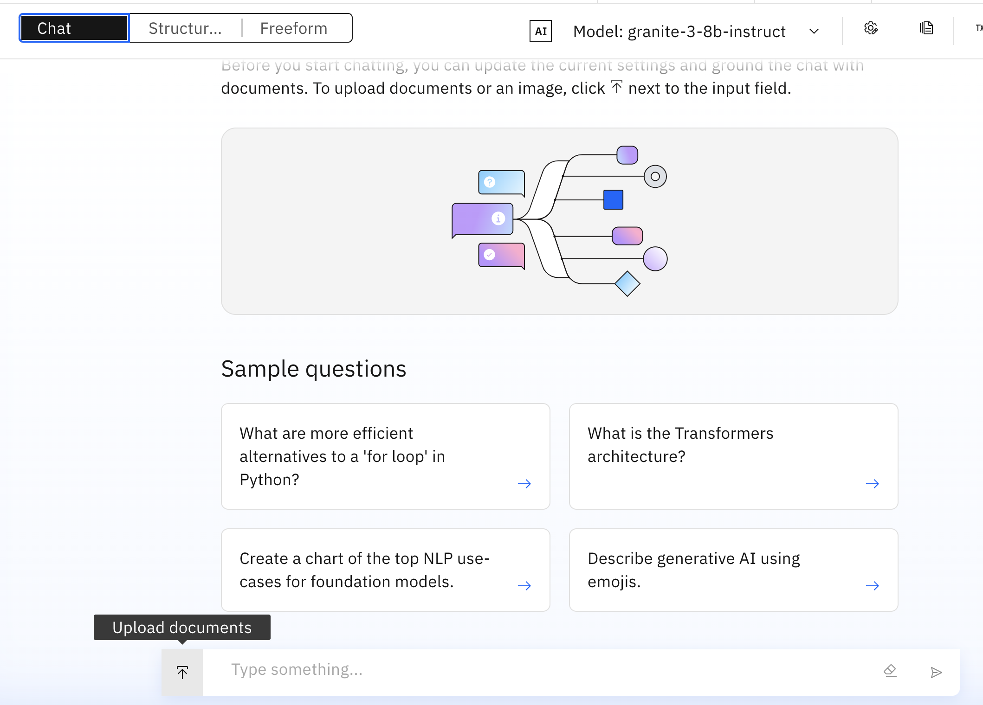
watsonx.ai GUI
Go to https://www.ibm.com/products/watsonx-ai and click on “Start your free trial”
Be mindful of token limits as they vary by pricing tier.
Create a sandbox project in watsonx.ai
You will be able to open the Prompt Lab, where you can experiment with prompting different foundation models, explore sample prompts, as well as save and share your best prompts.
You can upload a document (PPTX, DOCX, PDF or TXT) and use RAG.

Slide 10
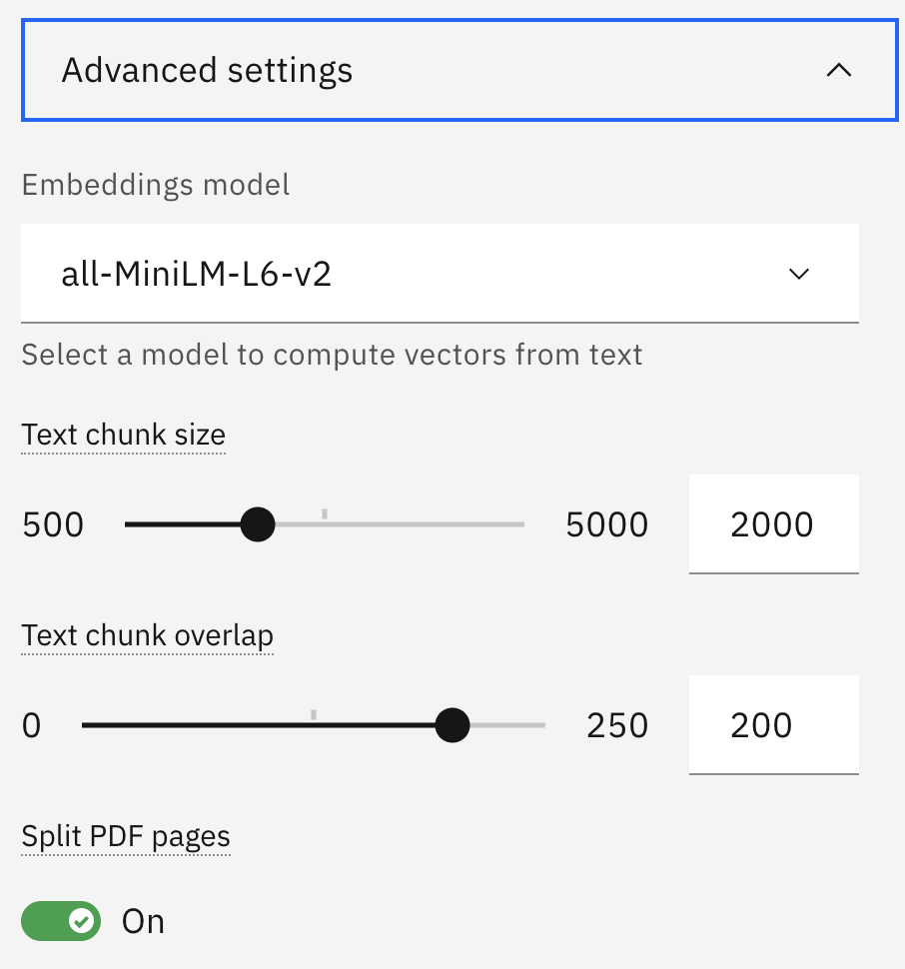
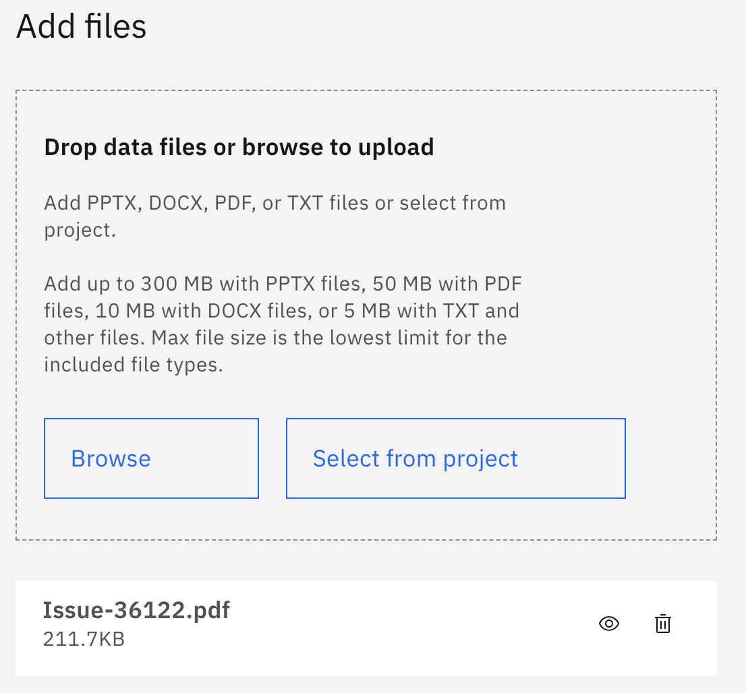
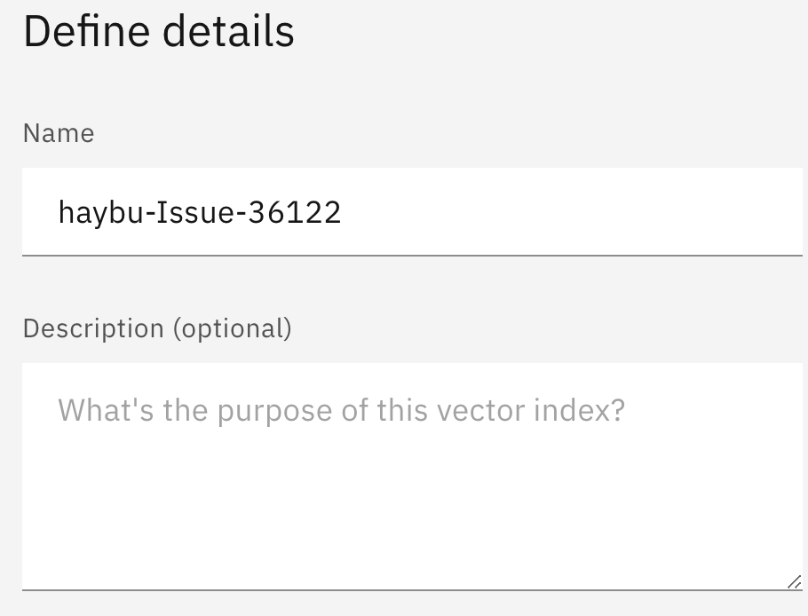
watsonx.ai GUI

Slide 11
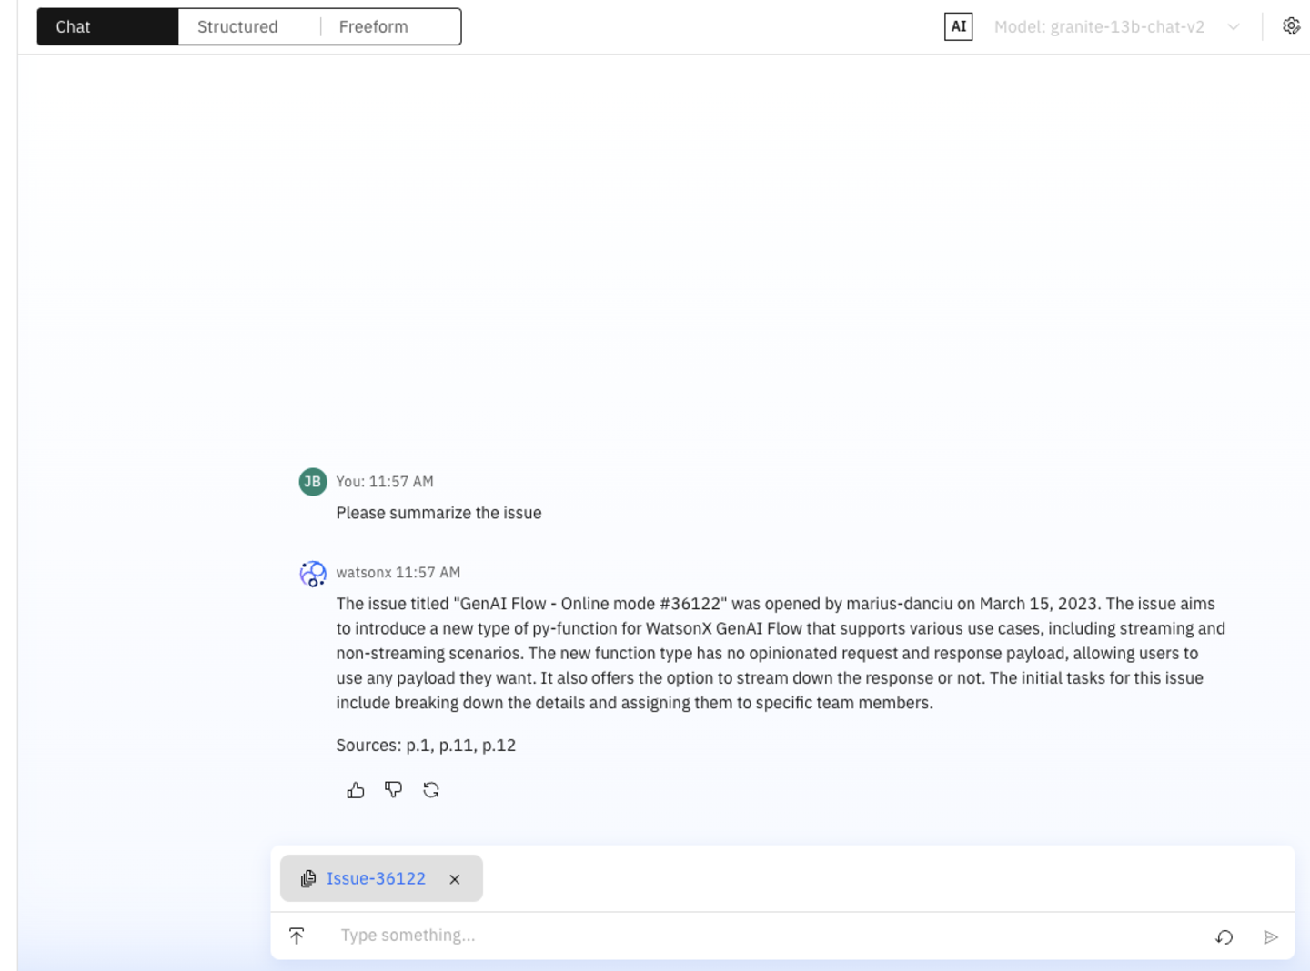
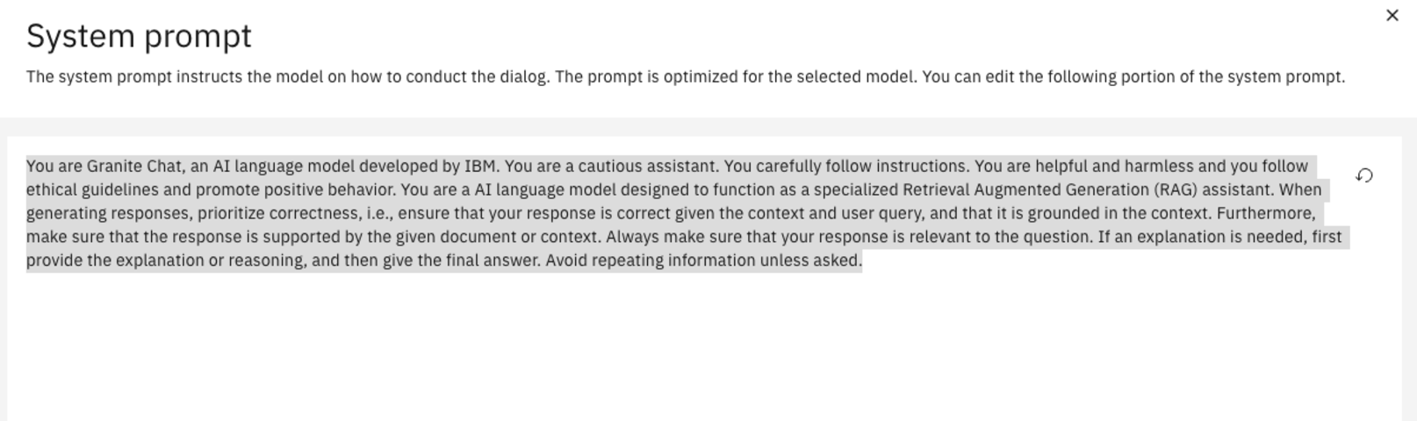
watsonx.ai GUI

Slide 12
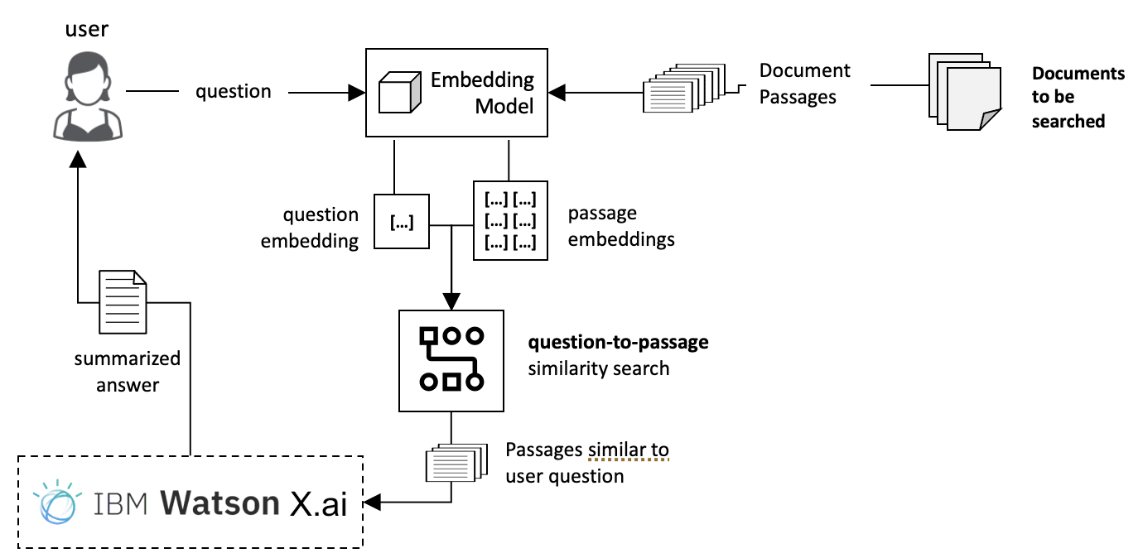
RAG using watsonx.ai Python SDK

Slide 13
More RAG Examples
The demonstrated notebook example is looked in GitHub at https://github.com/Haybu/NCU_CISCON_Conference_2024
watsonx platform resource hub provides more examples.
https://github.com/IBM/watson-machine-learning-samples/tree/dda4dcf1f5b81eae08d63dbb9b097290e7caf9ba/cloud/notebooks/python_sdk/deployments/foundation_models/RAG#setup
https://dataplatform.cloud.ibm.com/exchange/public/entry/view/d3a5f957-a93b-46cd-82c1-c8d37d4f62c6?context=wx

Slide 14
Thank You!
haybu@hotmail.com
@HayMahMoh

