Slide 1
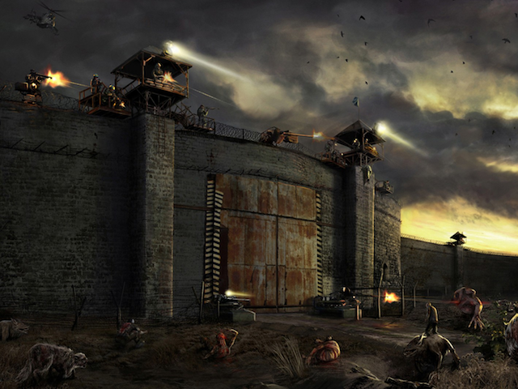

o
The Rise of the Dead
Created by:
Haydar Shariff – 300 828 076
Adalberto Cuevas de Paula – 300 917 462
Ostap Hamarnyk - 300 836 326
Notes:
http://zombierush.azurewebsites.net/

Slide 2
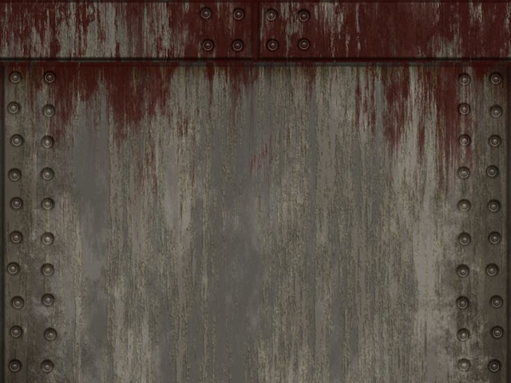
Game Story
The initial idea came from “The Walking Dead”
Failed scientific experiment
“The warriors of light” trying to find the cure
The professor from Alberta has a secret formula
Help the Warriors to clear the path to the largest security checkpoints

Slide 3
Game Details
Game Characters
8 types of regular zombies
2 types of easy difficulty
2 types of medium difficulty
3 types of hard difficulty
3 types of boss zombies

Slide 4
Game Details
Game Weapons
4 types of turrets to kill zombies
Each tower can upgrade up to 3rd level

Slide 5
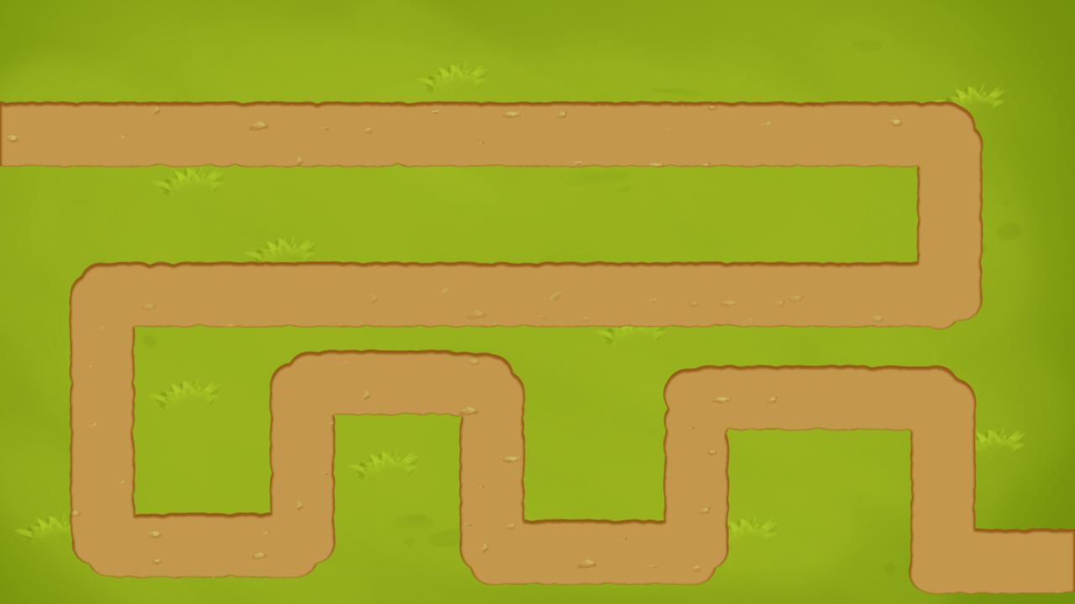
Game Details
Game Maps
4 types of maps in different environment
City
Field
Winter city

Slide 6
Tools Used
Visual Studio Code - Version 1.14.2
GIMP - image editing and special text effects
GitHub – version control
Azure – free host for the game

Slide 7
Next Steps
Select(or draw) weapons images and animations (shooting, turrets rotation etc.)
Create sprite sheets with enemies and implement their animation(walking in four directions, dying etc.)
Create maps
Implement first two game levels
Modify game interface(add menu controls to build turrets, access game settings and home screen)

