Slide 1
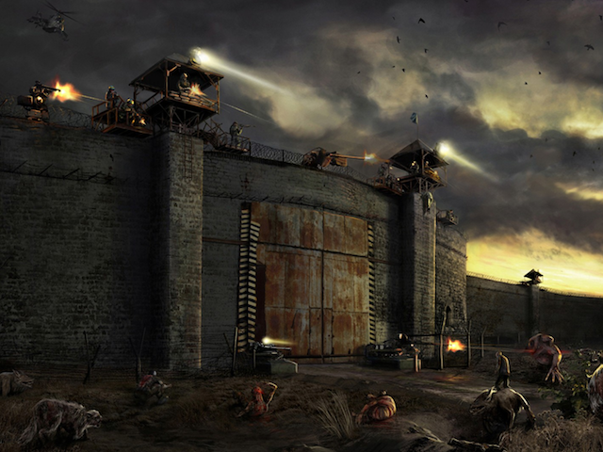


o
Created by:
Haydar Shariff – 300 828 076
Adalberto Cuevas de Paula – 300 917 462
Ostap Hamarnyk - 300 836 326
Crazy Game Creation
Notes:
http://zombierush.azurewebsites.net/

Slide 2
Game Overview
Failed scientific experiment
“The warriors of light” trying to find the cure
The professor from Alberta has a secret formula
Help the Warriors to clear the path to the largest security checkpoints
The initial idea came from “The Walking Dead”

Slide 3
Initial Plan
List of all classes and

Slide 4
Game Story
Failed scientific experiment
“The warriors of light” trying to find the cure
The professor from Alberta has a secret formula
Help the Warriors to clear the path to the largest security checkpoints
The initial idea came from “The Walking Dead”

Slide 5
Game Story
Failed scientific experiment
“The warriors of light” trying to find the cure
The professor from Alberta has a secret formula
Help the Warriors to clear the path to the largest security checkpoints
The initial idea came from “The Walking Dead”

Slide 6
Game Story
Failed scientific experiment
“The warriors of light” trying to find the cure
The professor from Alberta has a secret formula
Help the Warriors to clear the path to the largest security checkpoints
The initial idea came from “The Walking Dead”

