Slide 1


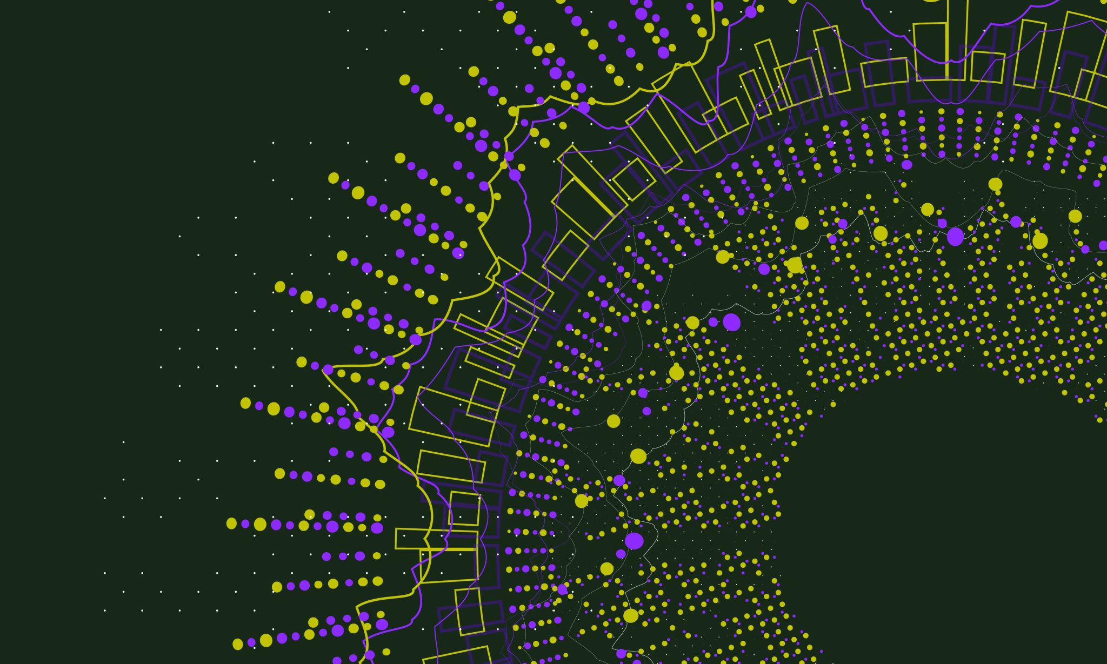
Lead Sheet Generator
By Hayden Dustin
Notes:
Hi! My name is Hayden Dustin and I will be going over my senior project.

Slide 2
Why This Project?
Notes:
Before I begin talking about my project, however, I would like to talk about why I chose this topic.

Slide 3
Most Influential Courses
Music
Computer Science
Theory I-IV
Aural Skills I-IV
Composition
Algorithm Analysis
Software Development
Game Development
Notes:
These are some of the most influential classes I have taken over my college career. I learned a lot from my music courses, mostly from Music Theory I-IV, and a lot from my computer science courses. Algorithm Analysis has proven to be the most useful, followed very closely by Software Development, which I am currently taking.

Slide 4
Background Information
Notes:
Before I delve too far into the actual program, there is a little bit of music knowledge that you need to know.

Slide 5
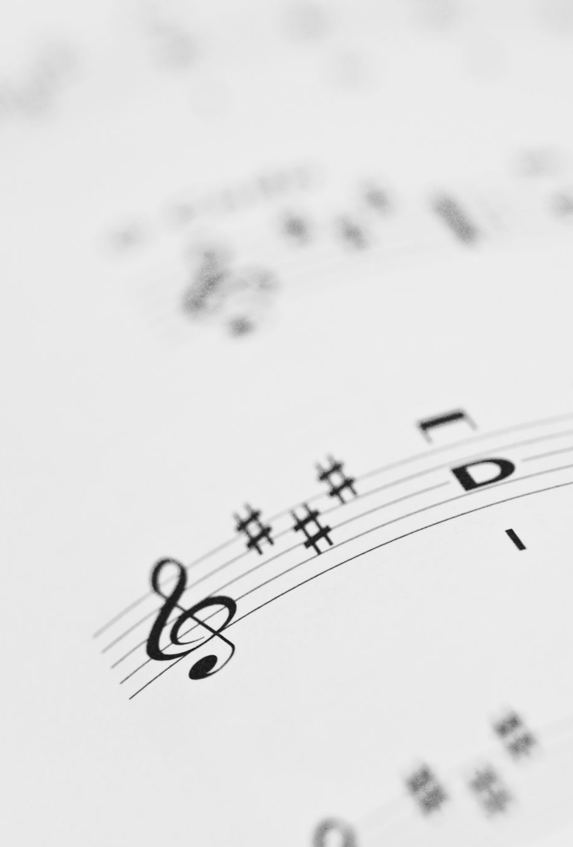
What is a Lead Sheet?
Accompaniment to a melody
Meant to be simple
Lists 1 – 2 chords per measure
Notes:
You may be wondering what a lead sheet is, as the title of the project is a “Lead Sheet Generator.” A lead sheet is a very simple set of instructions that an experienced musician can follow to accompany another musician, or musicians. The lead sheet is an instruction for the harmony to a melody.

Slide 6
Harmony vs. Melody
Harmony
Melody
The background
Usually multiple voices as an accompaniment
The main tune of a song
Usually the thing stuck in your head
Notes:
Now you might be wondering what is melody and what is harmony. Harmony is the background of a song, usually consisting of multiple instruments, or sometimes just piano. Melody is the catchy part of the song that gets stuck in your head. It’s the main chorus of a song or the “sick beat” that usually brings people back to the song.

Slide 7

Chords
Multiple notes played at once
Can have multiple variations
Called inversions
Usually help determine a key
Notes:
A big part of harmony is the use of chords. Chords are groups of notes played at the same time to create a more in depth sound. There are tons of different chords with all sorts of inversions, and all of these chords help determine the key of the piece.

Slide 8
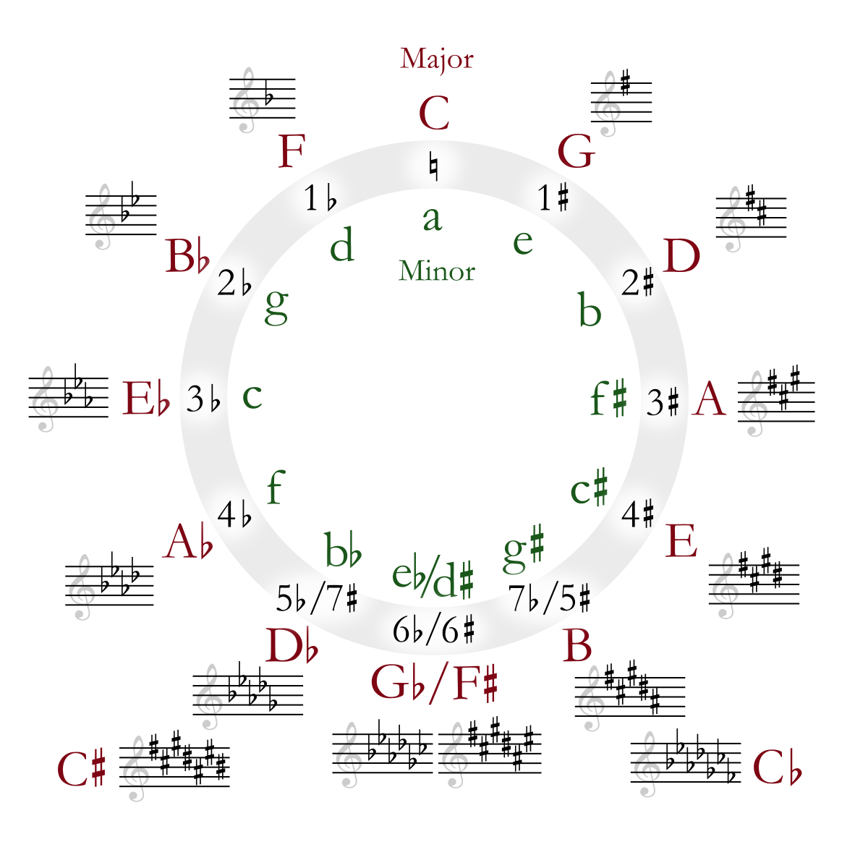
Key Signature
A formula for determining what notes to play
Main framework for a song
Notes:
The key is the base for all songs and musicians. It acts as the foundation that the song is built on, and provides a set of instructions to follow, like the 8 specific notes you’ll be playing, denoted with sharps and flats. This small limitation from 12 notes to 8 notes might not sound like much, but it makes a huge difference in the sound of a song.

Slide 9
My Program
Notes:
Now to the really exciting part, my program.

Slide 10

Overview
Python Program
Requires a .wav file
Outputs a lead sheet on the command line
Similar to AI music writing
AIVA
Notes:
Overall this is a python program that accepts a .wav file and turns the information contained within it into a lead sheet. Sounds simple enough, right? Not so much…but I’ll get into that in just a minute. This program follows in the footsteps of similar music writing AIs, but instead of creating the whole piece or just a melody, this program is designed to help beginning composers develop their already existing melodies.

Slide 11
Tools
Numpy
Data Organization
Matplot
Visualizing Graphs
Scipy
File Processing
Pydub
File Processing
Os
File Navigation
Notes:
There were a lot of data analysis tools I needed to utilize to make this program work. Most of which were array processing and graphing, such as the ones listed here. The tool that turned out to be the most useful was scipy, as without the fast Fourier transfer function, none of this would have been possible. That being said, it was definitely the hardest tool to actually get working because of all the errors.

Slide 12

The Future of this Program
Add a GUI for ease of access and usability
Polish the tempo accuracy
Improves chord accuracy
Notes:
The future of this program is pretty simple. I want to make a GUI so that anyone can use it and fix up the tempo algorithm’s accuracy. Overall, I want this to be an actual program for people to add to their composing toolbox and make music more accessible to the general public.

Slide 13
How It Works
Notes:
Now, let’s get into the best part, how everything works.

Slide 14

1) Read Files
Opens the .wav file
Creates a list of all note frequencies
Creates a list of all key signatures
Notes:
First, the program starts by reading the .wav file and the information files I made for it. These are a list of all the different weighted notes in each key signature, both major and minor, as well as the weights for all chords in each key. And for example, I will be showing you a very simple melody I used to train this data, which sounds like this:

Slide 15
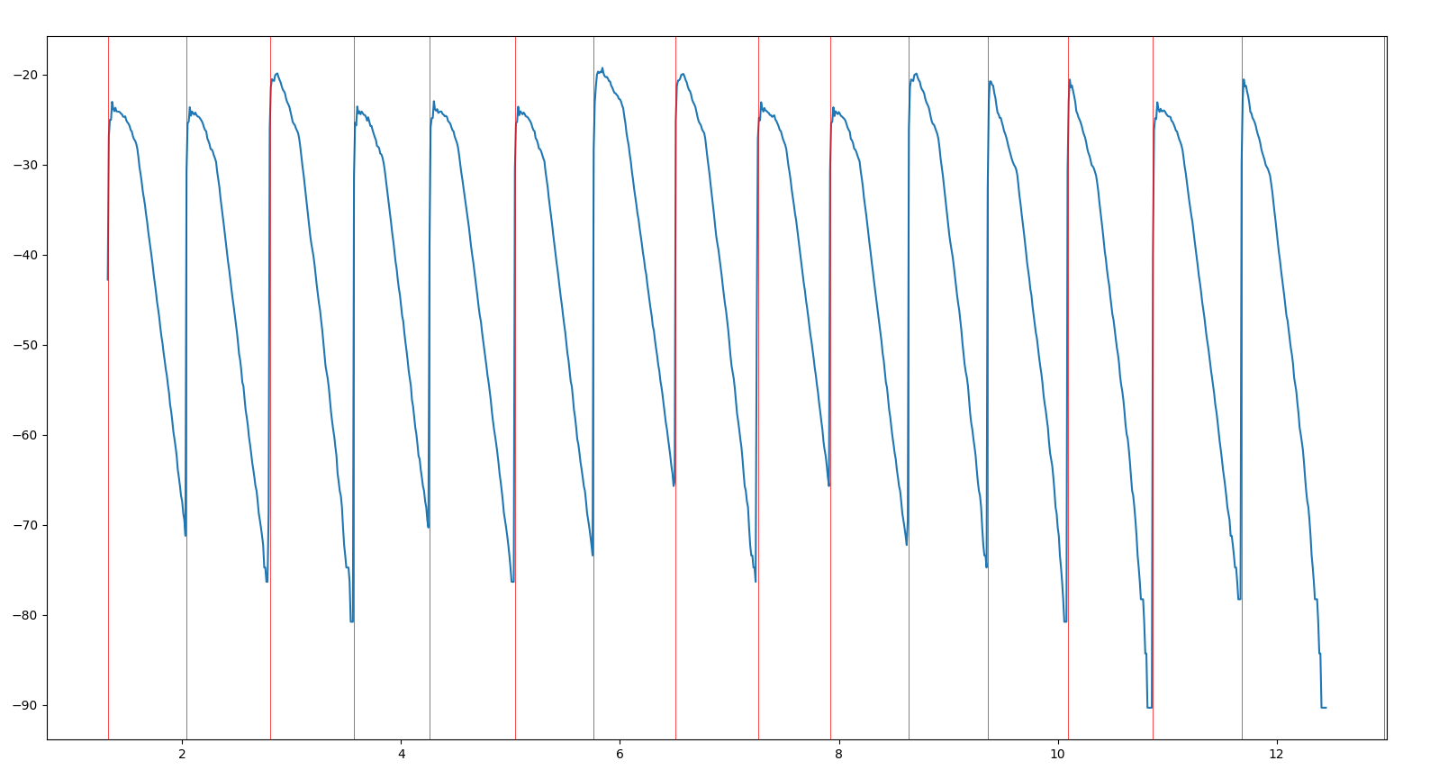
2) Find Note Locations
Identifies each note in the .wav file
Creates an array of each location
Can also output a graph for debugging
Uses pydub’s AudioSegment class
Making use of the volume feature
Notes:
Next it finds the locations of each note in the file, marked with a red line. This graph is a visual representation of the volume stored in the .wav file, which I retrieved using pydub’s AudioSegment class.

Slide 16
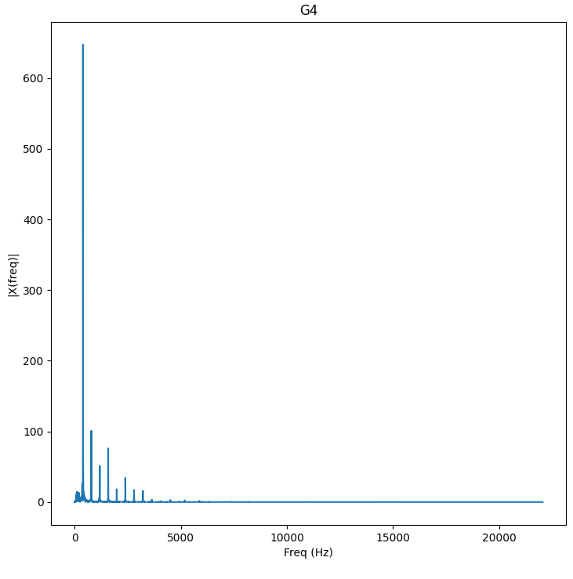
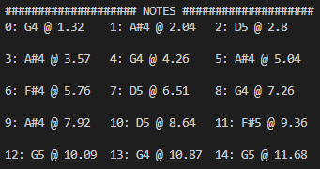
3) Identify Notes
Finds the exact frequency pattern of each note
Including harmonics
Uses numpy’s various methods
Most importantly “find_peaks”
Notes:
Next it identifies the frequency of each note, which it then reverse searches to find the specific note value. The graph seen is a visualization of the frequency graph of the first note, captured using numpy’s “find_peaks” method. This graph is constructed for each note in the file and used to output the chart you can see directly below the graph.

Slide 17
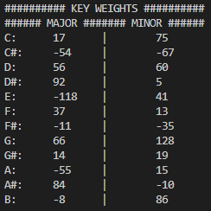
4) Finds the Key
Uses an AI I constructed with my music knowledge
Has a weight for each note in each key
Both for major and minor (including harmonic minor)
Takes the highest weight amongst keys
Notes:
The next step is to determine the key. This is the first AI that I wrote specifically for this program. It uses a specific weight file to determine the likelihood that each key describes this file. As you can see, each weight is totaled and compared to each other, and the highest weight is the overall key.
I had to TUNE the weight parameters meticulously

Slide 18

5) Find the Tempo
Finds the main roots of the key
The root and the dominant
Calculates the distance between them
Decreases distance between notes until it finds the best match
Notes:
Next it has to determine the tempo of the piece in order to construct proper measures. This is done using a fairly simple binary search algorithm that starts at the first and second occurrences of the main roots of the key and steadily decreases it’s jump distance between notes until it finds an appropriate tempo.

Slide 19
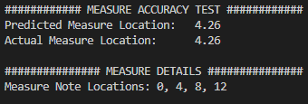
6) Create the Measures
Takes the whole melody and sections it
Each measure contains only a few notes
Makes the program view each measure as an individual melody with the key already in mind
Notes:
Next is another algorithm I wrote for this project, which constructs the measures using the newly defined tempo and time signature grouping. It refines the whole piece down into just a few select notes per measure, then passes that information into the last piece of processing for this program…
Mention that the system finds the measures, not just assuming it’s in 4/4

Slide 20

7) Create the Lead Sheet
Finds the most accurate key for each measure
Uses the same algorithm as finding the key
Because the piece is better understood it only has notes that apply to a specific chord progression
Notes:
Which is yet another AI I built for this program. This AI is based on the original one but has a slightly different approach to the problem it faces. It uses a new set of weights that is constructed specifically for the defined key. It then uses those weights to determine the most fitting chord for that measure. I essentially built an AI that would do all of my Music Theory I and II. Freshman year me would be so jealous of this.

Slide 21
Putting it to the Test
Notes:
So with all of that being said, I want to put my program to the real test, and I want to compose a piece of music here live. So does anyone want to give me a key signature?

Slide 22
A, A#, B, C, C#, D, D#, E, F, F#, G, G#
Major or Minor
Tempo

