Slide 1
Wildlife Image Classification for Conservation Monitoring
CNNs, Transfer Learning, and Traditional ML Models
Hayden Chu

Slide 2
Motivation & Goal
Why Classify Wildlife Images?
- Track biodiversity, estimate abundance
- Many rare species have very few images
Challenges:
- Small, imbalanced datasets
- Visually similar species
Goal:
- Compare deep learning vs. traditional ML for species classification
Notes:
Wildlife camera traps and biodiversity monitoring tools collect large volumes of unlabeled image data. Manually labeling these images is time-consuming and error-prone, especially for rare species.
The challenge we address is how to classify species in images when data is limited and the species look visually similar.
The goal of this project is to evaluate deep learning models—like CNNs and transfer learning—against traditional machine learning models like Random Forest and KNN for species classification across two datasets: a small one (monkeys) and a larger one (birds)

Slide 3
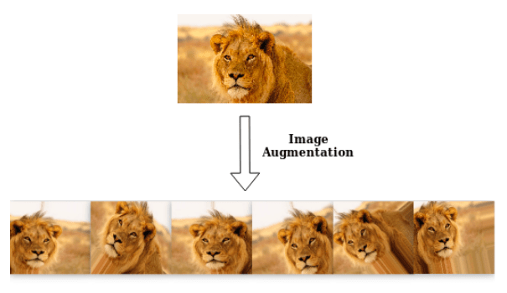
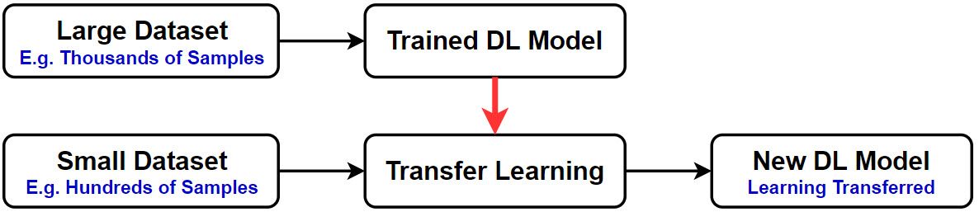
Methods Overview
We tested three types of models: a convolutional neural network (CNN), a transfer learning model using Xception, and two traditional classifiers—Random Forest and K-Nearest Neighbors.
Image augmentation was used to simulate visual diversity in rare species. For Random Forest and KNN, we extracted features from the frozen layers of the Xception model.
Notes:
First, we built our own deep learning model from scratch using a Convolutional Neural Network (CNN). This model learned to recognize species by identifying features in the images, such as fur patterns, shapes, or posture, directly from our dataset.
Next, we used a shortcut called transfer learning. Instead of starting from zero, we took a powerful pre-trained model called Xception, which had already learned to recognize patterns from millions of general images (like dogs, cats, and cars). We kept most of its learned knowledge and only retrained the final layers to specialize in recognizing our specific wildlife species. This approach is especially helpful when you have a smaller dataset, as it leverages knowledge from much larger datasets.
For comparison, we also tested simpler machine learning models, like Random Forest and K-Nearest Neighbors. These models make decisions by comparing features between images, but they struggled with the complexity and variability in real-world animal photos.
To help all our models learn better, we used image augmentation — artificially expanding our dataset by flipping images, zooming in, and changing brightness. This simulates seeing animals under different conditions, making our models more robust and less likely to overfit.

Slide 4
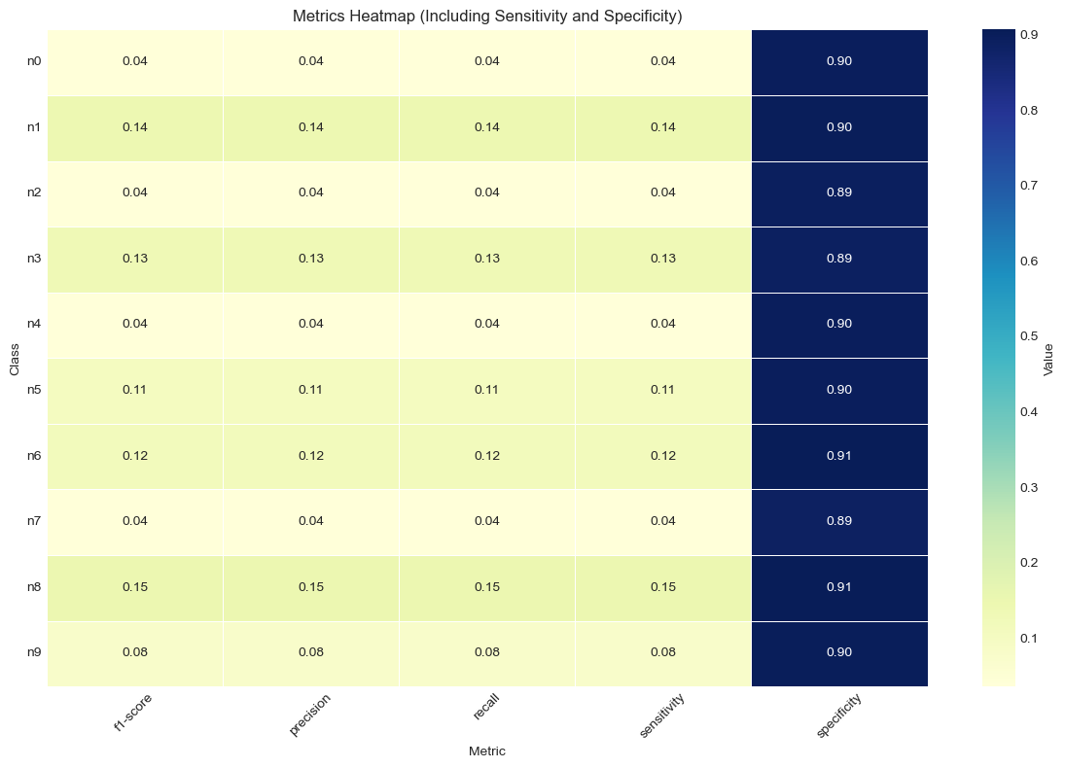
Key Results - Monkeys Dataset
Performance:
- Custom CNN Accuracy: ~12%
- Transfer Model Accuracy: ~10%
- Random Forest: ~10%
- KNN: ~7%
Challenges:
- Very limited images (10 per species)
- Generalization difficulties
Notes:
Our monkey dataset had very few images per species, often fewer than 10.
The custom CNN achieved 12% accuracy. The transfer model slightly underperformed at 10.29%, and traditional methods like Random Forest and KNN performed even worse at 10% and 7.35%, respectively.
These results show that deep learning struggles when species are rare and visually similar. Models tended to have high specificity but low sensitivity—meaning they were better at saying what wasn’t there than correctly identifying what was.
(Insert heatmap visual of sensitivity and specificity here.)

Slide 5
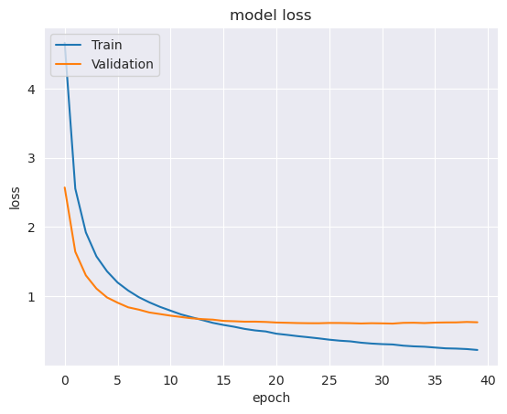
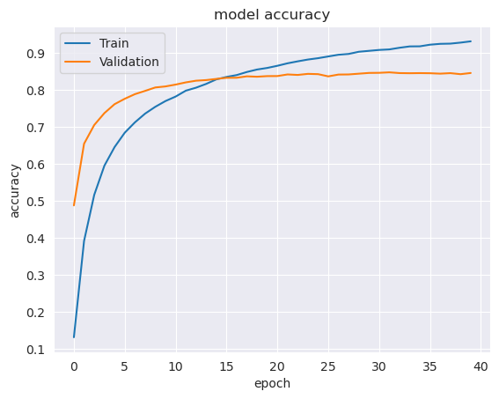
Key Results - Birds Dataset
Performance:
- Transfer Learning Accuracy: ~84%
- Strong generalization across 500 species
Highlights:
- Pre-trained models were crucial
Notes:
The bird dataset had 100 images per class and allowed better training of complex models.
Our transfer learning model using MobileNetV2 achieved accuracy of 84.11% after 40 epochs.
Validation and training curves showed consistent convergence, with minimal overfitting.

Slide 6
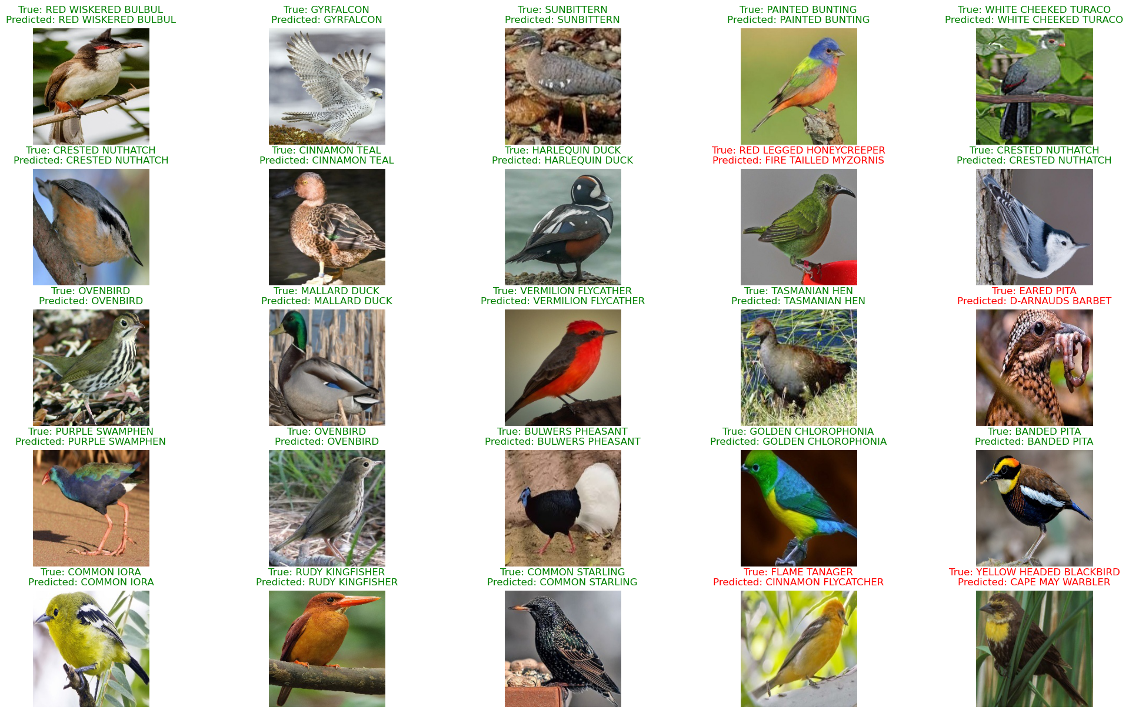
Key Results - Birds Dataset
Model correctly identified species like Ovenbird, Mallard Duck, and Crested Nuthatch, showing it learned meaningful visual features (e.g., plumage, beak, posture).
Misclassifications occurred mostly between visually similar species, such as Red Legged Honeycreeper and Fire Tailed Myzornis, indicating challenges with subtle differences.
Shows strong overall performance, but highlights common limits in fine-grained classification tasks.

Slide 7
Discussion - Lessons Learned
Deep Learning:
- Outperforms traditional ML for complex image tasks
Transfer Learning:
- Great for small datasets
- Improves accuracy and training speed
Traditional ML:
- Inadequate for fine-grained species classification
Notes:
Deep learning models, particularly those using transfer learning, clearly outperformed traditional classifiers in both datasets.
Transfer learning is essential when training data is limited. It reuses general visual patterns learned from millions of images, reducing training time while improving accuracy.
Traditional ML models, while computationally efficient, lacked the spatial and hierarchical pattern recognition required to distinguish fine details between species.

Slide 8
Conclusion & Future Work
- Transfer learning highly effective for monitoring
- Deep CNNs help identify rare species
Future Work:
- Active learning + human-in-the-loop
- Larger, more diverse datasets
- Edge AI for field deployment
Notes:
This project shows that transfer learning is a powerful approach for wildlife classification, especially when rare species or small datasets are involved.
Future directions include combining deep learning with active learning or semi-supervised methods, testing models on larger ecological datasets, and deploying them via edge AI devices for real-time monitoring in the field.

