Slide 1

LOTTO - AI
Dương Tam Lạc – Intern
Cốc Cốc

Slide 2

Agenda
Tech Stacks
Data Flow
Achievements
Shortcomings

Slide 3

Tech Stacks

Slide 4
Frontend
React, Vite, Tailwind CSS, Axios
Backend
FastAPI, Uvicorn, Psycopg2, Python-Jose, Argon2-CFFI
AI/ML
YOLO11n (Ultralytics), OpenCV, Numpy, EasyOCR
Web Scraping & Automation
Beautifulsoup4, Requests, APScheduler, Pytz
Database
Docker - PostgreSQL

Slide 5

Data Flow

Slide 6
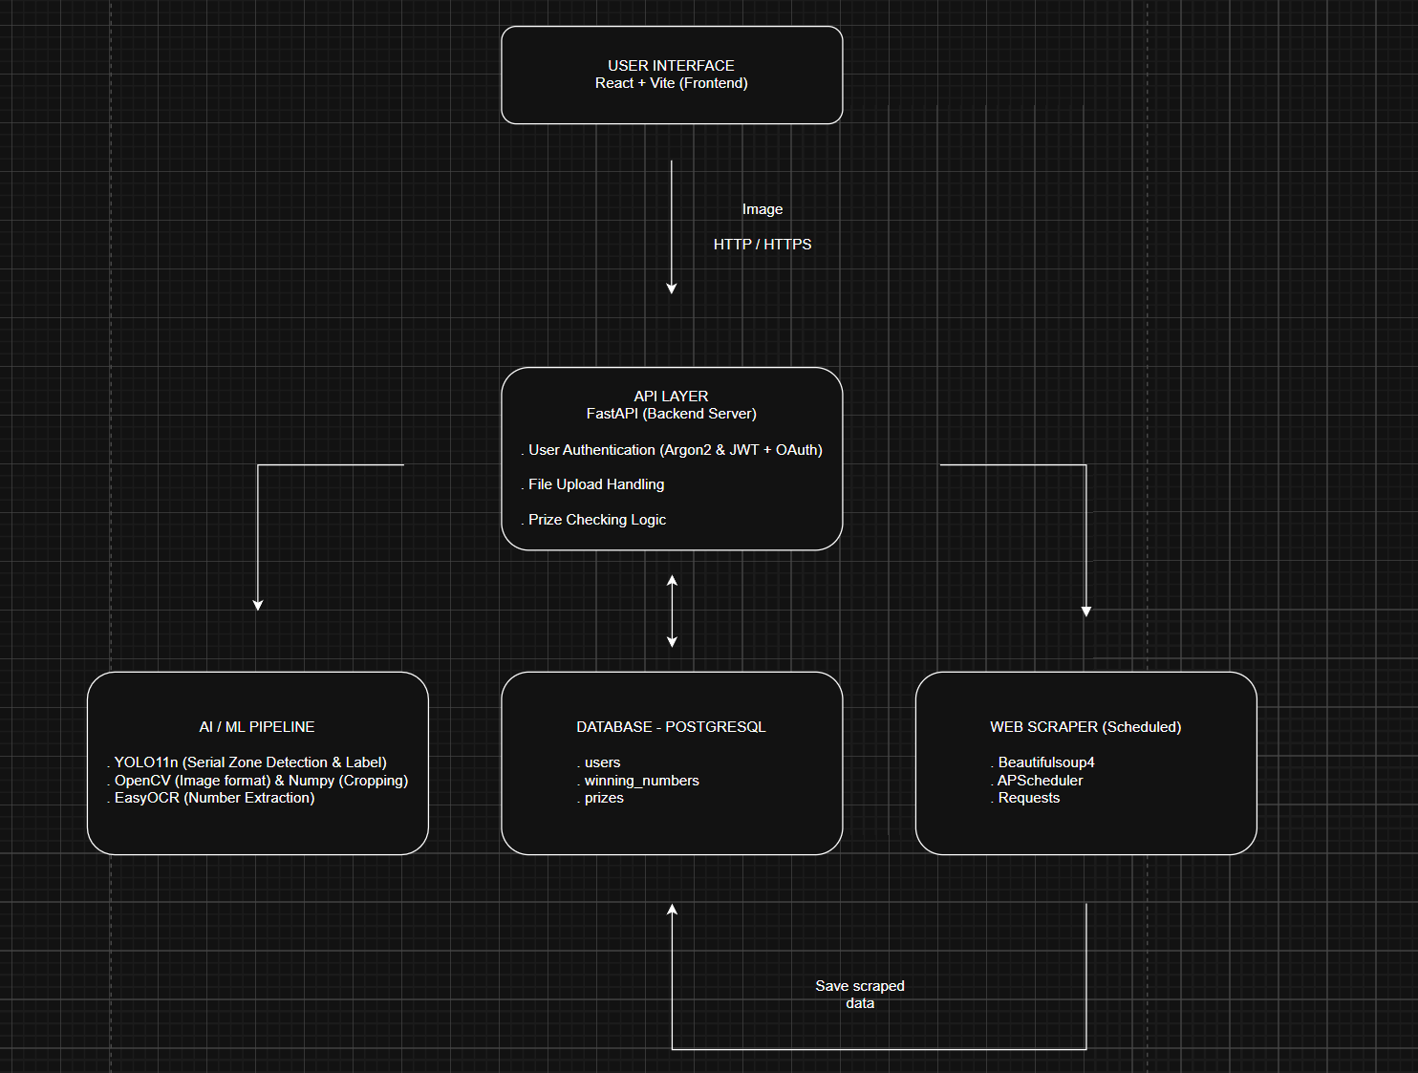

Slide 7

Achievements

Slide 8
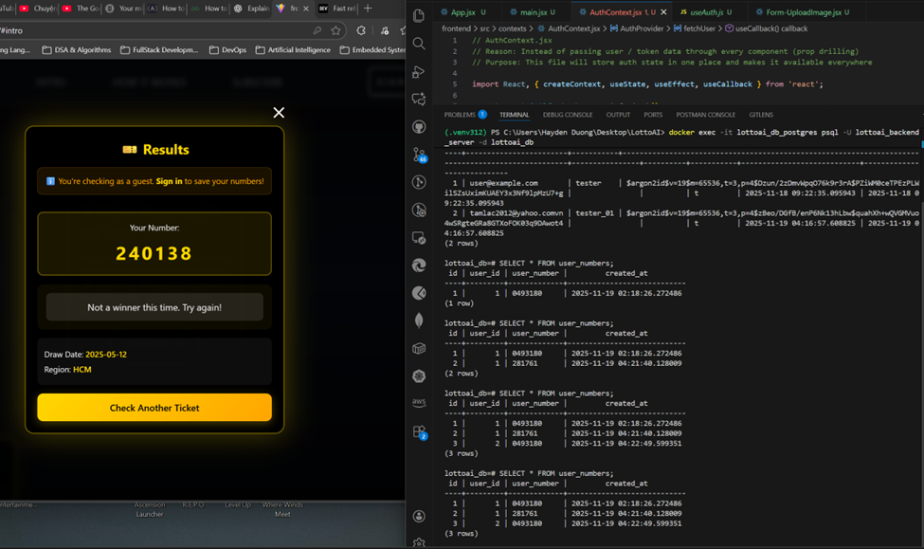
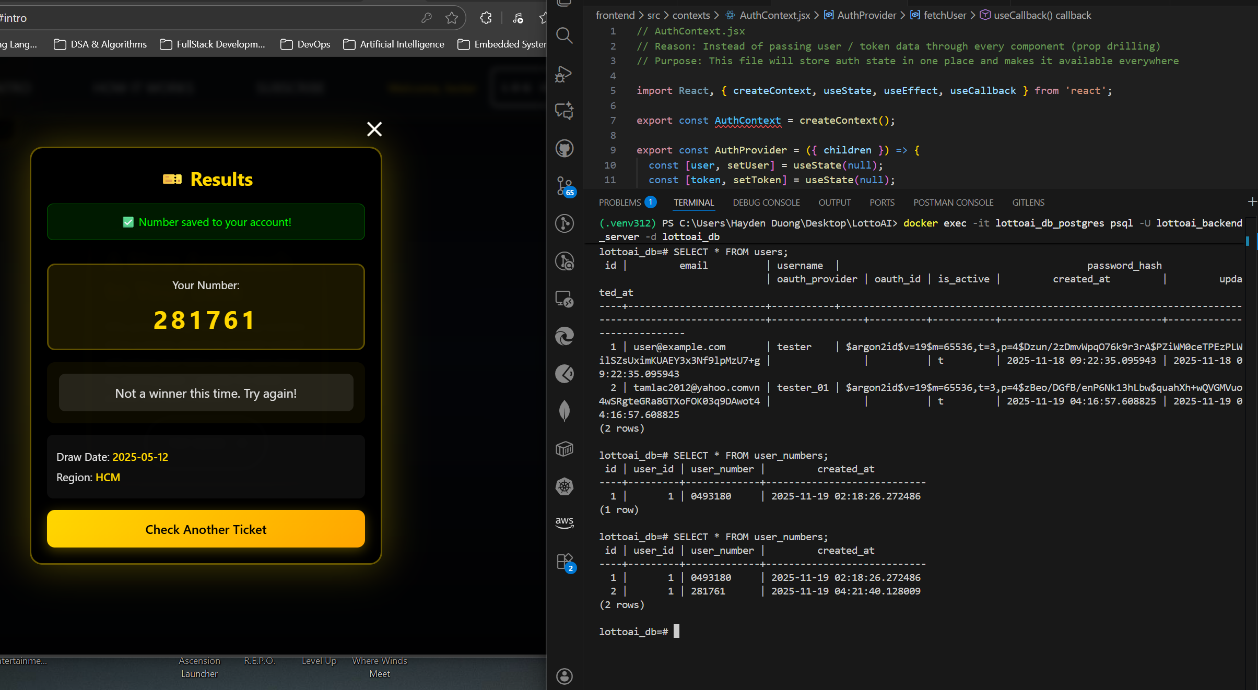
Integrated Pipeline

Slide 9
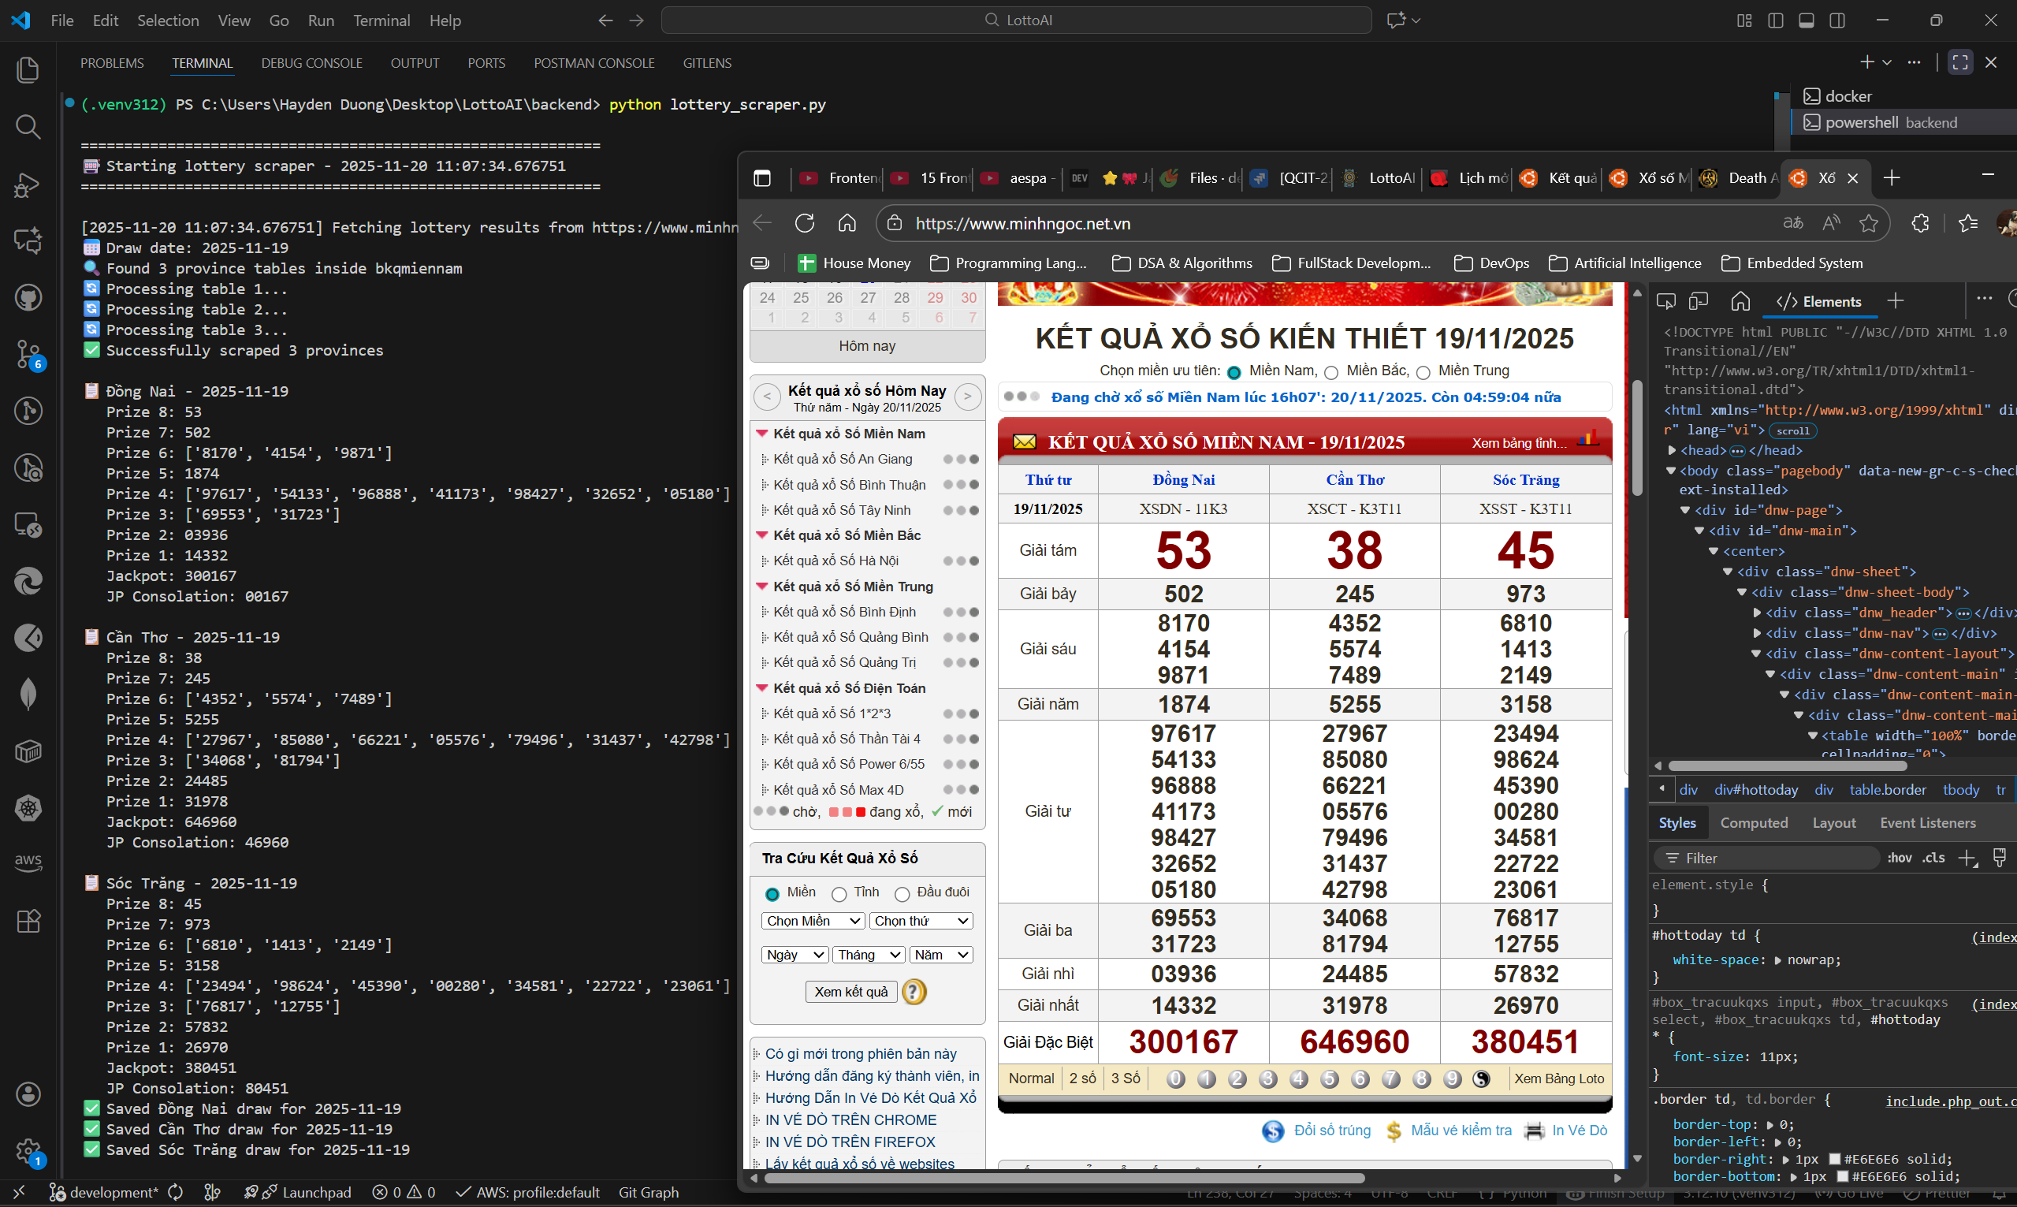
Web Scrapping

Slide 10
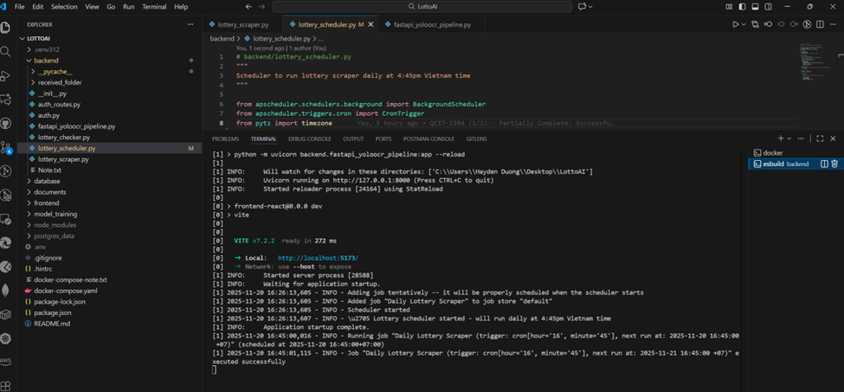
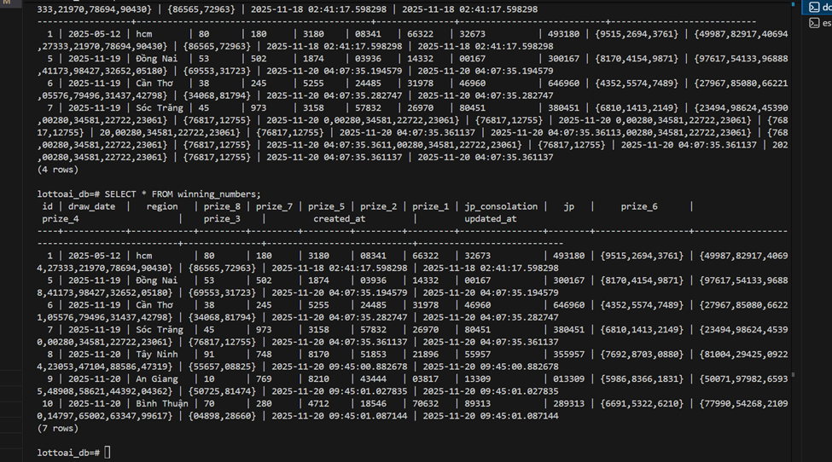
Automated Scraping

Slide 11

Shortcomings

Slide 12
Backend:
Basic comparison logic.
Support: 1 file upload & processing.
Missing: ORM & MailChimp
AI / ML:
Train: perfect condition images
Eval: low

Slide 13

Demo

