Slide 1
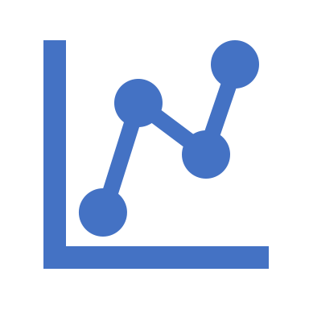
Calibration Workshop
Brian Lucena
Numeristical
www.numeristical.com
While we are waiting…
Clone / download repo at: https://github.com/numeristical/resources (ODSC West 2021)
Install ml_insights (`pip install ml_insights`)

Slide 2
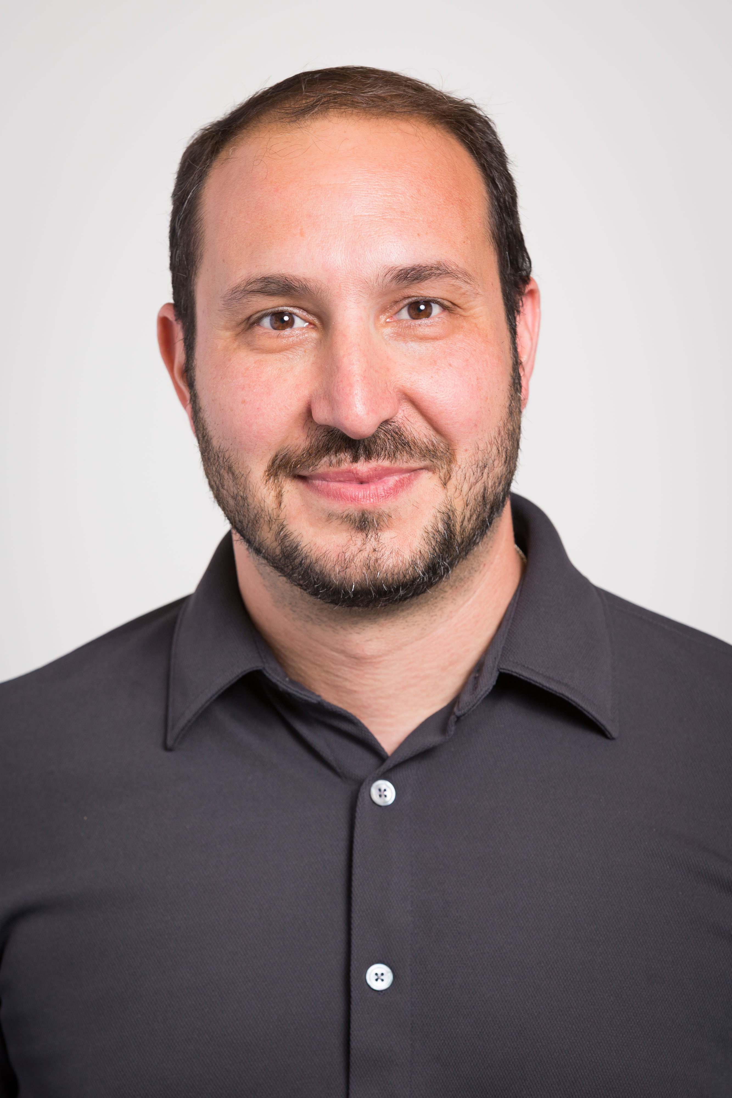
About me: Brian Lucena
Consultant, Researcher, Educator
Principal at Numeristical (www.numeristical.com)
YouTube channel: https://www.youtube.com/numeristical
Machine Learning projects for various companies: (large and small)
Creator of ML-Insights, SplineCalib, and StructureBoost
Publish Research papers (recently in AISTATS)
Frequent Conference Presenter (ODSC, PyData)

Slide 3
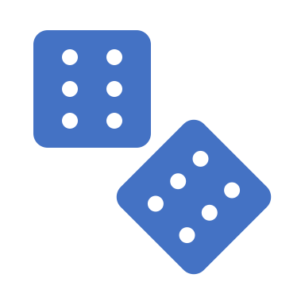
Workshop Outline
Calibration: What? Why? How?
Assessing Calibration
Tools and Methods for Calibration
Advanced Topics in Calibration

Slide 4
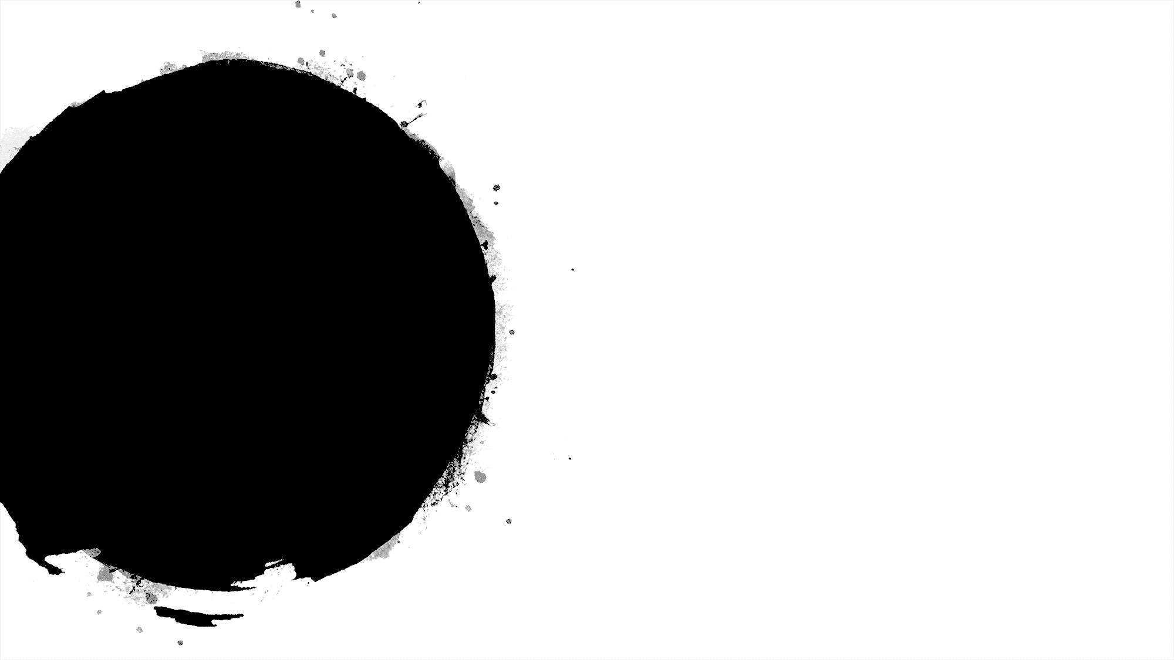
Types of Predictions
“Hard” Prediction:
Predict the exact value of y given x.
“Ranking” Prediction: (binary classification)
Provide a score for x, where higher score
means it is more likely that y is True
“Probabilistic” Prediction:
Predict the probabilities on y given x.

Slide 5
Types of Predictions
“Hard” Prediction
“Ranking” Prediction
“Probabilistic” Prediction
Choose Threshold
Direct

Slide 6
Types of Predictions
“Hard” Prediction
“Ranking” Prediction
“Probabilistic” Prediction
Not generally possible
Calibration!

Slide 7
What is Calibration?
Calibration:
Adjusting the predictions of a model so that they are probabilistically meaningful
Probabilistically meaningful:
When predicting probability .3, in the long run, 30% of those events occur.

Slide 8
Why Calibrate?
Action depends on a precise probability.
Assessing Model Quality
Assessing Model Impact (Simulation)
Implications for fairness, bias, etc.
Recalibrating for model drift (or use on a different population)

Slide 9
How to do Calibration?
Fit a function that maps the uncalibrated score to the “true” probability.
Use a data set of pairs (score, outcome) to fit this function.
Methods vary in what kinds of functions they fit, and how they fit them.
Different ways to get the data set on which to fit the calibration.
Multiclass – more complicated.

Slide 10
To the Notebook!
Clone the repo at: https://github.com/numeristical/resources
Navigate to the folder:
ODSC_West_2021
Open the notebook: CW_1.ipynb

