Slide 1
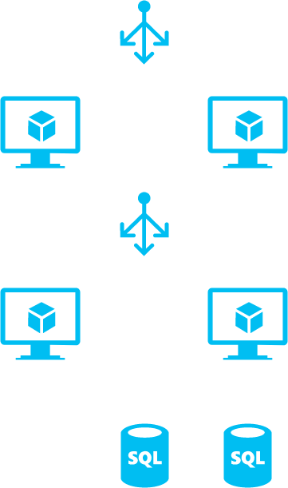

Slide 2




Web Tier
Application Tier
Data Tier

