Slide 1
Three-Tier Architecture
En Wu, Technical Instructor, eCloudvalley

Slide 2
Agenda
Intro 3-tier Architecture
Azure Architecture
Virtual Network
Subnet
Network Security Group
Availability Set
Windows & Linux VM
Load Balancer
SQL Database
What We will Create

Slide 3
Intro 3-tier Architecture

Slide 4
What is 3-Tier Architecture
A type of software architecture.
Composed of three “tiers” or “layers” of logical computing.
Allow to update a specific part of an application independently of the other parts.
Improve overall time-to-market and decrease development cycle times.
Notes:
A 3-tier architecture is a type of software architecture which is composed of three “tiers” or “layers” of logical computing. They are often used in applications as a specific type of client-server system. 3-tier architectures provide many benefits for production and development environments by modularizing the user interface, business logic, and data storage layers. Doing so gives greater flexibility to development teams by allowing them to update a specific part of an application independently of the other parts. This added flexibility can improve overall time-to-market and decrease development cycle times by giving development teams the ability to replace or upgrade independent tiers without affecting the other parts of the system.
For example, the user interface of a web application could be redeveloped or modernized without affecting the underlying functional business and data access logic underneath. This architectural system is often ideal for embedding and integrating 3rd party software into an existing application. This integration flexibility also makes it ideal for embedding analytics software into pre-existing applications and is often used by embedded analytics vendors for this reason. 3-tier architectures are often used in cloud or on-premises based applications as well as in software-as-a-service (SaaS) applications.

Slide 5
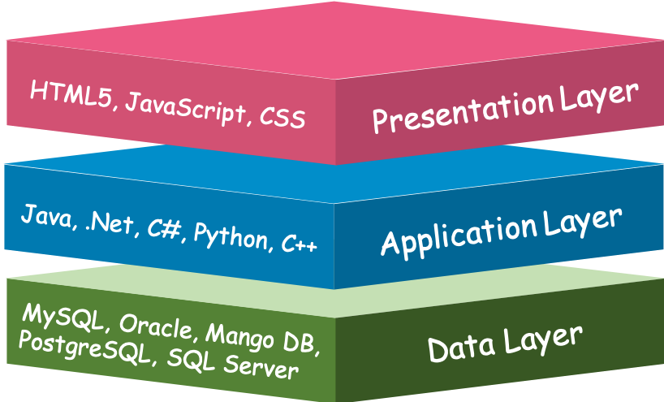
What do the 3-Tier Means?
Notes:
Presentation Tier- The presentation tier is the front end layer in the 3-tier system and consists of the user interface. This user interface is often a graphical one accessible through a web browser or web-based application and which displays content and information useful to an end user. This tier is often built on web technologies such as HTML5, JavaScript, CSS, or through other popular web development frameworks, and communicates with others layers through API calls.
Application Tier- The application tier contains the functional business logic which drives an application’s core capabilities. It’s often written in Java, .NET, C#, Python, C++, etc.
Data Tier- The data tier comprises of the database/data storage system and data access layer. Examples of such systems are MySQL, Oracle, PostgreSQL, Microsoft SQL Server, MongoDB, etc. Data is accessed by the application layer via API calls.

Slide 6
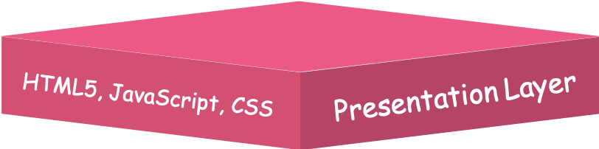
Presentation Layer
the front end layer in the 3-tier system
Notes:
Presentation Tier- The presentation tier is the front end layer in the 3-tier system and consists of the user interface. This user interface is often a graphical one accessible through a web browser or web-based application and which displays content and information useful to an end user. This tier is often built on web technologies such as HTML5, JavaScript, CSS, or through other popular web development frameworks, and communicates with others layers through API calls.

Slide 7
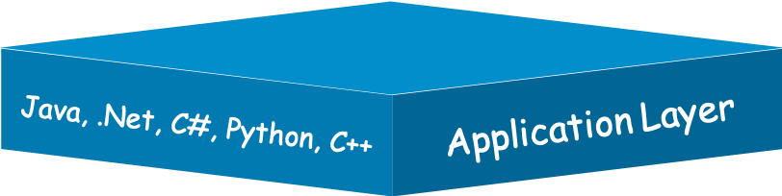
Application Tier
Notes:
Application Tier- The application tier contains the functional business logic which drives an application’s core capabilities. It’s often written in Java, .NET, C#, Python, C++, etc.

Slide 8
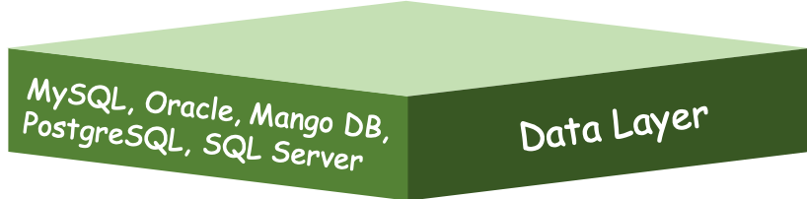
Data Tier
Notes:
Data Tier- The data tier comprises of the database/data storage system and data access layer. Examples of such systems are MySQL, Oracle, PostgreSQL, Microsoft SQL Server, MongoDB, etc. Data is accessed by the application layer via API calls.

Slide 9
What do the 3-Tier Means?
HTML5, JavaScript, CSS
Presentation Layer
Java, .Net, C#, Python, C++
Application Layer
MySQL, Oracle, Mango DB, PostgreSQL, SQL Server
Data Layer
Notes:
https://www.jinfonet.com/resources/bi-defined/3-tier-architecture-complete-overview/

Slide 10
Azure Architecture

Slide 11

Azure Virtual Network
Logically isolated network on Azure, which allows Azure resources to securely communicate with each other, the internet, and on-premises networks
Scoped to a single region, however, multiple virtual networks from different regions can be connected together using virtual network peering
Can be segmented into one or more subnets that help organize and secure your resources in discrete sections
Azure Virtual Network provide:
Isolation
Segmentation
Communication with on-premises and cloud resources
Routing
Filtering of network traffic

Slide 12

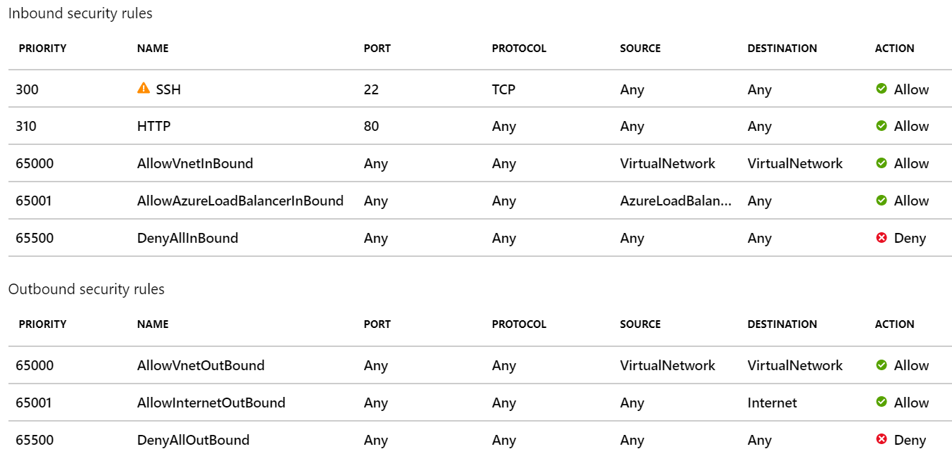
Network Security Group (NSG)
Allows or denies inbound network traffic to your Azure resources
Think of a network security group as a cloud-level firewall for network
Notes:
附圖是Azure Portal的NSG設定圖，可以設定允許/限制port (80 port for HTTP, 22 port for SSH)或source

Slide 13
Availability Set
Logical grouping of two or more VMs
Keep your application available during planned or unplanned maintenance
Ensure your application remains online if a hardware failure occurs
Fault Domain:
Avoid single point failure
Provide for the physical separation of your workload across different hardware in the datacenter
Update Domain:
Avoid all instances under maintenance in the same time
Update is sequenced through update domains
Notes:
Update domains (UD):
When a maintenance event occurs (such as a performance update or critical security patch applied to the host), the update is sequenced through update domains. Sequencing updates using update domains ensures that the entire datacenter isn't unavailable during platform updates and patching. Update domains are a logical section of the datacenter, and they are implemented with software and logic.
Fault domains (FD):
Fault domains provide for the physical separation of your workload across different hardware in the datacenter. This includes power, cooling, and network hardware that supports the physical servers located in server racks. In the event the hardware that supports a server rack becomes unavailable, only that rack of servers would be affected by the outage.
With an availability set, you get:
Up to three fault domains that each have a server rack with dedicated power and network resources
Five logical update domains

Slide 14
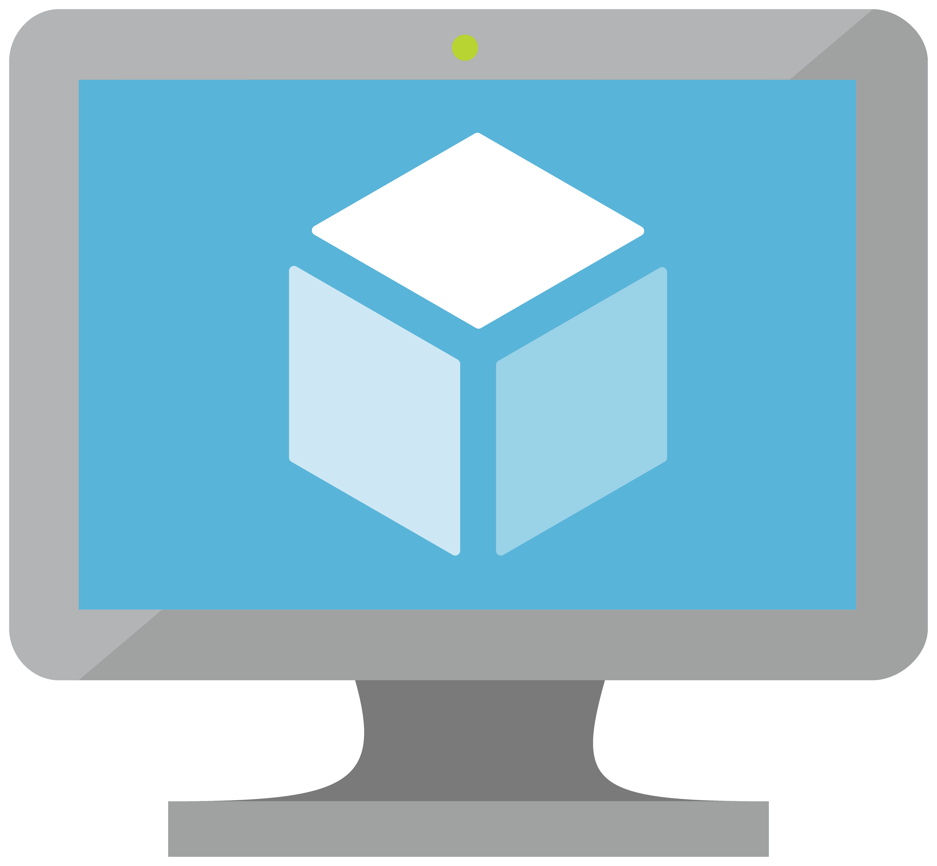
Azure Virtual Machines
Software emulations of physical computers, include virtual processors, memory, storage, and networking resources
Create and use virtual machines in the cloud (IaaS)
Ideal choice when you need:
Total control over operating system
Run custom software
Use custom hosting configurations

Slide 15

Azure Load Balancer
Provide scale for your applications and create high availability for your services
Support inbound and outbound scenarios
Provides low latency and high throughput
Scales up to millions of flows for all Transmission Control Protocol (TCP) and User Datagram Protocol (UDP) applications
Use Load Balancer with
Incoming internet traffic
Internal traffic across Azure services
Port forwarding for specific traffic
Outbound connectivity for VMs in your virtual network

Slide 16

Azure SQL Database
Relational database as a service (DaaS) based on the latest stable version of Microsoft SQL Server database engine
No need to manage infrastructure

Slide 17
What We will Create

Slide 18
What We will Create?
Public facing load balancer
2 Windows virtual machines(created by Azure Portal and PowerShell)
Internal facing load balancer
2 Linux virtual machines(created by Azure Portal and CLI)
Azure SQL Database(with failover configuration to another region)

Slide 19
Thank you very much.

