Slide 1
Senior Capstone Vehicle Sales Tableau
By:Hayden Randolph

Slide 2
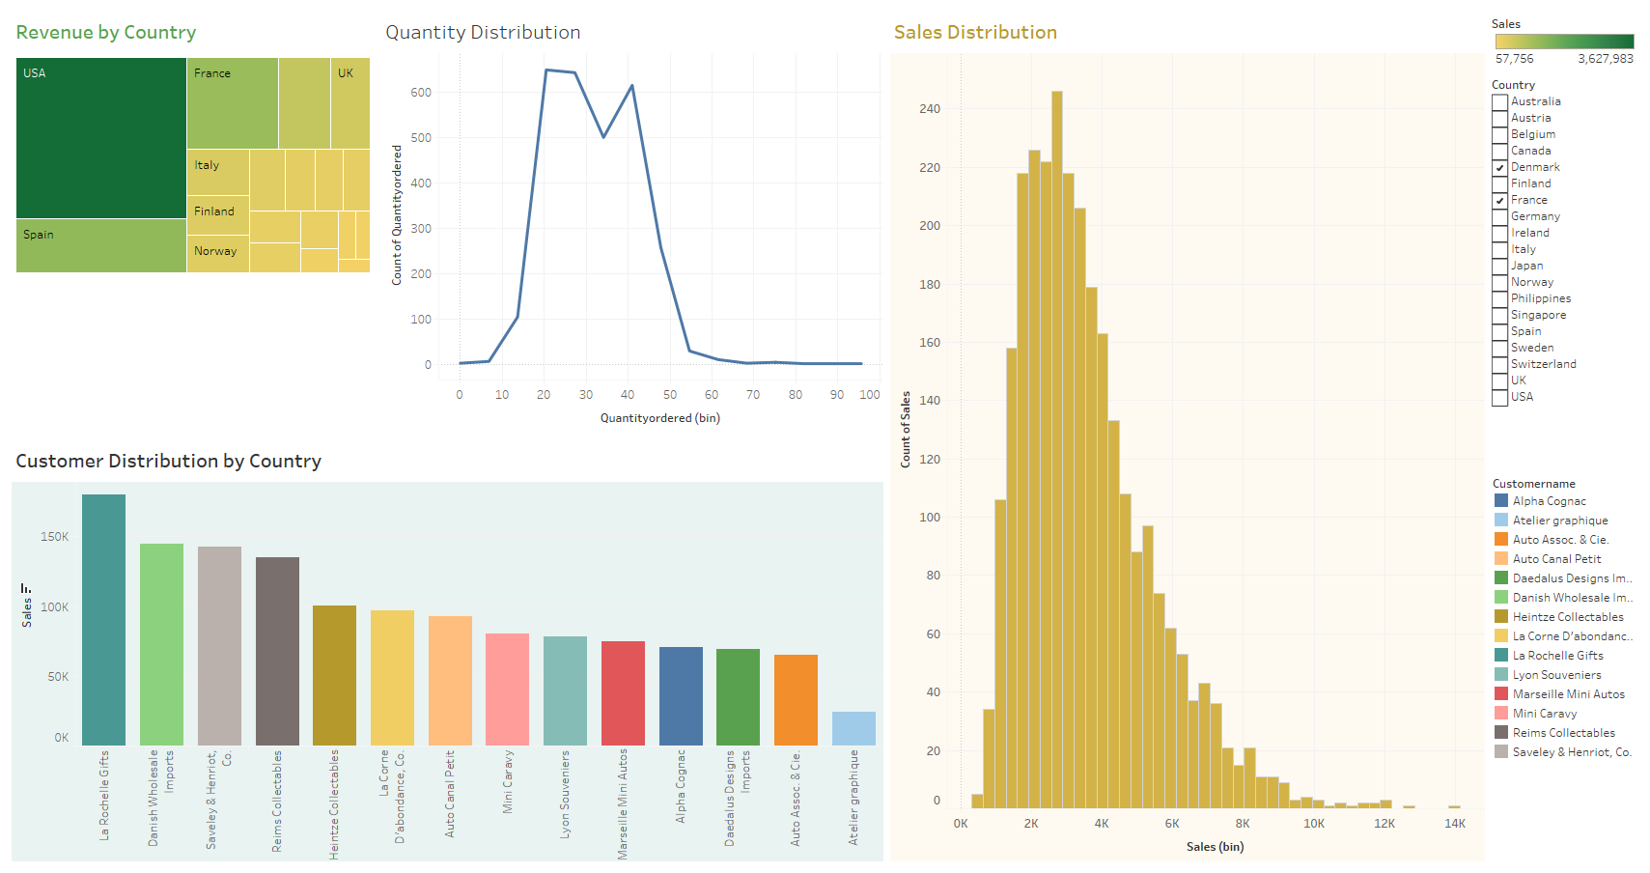

Slide 3
