Slide 1
EDES 301
In-Hand Palm 2DoF Manipulator Proposal
2/23/25
Hayden Webb (HMW5)

Slide 2
Background Information
What is being proposed?
As seen on the next slide, I am proposing an in-the-palm 2DoF manipulator that will be worn on both the forearm and hand. This device will be comprised of an active surface (i.e. a pulley belt) and turntable that will be actuated by two micro DC motors. The control of this device will be actuated by four pressure sensors that will be inlaid along the wrist to measure the bend of the wrist. Depending on the bend of the wrist, either the turntable or active surface will turn on and move.
Key Components
The electrical components for this device will be the two DC Motors, two motor drivers, four pressure sensors, a PocketBeagle, and a step-down power module
The mechanical components for this device will be 3D printed PLA and TPU components that will be designed in Onshape and printed on a Bambu X1-C printer and Prusa i3-Mini respectively.
Story
This device will act as the basis for direct driven human in-hand manipulation for those who are incapable of performing dexterous hand manipulations (finger gaiting, sliding, etc.) while still stably holding an object. Therefore, they will hopefully garner the manipulability of a precision grasp while still having the strength of a power grasp.

Slide 3
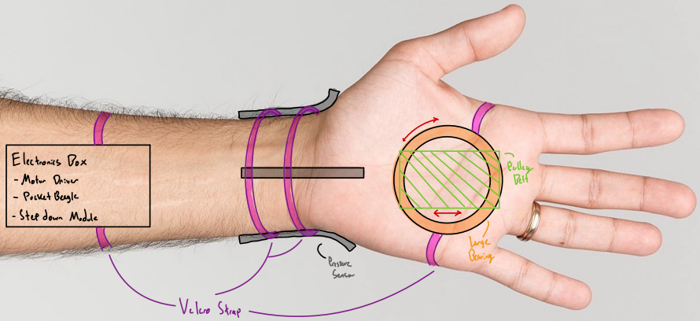
Background Information

Slide 4

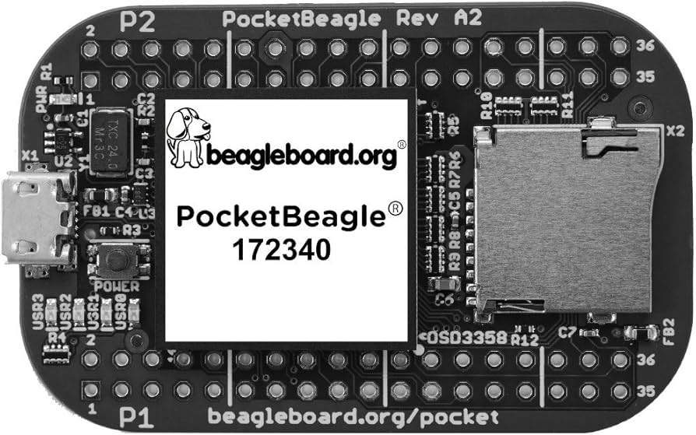
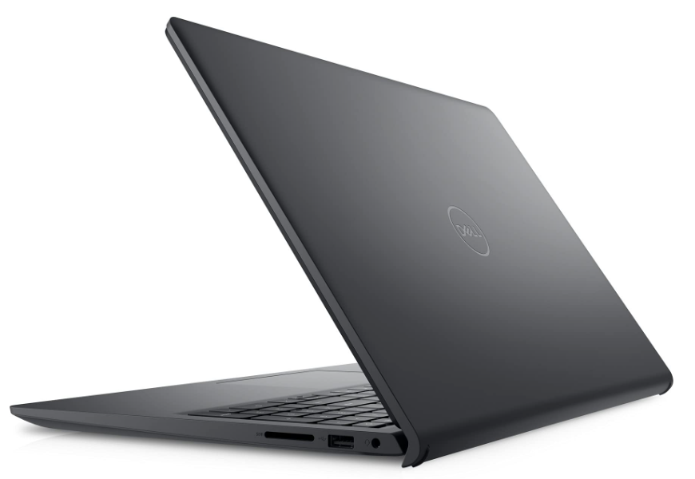
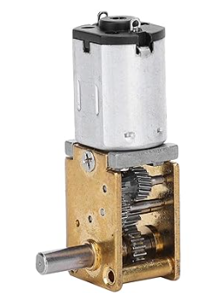
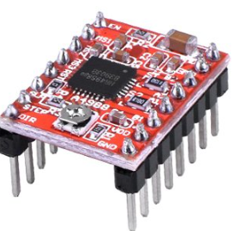
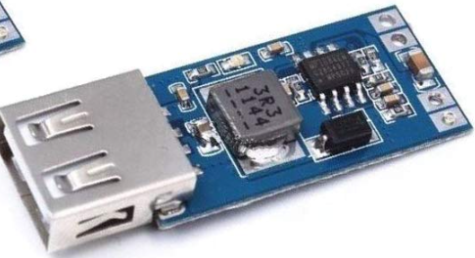
System Block Diagram
GPIO
DATA
GPIO & PWM
Note: Similar connections are shown in matching colors. Actual connections will not be run like this in final implementation
PocketBeagle
ZD10-100
PWM
A4988
1218GE‑N20
PWM
HiLetGo Step-down
A4988
1218GE‑N20
ZD10-100

Slide 5
Power Block Diagram
3.3V/10mA
5V
3.3V/8mA (Logic)
Note: Similar connections are shown in matching colors. Actual connections will not be run like this in final implementation
PocketBeagle
ZD10-100
5V/0.4mA
A4988
1218GE‑N20
5V/40mA
5V
5V/0.4mA
HiLetGo Step-down
A4988
1218GE‑N20
ZD10-100

Slide 6
Components / Budget
Component | EDES301 to Buy? | Cost
Orthogonal DC Motor (2x) | ✓ | 9.59
Motor Driver | ✓ | 10.19
Step Down Power Module | ✓ | 8.89
Thin Pressure Sensor (4x) [Supplied by OEDK] | X | 8.94
Large Bearing [Supplied by RobotPi Lab] | X | X
See Next Slide for Instructions

Slide 7
Component Selection (Remove slide for submission)
All components must be from either: Amazon, Adafruit, Sparkfun, Digi-Key, or Mouser
Select no more than two (2) components that are not on approved component spreadsheet
See Canvas 🡪 Files 🡪 assignments 🡪 EDES301_project_01_parts_list.xlsx
If there is a cheaper part that you would like to use, we can discuss in the project meeting
All components needed for the project should be listed on Slide 5
All components should have links to the website where they can be purchased
Please trim URLs for links to Amazon
EDES301 will supplement $25 to $35 dollars for components
Please indicate what components need to be purchased by EDES301
If you have a special request, we can discuss in the project meeting

