Slide 1

Detecting High-Risk of Alzheimer’s Disease Using Statistics and Machine Learning
Data Science Project by Chuck Tucker

Slide 2
Alzheimer’s Disease
"Worldwide, 50 million people are living with Alzheimer's and other dementias."
Alzheimer’s disease is terminal unlike other dementias
Source: alz.org

Slide 3
Cost of Care
15 million family members are providing 18.2 billion hours of unpaid care
Economic value of this care is more than $230 billion
Source: alz.org

Slide 4
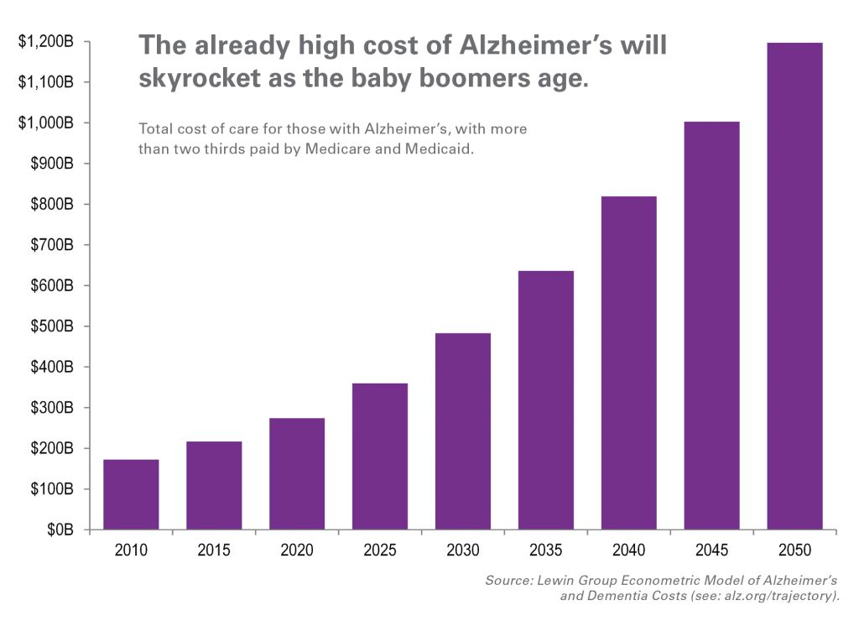

Slide 5
Best Outcomes from Early Treatment
Early Treatment Options
Changes in diet
Taking supplements and/or antioxidants
Avoid smoking and alcohol
Social activities
Exercising
Brain stimulating activities
Symptoms and disease progression are best mitigated with early treatment
Early treatment options are inexpensive compared to medication costs
Source: alzheimers.net

Slide 6
Better Early than Late
"Although the adage, 'better late than never' certainly applies, waiting for a full blown diagnosis of Alzheimer’s disease before making healthy diet and lifestyle changes, is not a very effective prevention plan."
Source: alzheimers.net

Slide 7
Primary Goal for this Analysis
Create tools that can detect or predict Alzheimer’s disease to identify high-risk patients
These patients can be referred for additional tests or begin early treatment

Slide 8
Target Audience
Medical professionals diagnosing or treating Alzheimer’s disease
Patients or family members of patients suspecting early cognitive impairment

Slide 9
Data Source and Analysis Tools
Data Source: Alzheimer’s Disease Neuroimaging Initiative
Cognitive tests and brain scans
Classical Statistical Methods
Threshold values that indicate high-risk
Machine Learning Algorithms
Predict high-risk patients

Slide 10
Approaches
Change in Biomarkers
Baseline Biomarkers
Screening Method
Change in biomarkers over time for a patient
Change between first exam and most recent exam
Detect a progression to Alzheimer’s disease
Biomarker measurements at a patient’s first exam
Predict Alzheimer’s risk using only initial measurements
Use only cognitive tests to create a recommendation system to refer patients for brain scans
Biomarkers = cognitive test results or scan results

Slide 11
Change in Biomarkers
Cognitive Test Thresholds for Identifying High-Risk Patients
Biomarker | Threshold | CN to AD Detect Rate | MCI to AD Detect Rate | False Positive Rate
CDRSB | + 2.07 | 100 % | 95 % | 4 %
ADAS11 Males | + 1.69 | 100 % | 81 % | 15 %
ADAS11 Females | + 2.41 | 100 % | 85 % | 14 %
ADAS13 Males | + 2.13 | 100 % | 80 % | 12 %
ADAS13 Females | + 0.60 | 100 % | 89 % | 19 %
MMSE | - 176.0 | 100 % | 84 % | 15 %
RAVLT Immediate | - 281.7 | 100 % | 74 % | 23 %

Slide 12
Clinical Dementia Rating Results
Change in Biomarker
Baseline Measurement
Threshold: increase of 2.07
(males and females)
Detection rates:
100% normal to Alzheimer’s
95% mild impairment to Alzheimer’s
False positive rate: 4%
Thresholds:
Males: 1.48
Females: 1.04
Detection rates:
Males: 83%
Females: 86%
False positive rate: 25%

