Slide 1
Software Engineering

Slide 2
Lecture7:Software Analysis & Design Tools
Software analysis and design
Design tools
DFD
Structure Charts
Decision Tables
ERD
Data Dictionary

Slide 3
Introduction
Software analysis and design includes all activities, which help the transformation of requirement specification into implementation.
Requirement specifications specify all Requirement functional and non-functional expectations.
These requirement specifications come in the shape of human readable and understandable documents, to which a computer has nothing to do.
يتضمن تحليل وتصميم البرمجيات جميع الأنشطة التي تساعد في تحويل مواصفات المتطلبات إلى التنفيذ.
تحدد مواصفات المتطلبات جميع المتطلبات الوظيفية وغير الوظيفية .
تأتي مواصفات المتطلبات هذه في شكل مستندات يمكن للإنسان قراءتها وفهمها، ولا علاقة للكمبيوتر بها.

Slide 4
Design tools used by software designers:
DFD
Structure Charts
Decision Tables
ERD
Data Dictionary

Slide 5
DFD
Data Flow Diagram

Slide 6
A data flow diagram (DFD) is a graphical or visual representation that uses a standardized set of symbols and notations to describe a business's operations through data movement.
A data flow diagram (DFD) maps out the flow of information for any process or system. It uses defined symbols like rectangles, circles and arrows, plus short text labels, to show data inputs, outputs, storage points and the routes between each destination.
مخطط تدفق البيانات (DFD) هو تمثيل رسومي أو مرئي يستخدم مجموعة موحدة من الرموز والملاحظات لوصف عمليات الشركة من خلال حركة البيانات.
يرسم مخطط تدفق البيانات (DFD) تدفق المعلومات لأي عملية أو نظام. ويستخدم رموزًا محددة مثل المستطيلات والدوائر والسهام، بالإضافة إلى تسميات نصية قصيرة، لإظهار مدخلات البيانات ومخرجاتها ونقاط التخزين والطرق بين كل وجهة.

Slide 7
Data Flow Diagram
Data flow diagram is graphical representation of flow of data in an information system.
It is capable of depicting incoming data flow, outgoing data flow and stored data.
The DFD does not mention anything about how data flows through the system.
There is a prominent difference between DFD and Flowchart.
The flowchart depicts flow of control in program modules. DFDs depict flow of data in the system at various levels.
DFD does not contain any control or branch elements.

Slide 8
مخطط تدفق البيانات
مخطط تدفق البيانات هو تمثيل بياني لتدفق البيانات في نظام المعلومات.
وهو قادر على تصوير تدفق البيانات الواردة وتدفق البيانات الصادرة والبيانات المخزنة
.
لا يذكر مخطط تدفق البيانات أي شيء عن كيفية تدفق البيانات عبر النظام
.
هناك فرق واضح بين مخطط تدفق البيانات و تصور مخططات.
يصور مخطط التدفق تدفق التحكم في وحدات البرنامج. تصور مخططات تدفق البيانات تدفق البيانات في النظام على مستويات مختلفة
.
لا يحتوي مخطط تدفق البيانات على أي عناصر تحكم أو عناصر فرعية.

Slide 9
Types of DFD
Data Flow Diagrams are either Logical or Physical.
Logical DFD - This type of DFD concentrates on the system process, and flow of data in the system.For example in a Banking software system, how data is moved between different entities.
Physical DFD - This type of DFD shows how the data flow is actually implemented in the system. It is more specific and close to the implementation.

Slide 10
DFD Components
DFD can represent Source, destination, storage and flow of data using the following set of components -
Entities - Entities are source and destination of information data. Entities are represented by a rectangles with their respective names.
Process - Activities and action taken on the data are represented by Circle or Round-edged rectangles.
Data Storage - There are two variants of data storage - it can either be represented as a rectangle with absence of both smaller sides or as an open-sided rectangle with only one side missing.
Data Flow - Movement of data is shown by pointed arrows. Data movement is shown from the base of arrow as its source towards head of the arrow as destination.

Slide 11


Slide 12
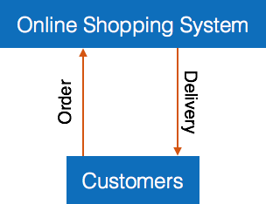
Levels of DFD
Level 0 - Highest abstraction level DFD is known as Level 0 DFD, which depicts the entire information system as one diagram concealing all the underlying details. Level 0 DFDs are also known as context level DFDs.

Slide 13
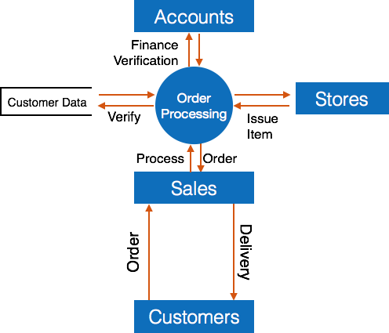
Level 1 - The Level 0 DFD is broken down into more specific, Level 1 DFD.
Level 1 DFD depicts basic modules in the system and flow of data among various modules.
Level 1 DFD also mentions basic processes and sources of information.

Slide 14
Level 2 - At this level, DFD shows how data flows inside the modules mentioned in Level 1.
Higher level DFDs can be transformed into more specific lower level DFDs with deeper level of understanding unless the desired level of specification is achieved.

Slide 15
Aspect | Level 0 DFD (Context Diagram) | Level 1 DFD (Decomposition of the System) | Level 2 DFD (Further Decomposition of Level 1)
Purpose | Provides an overall view of the system as a single process. | Breaks down the system into main sub-processes. | Further breaks down sub-processes from Level 1 into more detailed components.
Complexity | Simplest and most abstract representation. | More detailed but still focuses on the primary processes. | Highly detailed, focusing on specific actions within each sub-process.
Number of Processes | Usually only 1 process representing the entire system. | Multiple processes representing key functional areas of the system. | Many processes, representing the detailed steps of sub-processes.
External Entities | Shows external entities interacting with the system (e.g., customers, admin). | Shows external entities and how they interact with specific processes. | External entities may still be present but with interactions focused on very specific activities.
Data Flow | High-level data flows between the system and external entities. | More detailed data flows between sub-processes and external entities. | Very specific data flows between detailed processes and internal data stores.

Slide 16
Aspect | Level 0 DFD (Context Diagram) | Level 1 DFD (Decomposition of the System) | Level 2 DFD (Further Decomposition of Level 1)
Data Stores | Rarely shows data stores. | Introduces key data stores (e.g., customer accounts, transaction records). | Includes detailed data stores for each sub-process (e.g., records of specific transactions or actions).
Use Case | Used for initial analysis to understand system boundaries. | Used for a deeper understanding of the system’s functional areas. | Used for precise understanding and implementation of each process step.
Example Processes | Represents the entire banking system as one "Banking System" process. | Breaks down into processes like Account Management, Transaction Processing, Loan Processing. | Further breaks down processes like Loan Processing into Loan Application Review, Loan Approval, Loan Repayment Monitoring, etc.
Audience | High-level stakeholders (e.g., clients, project sponsors). | System analysts, designers, and developers for functional insight. | System developers, technical teams, and testers for detailed implementation and refinement.

Slide 17
Summary:
Level 0 gives a broad overview of the system, focusing on external interactions.
Level 1 breaks down the system into core functional areas to show internal workings.
Level 2 dives deeper into specific processes detailed understanding and system development.

Slide 18
Uses of DFD:
To model the logical flow of data in a system.
To identify data inputs, outputs, and storage points.
To analyze existing systems and design new systems.
Benefits:
Provides a clear and easy-to-understand representation of the system.
Helps identify redundant متكررprocesses and unnecessary data flows.
Facilitates communication between developers, analysts, and stakeholders.

Slide 19
Structure Charts

Slide 20
Structure Charts
Structure chart is a chart derived from Data Flow Diagram.
It represents the system in more detail than DFD.
It breaks down the entire system into lowest functional modules, describes functions and sub-functions of each module of the system to a greater detail than DFD.
Structure chart represents hierarchical structure of modules.
At each layer a specific task is performed.

Slide 21
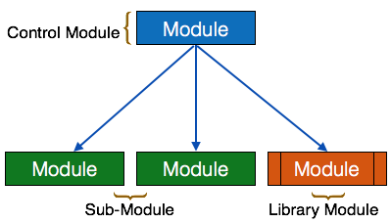
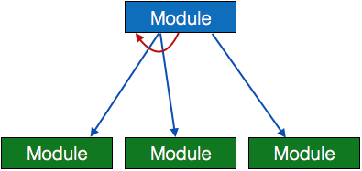
Here are the symbols used in construction of structure charts -
Module - It represents process or subroutine or task. A control module branches to more than one sub-module. Library Modules are re-usable and invokable from any module.
Loop - A curved arrow represents loop in the module. All sub-modules covered by loop repeat execution of module.

Slide 22
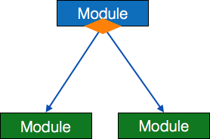
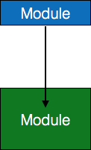
Condition - It is represented by small diamond at the base of module. It depicts that control module can select any of sub-routine based on some condition.
Jump - An arrow is shown pointing inside the module to depict that the control will jump in the middle of the sub-module.

Slide 23
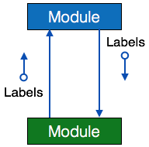
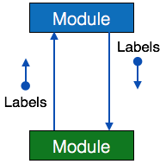
Data flow - A directed arrow with empty circle at the end represents data flow.
Control flow - A directed arrow with filled circle at the end represents control flow.

Slide 24
HIPO Diagram
HIPO (Hierarchical Input Process Output) diagram is a combination of two organized method to analyze the system and provide the means of documentation.
HIPO model was developed by IBM in year 1970.
HIPO diagram represents the hierarchy of modules in the software system.
Analyst uses HIPO diagram in order to obtain high-level view of system functions. It decomposes functions into sub-functions in a hierarchical manner. It depicts the functions performed by system.
HIPO diagrams are good for documentation purpose. Their graphical representation makes it easier for designers and managers to get the pictorial idea of the system structure.

Slide 25
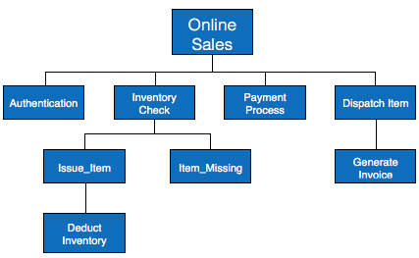

Slide 26
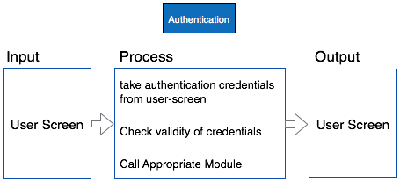
In contrast to IPO (Input Process Output) diagram, which depicts the flow of control and data in a module, HIPO does not provide any information about data flow or control flow.
Both parts of HIPO diagram, Hierarchical presentation and IPO Chart are used for structure design of software program as well as documentation of the same.

Slide 27
Decision Tables

Slide 28
A Decision table represents conditions and the respective actions to be taken to address them, in a structured tabular format.
It is a powerful tool to debug and prevent errors.
It helps group similar information into a single table and then by combining tables it delivers easy and convenient decision-making.
Creating Decision Table
To create the decision table, the developer must follow basic four steps:
Identify all possible conditions to be addressed
Determine actions for all identified conditions
Create Maximum possible rules
Define action for each rule
Decision Tables should be verified by end-users and can lately be simplified by eliminating duplicate rules and actions.

Slide 29
Example
Let us take a simple example of day-to-day problem with our Internet connectivity.
We begin by identifying all problems that can arise while starting the internet and their respective possible solutions.
We list all possible problems under column conditions and the prospective actions under column Actions.

Slide 30
 | Conditions/Actions | Rules
Conditions | Shows Connected |  | N | N | N | Y | Y | Y | Y
 | Ping is Working |  | N | Y | Y | N | N | Y | Y
 | Opens Website |  | N | Y | N | Y | N | Y | N
Actions | Check network cable
 | Check internet router |  |  |  |  | X | X | X
 | Restart Web Browser |  |  |  |  |  |  | X
 | Contact Service provider |  | X | X | X | X | X | X
 | Do no action

Slide 31
ERD
Entity-Relationship Model

Slide 32
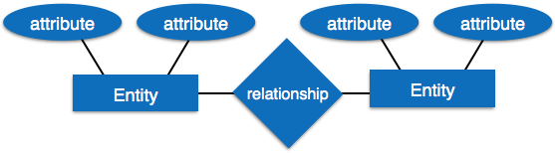
Entity-Relationship Model
Entity-Relationship model is a type of database model based on the notion of real world entities and relationship among them. We can map real world scenario onto ER database model. ER Model creates a set of entities with their attributes, a set of constraints and relation among them.
Definition: An Entity-Relationship Diagram (ERD) is a data modeling tool used to represent the relationships between entities in a database system. ERDs are essential for designing database structures, ensuring data integrity, and optimizing data organization.

Slide 33
Components of ERD
Entities: Represent objects or concepts that hold data, such as customers, orders, or products. Entities are depicted as rectangles.
Attributes: Characteristics or properties of entities, such as a customer’s name or an order date. Attributes are usually shown as ovals connected to their entity.
Relationships: Define how entities are related to each other, depicted as lines connecting entities. Relationships can have cardinality (one-to-one, one-to-many, many-to-many) indicating the number of connections between entities.
Primary Keys: Unique identifiers for each entity that distinguish individual records within the entity.
Foreign Keys: Attributes that link entities together, usually pointing to primary keys in related entities.

Slide 34
Uses of ERD
To design and visualize database schemas.
To ensure proper relationships and data integrity within the database.
To identify potential data redundancies and optimize storage.
Benefits
Provides a clear picture of the database structure and how data is interrelated.
Facilitates communication between database designers, developers, and stakeholders.
Helps in normalizing databases to reduce redundancy and improve data consistency.

Slide 35
Data Dictionary

Slide 36
Data Dictionary
Data dictionary is the centralized collection of information about data. It stores meaning and origin of data, its relationship with other data, data format for usage etc.
Data dictionary has rigorous definitions of all names in order to facilitate user and software designers.
Data dictionary is often referenced as meta-data (data about data) repository.
It is created along with DFD (Data Flow Diagram) model of software program and is expected to be updated whenever DFD is changed or updated.
Definition: A Data Dictionary is a centralized repository of information about data, including its meaning, relationships, origin, usage, and format.
It provides a detailed description of all the data elements within a system, serving as a reference guide for developers, analysts, and database administrators.

Slide 37
Requirement of Data Dictionary
The data is referenced via data dictionary while designing and implementing software.
Data dictionary removes any chances of ambiguity.
It helps keeping work of programmers and designers synchronized while using same object reference everywhere in the program.
Data dictionary provides a way of documentation for the complete database system in one place.
Validation of DFD is carried out using data dictionary.

Slide 38
Components of a Data Dictionary:
Data Elements: Definitions of data items, including names, descriptions, and types.
Attributes: Properties of data elements, such as data type, length, and default values.
Relationships: Descriptions of how data elements relate to each other, such as primary and foreign key relationships.
Validation Rules: Constraints and rules that define how data can be used or modified, such as allowable values or formats.
Data Sources: Information about where the data originates, such as user input or external systems.

Slide 39
Contents
Data dictionary should contain information about the following
Data Flow
Data Structure
Data Elements
Data Stores
Data Processing

Slide 40
Data Flow is described by means of DFDs as studied earlier and represented in algebraic form as described.
1. Data Elements
Data elements consist of Name and descriptions of Data and Control Items, Internal or External data stores etc. with the following details:
Primary Name
Secondary Name (Alias)
Use-case (How and where to use)
Content Description (Notation etc. )
Supplementary Information (preset values, constraints etc.)

Slide 41
2. Data Store
It stores the information from where the data enters into the system and exists out of the system.
The Data Store may include :-
Files
Internal to software.
External to software but on the same machine.
External to software and system, located on different machine.
Tables
Naming convention
Indexing property
3. Data Processing
There are two types of Data Processing:
Logical: As user sees it
Physical: As software sees it

Slide 42
Q/A

