Slide 1
HyperStyle: StyleGAN Inversion with HyperNetworks for Real Image Editing CVPR 2022
Ha yeon, KIM
5th August, 2022

Slide 2
Summary
Fine-tuning generator
Encoder-based inversion
Hypernetwork

Slide 3
Background
Hypernetwork : predict weights of a primary network. By training a hypernetwork over a large data collection, the primary network’s weights are adjusted with respect to specific inputs, yielding a more expressive model.
GAN inversion : obtaining a latent code that can be passed to the generator to reconstruct a given image.(optimize the latent vector, train an encoder over a large number of samples to learn a mapping, hybrid)
(Alaluf et al. iteratively refine the predicted latent code through a small passes) -> generator weight
3. Distortion-editability :
W : obtained via StyleGAN’s mapping network
W+ : each layer of the generator is assigned a different latent code
Images inverted into W has high editability, but poor expressiveness. So, prior works invert into the extended W+ space, achieving reduced distortion at the cost of the inferior editability.
Tov et al.(e4e) balances the two by predicting codes in W+ residing close to W.
Notes:
Alaluf : encoder based

Slide 4
Trade-off
1. Distortion-editability :
Good editability but less expressive
Roich et al. fine-tunes the generator in order to insert a target identity into
Well-behaved regions of the latent space.
- But, this approach relies on a costly per-image optimization of the generator.
2. Time-accuracy
Latent vector optimization approach : impressive reconstruction, but impractical
Encoder-based approach : leverage rich datasets to learn a mapping from images
to their latent representations but less faithful

Slide 5
Tuning the generator
1) Adapting it to an encoder-based approach
2) Hypernetwork : learns to refine the generator weights with respect to a
given input image
3) Lightweight feature extractor(ResNet) + set of refinement block
+ StyleGAN’s convolution layers
4) Refinement block : predict offsets for the weights of the convolutional filters
of its corresponding layer.

Slide 6
Challenge – number of parameter
Naively, predicting an offset for each parameter requires a hypernetwork with over
Three billion parameters.
-> sharing offsets between parameters
-> sharing network weights between different hypernetwork layers
-> approach inspired by depthwise-convolutions
2) Improve reconstruction : iterative refinement scheme(gradually predicts the desired
offsets over a small number of forward passes through the hypernetwork)
“It learns to optimize the generator”

Slide 7
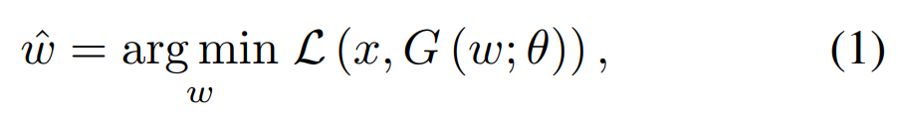
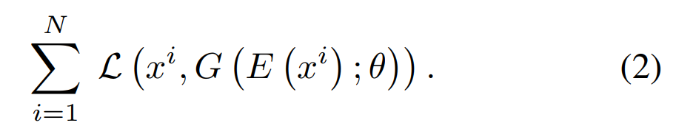
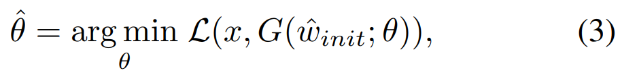
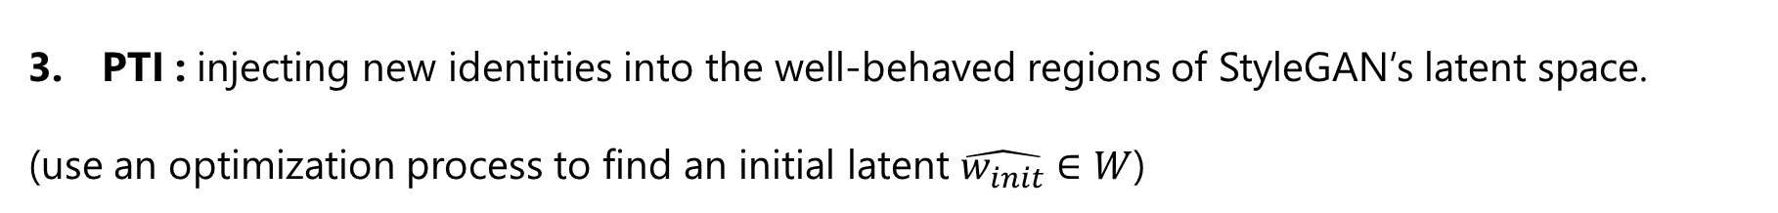
Method
GAN inversion task :
to identify a latent code that minimizes the reconstruction distortion with respect to a given target image x
Image produced by a pre-trained generator G
Encoder based : can be trained over a large set of images to minimize
PTI : injecting new identities into the well-behaved regions of StyleGAN’s latent space.
(use an optimization process to find an initial latent $\hat{w_{init}}∈W$)

Slide 8
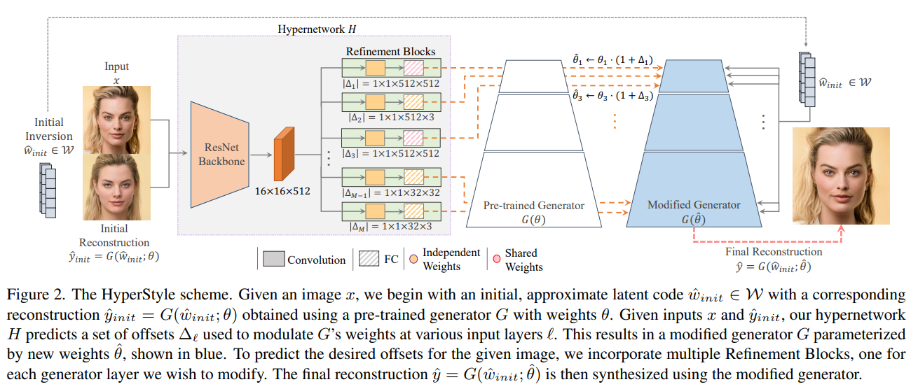

Method
Goal : to predict a new set of weights $\hat{θ}$ that minimizes the objective defined in Eq. (3).
Predicted weight : $\hat{θ}=H({\hat{y}}_{init},x)$

Slide 9

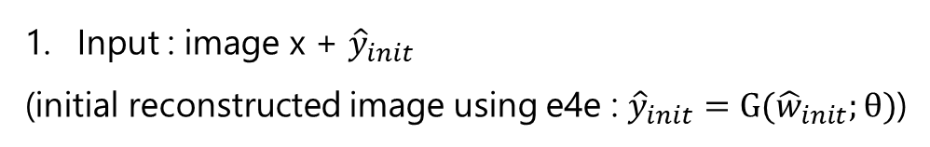
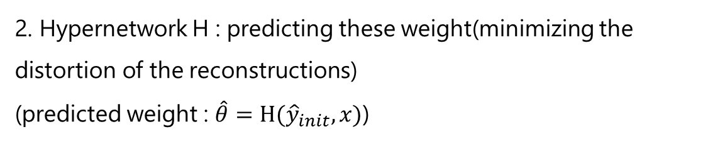
Method
Input : image x + ${\hat{y}}_{init}$
(initial reconstructed image using e4e : ${\hat{y}}_{init}=G({\hat{w}}_{init};θ)$)
2. Hypernetwork H : predicting these weight(minimizing the distortion of the reconstructions)
(predicted weight : $\hat{θ}=H({\hat{y}}_{init},x)$)
3. reconstruction-editability : initial latent code should reside within the well-behaved regions -> e4e encoder
4. Predicting a set of offsets with respect to the original weight :
small number of passes to gradually refine the predicted weight offsets, resulting in higher fidelity inversions.
5. Tuning generator : out of domain(standard encoders are restricted to encoding into existing latent spaces.)

Slide 10

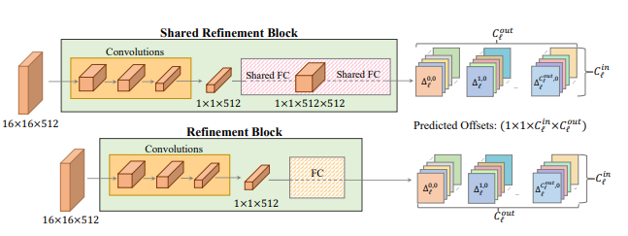

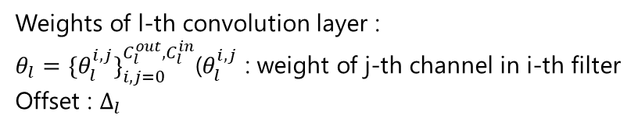
Design Hypernetwork
Challenge : requiring a balance between expressive power and number of trainable parameters
Weights of l-th convolution layer :
$θ_{l}={\{θ_{l}^{i,j}\}}_{i,j=0}^{C_{l}^{out},C_{l}^{in}}$($θ_{l}^{i,j}$ : weight of j-th channel in i-th filter
Offset : $Δ_{l}$
These offsets are then multiplied by the corresponding layer weights and added to the original weights in channel-wise fashion
Shared refinement block : reduce the network parameters and encourage information sharing between layers.
Iterative refinement : perform several passes through our hypernetwork for a single image inversion
(gradually refine its predicted weight offsets=>stronger expressive power & accurate inversion)

Slide 11
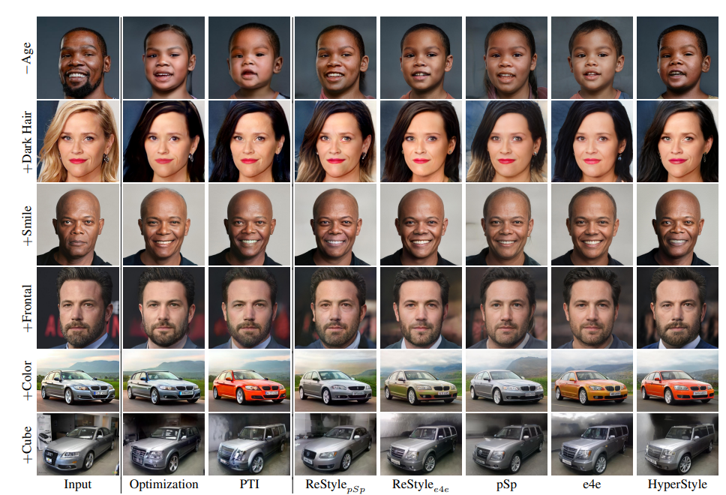
Result

Slide 12
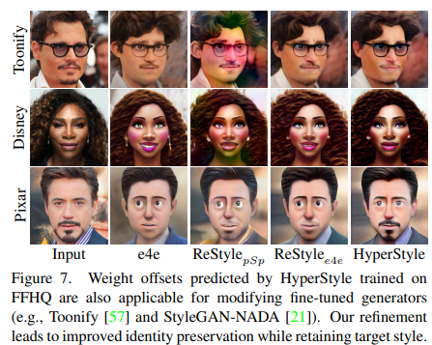
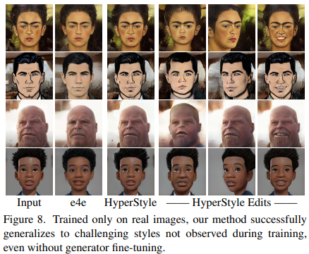
Result

Slide 13
Thank You!

Slide 14
Appendix

Slide 15
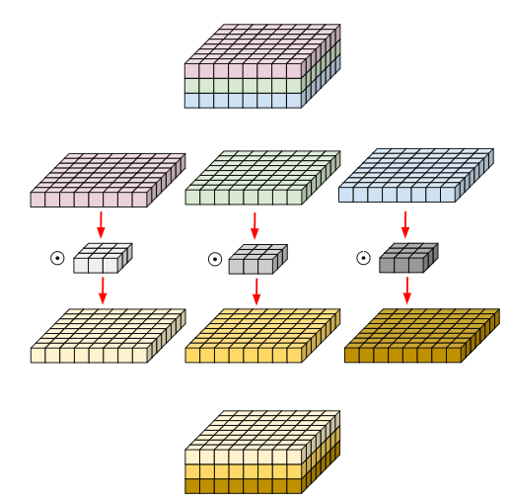
Depthwise convolution
일반적인 conv는 모든 채널에 영향을 받으므로, 특정 채널만의 spatial feature 추출이 불가능하다. 이러한 문제를 해결하고자, 각 채널에 대해서만 수행되는 filter를 사용한다.
(MobileNet은 이를 이용하여 연산량을 기하급수적으로 줄인다.)
: kernel과 matrix 모두 각 채널에 대해 분리하여 convolution을 진행한 후 이후에 합친다.
(즉, channel 방향 conv는 진행하지 않고, 공간 방향의 conv만 진행한다.)

Slide 16
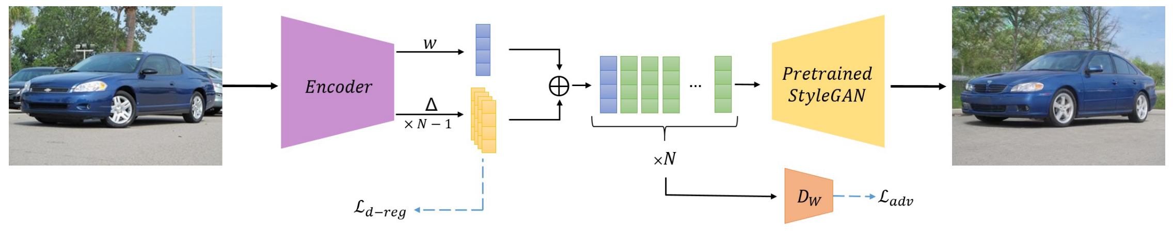
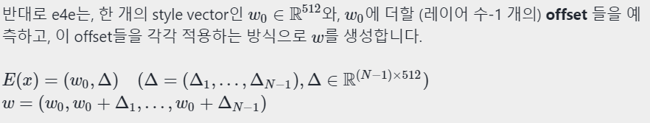
E4E
Distortion을 낮추기 위해 perceptual quality와 editability를 희생해야 하는 상황을 피하기 위해, 저자들은 W+는 최대한 W 분포와 ‘가까워’야 한다고 주장합니다 . 우선 style vector간 variance를 낮추기 위해, 저자들은 새로운 “progressive training” 방식을 제안합니다. 기존의 encoder-based optimization 방법들은 모두, 이미지 입력 xx를 받아 w0,w1,…w0,w1,…의 서로 다른 style vector들을 생성하는 방식이었고, 이는 style vector들 간의 분포가 지나치게 넓어지는 원인이 되었습니다.

