Slide 1
Non-Local Representation based Mutual Affine-Transfer Network for Photorealistic Stylization NL-MAT
Hayeon Kim
B.S Student, UNIST
18th February, 2022

Slide 2
Summary
Dictionary-based image decomposition을 이용하여 representation 추출
Three unique structure
Shared stick-breaking encoder : decoupling of non-local representation and color information
Affine-transfer decoder with sparse entropy function : local style transfer in a global-consistent fashion
Mutual discriminative network : correspondence of context-sensitive representations with statistical matching

Slide 3
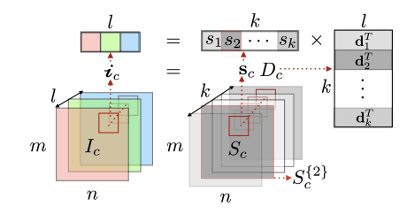


Problem Formulation
$I_{c}∈ℝ^{m\text{×}n\text{×}l}$+ $I_{s}∈ℝ^{M\text{×}N\text{×}l}$ => $I_{cs}∈ℝ^{m\text{×}n\text{×}l}$
“To capture the non-local similarities, the entire image is
enforced to share the same set of color bases”
1 × l
1 × k
k × l
Color basis
Color basis matrix
Single pixel
coefficient
Proportions of the 2nd color basis
k>>l
Representation for entire image

Slide 4
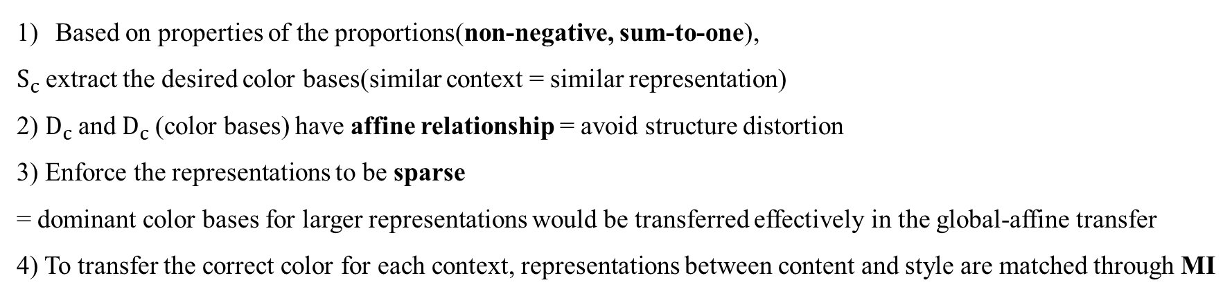
Problem Formulation
1 × l
1 × k
k × l
Color bases
Color basis matrix
Single pixel
coefficient
Proportions of the 2nd color basis
k>>l
Representation for entire image
Based on properties of the proportions(non-negative, sum-to-one),
$S_{c}$extract the desired color bases(similar context = similar representation)
2) $D_{c}$and $D_{c}$(color bases) have affine relationship = avoid structure distortion
3) Enforce the representations to be sparse
= dominant color bases for larger representations would be transferred effectively in the global-affine transfer
4) To transfer the correct color for each context, representations between content and style are matched through MI

Slide 5
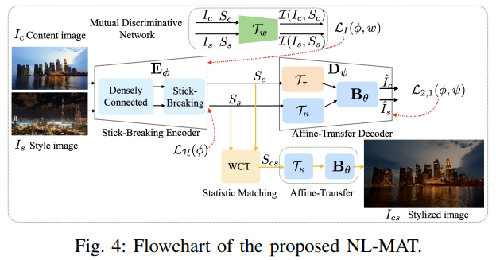
Network Architecture
Enforcing the correspondence of context-
Sensitive representations
with statistical matching
Executing local style transfer in a global
Consistent fashion with sparse entropy ftn
Decoupling of non-local representations
and color information
“Since the arrangement of adjacent pixels are untouched,
decoupling mechanism preserves spatial distribution.”

Slide 6
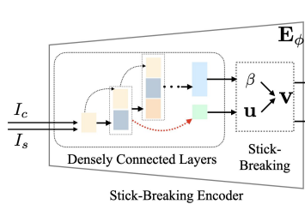

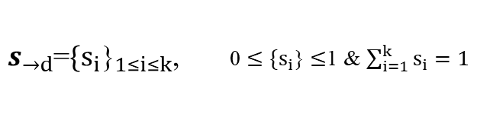
Stick-breaking encoder(representation)
Pixel = linear combination of a set of color bases with the coefficient
Coefficient constraint : sum-to-one, non-negativity => stick-breaking
Stick- breaking process : breaking a unit-length stick into k pieces
(length of each piece follows the Dirichlet distribution = satisfy constraint)
Draw the samples of representation S from the Kumaraswamy distribution
$s_{→d}$=${{\{s}_{i}\text{\}}}_{1≤i≤k}$, 0 $≤{\{s}_{i}$} $≤$1 & $\sum_{i=1}^{k}{s_{i}=1}$

Slide 7
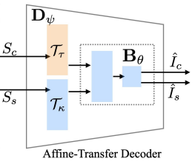






Affine-transfer decoder(color info)
$D_{c}$and $D_{c}$(color bases) have affine relationship
Decoder : carry color information and their transfer information
$D_{s}$ = a $D_{c}$+b
Improve the flexibility and the representative power
$$D_{c}$$
$$D_{s}$$
a
+ b
{a,b} : transfer information
$B_{θ}$: shared basis weights

Slide 8


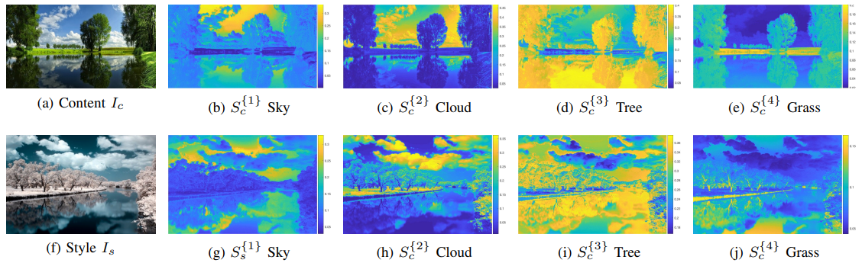
Context-correspondence local style transfer
Local style transfer with Entropy Function
To enforce the local style transfer, encourage the presentations to be sparse (representation : more discriminative)
=> context is mainly constructed by a few dominant color bases
=> perform local style transfer smoothly in a global consistent fashion
=> NL representation scheme is context-sensitive that would enable local style transfer
Need to regularize the sparsity of the network : normalized entropy function(decreases monotonically when sparse)
p=1 for efficiency
Sparse loss
When we transfer the representations of the entire image, different components of the transfer function would be activated according to the representations of the context, which means the network is able to perform diverse local style transfer in a global consistency fashion.

Slide 9
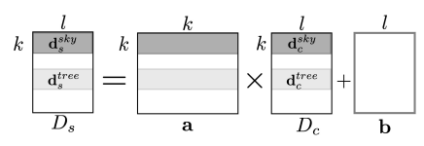


Context-correspondence local style transfer
2. Context-sensitive transfer through mutual discriminative network
Correct color matching according to the context correspondence of the objects using representation matching
=> affine relationship(decoder) + dominant color bases(sparse constraint)
$$d_{c}^{tree}$$
The representation of the content and style image should be matched
$$d_{s}^{tree}$$

Slide 10
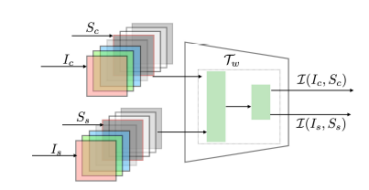
Context-correspondence local style transfer
2. Context-sensitive transfer through mutual discriminative network
The distribution of the representation from same context should be similar in content and style image
=> Maximize the dependency by maximizing their mutual information(MI) = mutual discriminative network

Slide 11


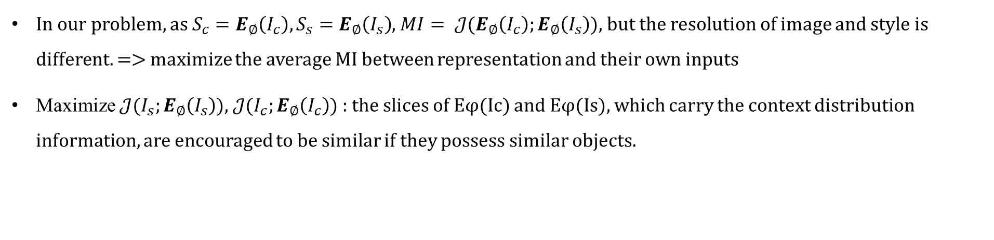
Context-correspondence local style transfer
Mutual Information(MI)
It is based-on Shannon-entropy
In our problem, $as S_{c}=E_{∅}\left(I_{c}\right),S_{s}=E_{∅}\left(I_{s}\right)$, $MI= 𝒥(E_{∅}\left(I_{c}\right);E_{∅}\left(I_{s}\right)$), but the resolution of image and style is different. => maximize the average MI between representation and their own inputs
Maximize $𝒥(I_{s};E_{∅}\left(I_{s}\right)$), $𝒥(I_{c};E_{∅}\left(I_{c}\right)$) : the slices of Eφ(Ic) and Eφ(Is), which carry the context distribution information, are encouraged to be similar if they possess similar objects.
By maximizing LI(φ, w), we could extract optimized representations Sc and Ss that can best represent Ic and Is, and the slices of Sc and Ss are ordered

Slide 12
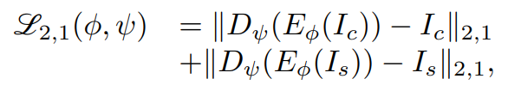
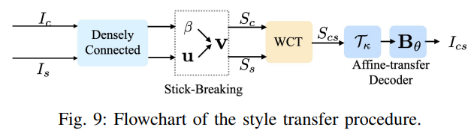
Style transfer
The matching might not be perfect due to content difference -> match statistic characteristic(WCT)
Reconstruction error
Sparse loss
Mutual information
Notes:
To extract better color bases, l2,1 norm 채택

Slide 13
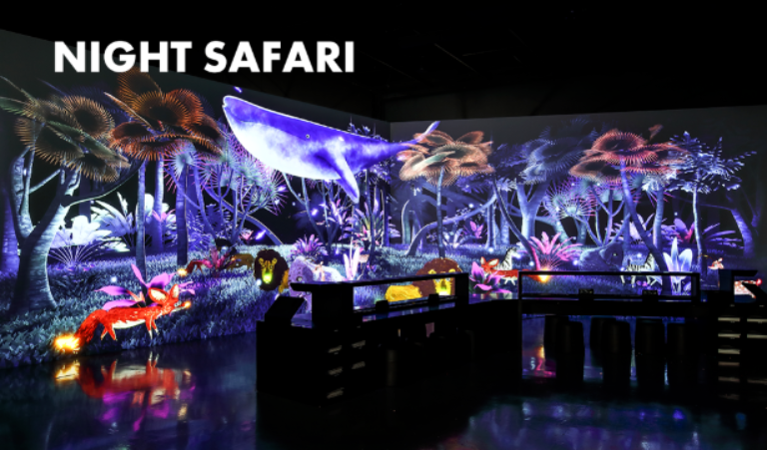
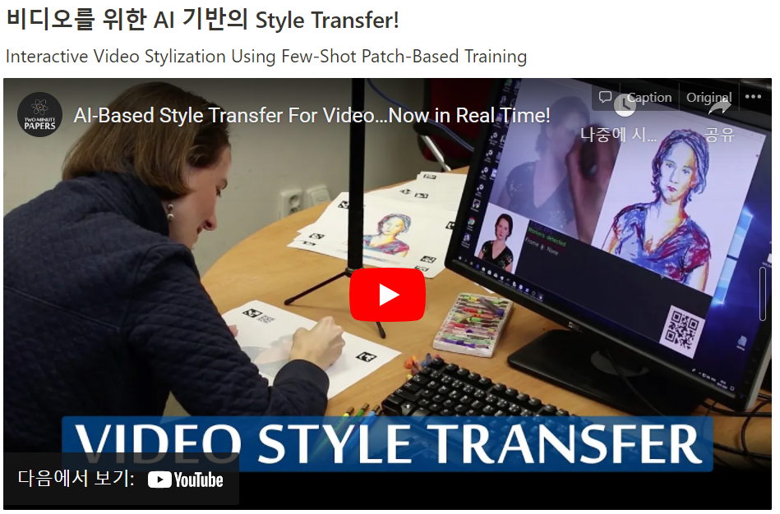
To Be Continued..

