Slide 1
Image Reward Model Background & Related Works
May 20th, 2026
Hayeon Jeong
Notes:
Tong, Yuanhao, Sohyun하고 이야기를 나눠봤는데, 가장 관심가는 주제가 image reward model이었습니다.
저는 Image Reward Model에 대해 많이 알지 못해서 이 연구 분야가 어떻게 발전되어 왔는지 공부해봤습니다.
I had discussion with Tong, Yuanhao, and Sohyun, / and the most interesting topic was the Image Reward Model.
Since I was not very familiar with Image Reward Models, I looked into how this research field has evolved over time.

Slide 2
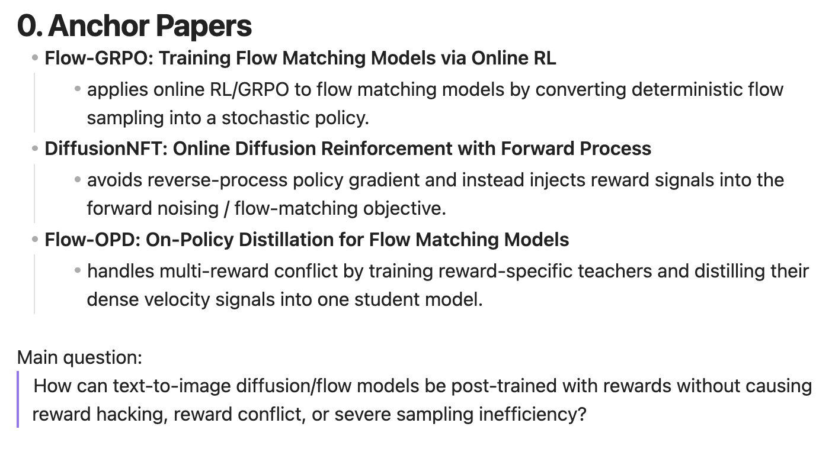
0. Anchor Papers
Notes:
교수님께서 저번 미팅에서 언급하셨던 논문이 DiffusionNFT였던 것 같은데 혹시 맞나요?
이런 최근 3개의 연구들을 anchor paper로 정해서, image reward 모델부터 이 논문들을 이해하기 위한 전반적인 공부를 했습니다.
I think the paper you mentioned in our previous meeting was probably DiffusionNFT.
Was that the correct one?
Using these three recent papers as anchor papers, I studied the broader background that is needed to understand them, starting from Image Reward Models.

Slide 3
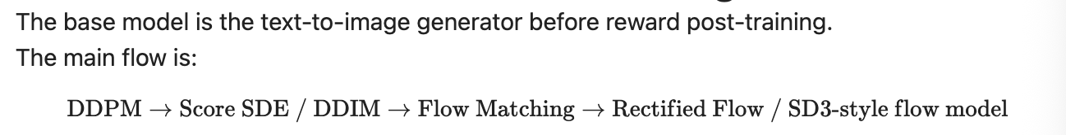
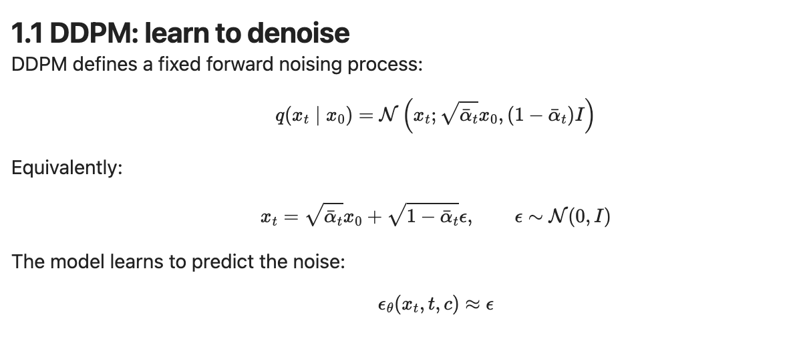
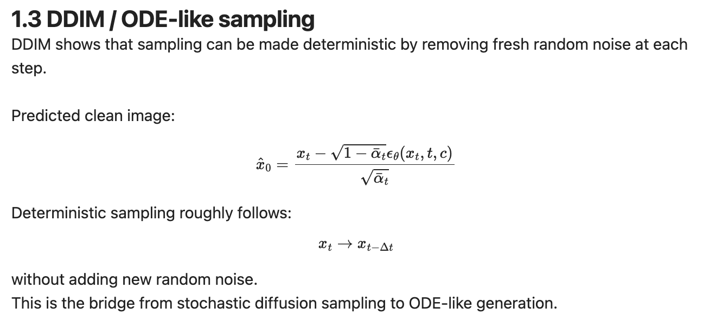
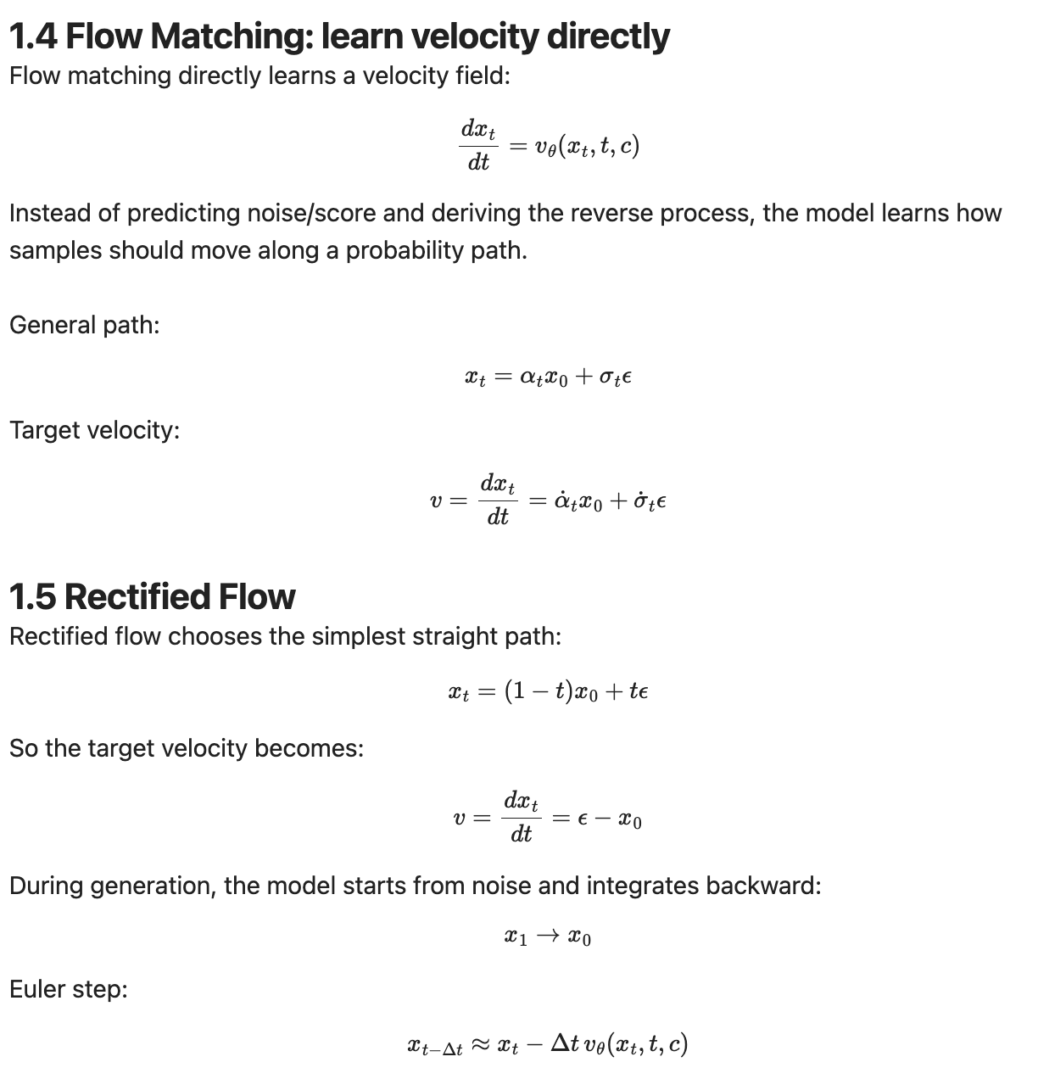
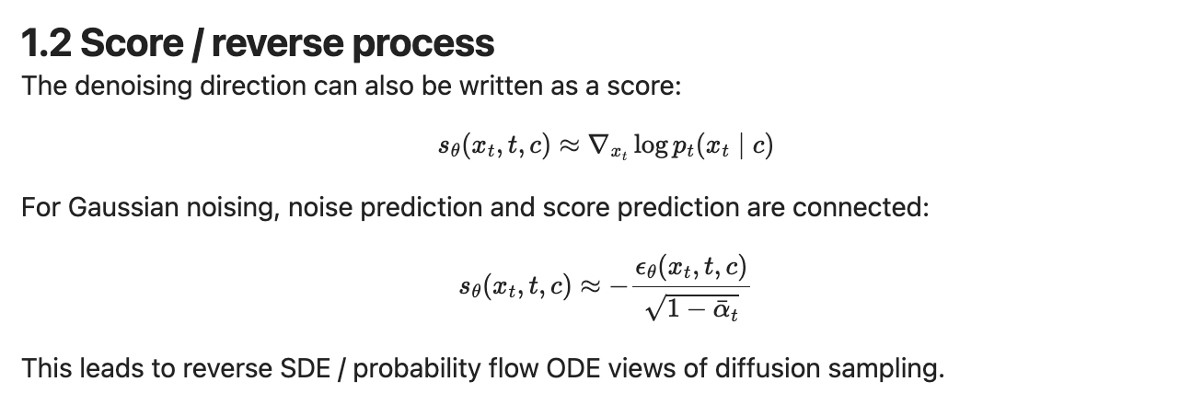
1. Base Model: Diffusion to Flow Matching
Notes:
근데 그 전에 Flow Matching, Rectified Flow 등
Image reward model에서 base model로 쓰이는 SD3.5 를 복습했습니다.
Before that, however, I reviewed Flow Matching and Rectified Flow,
since SD3.5 — which is used as the base model in Image Reward Models — is built upon those concepts.

Slide 4
2. Image Reward Models 2.1. Taxonomy of recent papers
Level | Category | Core question | Examples
1 | Reward model learning | How do we build a good image/prompt scorer? | ImageReward, PickScore, HPSv2, DeQA, UnifiedReward
2 | Single-reward post-training | How do we improve a generator using one reward? | ReFL, DDPO, DPOK, Flow-GRPO, DiffusionNFT
3 | Preference-pair direct alignment | Can we align the generator directly from preference pairs without an explicit reward model? | Diffusion-DPO, DSPO, Dense Reward View
4 | Multi-reward optimization | How do we optimize several reward axes without conflict? | Parrot, Rewards-in-Context, MixGRPO, GDPO, Flow-Multi
5 | Expert merging / blending | Can we train reward-specific experts and combine them later? | Rewarded Soups, Diffusion Soup, Bone Soups, Diffusion Blend
6 | Reward-trained teacher distillation | Can we transfer reward-specialized teacher abilities into one student? | Flow-OPD
7 | Reward hacking / evaluation robustness | How do we detect and reduce reward exploitation? | reward hacking analyses, MLLM judges, task-specific verifiers
Notes:
검색과 GPT를 통해 reward model의 연구 종류엔 뭐가 있는지 알아봤습니다.
크게 3-4가지가 있었는데,
Recent image reward research can be grouped into several directions.
Some papers focus on building better reward models, some use a single reward to post-train a generator, and others directly use preference pairs without an explicit reward model.
More recent work studies multi-reward optimization, expert merging or distillation, and reward hacking, which are especially relevant to Flow-GRPO, DiffusionNFT, and Flow-OPD.
--------
종합적으로, 이미 single task에 대한 reward model을 이용해서 post-training을 하는 연구는 많이 있는 것으로 보였다.
그래서 요즘엔 여러가지 reward model을 한 번에 이용하는 방법이 많이 연구되는 것 같다.
Overall, it seemed that there has already been substantial work on post-training / using reward models for single tasks.
As a result, recent research appears to focus more on how to utilize multiple reward models simultaneously.

Slide 5
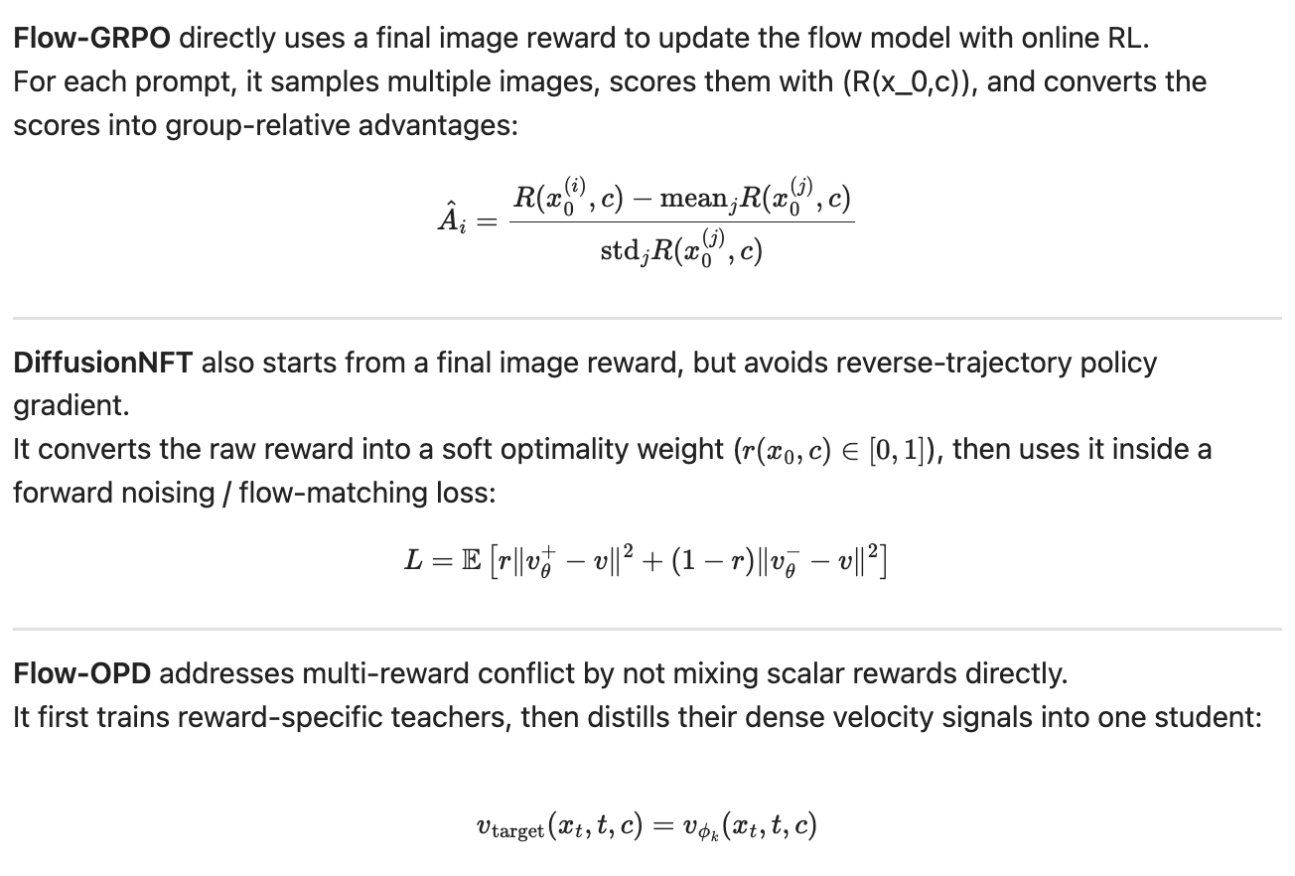
2.1.1 How the Anchor Papers Use Image Rewards

Slide 6
2.2. Taxonomy of Multi-Reward Models
Category | Intuition | What is mixed? | Final form | Examples
A. Multi-reward optimization during training | Mix rewards during training, but try to find a balanced trade-off. | reward scalars, advantages, reward-conditioned data | one trained model | Parrot (2024.01), Rewards-in-Context (2024.02), MixGRPO (2025.07), GDPO (2026.01), Flow-Multi (2026.02)
B. Train reward-specific experts, then merge weights | Fine-tune separate models for each reward, then merge them in parameter space. | model weights | one merged model | Rewarded Soups (2023.06), Diffusion Soup (2024.06), Bone Soups (2025.02)
C. Train reward-specific experts, then blend at inference time | Keep experts separate and combine their generation processes during inference. | denoising process, drift, LoRA/expert choice | inference-time ensemble/blend | Diffusion Blend (2025.05)
D. Train reward-specific experts, then distill | Transfer the capabilities of multiple teachers into one student model. | teacher predictions, teacher velocity, trajectory signals | one distilled student | Flow-OPD (2026.05)
E. Make the reward model multi-dimensional | Instead of one total score, output separate scores for different criteria. | reward dimensions | multi-dimensional scorer | VisionReward (2026.03), multi-head/rubric-style reward
F. Convert sparse reward into dense reward/supervision | Replace final scalar reward with timestep- or trajectory-level signals. | dense reward, timestep signals, velocity supervision | denser training signal | Dense Reward View (2024.02), Flow-OPD (2026.05)

Slide 7
2.3 Limitation of Image Reward Models
Limitation | Meaning
Limited human preference data | ImageReward, PickScore, and HPSv2 are trained with pairwise preferences, but they depend on the number of annotators, prompt distribution, and image generation model distribution. Generalization can become unstable for out-of-distribution prompts or images from new models.
Too much compressed into one scalar score | A single score compresses many different criteria, such as aesthetics, prompt following, text rendering, object counting, and safety. This loses information.
Limited reward capability | CLIP-based rewards can be weak at fine-grained counting, spatial relations, and OCR. VQA/MLLM judges are stronger but slower and more expensive. OCR rewards can check text, but they do not evaluate overall aesthetics.
The model exploits reward loopholes | The generator may shift toward colors, compositions, textures, or exaggerated sharpness that the reward prefers, or it may produce images that only satisfy the benchmark.
Rewards can conflict with each other | Improving OCR reward can reduce aesthetics, while improving aesthetic reward can hurt counting or spatial relations. This creates a seesaw effect.

Slide 8
2.3. Recent Research Trend
Do not treat a single reward model as an absolute standard.
Use multiple rewards/verifiers together.
Look for dense supervision instead of relying only on scalar rewards.
Distill reward-trained teachers.
Flow-OPD
Use MLLM judges or task-specific verifiers as auxiliary evaluators.
Analyze reward hacking separately.
Understanding Reward Hacking in Text-to-Image Reinforcement Learning
Notes:
그리고 reward hacking 문제도 많이 다뤄지고 있는 것 같아서 살펴보다가, Yunqi가 쓴 논문도 있는거 발견했다.
It also seems that the reward hacking problem is receiving increasing attention. I suddenly found a paper written by Yunqi related to this topic.

Slide 9
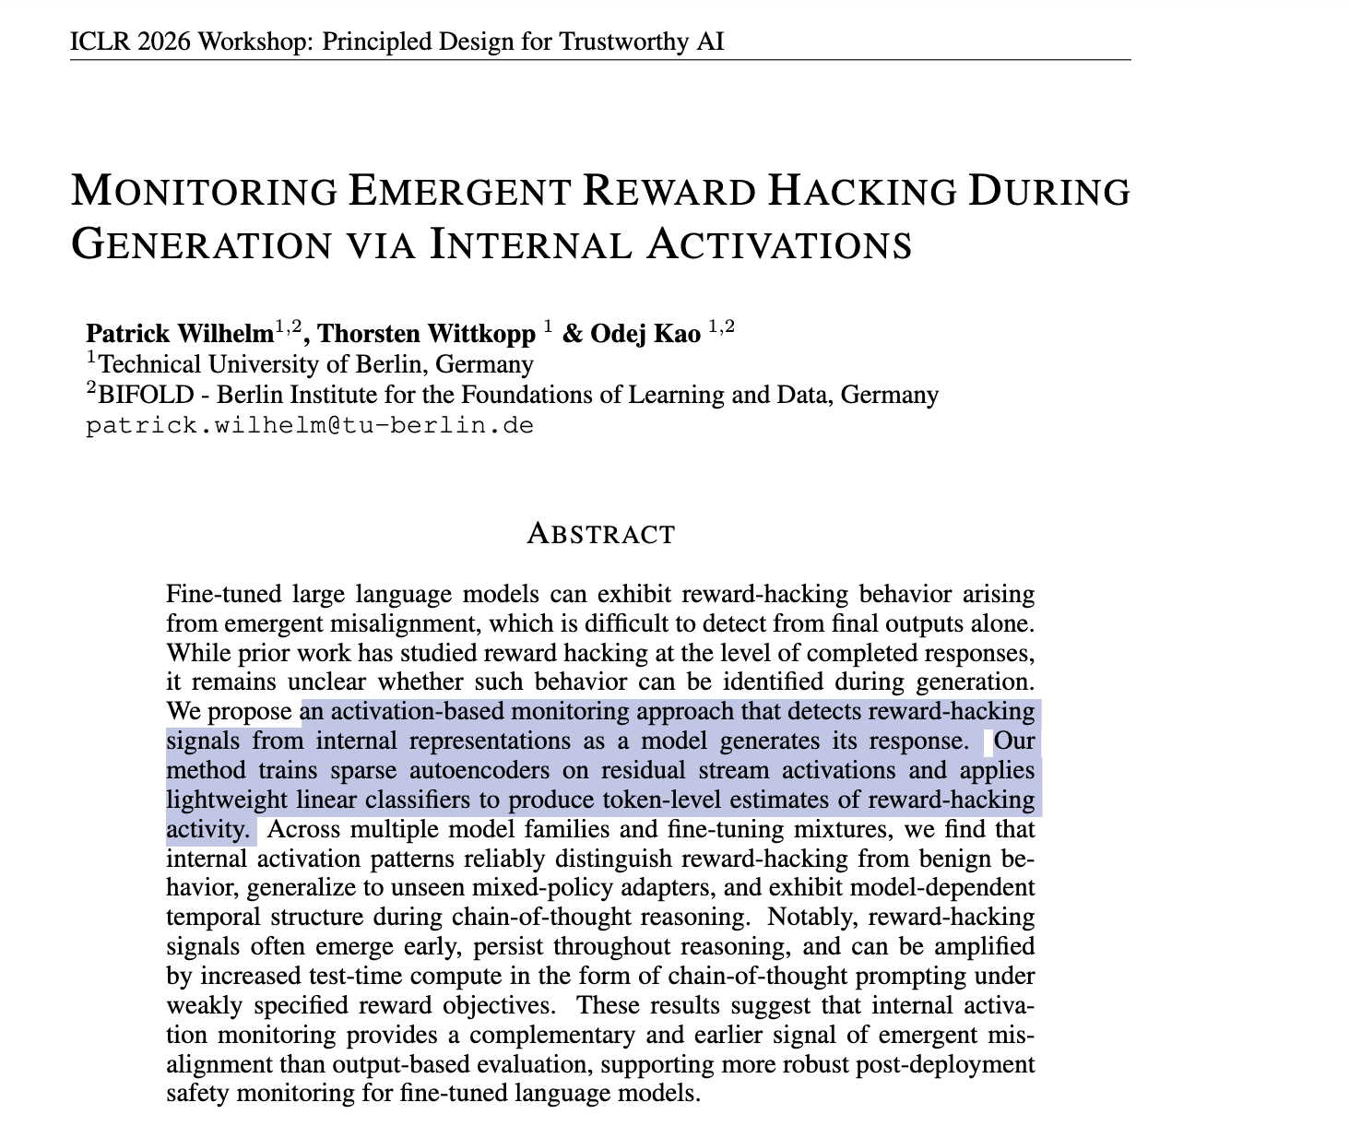
Idea? Next Plan?
Early Detection of reward hacking
Diffusion Probe: Generated Image Result Prediction Using CNN Probes
Uses early cross-attention signals to predict final image quality before generation is finished.
Not All Diffusion Model Activations Have Been Evaluated as Discriminative Features
Shows that diffusion model activations can be useful features for downstream tasks like segmentation.
TIDE: Temporal-Aware Sparse Autoencoders for Interpretable Diffusion Transformers in Image Generation
Uses sparse autoencoders to interpret DiT activations across denoising timesteps.
eDiff-I: Text-to-Image Diffusion Models with an Ensemble of Expert Denoisers
Shows that different denoising stages can play different roles in image generation.
Text-to-Image Alignment in Denoising-Based Models through Step Selection
Studies how text-image alignment changes depending on which denoising steps are used.
Mechanistic Interpretability of Diffusion Models
Analyzes internal concepts, attention, and feature evolution inside diffusion models.
--> Early/Intermediate actiations in T2I models can already reveal information about the final generated output
Notes:
지금 하나 생각이 드는 것은, reward hacking을
LLM에는 이렇게 reward hacking을 generation이 다 끝나고 판단하는게 아니라 생성 과정에서 / SAE를 활용해서 / 탐지할 수 있다는 논문이 있었다.
근데 T2I 에는 그게 아직 없는 것 같다.
T2I에서 “early/internal activation을 보면 final output에 대해 뭔가 예측할 수 있다”는 연구들이 있더라.
아직 논문들을 완벽하게 읽은 건 아니라 그냥 brainstorming 수준이다.
이 주제에 대해서 어떻게 생각하시나요?
그럼 다음주에는 yunqi랑 얘기해보고, 논문도 더 자세히 읽어오겠다.
---------------------------------------------------------
One idea I recently had is related to reward hacking. In the LLM domain, there have been papers showing that reward hacking can be detected during the generation process — for example, by monitoring internal activations or using SAE-based approaches — rather than only evaluating the final output after generation is complete.
However, it seems that similar approaches have not really been explored yet for T2I models. I found several works suggesting that early or intermediate activations in T2I models can already reveal information about the final generated output.
I have not finished reading all the papers in detail yet, so this is still at the brainstorming stage, but I was wondering what you think about this direction.
For next week, I will discuss this further with Yunqi and read the papers more carefully.

