Slide 1
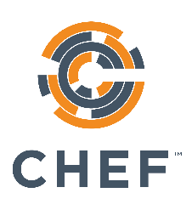
Cookbook Style & Correctness
The Real Benefits of Infrastructure as Code
v1.2.0
Copyright © 2015 Chef Software, Inc.
7-

Slide 2
Lesson Objectives
After completing this lesson, you will be able to:
Explain the benefits of correctness checking your cookbooks
Explain how and why you should test your cookbooks
Use Foodcritic to check the validity of your cookbooks
Verify your code adheres to the community Ruby style guide by using Rubocop

Slide 3

Devops is a Two-Way Street
285
It’s great when developers care about
uptime!
scaling!
deployment!
Put them on call! etc. etc. etc.

Slide 4

Devops is a Two-Way Street
Operations also has as much or more to learn from developers as well!

Slide 5

Old Software Development Workflow
Write some code
<ad-hoc verification here>
Go to pre-production
<ad-hoc verification here>
Go to production
Production failure

Slide 6

New Software Development Workflow
Write some code
Write and run some unit tests
Go to pre-production
Run some integration/ acceptance tests
Go to production
Lowered chance of production failure

Slide 7

Old Chef Cookbook Workflow
Write some cookbook code
<ad-hoc verification here>
Go to pre-production
<ad-hoc verification here>
Go to production
Whoops, broke production

Slide 8

New Chef Cookbook Workflow
Write some cookbook code
Check for code correctness
Write and run some unit tests
Go to pre-production
Run some integration tests
Go to production

Slide 9
Tools of the Trade
Code correctness: Foodcritic, Rubocop
Unit tests: ChefSpec
Integration tests (not covered in this class): Test Kitchen, ServerSpec, BATS

