Slide 1

Chef Client Run Internals
What Really Happens When Chef Runs?
v1.2.0
Copyright © 2015 Chef Software, Inc.
5-

Slide 2
Lesson Objectives
After completing the lesson, you will be able to:
Explain what happens under the hood when Chef Client runs
Describe the purpose of the run_context and
run_status objects
Use node.run_state to pass information around the recipe at execution time
Describe the event subsystem and how it can be used

Slide 3
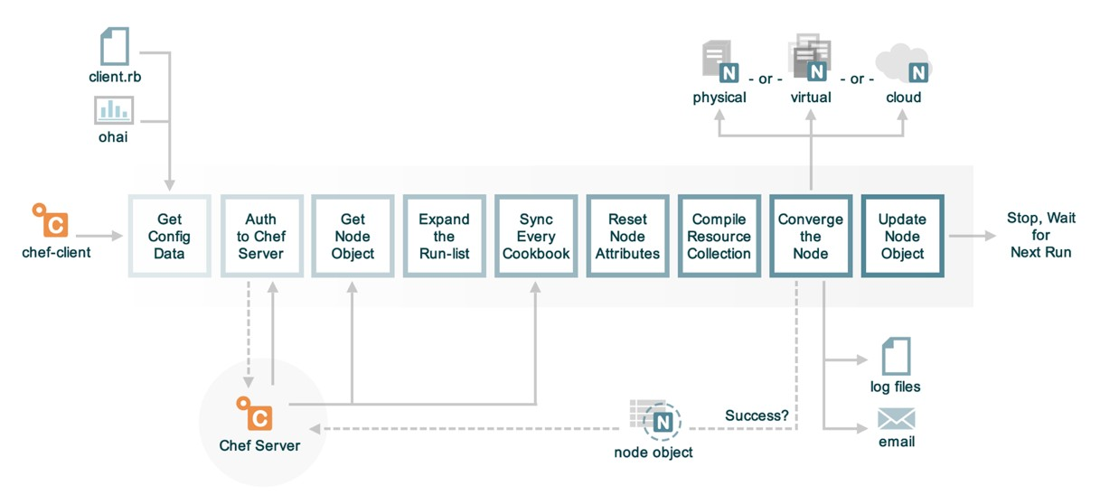
Remember This From Fundamentals?

Slide 4
Customizations
Ohai Plugins
Start Handlers
Event Dispatcher

Slide 5
Customizations
LWRPs
HWRPs
Libraries

Slide 6
Customizations
Exception Handlers
Report Handlers

Slide 7
What is the run_context?
Master object for the Chef run for this node
Important parts of the hierarchy:
•run_context
•node
•chef_environment
•run_status
•run_state
•cookbook_collection
•resource_collection
•events

Slide 8
What is the run_status?
Hangs off node
Stores current status of run
Resources that are converged, resources that changed during this run
Run status methods (success? / failed?)
We’ll use this object later when we write event handlers

Slide 9

What is the run_state?
A Hash that hangs off
node
A place for you to stash transient data during the run
Transmits data between resources

Slide 10


The Problem and Success Criteria
Problem: We can’t decide what scripting language we want to use to write our web application.
or
Success Criteria: Chef has randomly chosen one for us each time it runs.

Slide 11


Exercise: Edit Apache recipe
OPEN IN EDITOR: apache/recipes/default.rb
package "httpd" do
action :install
end
ruby_block "randomly_choose_language" do
block do
if Random.rand > 0.5
node.run_state['scripting_language'] = 'php'
else
node.run_state['scripting_language'] = 'perl'
end
end
end
package "scripting_language" do
package_name lazy { node.run_state['scripting_language'] }
action :install
end
SAVE FILE!

Slide 12
ruby_block resource
ruby_block "randomly_choose_language" do
block do
if Random.rand > 0.5
node.run_state['scripting_language'] = 'php'
else
node.run_state['scripting_language'] = 'perl'
end
end
end
ruby_block declares a block of Ruby to run at execute time
It has direct access to the node structure and other aspects of the run
Store something on node.run_state for later use

Slide 13
node.run_state
node.run_state['scripting_language'] = 'php'
node.run_state is an empty Hash
Discarded at the end of the run

Slide 14
Lazy parameter evaluation
package "scripting_language" do
package_name lazy { node.run_state['scripting_language'] } action :install
end
Normally resource parameters must be specified completely at compile time
Sometimes their value is not known until execute time
Use the lazy{} block to have parameters evaluated then

Slide 15
Upload the new apache cookbook
$ knife cookbook upload apache
Uploading apache [0.4.0]
Uploaded 1 cookbook.

Slide 16
Run Chef Client
chef@node1$ sudo chef-client
* ruby_block[randomly_choose_language] action run
- execute the ruby block randomly_choose_language
* package[scripting_language] action install
- install version 5.3.3-27.el6_5 of package php

Slide 17
Event Dispatcher Subsystem
Used by logging, Enterprise Chef reporting
Simple queue-free publish/subscribe model
All listeners get all events
Log formatters (:min, :doc, etc.) are examples of Event Dispatcher subclasses

Slide 18
Implementing Event Dispatchers
Write a subclass of
Chef::EventDispatch::Base
Base methods are all set to take no action
Implement methods in subclass to be called
Examples: run_start, run_completed
Create a start handler to load your event dispatcher
Register your handler with Chef (next chapter)

Slide 19
Review Questions
What is the name of the root object of the Chef run?
Where would you stash transient data during the run?
What object stores the current status of the run?
What can be used to populate resource attributes at execute time?

