Slide 1
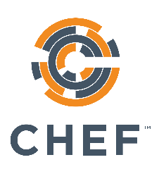
Cookbook Style & Correctness
The Real Benefits of Infrastructure as Code
v1.2.0
Copyright © 2015 Chef Software, Inc.
7-

Slide 2
Lesson Objectives
After completing this lesson, you will be able to:
Explain the benefits of correctness checking your cookbooks
Explain how and why you should test your cookbooks

Slide 3

Devops is a Two-Way Street
285
It’s great when developers care about
uptime!
scaling!
deployment!
Put them on call! etc. etc. etc.

Slide 4

Devops is a Two-Way Street
Operations also has as much or more to learn from developers as well!

Slide 5

Old Software Development Workflow
Write some code
<ad-hoc verification here>
Go to pre-production
<ad-hoc verification here>
Go to production
Production failure

Slide 6

New Software Development Workflow
Write some code
Write and run some unit tests
Go to pre-production
Run some integration/ acceptance tests
Go to production
Lowered chance of production failure

Slide 7

Old Chef Cookbook Workflow
Write some cookbook code
<ad-hoc verification here>
Go to pre-production
<ad-hoc verification here>
Go to production
Whoops, broke production

Slide 8

New Chef Cookbook Workflow
Write some cookbook code
Check for code correctness
Write and run some unit tests
Go to pre-production
Run some integration tests
Go to production

Slide 9
Tools of the Trade
Code correctness: Foodcritic, Rubocop
Unit tests: ChefSpec
Integration tests (not covered in this class): Test Kitchen, ServerSpec, BATS

