Slide 1

Foodcritic
v1.2.1
Copyright © 2015 Chef Software, Inc.
8-

Slide 2
Module Objectives
After completing this module, you should be able to:
Use Foodcritic to avoid common cookbook errors

Slide 3

What is Foodcritic?
A lint testing tool, or correctness checker
Ensure you adhere to best practices for cookbook style
Ability to write and use custom rules
http://foodcritic.io/

Slide 4
Foodcritic
A code linting tool for Chef
Checks code correctness
Catches common mistakes before they cause problems
Extensible & Configurable
Create new rulesets
Ignore existing rulesets
Integrates nicely into CI pipelines

Slide 5
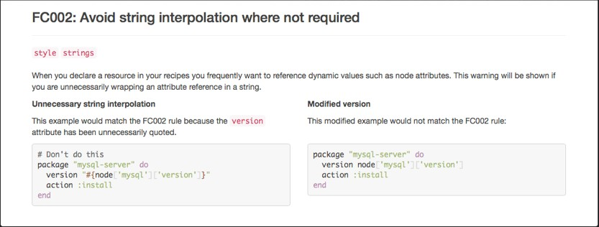
Rules and Tags
All rules are numbered, e.g.
FC002 - "Avoid string interpolation where not required"
FC034 - "Unused template variables"
Rules can be categorized and tagged, e.g.
'style'
'portability'
• ...
8-

Slide 6
Abide by Best Practices
There are 50+ rules in Foodcritic; your cookbooks should pass them (or have a good reason if they do not)
You can write your own rules.
Extra community-contributed rules: http://www.foodcritic.io/#extra-rules

Slide 7
The Problem and the Success Criteria
The Problem: We want to make sure our Apache cookbook follows best practice for Chef code
Success Criteria: We use Foodcritic to check our cookbook before committing it

Slide 8
Foodcritic
If you are using the ChefDK, you already have foodcritic installed
Located at: .\chefdk\embedded\bin\foodcritic

Slide 9
Exercise: Check Cookbook Correctness with Foodcritic
$ foodcritic cookbooks/apache
FC003: Check whether you are running with chef server before using server-specific features: ./recipes/default.rb:43
FC003: Check whether you are running with chef server before using server-specific features: ./recipes/iplogger.rb:1
FC008: Generated cookbook metadata needs updating: ./metadata.rb:2
FC008: Generated cookbook metadata needs updating: ./metadata.rb:3
FC009: Resource attribute not recognised: ./recipes/default.rb:27
FC016: LWRP does not declare a default action: ./resources/vhost.rb:1

Slide 10
Exercise: Narrow the Tests
$ foodcritic cookbooks/apache -t ~FC003 -t ~FC009
FC008: Generated cookbook metadata needs updating: ./metadata.rb:2
FC008: Generated cookbook metadata needs updating: ./metadata.rb:3
FC016: LWRP does not declare a default action: ./resources/vhost.rb:1
Notes:
The tilde means to ignore this rule.

Slide 11
Exercise: Fix the Cookbook to Clear the Errors
$ foodcritic cookbooks/apache -t ~FC003 -t ~FC009
(no output)
Edit your cookbook to fix the FC008 & FC016 errors, then rerun your Foodcritic
Refer to http://www.foodcritic.io/ to find the errors
No output means no errors!

Slide 12
Running Certain Tests
Run only certain categories of test
$ foodcritic <path> -t style
Run specific tests
$ foodcritic <path> -t FC034
Exclude specific tests
$ foodcritic <path> -t ~FC034

Slide 13
Saving Foodcritic Rules
$ foodcritic -t services -t ~style -t ~FC002 .
$ echo "services,~style,~FC002" > .foodcritic
When you have defined your set of tag options, you can save them to a file called .foodcritic
Foodcritic will read that file upon execution, and use those as the default options
http://www.foodcritic.io/#FC003

Slide 14
Best Practice: Run Foodcritic Before Each Commit
Always check in correct code!
Make Foodcritic a part of your build pipeline with commit hooks or other methods
The Foodcritic web page has extensive documentation & examples showing how to build Foodcritic rules into Jenkins or Travis-CI

