Slide 1

Intermediate Chef
training@chef.io
Copyright (C) 2014 Chef Software, Inc.
v1.1.4

Slide 2
Introductions
v1.1.4

Slide 3
Introduce Yourselves
Name
Current job role
Previous job roles/background
Experience with Chef and/or config management
Location
What are you hoping to get out of the class?

Slide 4
Course Objectives and Style
v1.1.4

Slide 5
Course Objectives
Upon completion of this course you will be able to:
Extend Chef with custom resources and providers
Understand the internals of a Chef Client run
Create, debug, and distribute custom Ohai plugins
Use the chef-shell debugger to interactively debug cookbooks
Configure report and exception handlers
Avoid common cookbook errors using Foodcritic and Rubocop
Gain an introduction to unit testing using ChefSpec

Slide 6
Course Pre-Requisites
Completed Chef Fundamentals or equivalent experience
You should install the most recent version of Chef Development Kit from here
http://downloads.chef.io/chef-dk/
You can check your version with the command chef -v

Slide 7
How to learn Chef
You bring the domain expertise about your business and problems
Chef provides a framework for solving those problems
Our job is to work together to teach you how to express solutions to your problems with Chef

Slide 8
Training is really a discussion
We will be doing things the hard way
We’re going to do a lot of typing
You can’t be:
Absent
Late
Left Behind
We will troubleshoot and fix bugs on the spot
The result is you reaching fluency fast

Slide 9
Training is really a discussion
I’ll post objectives at the beginning of a section
Ask questions when they come to you
Ask for help when you need it
You’ll get the slides at the end of class

Slide 10
Agenda
v1.1.4

Slide 11
Topics
Chef Fundamentals Refresher
Building Custom Resources
chef-shell - The Chef Debugger
Writing Ohai Plugins
Chef Client Run Internals
Implementing Chef Handlers
Correctness Checking Your Cookbooks
An Introduction to ChefSpec
Further Resources

Slide 12
Breaks!
We’ll take a break between each section, or every hour, whichever comes first
We’ll obviously break for lunch :)

Slide 13
Legend
v1.1.4

Slide 14
Legend: Do I run that command on my workstation?
This is an example of a command to run on your workstation
$ whoami
i-am-a-workstation
This is an example of a command to run on your target node via SSH.
user@hostname:~$ whoami i-am-a-chef-node

Slide 15
Legend: Example Terminal Command and Output
$ ifconfig
lo0: flags=8049<UP,LOOPBACK,RUNNING,MULTICAST> mtu 16384 options=3<RXCSUM,TXCSUM>
inet6 fe80::1%lo0 prefixlen 64 scopeid 0x1 inet 127.0.0.1 netmask 0xff000000
inet6 ::1 prefixlen 128
gif0: flags=8010<POINTOPOINT,MULTICAST> mtu 1280
stf0: flags=0<> mtu 1280
en0: flags=8863<UP,BROADCAST,SMART,RUNNING,SIMPLEX,MULTICAST> mtu 1500
ether 28:cf:e9:1f:79:a3
inet6 fe80::2acf:e9ff:fe1f:79a3%en0 prefixlen 64 scopeid 0x4 inet 10.100.0.84 netmask 0xffffff00 broadcast 10.100.0.255 media: autoselect
status: active
p2p0: flags=8843<UP,BROADCAST,RUNNING,SIMPLEX,MULTICAST> mtu 2304
ether 0a:cf:e9:1f:79:a3 media: autoselect status: inactive

Slide 16


Legend: Example of editing a file on your workstation
OPEN IN EDITOR: ~/hello_world
Hi!
I am a friendly file.
SAVE FILE!

Slide 17
Training Environment (CloudShare)
v1.1.4

Slide 18
CloudShare Environment
https://use.cloudshare.com/Class/20022
Passphrase: getcooking

Slide 19
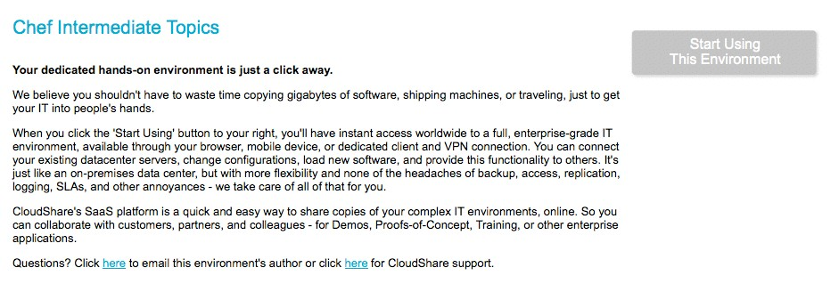
CloudShare Node
Register and login to CloudShare (see invite)
Start Using This Environment

Slide 20
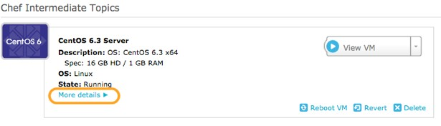
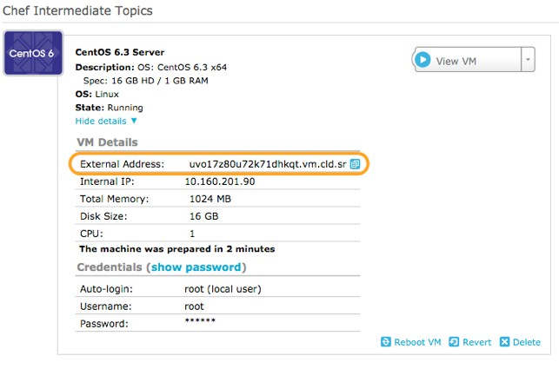
CloudShare Node

Slide 21
Lab - Login
$ ssh chef@<EXTERNAL_ADDRESS>
The authenticity
of host
'uvo1qrwls0jdgs3blvt.vm.cld.sr
(69.195.232.110)'
can't be established.
RSA key
fingerprint
is d9:95:a3:b9:02:27:e9:cd:
74:e4:a2:34:23:f5:a6:8b.
Are you sure you
want
to continue connecting (yes/no)? yes
Warning: Permanently
added
'uvo1qrwls0jdgs3blvt.vm.cld.sr,
69.195.232.110' (RSA)
to the list of known hosts.
chef@uvo1qrwls0jdgs3blvt.vm.cld.sr's Last login: Mon Jan 6 16:26:24 2014
password: from
host86-145-117-53.range86-145.btcentralplus.com [chef@CentOS63 ~]$

Slide 22
Checkpoint
At this point you should have
One virtual machine (VM) or server that you’ll use for the lab exercises
The IP address or public hostname
An application for establishing an ssh connection
'sudo' or 'root' permissions on the VM

