Slide 1
Further Resources
v1.1.4

Slide 2
Chef Fundamentals - Q&A Forum
Chef Intermediate Google Group Q&A Forum
http://bit.ly/ChefIntermediateForum
Join the group and post questions

Slide 3
Custom Resources
Documentation
http://docs.chef.io/chef/lwrps_custom.html
Examples
http://docs.chef.io/lwrp_yum.html
https://github.com/opscode-cookbooks/powershell
https://github.com/opscode-cookbooks/aws

Slide 4
Ohai Plugins
Documentation
http://docs.chef.io/ohai.html
Examples
https://github.com/opscode/ohai/tree/master/lib/ ohai/plugins
https://github.com/SPSCommerce/chef-etchosts/ blob/master/templates/default/plugins/ dhcpinfo_v7.rb

Slide 5
Style and Correctness
Documentation
http://docs.chef.io/foodcritic.html
http://batsov.com/rubocop/
Style and Correctness Rules
http://foodcritic.io/
https://github.com/bbatsov/ruby-style-guide

Slide 6
Unit Testing
Documentation
http://docs.chef.io/chefspec.html
https://sethvargo.github.io/chefspec/
Examples
https://github.com/sethvargo/chefspec/tree/master/ examples

Slide 7
Further Resources
http://chef.io/
http://supermarket.chef.io/
http://docs.chef.io/
http://learnchef.com
http://lists.opscode.com
http://youtube.com/user/getchef
irc.freenode.net #chef, #chef-hacking
Twitter @chef #getchef

Slide 8
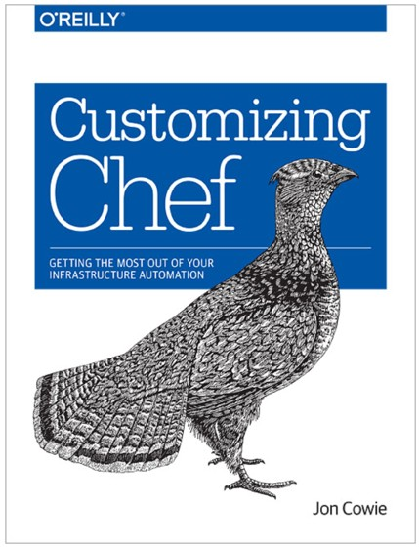
Learning Chef
by Mischa Taylor & Seth Vargo of Chef
The basics

Slide 9
Customizing Chef
by Jon Cowie of Etsy
More detailed treatment of handlers, Ohai plugins, event subsystem

Slide 10

Food Fight Show
http://foodfightshow.org
The Podcast Where DevOps Chef Do Battle
Regular updates about new Cookbooks, Knife- plugins, and more
Best Practices for working with Chef

Slide 11

ChefConf 2015
April 31 - March 2, 2015 | Santa Clara, CA at Convention Center
ChefConf
ChefConf 2015 is the largest, most vibrant gathering of web-scale IT and DevOps leaders, practitioners, and innovators. Featuring three days of inspired discussions, collaborative presentations, technical training, and hands-on labs focused on automating infrastructure and the continuous delivery of applications.

