Slide 1
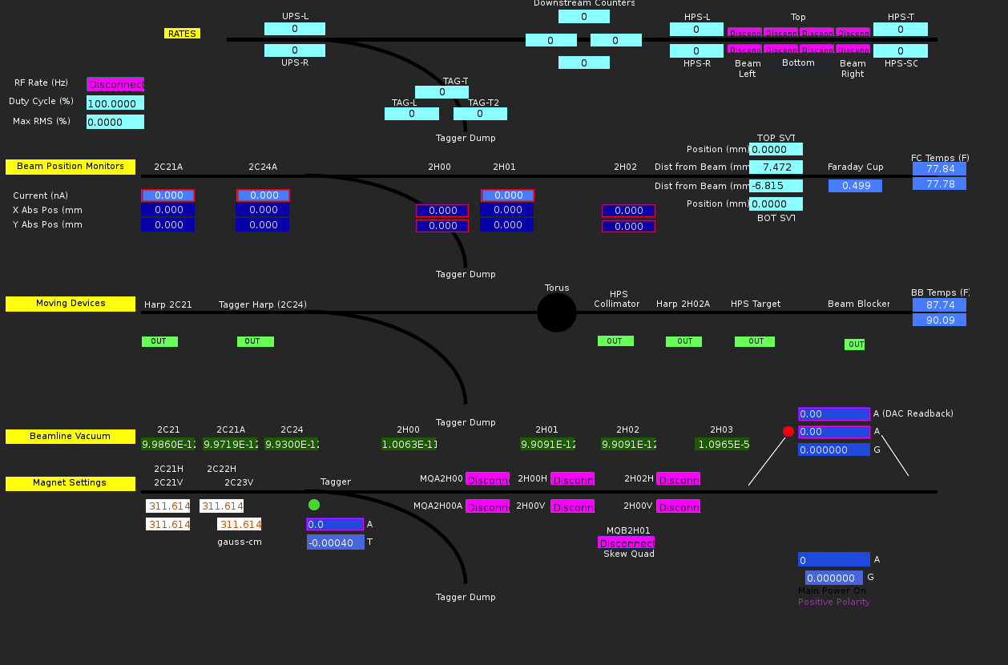
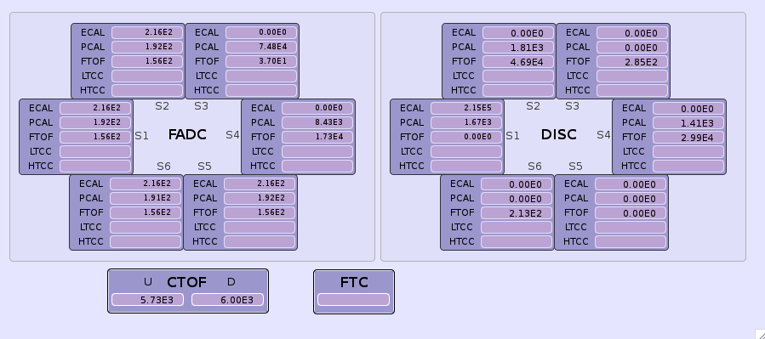
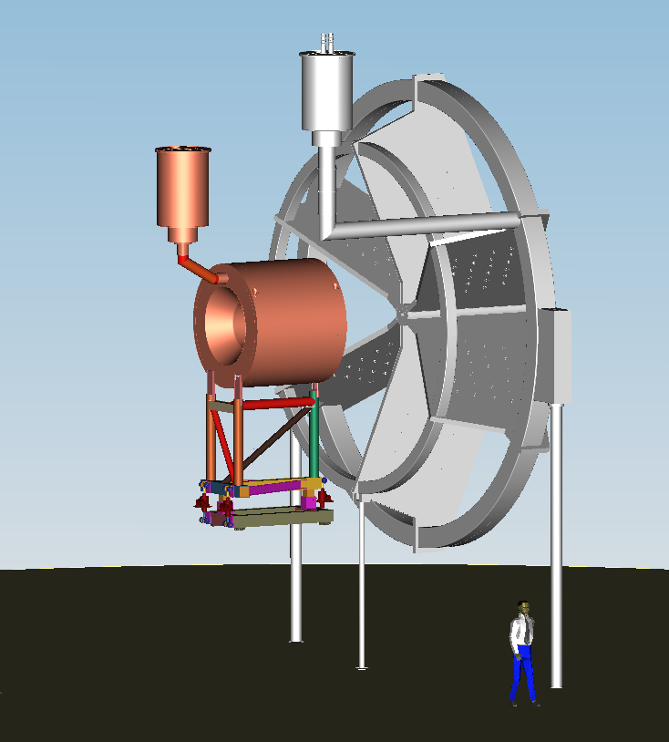
Tag-L
T
R
T
R
Tag-R
L
B
L
B
Upstream halo counters
Downstream halo counters
Collimator
2H01 harp/target
Beam viewer
Chromox
20 mm
YAG
12 mm
Buffer Dewar Liquid Level
OTR
Empty
Solenoid
MQA2H00
2H00 H
Torus
MQA2H00A
2H00 V

