Slide 1
The Guitar Management System

Slide 2
Introduction
The presented C program is designed to streamline the management of a guitar collection, offering a versatile and user-friendly interface for users to interact with the data. This application provides functionalities for adding new guitars, removing existing ones, searching for specific guitars, and displaying the entire collection. The program focuses on maintaining data integrity through quality control checks, ensuring that only guitars meeting specified criteria are accepted into the collection.
With a commitment to modularity, the code is organized into distinct functions, promoting readability and ease of maintenance. Additionally, robust error handling mechanisms are implemented, especially in file operations, to enhance the program's reliability. This introduction sets the stage for a detailed exploration of the program's architecture, functionalities, and the underlying principles that make it an effective tool for managing guitar collections.

Slide 3
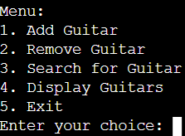
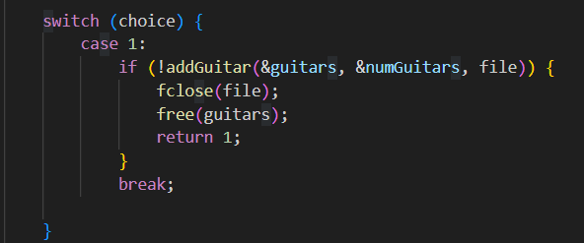
Menu
When first running the program, you will get this output where you will have to enter a number from 1 to 5
Depending on your input the program will continue
The menu functionality is implemented using a “switch” statement

Slide 4
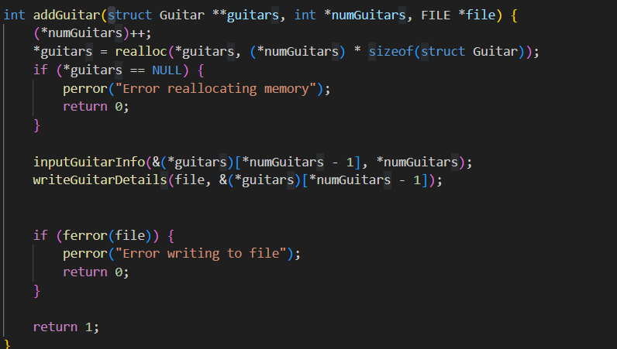
Add guitar
The "add" function seamlessly incorporates new guitar details into the system.
After adding the guitar, function increments “numGuitars” variable.
The function returns 1 to indicate that the addition was successful

Slide 5
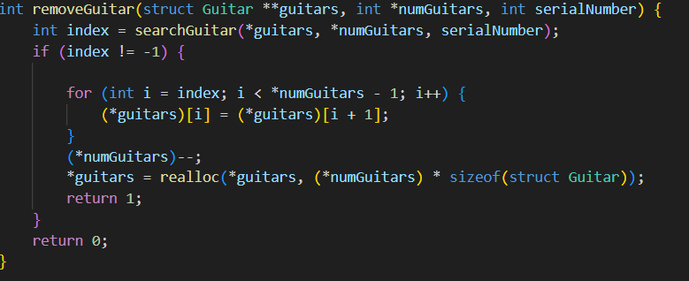
Remove guitar
The “remove” funciton is designed to remove a guitar from the array of guitars.
It initializes a variable “found” to 0, for indicating if the guitar was found.
If the guitar with such ID was not found the program prints the message.

Slide 6
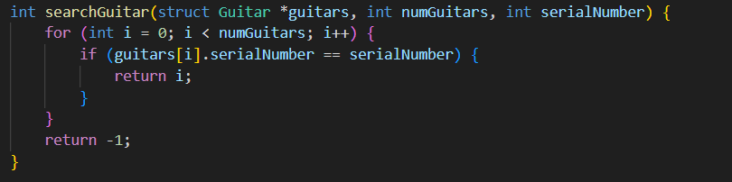
Search guitar
The “searchGuitars” function is designed to search for a guitar with specified serial number
It uses the same technique to find the guitar as the remove function
If it finds the guitar, it prints a message

Slide 7
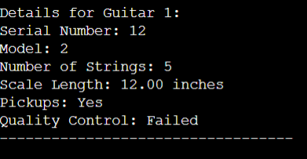
Display guitars
The “display” function is responsible for displaying a list of guitars
This is how it looks like

Slide 8
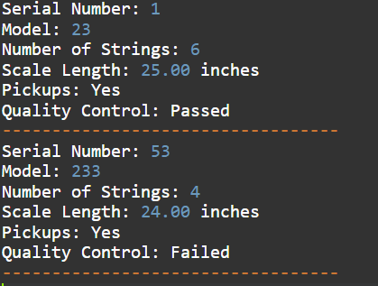
Exit
When choosing option 5 the program will stop
Function: write all guitars with their details and feedbacks to the file
Purpose: Terminates the program

Slide 9
THANK YOU!

