Slide 1

How to give a
good presentation?
Interpretable Machine Learning Group
Chair for Statistical Learning and Data Science
LMU München
Some parts of this presentation are adapted from earlier presentations prepared by Thomas Brox, Frank Hutter, Andre Biedenkapp, Katharina Eggensperger and Matthias Feurer.

Slide 2

Why should you aim for a good presentation?
→ You’ll have to give a lot of presentations in your life (in academia and industry)
Such presentations can decide whether
You get a job
You get a promotion
Your favourite project gets funded
You get the resources you need
…
You get a good grade ;-)
Photo by Matthew Jungling on Unsplash

Slide 3
Getting your points across
What matters is what your audience gets (not which points you “covered”)
Often, the audience is not as interested in the topic as you
You’ll have to tell them why they should care
If nobody cares or understands it’s typically your own fault
At least the key points must get across to everyone Some details may only be for experts, that’s OK

Slide 4
A few simple rules
Structure is key
Adapt your talk to your audience
Present in pictures
Readable slides
Practice, Practice, Practice!
Check your technical equipment before
Behave naturally
Learn from the mistakes of others

Slide 5
#1 Structure is key
High level to low level to high level
Catch your audience’s attention
Then tell them what you’ll tell them and why they should care (priming)
Then tell it to them
Then tell them what you just told them
Make transitions clear, don’t forget the “meta-talk”
E.g., In order to explain X, first I’ll need to explain Y
E.g., Now that we’ve seen X and Y, we have the ingredients to do Z
Remind the audience where you are in the talk, e.g. using a reoccurring outline slide
Use meaningful titles
Don’t get lost in details
In case of doubt leave out some details
Use a “T-structure”: combine broad coverage of a topic with depth about one (or few) key aspects
Focus on what you find most interesting

Slide 6
#1 Structure is key
Start your presentation with
a brief introduction of yourself
a motivation of why your topic matters and why the audience should care
what you will talk about (outline slide only after the motivation)
End your presentation with
the main takeaways
an outlook
a clear statement announcing the end of your presentation, e.g. That‘s it from my side and now I am happy to answer questions
a Thank-you slide is not necessary, better show the conclusion/discussion slide (unless you thank collaborators)

Slide 7
#2 Adapt your talk to your audience
The paper you are presenting is written for a specialized research community.
Your audience often has a different background
“Customize” the motivation (and ideally connect it to the topic of event/prior talk)
Cover the necessary background
We are experts on some topics – don’t bore us with what we already know
In general
A talk to the CEO is completely different than one to the tech support group
A talk applying method X to problem Y is completely different when you’re talking to community studying X or Y

Slide 8
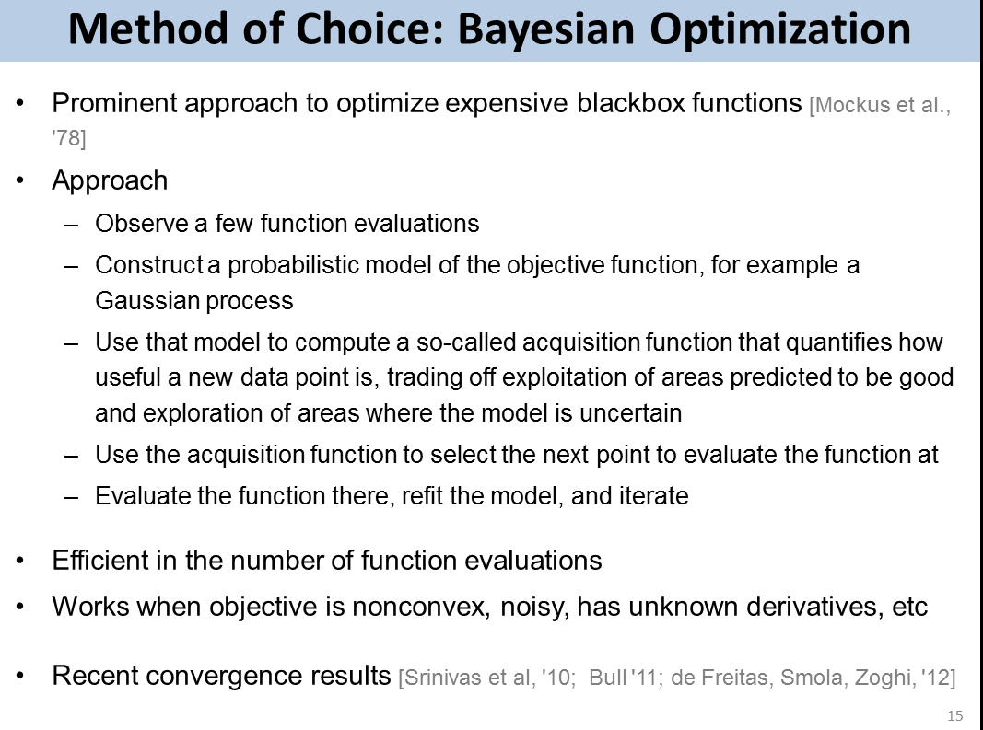
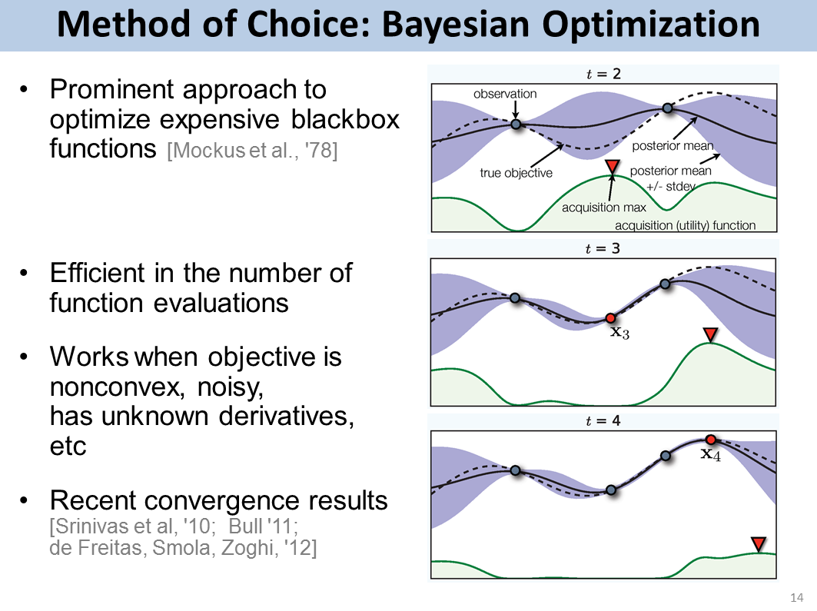
#3 Present in Pictures
Slides full of text are hard to follow
The audience will read and not listen to you
Reduce text, use more images
Use animation to guide focus of attention
❌
✅

Slide 9
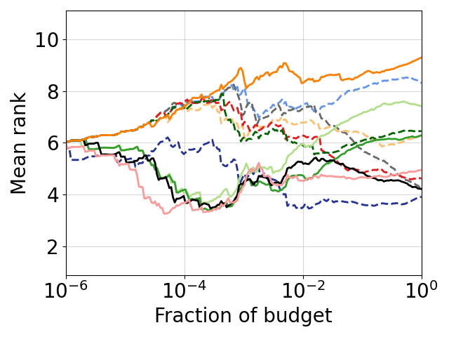
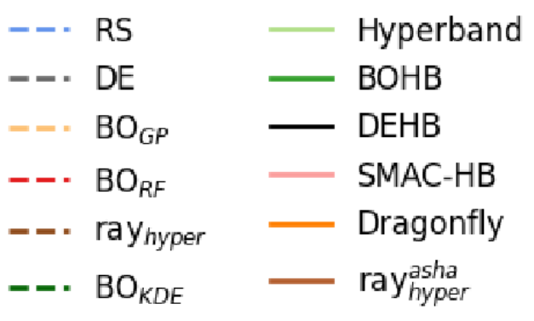
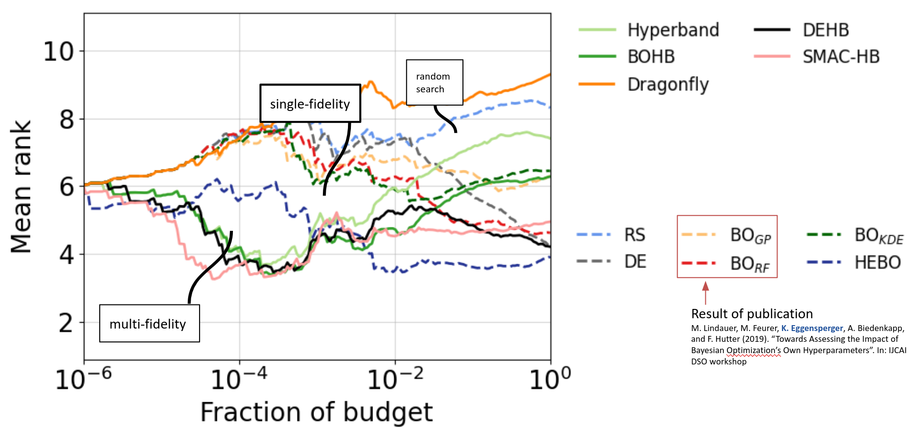
#3 Present in Pictures
How to present a graph/plot?
always explain what the graph shows (ideally with some visual highlighting)
use presenter to guide audience
take enough time
→ The same applies to equations and tables
❌
✅

Slide 10
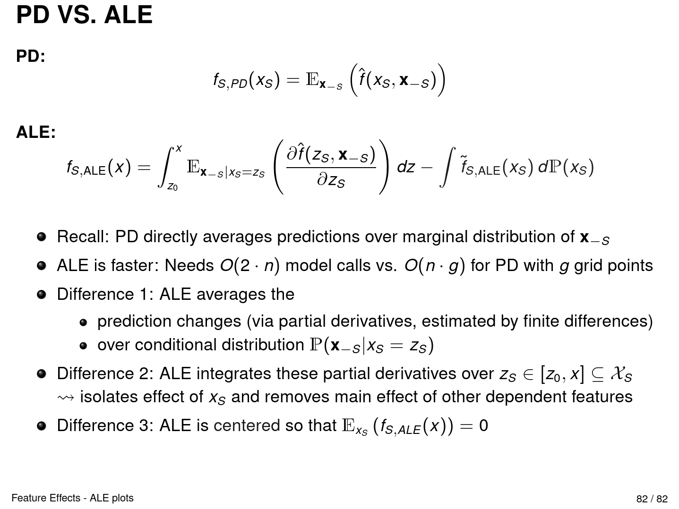
#3 Present in Pictures, and use animations
❌

Slide 11
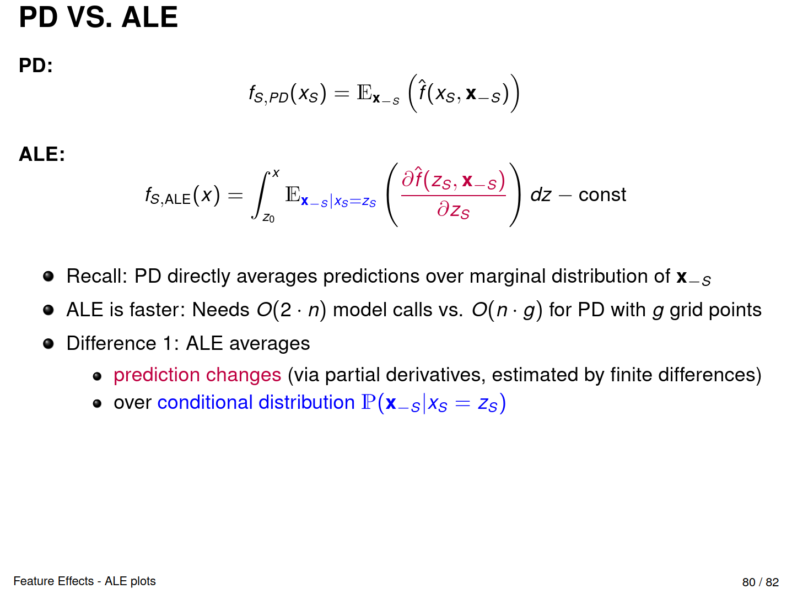
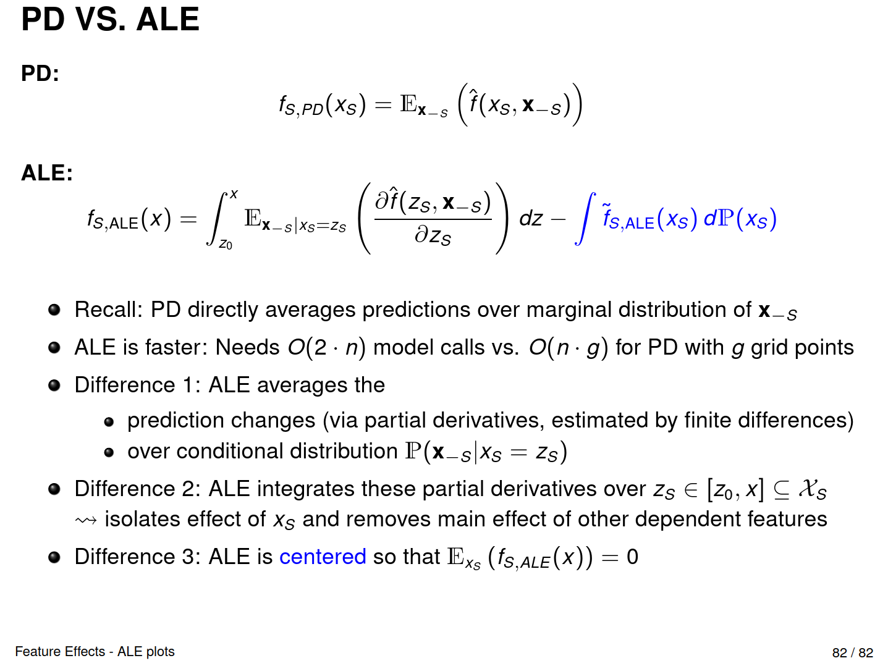
#3 Present in Pictures, and use animations
❌
✅

Slide 12
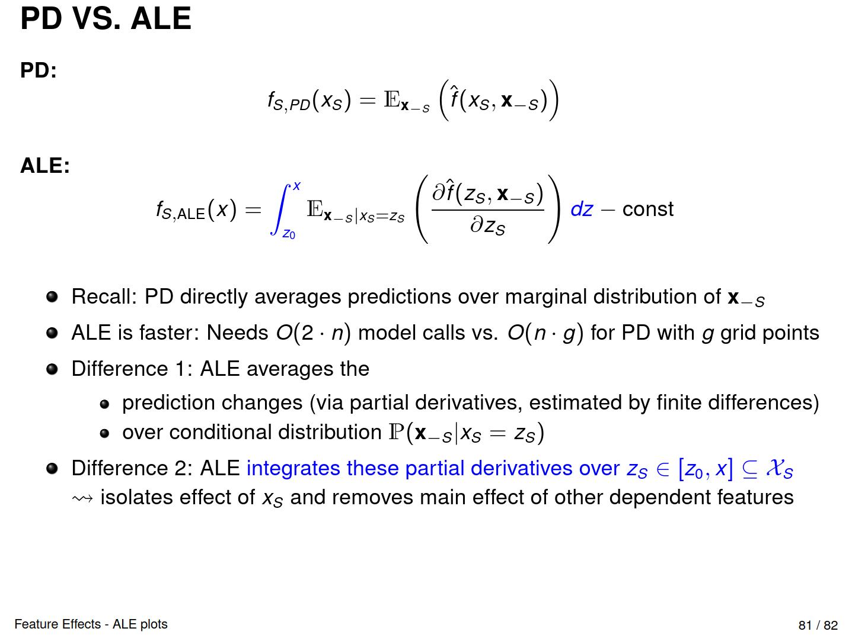
#3 Present in Pictures, and use animations
❌
✅

Slide 13
#3 Present in Pictures, and use animations
❌
✅

Slide 14
#4 Readable slides - some tips
Text, Font & Color
Make sure to pick a reasonable text and background color
Can you read this? Also from the back? Remember: Contrast & resolution of your laptop is better than that of the projector (so test it before)
Sometimes the font size is too tiny. This also applies to axis labels.
Pick a single font type and color and use it throughout the whole presentation
Highlight important keywords when there is a lot of text, but: choose a consistent way of highlighting
Graphics
Size up figures to use most of the slide.
Add some bullet points so its self-contained.
Not all animations are useful.
Screenshots are okay, if you do not have access to the original image.
Other
Meke sure tere are no typos in yur slides
A list needs more than one entry
e.g. this is not a list!
Make sure slides are self-contained (important for most presentation types)
Have slide numbers
Have only little content per slide

Slide 15
#5 Practice, Practice, Practice
Plan each part!
Have a time budget
Have bullet points with the main points
Practice & check the timing for the part
Put it all together and practice!
Do the transitions work?
Always get stuck at the same point? Change that point!
Don’t speak too fast! Speaking too slowly is almost impossible
Make use of breaks
Finetune start and beginning!
Know how you want to start (when you’re most nervous)
Know how you want to end (what the audience remembers)
⭐ Bonus tipps
Starting at a random slide of your presentation
Stand and use presentation mode (as realistic as possible)
Think about potential questions
Have backup slides with left out details
Notes:
Why can seasoned speakers put together a few slides and give a good presentation? Because they present the same work over and over again and have already practiced this
Practice the first and last minute at least 10 times

Slide 16
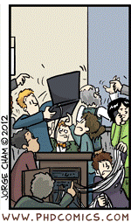
#6 Check your technical equipment before
Checklist
Do you have to bring your own laptop?
Does your laptop work with the projector?
Do you have the right dongle?
Instant messaging (Teams, Zoom, Slack, Mattermost, etc) switched off?
Desktop free of too personal items?
Screen saver switched off?
Enough battery or laptop plugged in?
Are all updates installed?
Is your presentation in the right format?
Do all videos show properly?
Does audio work?
(if applicable) Does your laser pointer work?
⭐ Bonus tipps
Prepare and test your equipment before the talk!
Have your slides also as a PDF ready

Slide 17
#7 Behave Naturally
Keep eye contact with the audience; don’t turn your back
→ But do not wonder what they might think of your presentation! (now it’s too late)
Relax!
Answering questions:
Listen to the whole question carefully; don’t interrupt
Repeat what you understood, especially for long/multiple questions.
Think before you answer
Short and precise
If you don’t know the answer, say so. This is okay.
⭐ Bonus tipp: Ask someone to take a video of you presenting and watch it

Slide 18
#8 Learn from the mistakes of others
Have you ever been to a presentation where you were
🥱, 😕, 😵‍💫 or irritated by a specific behaviour of the presenter?
Then
Analyze what went wrong
(if possible) give them (friendly & constructive) feedback
Do not make the same mistakes
⭐ Bonus tipp
If you see a great presentation, learn from it (and let the presenter know that you enjoyed the presentation)

Slide 19
Giving constructive feedback
Start with something positive
In your own reviews you don’t want to hear only negative things, either
People are more receptive to criticism after hearing something positive
Make concrete suggestions
Bad example: The lecture was bad
Good example: I couldn’t follow the math because I couldn’t read your handwriting on the board – better use a projector or slides

Slide 20
Rule #8: Learn from the mistakes of others
Mistakes, that are easy to avoid:
Talking too slow/fast/loud/quietly
Bad time management, e.g. a 15 minute talk should last 15 minutes
Preparing too many slides, e.g. 100 slides for 15 minutes
Not spending enough time on a slide
Technical difficulties
Improvising

Slide 21
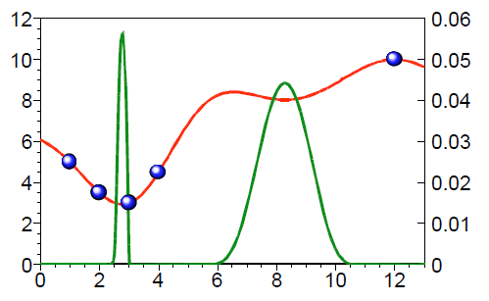
Good scientific practice
Never present other people’s work as your own
Never copy-paste (even critical if it is your own work)
State explicitly what is your contribution
Give appropriate credit
references for figures
licence for photos/icons
Quotes: X and Y [12] define this problem as follows : “…”
→ Never cheat or plagiarize on purpose, clearly mark your references, adopt best practices for avoiding mistakes
Source: Jones et al [1998]

Slide 22
What else matters?
During the presentation
First & Last 30s sec of your presentation
How well did you motivate your problem
How well did you explain technical details
During Q&A
It is part of your presentation.
Good things to do:
Think about questions that you might want to discuss with the audience? Open problems?
Prepare answers for obvious questions

Slide 23
Takeaways
Structure is key
Adapt your talk to your audience
Present in pictures
Readable slides
Practice, Practice, Practice!
Check your technical equipment before
Behave naturally
Learn from the mistakes of others

Slide 24
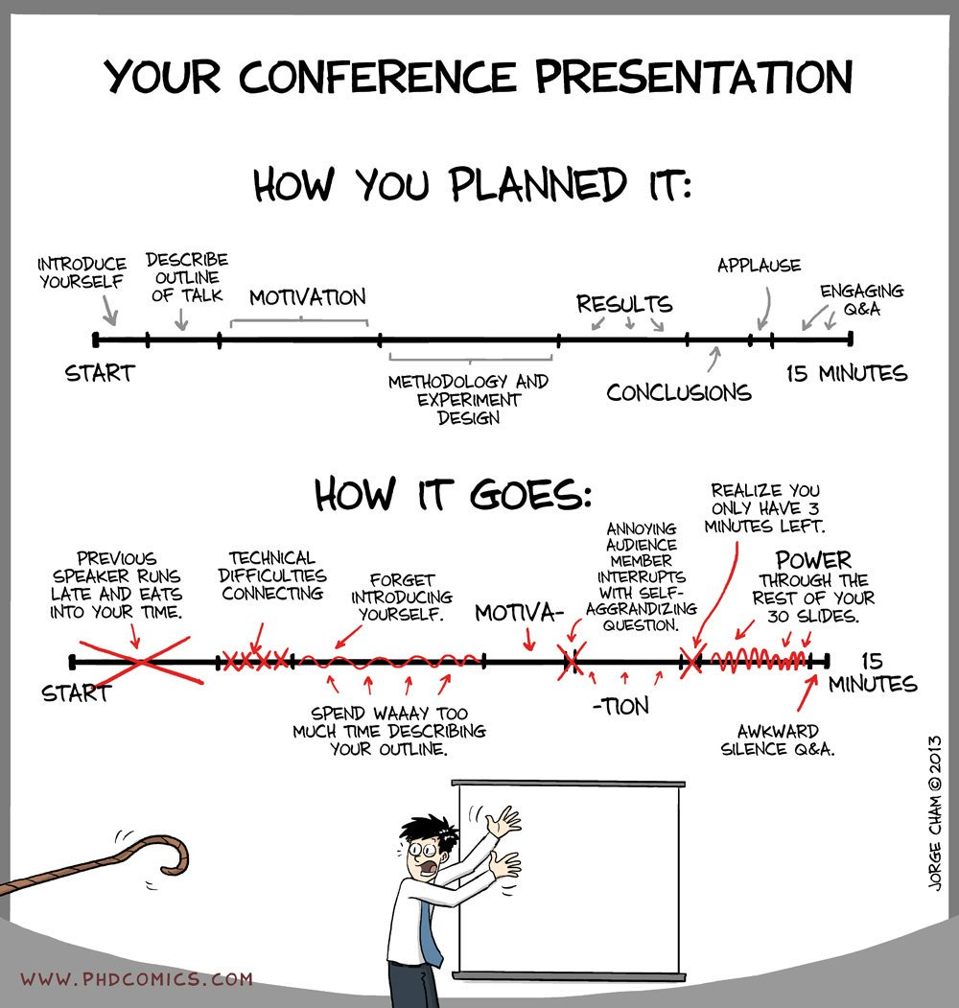
Questions?
SEMINAR
NOT
Source: phdcomics.com/comics/archive.php?comicid=1553

Slide 25
More resources
LMU Schreibzentrum Workshop https://www.schreibzentrum.fak13.uni-muenchen.de/freitagsworkshops/index.html
How to give a great scientific talk https://www.nature.com/articles/d41586-018-07780-5
Free Images https://www.pexels.com/, https://unsplash.com/
How to read a research paper http://ccr.sigcomm.org/online/files/p83-keshavA.pdf

