Slide 1
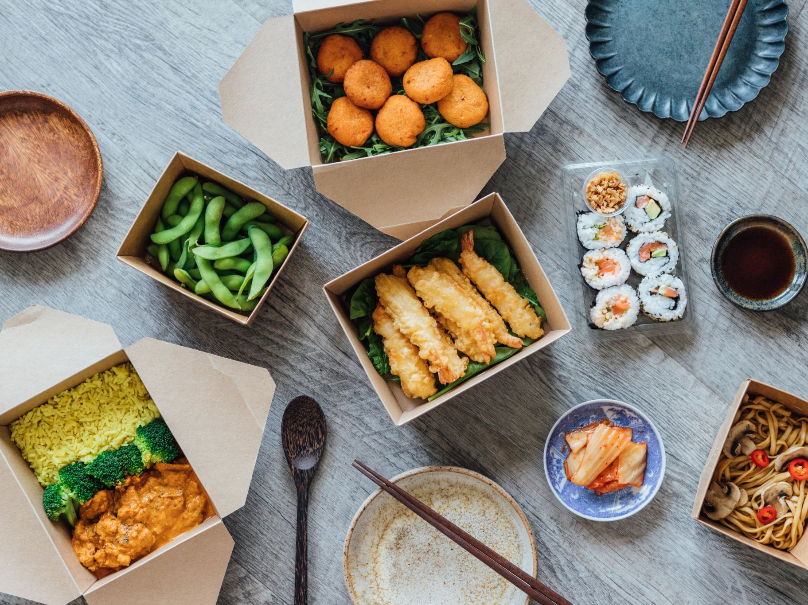
Afropot – Nigerian Food Ordering & Delivery Platform
Software Engineering 2 Project
Lecturer: Dr. Ali Mehmood Khan
Group Members: Akinseye Akinwande 73524358
Rahaman Saana Abdul-Razak 81832589
Guven Cirpanli 27454246
Sevval Dagar 40238599

Slide 2
Introduction
Afropot is a mobile-based restaurant and delivery platform for authentic Nigerian dishes.
It allows users to browse meals, place orders, and get deliveries easily.
Afropot modernizes Nigerian food access through a digital platform.
Problem Statement
Limited digital access to authentic Nigerian dishes in many regions.
Existing apps do not specialize in Nigerian cuisine.
Manual order management by local restaurants leads to inefficiency.
Afropot addresses these challenges with a specialized digital solution.

Slide 3

Objectives
1. Develop a simple, intuitive Android app for Nigerian meal ordering.
2. Enable browsing, ordering, and secure payment for meals.
3. Provide live order tracking and delivery status updates.
4. Equip admins to manage menus, orders, and riders efficiently.

Slide 4
Platform Overview
• Platform: Android Mobile App (Java)
• Backend: Spring Boot Microservices (Java)
• Database: PostgreSQL
• Deployment: Docker containers
• Version Control: GitHub repository
• APIs: RESTful communication between services

Slide 5
Core Modules
1. User Service – manages users (Customer, Admin, Rider).
2. Menu Service – maintains Nigerian dishes and prices.
3. Order Service – handles order creation and payment.
4. Delivery Service – manages riders and delivery tracking.
5. Notification Service – sends push notifications.

Slide 6
System Architecture
Afropot uses a modular microservice-based architecture.
Services communicate via REST APIs and each has its own database.
The Android app interacts securely with the backend APIs through HTTP.
Architecture Example:
[Android App] → [API Gateway] → [User/Menu/Order/Delivery Services]

Slide 7
Use Case Overview
Actors:
• Customer – browse dishes, place orders, and track delivery.
• Admin – manage menu, orders, and assign riders.
• Rider – view assigned deliveries and update delivery status.
Key Use Cases:
• Browse Menu • Place Order • Track Delivery • Manage Menu • Manage Orders

Slide 8
Example Nigerian Dishes
• Jollof Rice with Fried Chicken 🍗
• Efo Riro with Pounded Yam 🍲
• Egusi Soup with Fufu 🥣
• Suya (Spicy Grilled Meat) 🌶️
• Ofada Rice with Ayamase (Designer Stew) 🍛
• Moi Moi (Bean Cake) and Plantain 🍌

Slide 9
Functional Requirements
FR1 – User Registration and Login
FR2 – View Menu of Nigerian Dishes
FR3 – Place Orders and Make Payments
FR4 – Real-Time Order Tracking
FR5 – Manage Menu Items (Admin)
FR6 – Assign Deliveries (Admin)
FR7 – Receive Push Notifications

Slide 10
Non-Functional Requirements
NFR1 – Usability: Simple and intuitive interface.
NFR2 – Performance: Load menus in under 2 seconds.
NFR3 – Security: Encrypted communication and JWT auth.
NFR4 – Reliability: Continuous uptime for live orders.
NFR5 – Scalability: Support multiple branches/restaurants.
NFR6 – Localization: Display in Naira (₦) and Nigerian dishes.

Slide 11
Tools & Technologies
• Android Studio (Java)
• Spring Boot Framework (Java)
• PostgreSQL Database
• Docker & Docker Compose
• GitHub (Version Control)
• Postman & JUnit (Testing)

Slide 12
Future Enhancements
• Integration with Paystack or Flutterwave for payments.
• AI-based food recommendation engine.
• Route optimization for delivery riders.
• Ratings and review system for dishes and delivery.
• Expansion to multiple cities and countries.

Slide 13
Conclusion
Afropot provides a complete Nigerian food ordering and delivery experience.
It promotes Nigerian cuisine globally through technology.
With its modular and scalable architecture, Afropot is ready for real-world deployment and future growth.

