Slide 1
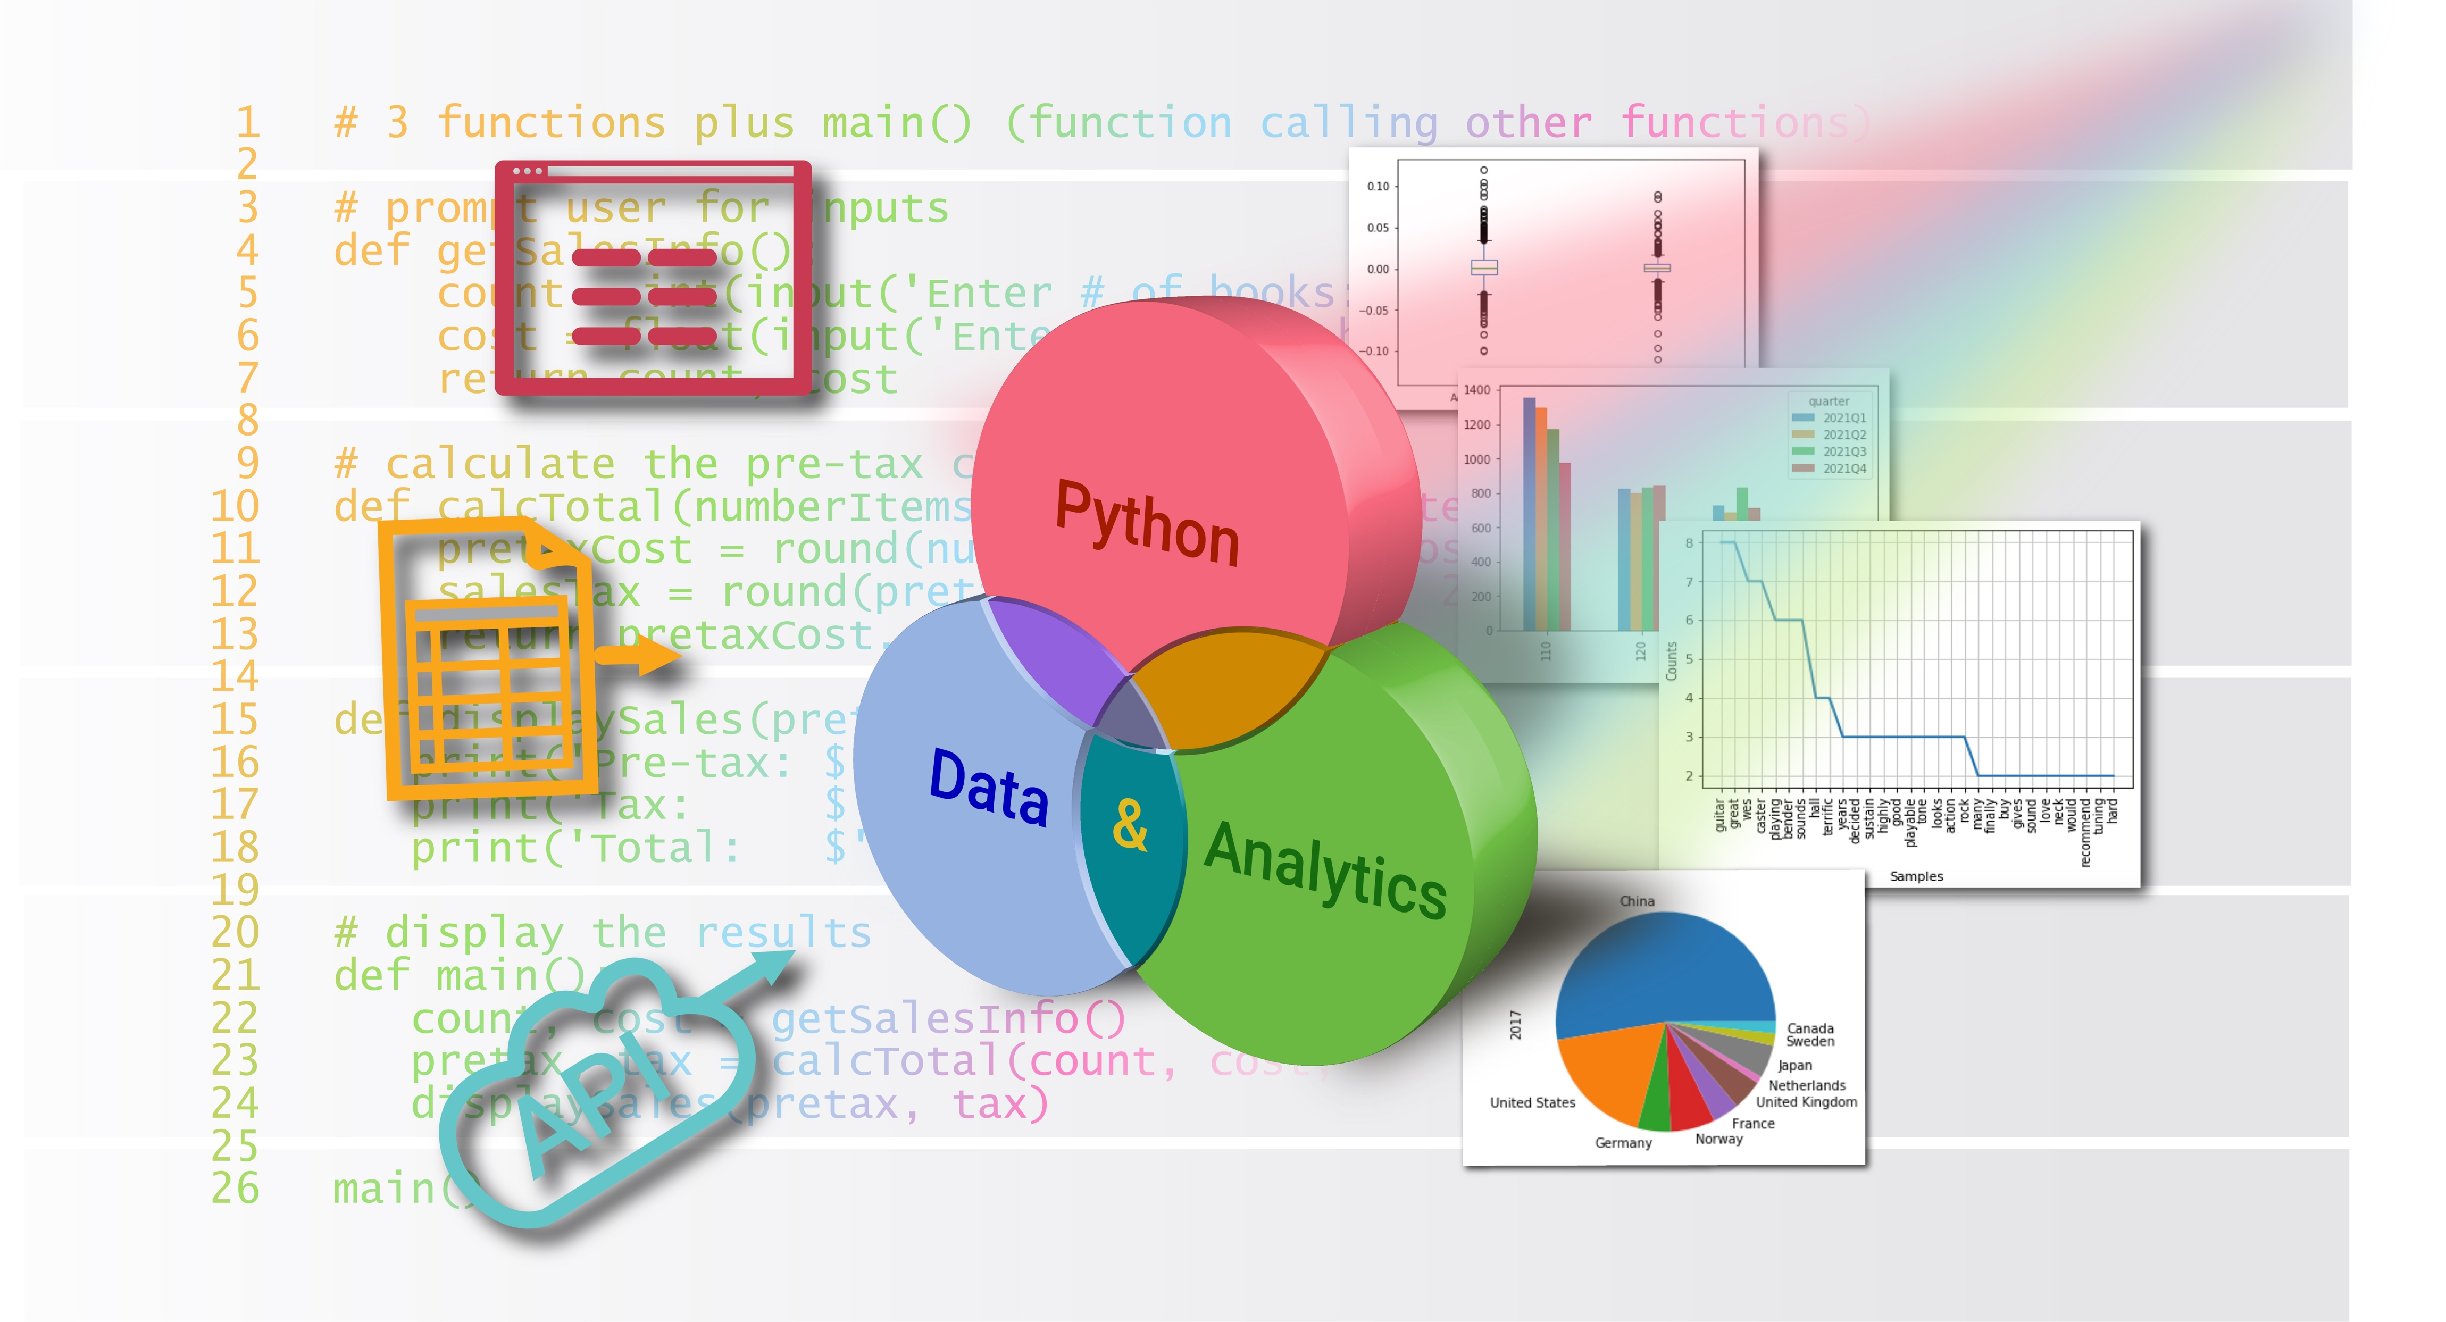
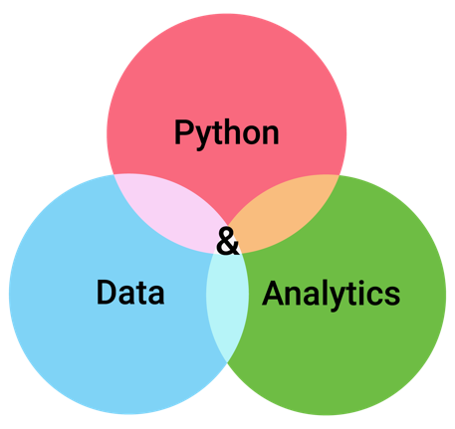


Lists
Chapter 6
Python for Data & Analytics
A Business-Oriented Approach
© 2023 Rose River Software, LLC

Slide 2
Topics
About Lists
Creating Lists
Iterating over a list to get its items
Getting part of a list using slicing
Asking questions of a list
Maintaining a list
Ordering a list – sorted(), sort(), reverse()
Representing a table in a list
About tuples – unchangeable lists

Slide 3
Topics
About Lists
Creating Lists
Iterating over a list to get its items
Getting part of a list using slicing
Asking questions of a list
Maintaining a list
Ordering a list – sorted(), sort(), reverse()
Representing a table in a list
About tuples – unchangeable lists

Slide 4
About Lists
So far, each value and variable has represented a single data item
e.g., single number, single string
In many programs, we want to keep track of related items together
A Python list is a way to keep an ordered set of items
Some list features:
Create a list and access its individual items
Ask questions, for example:
how many items in the list
is a certain value within the list
Get part of a list using slicing

Slide 5
About Lists
Spreadsheet Compare/Contrast: Lists vs. Cell Ranges
A list in Python is similar to a range of cells in a spreadsheet.
For example, in a spreadsheet you may sum the ten values in A1:A10
This set of cells and their values is similar to a Python list
However, as with single valued variables, in Python you provide a name for a list

Slide 6
Topics
About Lists
Creating Lists
Lists as a fixed set of items in code
Creating an empty list and adding items with append()
Iterating over a list to get its items
Getting part of a list using slicing
Asking questions of a list
Maintaining a list
Ordering a list – sorted(), sort(), reverse()
Representing a table in a list
About tuples – unchangeable lists

Slide 7
Creating Lists Lists as a fixed set of items in code
Lists can be create in a single statement
colors = ['red', 'green', 'blue']
Create a list with the ordered set of values 'red', 'green', and 'blue' and assign the variable colors to this list
The square brackets [ ] indicate that this is a list
Could use this statement in a program, or interactively
'red', 'green', 'blue' are the items (elements) in the list
The items of a list can be any Python type, e.g., numeric
squares = [1, 4, 9, 16]

Slide 8
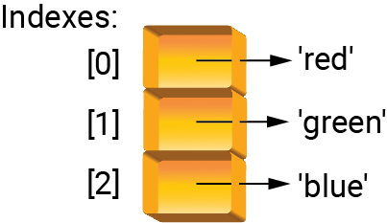
Creating Lists Lists as a fixed set of items in code
To refer to one item of the list, use square brackets
>>> colors = ['red', 'green', 'blue']
>>> colors[0]
'red'
Each item of a list is numbered – this is called the index
In above, color[0] refers to the value at index location 0
The first index of a list is 0

Slide 9
Creating Lists Lists as a fixed set of items in code
Example: Air Quality Index (AQI) lookup
AQI range | Color | Concern
0 - 50 | green | Good
51 - 100 | yellow | Moderate
101 - 150 | orange | Unhealthy for sensitive groups
151 - 200 | red | Unhealthy
201 - 300 | purple | Very Unhealthy
Above 300 | maroon | Hazardous

Slide 10

Creating Lists Lists as a fixed set of items in code
Program 6-1
# Translate Air Quality Index (AQI) from number to color and concern
# lists of levels and corresponding colors and concerns
levels = [301, 201, 151, 101, 51, 0]
colors = ['Maroon', 'Purple', 'Red', 'Orange', 'Yellow', 'Green']
concerns = ['Hazardous', 'Very Unhealthy', 'Unhealthy',
'Unhealthy for Sensitive Groups', 'Moderate', 'Good']
# input
level = int(input('Enter an AQI level (integer): '))
# processing
for i in range(len(levels)):
if level >= levels[i]:
color = colors[i]
concern = concerns[i]
break
# output
print('AQI color:', color)
print('AQI concern level:', concern)
3 parallel lists are defined
len() indicates how many items in list
How would you rewrite without using break?
Enter an AQI level (integer): 75
AQI color: Yellow
AQI concern level: Moderate

Slide 11
Creating Lists Creating an empty list and adding items with append()
As an alternative to defining a list in one statement, you can create an empty list and then subsequently add items to the list
To define an empty list:
listName = []
Then, to add an item to end of list, use the append() method
A method is like a function, but can be used after a variable (or constant or expression)
variableName.methodName(arguments)
listName.append(item)

Slide 12
Creating Lists Creating an empty list and adding items with append()
Program 6-2
# show how to create an empty list and add elements to it
# prompt for a series of values and build and return a list
def getValues():
result = [] # define an empty list
entry = input('Enter a value, or <return> when done: ')
while entry != '':
result.append(float(entry)) # add a value to end of list
entry = input('Enter a value, or <return> when done: ')
return result
# calculate the mean of a list
def calcMean(alist):
n = len(alist) # determine the number of elements in the list
if n == 0: return None # handle an empty list
sum = 0 # sum will cumulate the list's values
for i in range(n):
sum += alist[i]
return sum / n # calculate and return the average
measures = getValues()
mean = calcMean(measures)
print('Mean=', mean)
define empty list
append() is used to add items to the list
Enter a value, or <return> when done: 9.8
Enter a value, or <return> when done: 10.1
Enter a value, or <return> when done: 10.7
Enter a value, or <return> when done:
Mean= 10.2

Slide 13
Topics
About Lists
Creating Lists
Iterating over a list to get its items
Getting part of a list using slicing
Asking questions of a list
Maintaining a list
Ordering a list – sorted(), sort(), reverse()
Representing a table in a list
About tuples – unchangeable lists

Slide 14
Iterating over a list to get its items
for can be used directly with a list to iterate over the list's items
Program 6-4
# demonstrate the use of for, to iterate over a list's elements
# calculate the mean of a list of numbers
def calcMean(alist):
sum = 0
for value in alist: # iterate over the elements of the list
sum += value
return sum / len(alist)
measures = [10, 10.1, 9.9, 9.6, 10.1, 9.9, 9.8, 9.9, 10.3, 10]
mean = calcMean(measures)
print('Mean=', mean)
Uses the pattern:
for <variable> in <list variable>:
+= is shorthand for
sum = sum + value
Mean= 9.96

Slide 15
Topics
About Lists
Creating Lists
Iterating over a list to get its items
Getting part of a list using slicing
Asking questions of a list
Maintaining a list
Ordering a list – sorted(), sort(), reverse()
Representing a table in a list
About tuples – unchangeable lists

Slide 16
Getting part of a list using slicing
To generate a list with some of the of the items from a source list, Python provides a very concise and powerful feature called slicing
Slicing involves using square brackets [ ] and one or two colons within
One variation:
alist[start:end]
For example:
>>> alist = [1, 4, 9, 16, 25]
>>> alist[0:3]
[1, 4, 9]
In above, alist[0:3] returns list with items at index locations 0, 1, and 2
The 3 in 0:3 indicates to up to but not including index 3

Slide 17
Getting part of a list using slicing
If you omit the start argument, the slice starts at item 0
>>> alist = [1, 4, 9, 16, 25]
>>> alist[:2]
[1, 4]
If you omit the end argument, the slice ends at the last item of the list
>>> alist[3:]
[16, 25]
Slicing allows for a 3rd argument, indicating how to skip (like range())
>>> alist[0:4:2]
[1, 9]

Slide 18
Topics
About Lists
Creating Lists
Iterating over a list to get its items
Getting part of a list using slicing
Asking questions of a list
Maintaining a list
Ordering a list – sorted(), sort(), reverse()
Representing a table in a list
About tuples – unchangeable lists

Slide 19
Asking questions of a list
functions
len(alist) – how many items are in a list
min(alist) – what is the smallest value in a list
max(alist) – what is the largest value in a list
keyword
in – is a particular value in a list?
<value> in <a list>
<value> not in <a list>
Returns True or False

Slide 20
Topics
About Lists
Creating Lists
Iterating over a list to get its items
Getting part of a list using slicing
Asking questions of a list
Maintaining a list
Changing a list's elements
Methods for adding elements: append(), insert(), extend()
Removing elements: del, remove(), pop(), clear()
Copying a list
Ordering a list – sorted(), sort(), reverse()
Representing a table in a list
About tuples – unchangeable lists

Slide 21
Maintaining a list Changing a list's elements
To change an item at an index location, use [ ] before equals sign
Program 6-8
# demonstrate list indexing on the left-hand side
# determine counts of items above or below a certain value
def aboveBelow(alist, splitValue):
result = [0, 0] # this list will track counts below/above splitValue
for i in range(len(alist)):
if alist[i] <= splitValue: result[0] += 1
else: result[1] += 1
return result
measures = [10, 10.1, 9.9, 9.6, 10.1, 9.9, 9.8, 9.9, 10.3, 10]
result = aboveBelow(measures, 10)
print(result)
Update list with [ ] on left side of =
[7, 3]

Slide 22
Maintaining a list Methods for adding elements - append(), insert(), extend()
append(item) – add item to end of a list
insert(index, item) – insert item into list at location index
extend(anotherList) – append anotherList to the end of a list

Slide 23
Maintaining a list Removing elements - del, remove(), pop(), clear()
Methods
remove(value) – remove the value from the list (or error if not found)
pop() – remove the last item from the list (and return its value)
clear() – remove all items from the list
Keyword
del – remove a particular item from a list

Slide 24
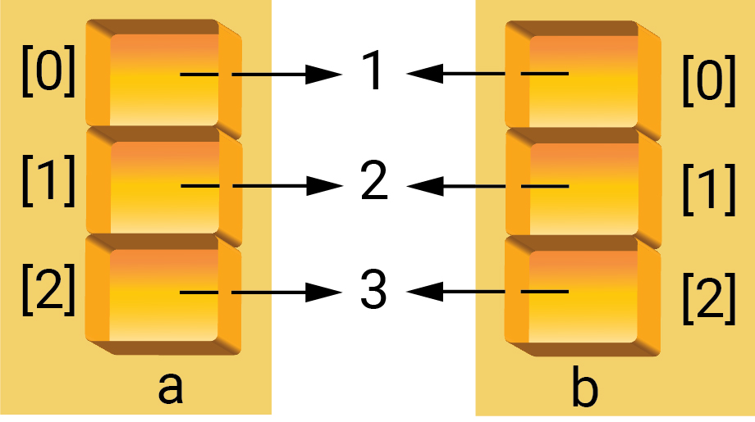
Maintaining a list Copying a list
If you assign a list variable to another variable, these two variables are pointing to the same set of items
>>> a = [1, 2, 3]
>>> b = a
>>> a[1] = 10
>>> b
[1, 10, 3]
Alternatively, if you do not want to share items, use copy()
b = a.copy()

Slide 25
Topics
About Lists
Creating Lists
Iterating over a list to get its items
Getting part of a list using slicing
Asking questions of a list
Maintaining a list
Ordering a list – sorted(), sort(), reverse()
Representing a table in a list
About tuples – unchangeable lists

Slide 26
Ordering a list – sorted(), sort(), reverse()
sorted() function – generate a new list that is ordered
newlist = sorted(alist)
Original list alist is unchanged
sort() method – order the list itself, without generating a new list
alist.sort()
reverse() method – reverse order the list itself
alist.reverse()

Slide 27
Topics
About Lists
Creating Lists
Iterating over a list to get its items
Getting part of a list using slicing
Asking questions of a list
Maintaining a list
Ordering a list – sorted(), sort(), reverse()
Representing a table in a list
About tuples – unchangeable lists

Slide 28
Representing a table in a list
One option for representing a table is as a list of lists
matrix = [['John', 'Jones'], ['Jane', 'Doe'], ['Jim', 'Johnson']]
# display the list of lists
for row in matrix:
for cell in row:
print(cell, end='|')
print()
Table as lists of lists
Step through the list, then through the sub-lists
John|Jones
Jane|Doe
Jim|Johnson

Slide 29
Topics
About Lists
Creating Lists
Iterating over a list to get its items
Getting part of a list using slicing
Asking questions of a list
Maintaining a list
Ordering a list – sorted(), sort(), reverse()
Representing a table in a list
About tuples – unchangeable lists

Slide 30
About tuples – unchangeable lists
A tuple, like a list, is an ordered set of items
A tuple, unlike lists, cannot have their items changed once tuple is created
A tuple is more efficient or suitable when your items are static
A tuple can be created using parentheses, for example
colors = ('Maroon', 'Purple', 'Red', 'Orange', 'Yellow', 'Green')
Access an item using square brackets [ ] as with lists
colors[0]
Cannot update an item in a tuple, if colors is a tuple, the following generates an error:
colors[0] = 'Brown'

Slide 31
Topic Recap
About Lists
Creating Lists
Iterating over a list to get its items
Getting part of a list using slicing
Asking questions of a list
Maintaining a list
Ordering a list – sorted(), sort(), reverse()
Representing a table in a list
About tuples – unchangeable lists

Slide 32
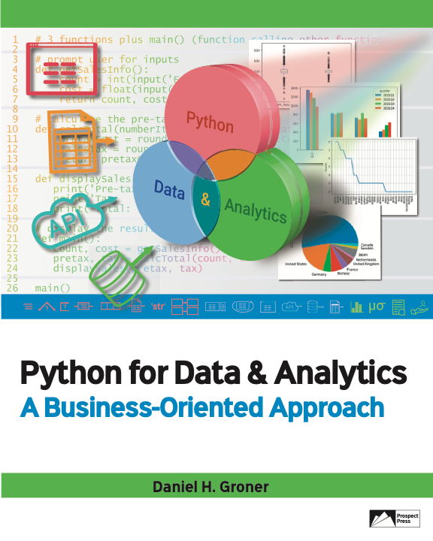
© 2023 Rose River Software, LLC
All rights reserved. This material may not be copied or distributed without permission from Prospect Press

