Slide 1
Flowcharts

Slide 2
Main symbols
Terminator: used to depict start and stop of a program
parallelogram: used to depict input or output
rectangle: used to depict a process that happens in the background (ex a calculation)
Dimond: used to depict a decision structure or loop

Slide 3
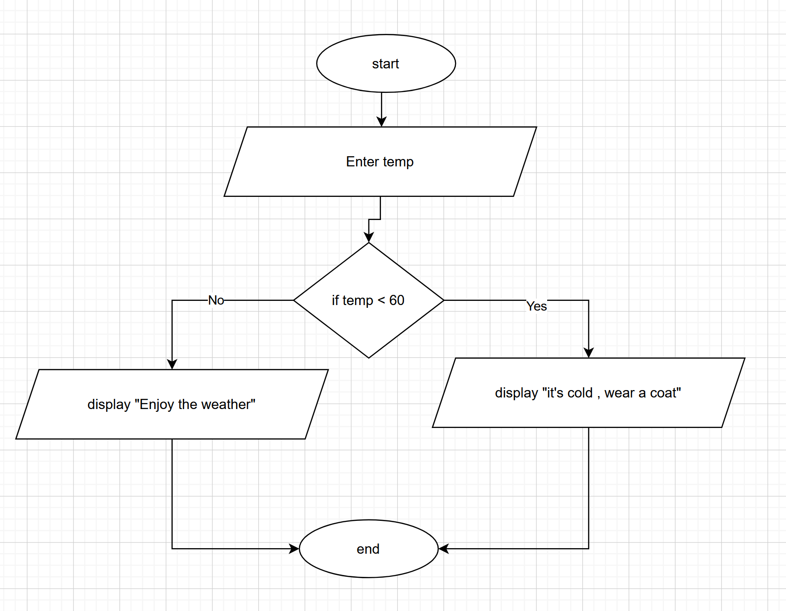
Example (flowchart is for program with decision structure , no loop)

Slide 4
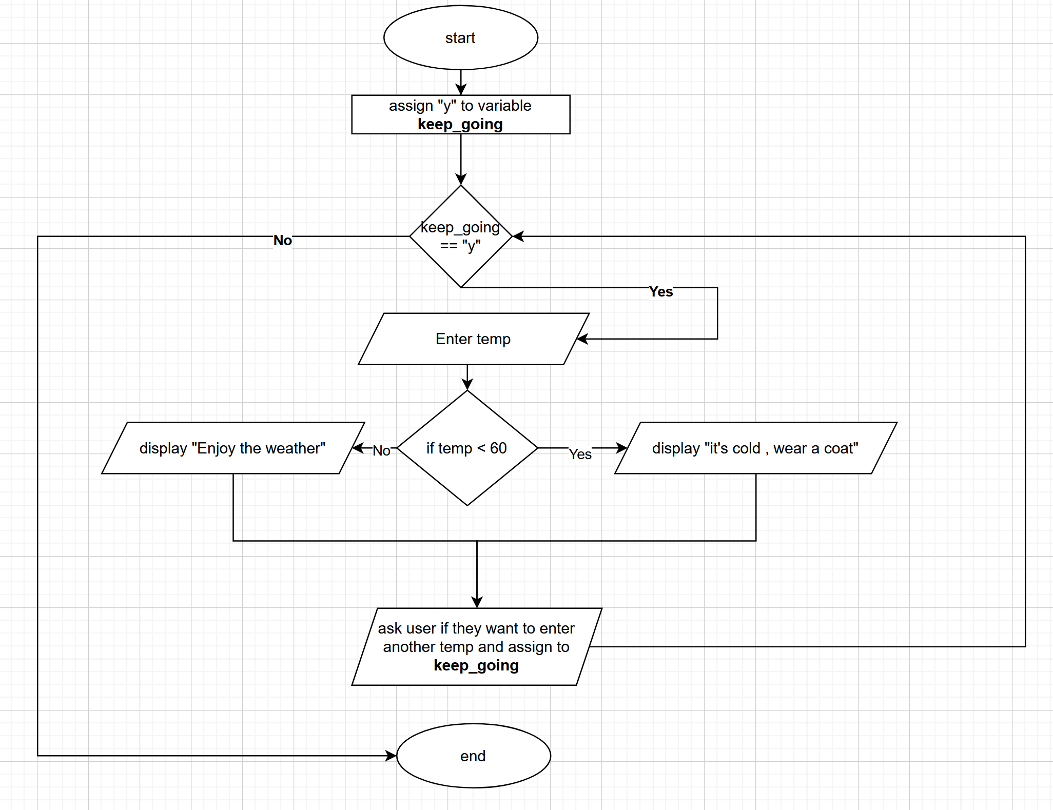
Example (flowchart is for program that has a decision structure AND loop)

Slide 5
More symbols
used to depict a function call ( will be covered in Module 2)

