Slide 1
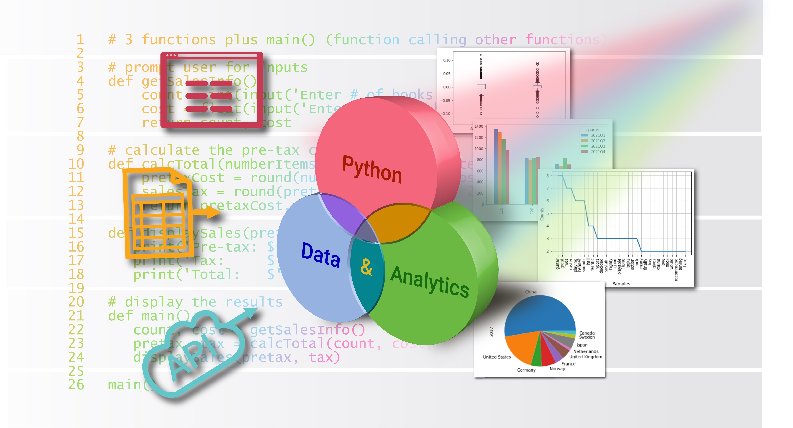
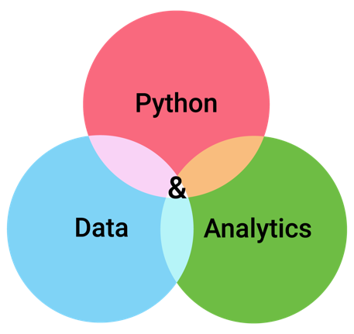


Decisions
Chapter 3
Python for Data & Analytics
A Business-Oriented Approach
© 2023 Rose River Software, LLC

Slide 2
Topics
About Decisions in Programs
Multi-way Decisions
Nested (Sequential) Decisions
More About Decisions

Slide 3
Topics
About Decisions in Programs
The if statement
About the colon and indenting
Comparison operators
Multi-way Decisions
Nested (Sequential) Decisions
More About Decisions

Slide 4
About Decisions in Programs
In chapter 2, example programs have simple flow (top to bottom)
In more involved cases, there may be conditions
Where certain statements may not execute
Referred to as decision structures
There are several variations for handling decisions, in order for your program to select among alternative logic
The Python keywords used for decision structures are:
if
else
elif

Slide 5
About Decisions in Programs the if statement
The primary decision making statement in Python is the if statement
The if statement contains a logical expression
evaluates to True or False
Following the if statement are one or more statements that execute if the logical expression evaluates to True
Pattern is
if logical_expression:
statement(s)
a question
a colon
indented line(s) (indenting is required)

Slide 6
About Decisions in Programs the if statement
A simple if program
Program 3-1
userNumber = float(input('Please enter a number: '))
if userNumber > 0:
print('The value you entered was positive')
Program 3-1 example run
Please enter a number: 10
The value you entered was positive

Slide 7
About Decisions in Programs about the colon and indenting in Python
Note in the previous program
The colon on line 2
Line 3 is indented
Python uses the colon to introduce one or more indented statements
This is used for decisions, and also many other Python statements
If you omit the indenting, Python will give an error:
IndentationError: expected an indented block
Typical Python style uses 3 or 4 spaces for the indenting

Slide 8
About Decisions in Programs comparison operators
The previous program uses the comparison operator >
userNumber > 0
Python's comparison operators:
Operator | Meaning
< | less than
<= | less than or equal to
> | greater than
>= | greater than or equal to
== | equal to
!= | not equal to
Note == as opposed to =

Slide 9
About Decisions in Programs comparison operators
You can use an expression on either side of a comparison operator
Program 3-4
userNumber1 = float(input('Please enter a number: '))
userNumber2 = float(input('Please enter another number: '))
if userNumber1 * userNumber2 > 0:
print('The product of your numbers is positive')
if with expression
Program 3-4 example run
Please enter a number: -3
Please enter another number: -4
The product of your numbers is positive

Slide 10
Topics
About Decisions in Programs
Multi-way Decisions
Two-way decisions: if/else
Three-way decisions: if/elif/else
More decisions: multiple elif
When to include or omit else
Nested (Sequential) Decisions
More About Decisions

Slide 11
Multi-way Decisions two-way decisions: if/else
Another decision pattern involves 2 possible outcomes
If the logical expression is True, one or more statements execute
If it is False, a different set of one or more statements execute
The else keyword is used together with if to handle two-way decisions
if logical_expression:
statement(s)
else:
statement(s)

Slide 12
Multi-way Decisions two-way decisions: if/else
A simple example using if and else
Program 3-5
userNumber = float(input('Please enter a number: '))
if userNumber == 0:
print('The value you entered was zero')
else:
print('The value you entered was not zero')
only one of these print statements will execute
Program 3-5 example run
Please enter a number: -1
The value you entered was not zero

Slide 13

Multi-way Decisions two-way decisions: if/else
Program 3-6
# Calculate the ending balance of a 1-year certificate of deposit (2 rates)
# Prompt for the initial investment
invest = float(input('Please enter investment amount: '))
# Determine the interest rate, depending on the size of the investment
if invest >= 1000:
interestRate = 3.25
else:
interestRate = 3.0
# calculate the ending balance
endBalance = invest * (1 + interestRate/100)
# display the result
print('Interest rate=', interestRate, '%')
print('Ending balance= $', endBalance)
If/else to set interestRate
Please enter investment amount: 1000
Interest rate= 3.25 %
Ending balance= $ 1032.5

Slide 14
Multi-way Decisions two-way decisions: if/else
The statement block below an if or else can have multiple statements
if invest >= 1000:
print('Bonus interest earned on investments of $1,000 or more')
interestRate = 3.25
else:
interestRate = 3.0

Slide 15
Multi-way Decisions two-way decisions: if/else
Spreadsheet Compare/Contrast
In a spreadsheet you can use an if function to allow for choices in a formula. The form of the spreadsheet if function is:
if(logical_expression, true_expression, false_expression)
You can use the if function in a cell, in order to choose between two constants, two equations, or a constant and an equation.
Though Python's if/else structure involves multiple lines of code, Python if/else logic can be easier to see, as compared with an if() function in a spreadsheet cell.

Slide 16
Multi-way Decisions three-way decisions: if/elif/else
To handle 3-way decisions, e.g.,
go straight, turn left, turn right
Python provides elif keyword
in combination with if and else, can model 3-way choices
if logical_expression1:
statement(s)
elif logical_expression2:
statement(s)
else:
statement(s)

Slide 17
Multi-way Decisions three-way decisions: if/elif/else
Program 3-7
userNumber = float(input('Please enter a number: '))
if userNumber > 0:
print('The value you entered was positive')
elif userNumber < 0:
print('The value you entered was negative')
else:
print('The value you entered was zero')
if/elif/else
Please enter a number: -1
The value you entered was negative

Slide 18
Multi-way Decisions three-way decisions: if/elif/else
In previous program
3 outcomes
2 logical conditions
Since else handles everything not covered above it
When if condition is true, related elif condition is not tested
When if condition is false, related elif condition is next tested

Slide 19
Multi-way Decisions three-way decisions: if/elif/else
Program 3-8
# Calculate the ending balance of a 1-year certificate of deposit (3 rates)
# Prompt for the initial investment
invest = float(input('Please enter investment amount: '))
# Determine the interest rate, depending on the size of the investment
if invest >= 10000:
interestRate = 3.5
elif invest >= 1000:
interestRate = 3.25
else:
interestRate = 3.0
# calculate the ending balance
endBalance = invest * (1 + interestRate/100)
# display the result
print('Interest rate=', interestRate, '%')
print('Ending balance= $', endBalance)
if/elif/else to set interestRate
Please enter investment amount: 1000
Interest rate= 3.25 %
Ending balance= $ 1032.5

Slide 20
Multi-way Decisions more decisions: multiple elif
To handle more than 3 choices, can use multiple elif statements
Investment range | Interest rate
less than $1,000 | 3.0%
$1,000 - $4,999 | 3.2%
$5,000 - $9,999 | 3.4%
$10,000 and above | 3.6%
# handle 4 alternative interest rates with multiple elif statements
if invest >= 10000:
interestRate = 3.6
elif invest >= 5000:
interestRate = 3.4
elif invest >= 1000:
interestRate = 3.2
else:
interestRate = 3.0

Slide 21
Multi-way Decisions when to include or omit else
In decision structures, if is always used
Depending on the problem, one or more elif statements can be used
else is useful to handle "none of the above" cases
else ensures that one of a set of related decision blocks is executed

Slide 22
Topics
About Decisions in Programs
Multi-way Decisions
Nested (Sequential) Decisions
More About Decisions

Slide 23
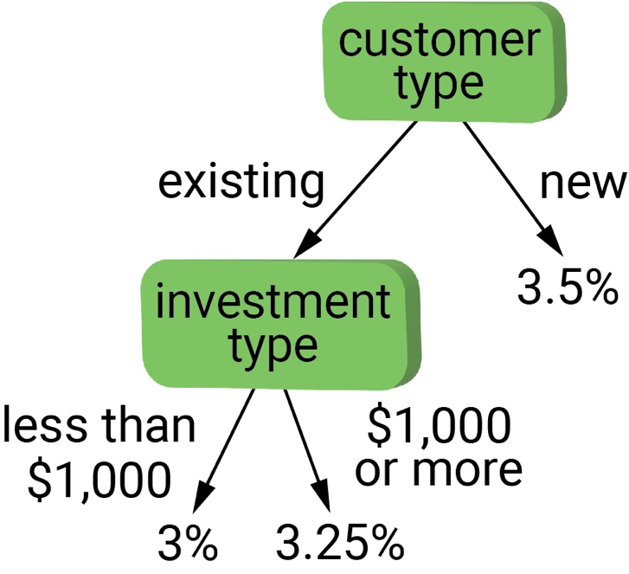
Nested (Sequential) Decisions
There can be more complexity in decision structures
Nested decisions: placing more decision statements within an if, elif, or else.
Example use: primary decision, then secondary decision
Example: investment rates: customer type, investment amount

Slide 24
Nested (Sequential) Decisions
Program 3-9
# Calculate the ending balance of a 1-year certificate of deposit
# Consider new vs existing customers, and 2 rates for existing customers
# Prompt for type of customer
customer = input('Enter n if customer is new, or e for existing: ')
# Prompt for the initial investment
invest = float(input('Please enter investment amount: '))
if customer == 'e':
# Determine the interest rate, depending on the size of the investment
if invest >= 1000:
interestRate = 3.25
else:
interestRate = 3.0
else:
interestRate = 3.5
# Calculate the ending balance
endBalance = invest * (1 + interestRate/100)
# Display the result
print('Interest rate=', interestRate, '%')
print('Ending balance= $', endBalance)
if/else with nesting
Enter n if customer is new, or e for existing: e
Please enter investment amount: 1000
Interest rate= 3.25 %
Ending balance= $ 1032.5

Slide 25
Topics
About Decisions in Programs
Multi-way Decisions
Nested (Sequential) Decisions
More About Decisions
Combining conditions with and, or, not
Comparing strings
Terse if/else

Slide 26
More About Decisions combining conditions with and, or, not
More involved comparisons can use these Python keywords:
and
or
not
For example:
if customer == 'e' and invest >= 1000:
interestRate = 3.25
…

Slide 27
More About Decisions comparing strings
In the prior example…
if customer == 'e':
…compares a string variable with a string constant
Strings can be compared with the same operators that are used to compare numbers
== checks if the sequence of characters match
String comparisons are case sensitive, e.g., 'rate' does not equal 'Rate'
For other comparators (< <= > >=), Python checks alphabetic order
However, all uppercase letters are considered to be before lowercase letters

Slide 28
More About Decisions terse if/else
Simple if/else cases are common, so Python provides a short hand
General format of terse if/else
<true-expression> if <condition> else <false-expression>
Example:
interestRate = 3.25 if (invest >=0) else 3.0

Slide 29
Topic Recap
About Decisions in Programs
The if statement
About the colon and indenting
Comparison operators
Multi-way Decisions
Two-way decisions: if/else
Three-way decisions: if/elif/else
More decisions: multiple elif
When to include or omit else
Nested (Sequential) Decisions
More About Decisions
Combining conditions with and, or, not
Comparing strings
Terse if/else

Slide 30
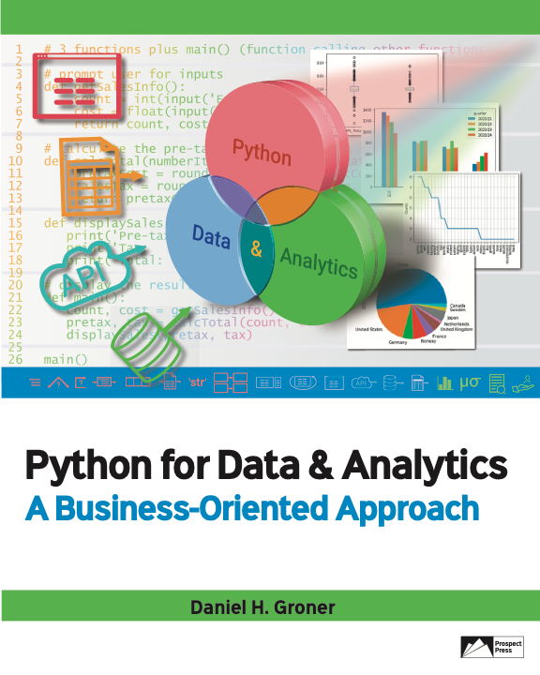
© 2023 Rose River Software, LLC
All rights reserved. This material may not be copied or distributed without permission from Prospect Press

