Slide 1
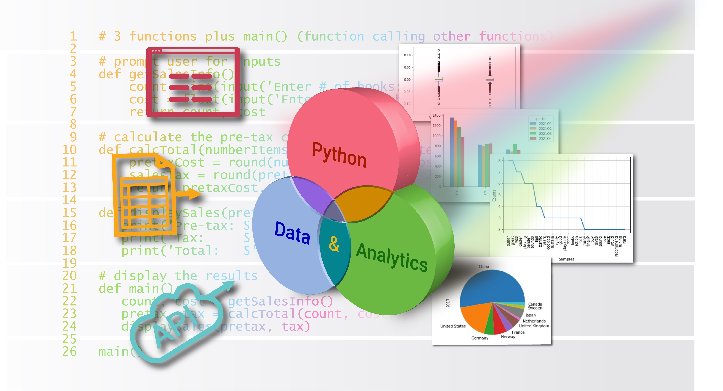
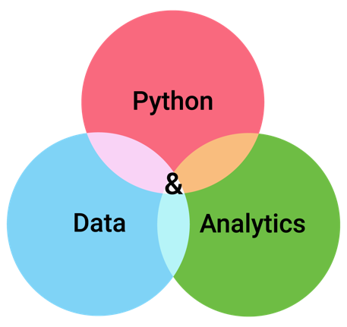


Repetition
Chapter 4
Python for Data & Analytics
A Business-Oriented Approach
© 2023 Rose River Software, LLC

Slide 2
Topics
About Repetition
The while statement
The for statement, with range() function
Using while vs. for
Infinite loops
Adding validation
About break and continue

Slide 3
Topics
About Repetition
The while statement
The for statement, with range() function
Using while vs. for
Infinite loops
Adding validation
About break and continue

Slide 4
About Repetition
Repetition allows statements to execute multiple times
An important and common aspect of programs
Program flow may move to a prior statement
Also referred to as looping
Examples
Process different scenarios
Creating tables
Read and process each line of a datafile
Repetition keywords in Python: while , for

Slide 5
About Repetition
Spreadsheet Compare/Contrast: Repetition vs. Copying Cells
Repetition in programming languages is very different from how spreadsheets handle repeating calculations
In a spreadsheet, you might define a formula to calculate a result for one row, and then copy this down to other rows. In this way, a spreadsheet calculation can be repeated and applied to different cells
In contrast, in Python and other programming languages, the repeatedly used logic is indicated once, and the flow of the program controls the reuse of the logic for different scenarios

Slide 6
Topics
About Repetition
The while statement
Repeating with while
Cumulating
Maximum
Using a specific control variable
Using a special value
Repeating with start, increment, end
Conditions recap
The for statement, with range() function
Using while vs. for
Infinite loops
Adding validation
About break and continue

Slide 7
The while statement repeating with while
The while keyword is used in this pattern:
initializing statement(s)
while logical_condition:
loop body (i.e., repeating statement(s)
change statements(s)
Statements indented below while are repeated as long as the logical condition is True

Slide 8

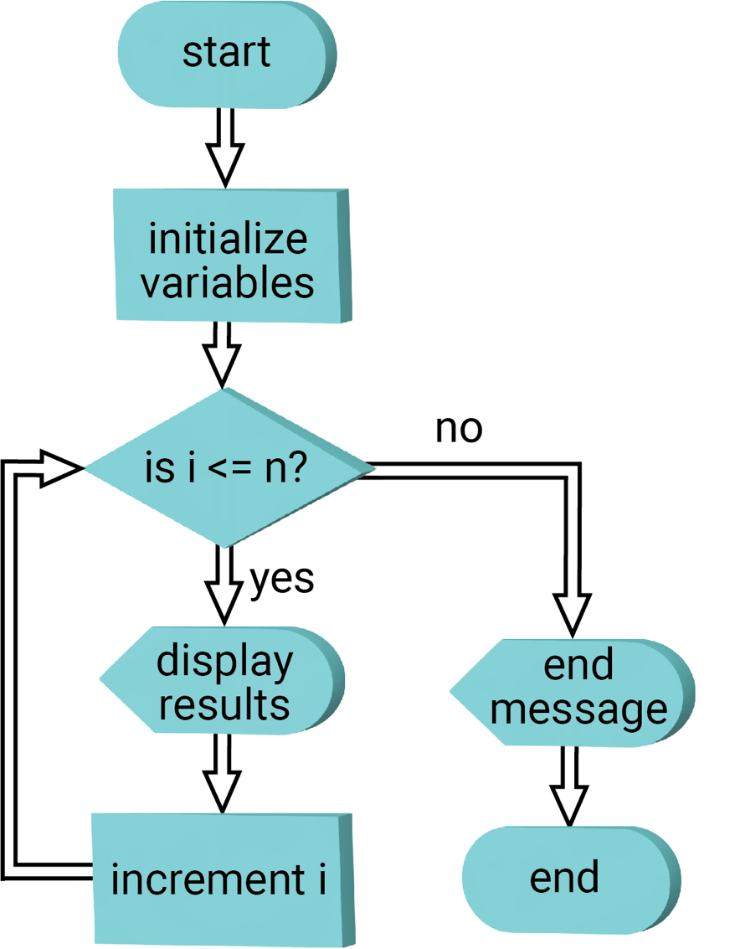
The while statement repeating with while
Program 4-1
# Using while repetition, generate a table of squares and cubes
#initialization
i = 1 # starting value for the table
n = 5 # ending value for the table
# using repetition, generate the table
while i <= n: # condition
# calculation and display
print(i, i**2, i**3)
# change value before restarting loop
i = i + 1
print('Program ends')
While checks condition, if true then repeats block below
1 1 1
2 4 8
3 9 27
4 16 64
5 25 125
Program ends

Slide 9
The while statement cumulating
Program 4-2
# Cumulate a set of user-entered numbers
# Initialize values before repetition
count = 0 # number of values entered by user
total = 0 # keep track of the running total of user-entered values
# repetition to prompt for and cumulate total
value = float(input('Enter a value: ')) # prompt for the first value
while value != 0:
total = total + value # keep a running total
count = count + 1 # keep track of number of values entered
value = float(input('Enter a value (or 0 to end): ')) # prompt for values
# Output results
print()
print('Number of values:', count)
print('Total of values:', total)
variable total cumulates user-entered values
Enter a value: 10
Enter a value (or 0 to end): 30
Enter a value (or 0 to end): 25
Enter a value (or 0 to end): 0
Number of values: 3
Total of values: 65.0

Slide 10
The while statement maximum
Program 4-3
# Find the maximum of a set of user-entered numbers
# repetition to prompt for values and track largest
value = float(input('Enter an initial value: ')) # prompt for the first value
largest = value
while value != 0:
if value > largest: # is latest entry larger than the largest so far?
largest = value # if so, track this as the new largest value
print('New largest value:', largest)
# prompt for subsequent values
value = float(input('Enter another value (or 0 to end): '))
# Output result
print('\nLargest value:', largest)
variable largest keeps track of maximum of user-entered values
Enter an initial value: 10
Enter another value (or 0 to end): 30
New largest value: 30.0
Enter another value (or 0 to end): 25
Enter another value (or 0 to end): 0
Largest value: 30.0

Slide 11
The while statement using a specific control variable
Program 4-4
# Using while repetition and a control variable,
# generate a table of weights and BMIs
height = float(input('Enter height (inches): '))
anotherWeight = 'y' # this is the control variable, for looping
while anotherWeight == 'y':
weight = float(input('\nEnter weight (pounds): '))
bmi = weight / height**2 * 703
print('BMI = ', round(bmi, 1))
anotherWeight = input('Enter another weight (y/n)? ')
variable anotherweight is a control variable
Enter height (inches): 68
Enter weight (pounds): 150
BMI = 22.8
Enter another weight (y/n)? y
Enter weight (pounds): 145
BMI = 22.0
Enter another weight (y/n)? n

Slide 12
The while statement using a specific control variable
Program 4-5
# Using while repetition and a bool control variable,
# generate a table of weights and BMIs
height = float(input('Enter height (inches): '))
anotherWeight = True # this is the control variable, for looping
while anotherWeight:
weight = float(input('\nEnter weight (pounds): '))
bmi = weight / height**2 * 703
print('BMI = ', round(bmi, 1))
reply = input('Enter another weight (y/n)? ')
anotherWeight = (reply == 'y')
variable anotherweight is a control variable
Enter height (inches): 68
Enter weight (pounds): 150
BMI = 22.8
Enter another weight (y/n)? y
Enter weight (pounds): 145
BMI = 22.0
Enter another weight (y/n)? n

Slide 13
The while statement using a special value
Program 4-6
# Using while repetition and special end value,
# generate a table of weights and BMIs
# get input height (common for all calculations)
height = float(input('Enter height (inches): '))
# get initial weight to calculate with
weight = float(input('Enter weight (pounds): '))
# repeat calculating as long as entered weight is non-zero
while weight != 0:
bmi = weight / height**2 * 703
print('BMI = ', round(bmi, 1))
weight = float(input('\nEnter weight goal (or 0 to end): '))
Enter height (inches): 68
Enter weight (pounds): 150
BMI = 22.8
Enter weight goal (or 0 to end): 145
BMI = 22.0
Enter weight goal (or 0 to end): 0
0 is a special end value for weight

Slide 14
The while statement repeating with start, increment, end
Program 4-7
# Using while repetition, generate a table of
# CD interest rates and interest earned
invest = float(input('Enter initial investment ($): '))
years = int(input('Enter years: '))
rateMin = float(input('Minimum rate: '))
rateMax = float(input('Maximum rate: '))
rateIncr = float(input('Increment rate: '))
# print the header rows for the table
print()
print('Interest', 'Interest')
print(' Rate', ' Earned')
# generate a table of interest rates and corresponding interest earned
rate = rateMin # the initial rate for the table
while rate <= rateMax:
endBalance = invest * (1 + rate/100) ** years
interest = endBalance - invest
print(format(rate,'8.3f'), format(interest, '8,.2f'))
rate += rateIncr # the next rate
Start, increment, and end values are defined
Enter initial investment ($): 1000
Enter years: 3
Minimum rate: 2
Maximum rate: 3
Increment rate: .25
Interest Interest
Rate Earned
2.000 61.21
2.250 69.03
2.500 76.89
2.750 84.79
3.000 92.73

Slide 15
The while statement conditions recap
The types of conditions that are used with while are the same as those that can be used with if
Operator | Meaning
< | less than
<= | less than or equal to
> | greater than
>= | greater than or equal to
== | equal to
!= | not equal to
Operator | Meaning
and | True if both statements are True
or | True if either statement in True
not | reverses the True/False result

Slide 16
Topics
About Repetition
The while statement
The for statement, with range() function
for with range(start, end)
range(count)
range(start, end, skip)
Using while vs. for
Infinite loops
Adding validation
About break and continue

Slide 17
The for statement, with range() function
Like while, the for statement can be used to achieve repetition
for works with a sequence of things, e.g.,
integers
lines in a file
records in a database
The range() function is used together with for, to work with a sequence of integers

Slide 18
The for statement, with range() function for with range(start, end)
Example use of range():
range(1, 6) generates the integers 1, 2, 3, 4, 5
range() generates the integers up to, but not including, the second argument
range() can be used as part of a for statement
Program 4-8
# Using for repetition, generate a table of squares and cubes
n = 5 # number of rows in the table
# using for with range(), generate the table
for i in range(1, n+1):
print(i, i**2, i**3)
1 1 1
2 4 8
3 9 27
4 16 64
5 25 125
for used with range()

Slide 19
The for statement, with range() function for with range(start, end)
Program 4-9
# Using for repetition, generate table of
# annual CD balances and interest
# get input parameters for the CD
initial = int(input('Initial investment ($): '))
years = int(input('Number of years: '))
interestRate = float(input('Interest rate (%): '))
# set up variables used in the loop
balance = initial
interestRateDecimal = interestRate / 100
print('\nyear', ' start', 'interest', ' end') # header for table
# for each year, calculate and display balances and interest earned
for year in range(1, years+1):
interestEarned = int(balance * interestRateDecimal) # round down
end = balance + interestEarned
print(format(year,'4d'), format(balance, '8,d'),
format(interestEarned, '8,d'), format(end, '8,d'))
balance = end # roll over balance from year end to next year start
for used with range(start, end)
Initial investment ($): 1000
Number of years: 3
Interest rate (%): 5
year start interest end
1 1,000 50 1,050
2 1,050 52 1,102
3 1,102 55 1,157

Slide 20
The for statement, with range() function range(count)
If range() is given 1 argument as range(count), it generates the integers from 0 to count-1
Program 4-10
# Using for repetition, prompt for weights and calculate several BMIs
# height is an input common to all calculations, so outside the loop
height = float(input('Enter height (inches): '))
# n will be the number of times the loop executes
n = int(input('Number of BMIs to calculate: '))
for i in range(n): # control the number of times the loop executes
weight = float(input('\nEnter weight (pounds): '))
bmi = weight / height**2 * 703
print('BMI = ', round(bmi, 1))
Enter height (inches): 68
Number of BMIs to calculate: 3
Enter weight (pounds): 150
BMI = 22.8
Enter weight (pounds): 145
BMI = 22.0
Enter weight (pounds): 140
BMI = 21.3
for used with range()

Slide 21
The for statement, with range() function range(start, end, skip)
If range() is given 3 arguments, it uses the last argument to skip between the generated integers, e.g., range(1, 6, 2) generates 1, 3, 5
Program 4-11
# Using for repetition, generate a table of weights and calculated BMIS
# height is an input common to all calculations, so get outside the loop
height = float(input('Enter height (inches): '))
# These variables control the beginning, steps, and end of the table
weightMin = int(input('Minimum weight: '))
weightMax = int(input('Maximum weight: '))
weightIncr = int(input('Increment weight: '))
print() # print a blank line
print('Weight', 'BMI') # heading for table
# use for statement to generate a table, using 3-part range()
for weight in range(weightMin, weightMax+1, weightIncr):
bmi = weight / height**2 * 703
print(weight, ' ', round(bmi, 1))
Enter height (inches): 68
Minimum weight: 140
Maximum weight: 150
Increment weight: 2
Weight BMI
140 21.3
142 21.6
144 21.9
146 22.2
148 22.5
150 22.8
for used with range()

Slide 22
Topics
About Repetition
The while statement
The for statement, with range() function
Using while vs. for
Infinite loops
Adding validation
About break and continue

Slide 23
Using while vs. for
In some cases, repetition can be written either with while or for
In general for is more concise
for combines: initial condition, repeating test, variable change
In cases where number of repetitions is not known during execution
while is appropriate
Example: user input – see example programs 4-5, 4-6

Slide 24
Topics
About Repetition
The while statement
The for statement, with range() function
Using while vs. for
Infinite loops
Adding validation
About break and continue

Slide 25
Infinite loops
Programs with repetition are usually designed to stop at some point
A program that incorrectly keeps repeating is referred to as having an infinite loop
to correct: add statement that updates the variable checked in repetition
Program 4-12
# This program demonstrates an infinite loop error
#initialization
i = 1 # starting value for the table
n = 5 # ending value for the table
# using repetition, generate the table
while i <= n: # condition will always be true
# calculation and display
print(i, i**2, i**3)
# missing statement below here should increment variable i
# instead, i is stuck at 1
Correction: add the statement
i = i + 1

Slide 26
Topics
About Repetition
The while statement
The for statement, with range() function
Using while vs. for
Infinite loops
Adding validation
About break and continue

Slide 27
Adding validation
Program 4-13
# Using while repetition and control variable,
# generate a table of weights and BMIs
# Check that weight is > 0
height = float(input('Enter height (inches): '))
keepGoing = 'y' # this is the control variable, for looping
while keepGoing == 'y':
weight = float(input('\nEnter weight (pounds): '))
if weight > 0:
bmi = weight / height**2 * 703
print('BMI = ', round(bmi, 1))
else:
print('Error, weight must be positive')
keepGoing = input('Enter another weight (y/n)? ')
Enter height (inches): 68
Enter weight (pounds): 0
Error, weight must be positive
Enter another weight (y/n)? y
Enter weight (pounds): 145
BMI = 22.0
Enter another weight (y/n)? n
Validation with if/else

Slide 28
Topics
About Repetition
The while statement
The for statement, with range() function
Using while vs. for
Infinite loops
Adding validation
About break and continue

Slide 29
About break and continue
break and continue statements interrupt the usual repetition flow
break causes the body of repetition to stop
Execution continues at statement after repetition (indented) block
Because break causes a jump in flow, try to avoid using it

Slide 30
About break and continue
Program 4-16
# Using while repetition and special end value, generate BMI scenarios
# includes use of break statement to end looping
# get input height (common for all calculations)
height = float(input('Enter height (inches): '))
# get initial weight to calculate with
weight = float(input('Enter weight (pounds): '))
# repeat calculating as long as entered weight is non-zero
while True:
if weight == 0:
break
bmi = weight / height**2 * 703
print('BMI = ', round(bmi, 1))
weight = float(input('\nEnter weight goal (or 0 to end): '))
print('Program ends')
Enter height (inches): 68
Enter weight (pounds): 150
BMI = 22.8
Enter weight goal (or 0 to end): 140
BMI = 21.3
Enter weight goal (or 0 to end): 0
Program ends
Validation with break

Slide 31
About break and continue
continue causes the flow to jump back to the while or for
i.e., continue indicates to stop processing the rest of the repetition block, and proceed to the next iteration of the loop (if there is one)
An example use: validating one or more variable values
See next slide for example

Slide 32
About break and continue
Program 4-17
# Using while repetition, generate scenarios for weights and BMIs
# includes use of continue statement for invalid weight
# get input height
height = float(input('Enter height (inches): '))
# repeat calculating as long as entered weight is non-zero
weight = -1 # initialize weight so at least 1 repetition executes
while weight != 0:
weight = float(input('Enter weight (pounds), or 0 to end: '))
if weight < 0:
print('Error, weight must be positive')
continue
elif weight > 0:
bmi = weight / height**2 * 703
print('BMI = ', round(bmi, 1))
Enter height (inches): 68
Enter weight (pounds), or 0 to end: -150
Error, weight must be positive
Enter weight (pounds), or 0 to end: 150
BMI = 22.8
Enter weight (pounds), or 0 to end: 0
Validation with continue

Slide 33
Topic Recap
About Repetition
The while statement
The for statement, with range() function
Using while vs. for
Infinite loops
Adding validation
About break and continue

Slide 34
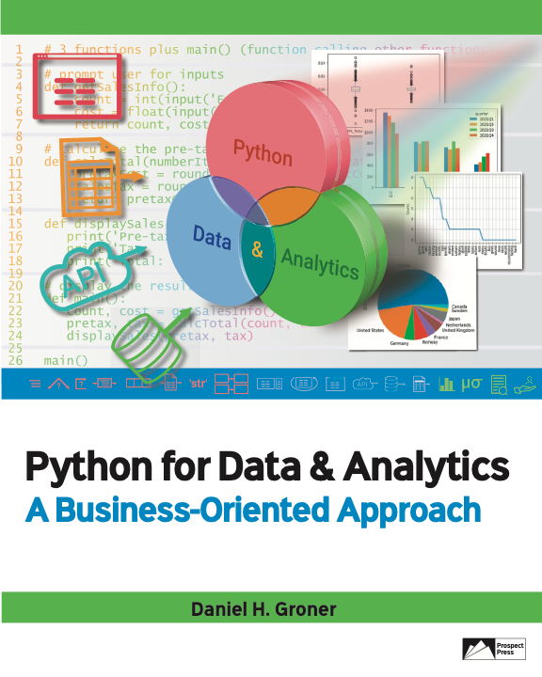
© 2023 Rose River Software, LLC
All rights reserved. This material may not be copied or distributed without permission from Prospect Press

