Slide 1
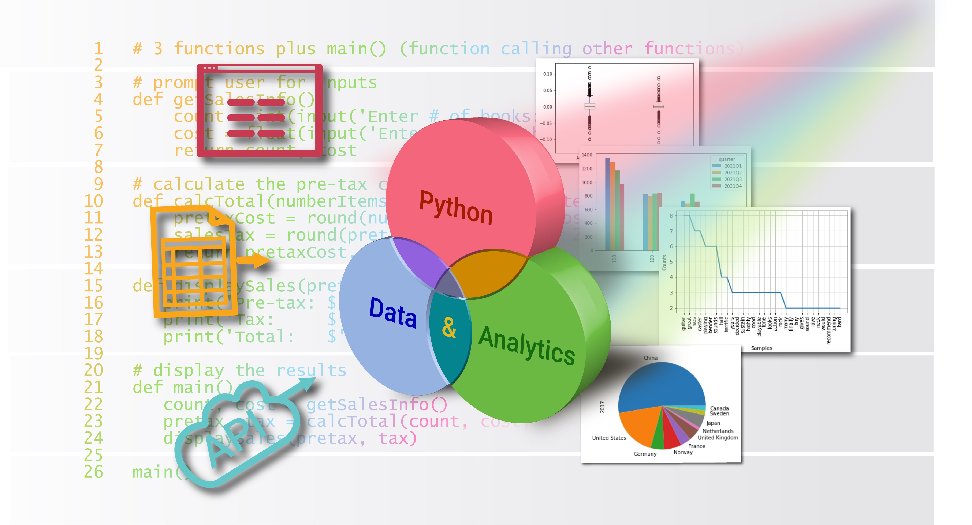
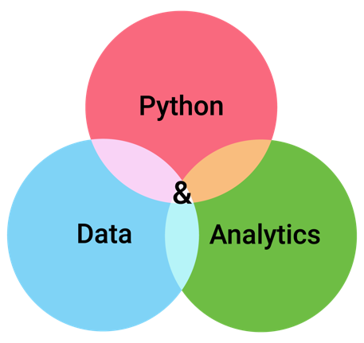
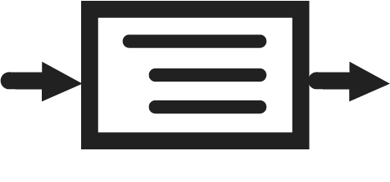

Defining Functions
Chapter 5
Python for Data & Analytics
A Business-Oriented Approach
© 2023 Rose River Software, LLC

Slide 2
Topics
Introduction to Functions
Multiple parameters
More function features
Functions and the console: input and output
A function calling another function
Some further design points for functions
Combining concepts: functions and decisions

Slide 3
Topics
Introduction to Functions
About functions
Defining your own functions
A function that returns a result
Multiple parameters
More function features
Functions and the console: input and output
A function calling another function
Some further design points for functions
Combining concepts: functions and decisions

Slide 4
Introduction to Functions About functions
Python provides built-in functions that can be used "off-the-shelf"
We've seen several examples: print(), input(), round(), others
You can also define your own functions
Functions help you organize your programs
Analogy: like paragraphs are used to organize an essay
Functions…
often accept one or more inputs
based on the inputs, perform processing
provide one or more outputs (the returned result)
The above 3 aspects correspond to the IPO (input/processing/output) model

Slide 5
Introduction to functions About functions
Looking more closely at built-in function float()
Input: Takes one input argument (inside its parentheses)
Processing: float() tries to convert the input into a number
Output: float() returns a float result
if it can convert the result into a number
Error: float() may generate an error (a Python Exception)
if it cannot convert the input into a number

Slide 6
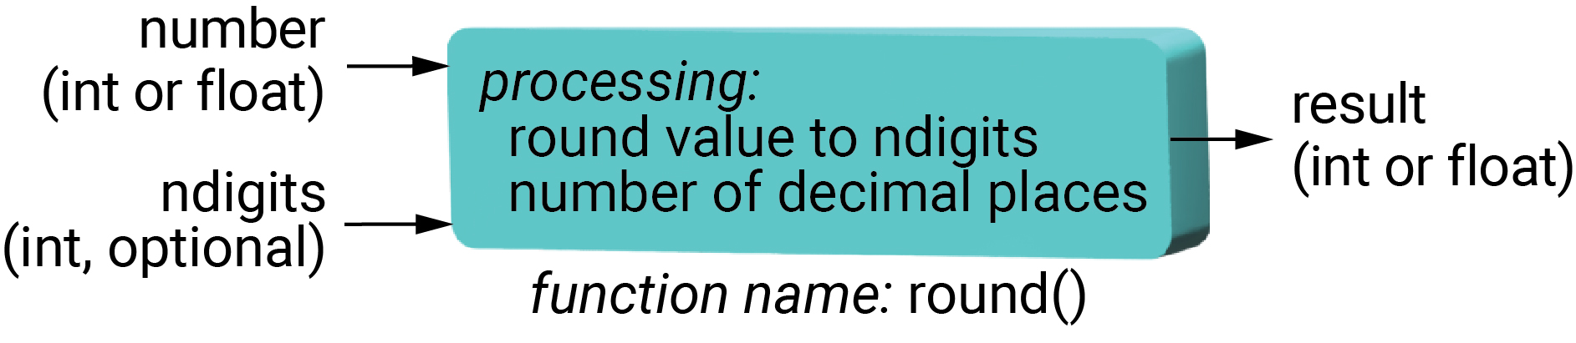
Introduction to functions About functions
Looking more closely at the built-in function round()
Input: takes one or two arguments (a number, and optionally an integer)
Processing: determine the number rounded to requested # of decimal places
Output: a rounded number

Slide 7
Introduction to functions Defining your own functions
You can write your own function; decide on:
Name of your function
Your function's input parameter(s)
These are variables – need to choose names and valid types
What processing the function will do
What error conditions may be hit, and how to handle them
What result your function will return, i.e., the answer
Terminology: input argument vs. input parameter
When you define a function, its inputs are referred to input parameters
When you use the function, what is placed within the parentheses are referred to as input arguments

Slide 8
Introduction to functions Defining your own functions
A first function: greeting
Specification
Name of function: hello
Functions have a name that allows the program to find and use the function
Input: one input parameter, a variable called nameParameter
This variable will contain the name of the person we are displaying a greeting to
Processing: display the message 'Hello, ' and the value in nameParameter
Output: there is nothing the function will return to the calling statement

Slide 9
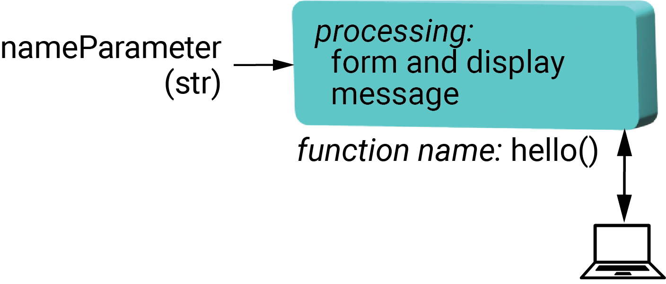

Introduction to functions Defining your own functions
The greeting function as described on the prior slide is defined and used below
Program 5-1
# define and use a function to display a greeting
# the hello() function has 1 parameter: 'nameParameter'
def hello(nameParameter):
print('Hello,', nameParameter, '!')
name = input('Please enter your name: ')
hello(name) # call the function with the argument 'name'
function's signature
function's body
Please enter your name: Stefanie
Hello, Stefanie !
calling the function

Slide 10
Introduction to functions Defining your own functions
Spreadsheet Compare/Contrast: Spreadsheet functions
Spreadsheets provide many built-in functions that, like Python functions, can take input arguments and provide a result
Python also provides built-in functions, some of which are covered in chapter 2
However, in contrast with spreadsheets, Python provides a straightforward way to define your own functions within your code

Slide 11
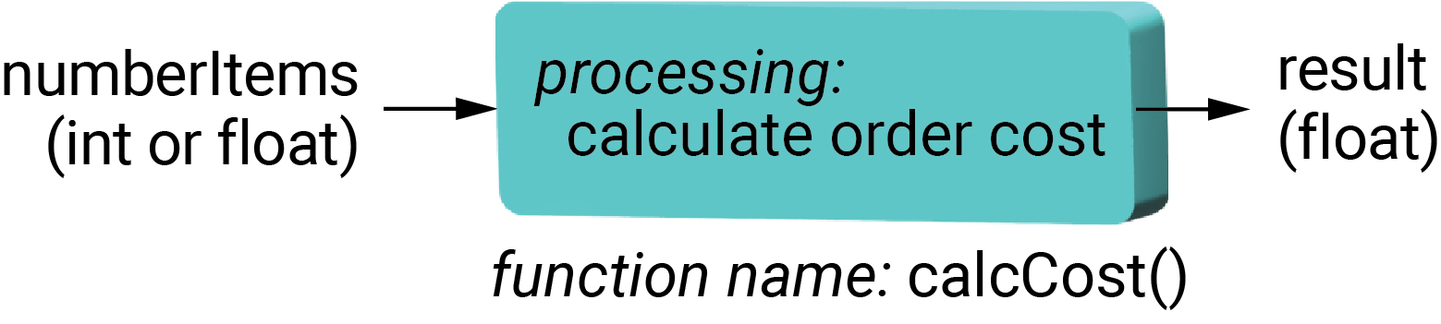
Introduction to functions A function that returns a result
The return statement returns a result
Program 5-2
# one input, one output (assumes all books are $17.50)
# define the function
def calcCost(numberItems):
totalCost = 17.50 * numberItems
return totalCost
# input
count = int(input('Enter # of books: '))
# processing - call the function
total = calcCost(count)
# output
print('Total: $', total)
The return statement provides the function's output result to the calling statement
This is the calling statement
Enter # of books: 5
Total: $ 87.5

Slide 12
Topics
Introduction to Functions
Multiple parameters
About argument types
Constants as arguments
More function features
Functions and the console: input and output
A function calling another function
Some further design points for functions
Combining concepts: functions and decisions

Slide 13
Multiple Parameters
Functions can have multiple input parameters
round() is an example
The variable names in the function signature are separated by commas
When calling a function with multiple parameters, the order of the input arguments must match the order of the input parameters

Slide 14
Multiple Parameters
Program 5-3
# two inputs, one output
# define the function
def calcTotal(numberItems, unitCost):
totalCost = numberItems * unitCost
return totalCost
# get inputs
count = int(input('Enter # of books: '))
cost = float(input('Enter cost per book ($): '))
# processing - call the function
total = calcTotal(count, cost)
# display the result
print('Total: $', total)
When a function is called, the arguments are passed to the function's parameters
Enter # of books: 10
Enter cost per book ($): 20.50
Total: $ 205.0

Slide 15
Multiple Parameters Constants as arguments
Program 5-4
# 3 inputs (1 passed as constant)
def calcTotal(numberItems, unitCost, taxRate):
pretaxCost = numberItems * unitCost
aftertaxCost = pretaxCost * (1 + taxRate)
return aftertaxCost
# get inputs
count = int(input('Enter # of books: '))
cost = float(input('Enter cost per book ($): '))
# processing - call the function
total = calcTotal(count, cost, .075)
# display the result
print('Total: $', total)
The last argument is a constant (alternatively could be a variable or expression)
Enter # of books: 10
Enter cost per book ($): 17.50
Total: $ 188.125

Slide 16
Topics
Introduction to Functions
Multiple parameters
More function features
Named optional parameters
Multiple returned results
Functions and the console: input and output
A function calling another function
Some further design points for functions
Combining concepts: functions and decisions

Slide 17
More function features Named optional parameters
For functions where there is a good default for an input, but you want to allow flexibility to override this default, named optional parameters can be used
Named optional parameters are included in the function signature:
As: paramName=defaultValue
After the required parameters

Slide 18
More function features Named optional parameters
Program 5-5
named parameter with default value of 2
# named parameter
# define the function, including a named argument
def calcTotal(numberItems, unitCost, taxRate, decimals=2):
pretaxCost = round(numberItems * unitCost, decimals)
aftertaxCost = round(pretaxCost * (1 + taxRate), 2)
return aftertaxCost
# inputs
count = int(input('Enter # of books: '))
cost = float(input('Enter cost per book ($): '))
# processing – call the functions
total = calcTotal(count, cost, .075, decimals=0)
# output
print('Total: $', total)
argument of 0 provided to override named parameter's default value of 2
Enter # of books: 10
Enter cost per book ($): 17.50
Total: $ 188.12

Slide 19
More function features Multiple returned results
A well-designed function should have a clear output
In many cases the output is a single value (e.g., number or string)
In some cases, it may be multiple values
Python offers a simple way to return multiple results from a function
The return statement includes comma-separated items
The calling statement can receive these into comma-separated variables

Slide 20
More function features Multiple returned results
Program 5-6
# return 2 values from a function
# define the function
def calcTotal(numberItems, unitCost, taxRate):
pretaxCost = round(numberItems * unitCost, 2)
salesTax = round(pretaxCost * taxRate, 2)
return pretaxCost, salesTax # return 2 results to the caller
# inputs
count = int(input('Enter # of books: '))
cost = float(input('Enter cost per book ($): '))
# call the function, receiving two results on the left hand side
pretax, tax = calcTotal(count, cost, .075)
# output
print('Pre-tax: $', pretax)
print('Tax: $', tax)
print('Total: $', pretax+tax)
returns 2 values
Enter # of books: 10
Enter cost per book ($): 17.50
Pre-tax: $ 175.0
Tax: $ 13.12
Total: $ 188.12
two values returned and received

Slide 21
Topics
Introduction to Functions
Multiple parameters
More function features
Functions and the console: input and output
Functions for displaying output
Functions for getting input
A function calling another function
Some further design points for functions
Combining concepts: functions and decisions

Slide 22
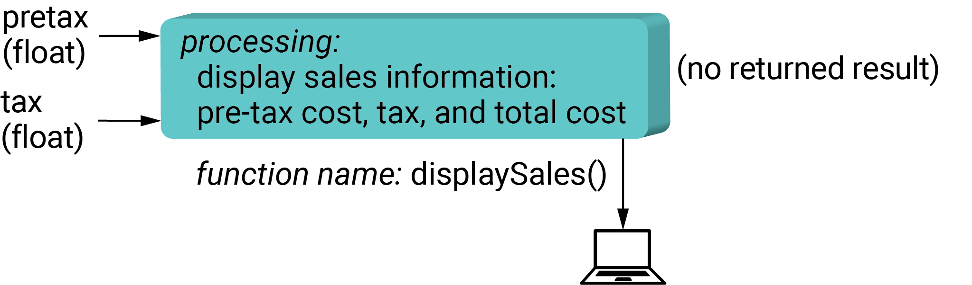
Functions and the console Functions for displaying output
Program 5-7
# 2 functions (including a display function)
# calculate the pre-tax cost and tax
def calcTotal(numberItems, unitCost, taxRate):
pretaxCost = round(numberItems * unitCost, 2)
salesTax = round(pretaxCost * taxRate, 2)
return pretaxCost, salesTax
# display the results
def displaySales(pretax, tax):
print('Pre-tax: $', pretax)
print('Tax: $', tax)
print('Total: $', pretax+tax)
return
# inputs
count = int(input('Enter # of books: '))
cost = float(input('Enter cost per book ($): '))
# processing
pretax, tax = calcTotal(count, cost, .075)
# output
displaySales(pretax, tax)
implicitly returns the special value None
Enter # of books: 10
Enter cost per book ($): 17.50
Pre-tax: $ 175.0
Tax: $ 13.12
Total: $ 188.12

Slide 23
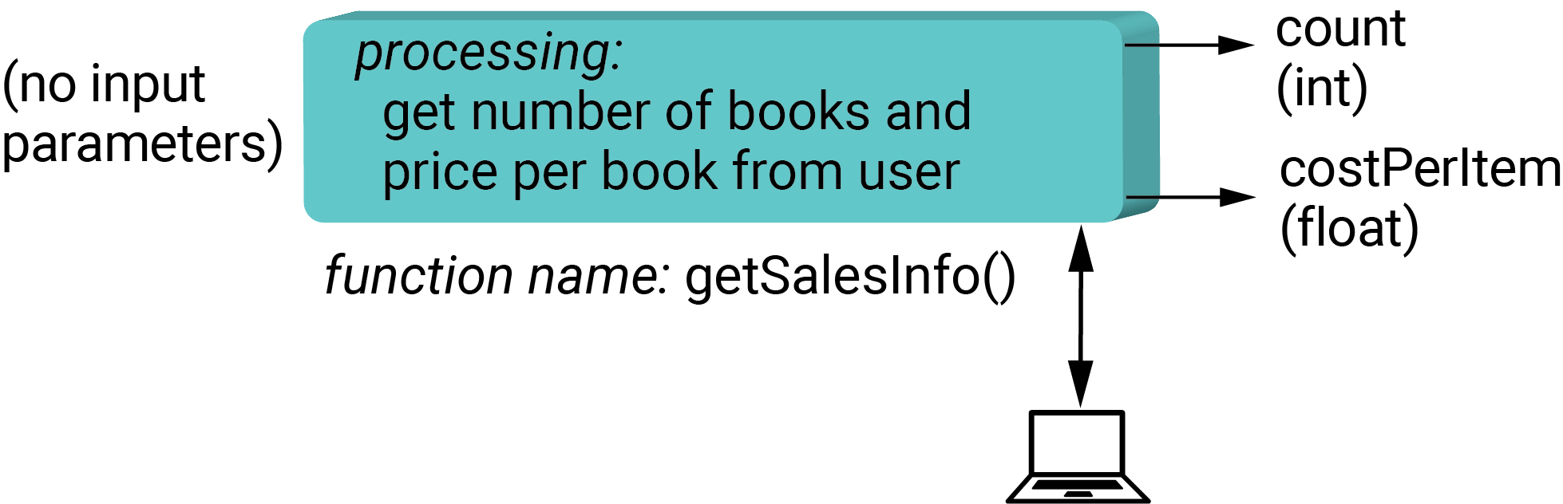
Functions and the console Functions for getting input
Program 5-8
# 3 functions (including an input function w/ no parameters)
# prompt user for inputs
def getSalesInfo():
count = int(input('Enter # of books: '))
costPerItem = float(input('Enter cost per book ($): '))
return count, costPerItem
# calculate the pre-tax cost and tax
def calcTotal(numberItems, unitCost, taxRate):
pretaxCost = round(numberItems * unitCost, 2)
salesTax = round(pretaxCost * taxRate, 2)
return pretaxCost, salesTax
# display the results
def displaySales(pretax, tax):
print('Pre-tax: $', pretax)
print('Tax: $', tax)
print('Total: $', pretax+tax)
# input, processing, output
count, costPerBook = getSalesInfo()
pretax, tax = calcTotal(count, costPerBook, .075)
displaySales(pretax, tax)
function gets input and returns 2 values
Enter # of books: 10
Enter cost per book ($): 17.50
Pre-tax: $ 175.0
Tax: $ 13.12
Total: $ 188.12

Slide 24
Topics
Introduction to Functions
Multiple parameters
More function features
Functions and the console: input and output
A function calling another function
Some further design points for functions
Combining concepts: functions and decisions

Slide 25
A function calling another function
Program 5-9
# 3 functions plus main() (function calling other functions)
# prompt user for inputs
def getSalesInfo():
count = int(input('Enter # of books: '))
cost = float(input('Enter cost per book ($): '))
return count, cost
# calculate the pre-tax cost and tax
def calcTotal(numberItems, unitCost, taxRate):
pretaxCost = round(numberItems * unitCost, 2)
salesTax = round(pretaxCost * taxRate, 2)
return pretaxCost, salesTax
def displaySales(pretax, tax):
print('Pre-tax: $', pretax)
print('Tax: $', tax)
print('Total: $', pretax+tax)
# display the results
def main():
count, cost = getSalesInfo()
pretax, tax = calcTotal(count, cost, .075)
displaySales(pretax, tax)
main()
main() function calls 3 other functions
Enter # of books: 10
Enter cost per book ($): 17.50
Pre-tax: $ 175.0
Tax: $ 13.12
Total: $ 188.12

Slide 26
Topics
Introduction to Functions
Multiple parameters
More function features
Functions and the console: input and output
A function calling another function
Some further design points for functions
Function design
Functions and local vs. global variables
Combining concepts: functions and decisions

Slide 27
Some further design points for functions Function design
What functions you write is part of your program's design
Each function should do a well-defined task
and have well-defined input and output
Regarding a function's size (e.g., number of statements),
A function with one statement could be useful
A function with more lines than a display can be harder to understand
Though larger functions are not uncommon
If a function seems "too large", you can break into into two or more functions

Slide 28
Some further design points for functions Functions and local vs. global variables
A global variable is one that is not defined in a particular function
A local variable is defined in a particular function
Ideally a function does not refer to a global variable
In this way, the function is self-contained and more reusable

Slide 29
Topics
Introduction to Functions
Multiple parameters
More function features
Functions and the console: input and output
A function calling another function
Some further design points for functions
Combining concepts: functions and decisions

Slide 30
Combining concepts: functions and decisions
Program 5-9
# use if within a function
# define the function
def calcTotal(numberItems, unitCost, taxRate):
if numberItems < 10:
discountFactor = 1.0
else: # discount of 10% off for 10 or more items
discountFactor = .90
pretaxCost = round(numberItems * unitCost * discountFactor, 2)
salesTax = round(pretaxCost * taxRate, 2)
return pretaxCost, salesTax # return 2 results to the caller
# inputs
count = int(input('Enter # of books: '))
cost = float(input('Enter cost per book ($): '))
# call the function, receiving two results on the left hand side
pretax, tax = calcTotal(count, cost, .075)
# output
print('Pre-tax: $', pretax)
print('Tax: $', tax)
print('Total: $', pretax+tax)
decision structure within a function
Enter # of books: 10
Enter cost per book ($): 17.50
Pre-tax: $ 157.5
Tax: $ 11.81
Total: $ 169.31

Slide 31
Topic Recap
Introduction to Functions
Multiple parameters
More function features
Functions and the console: input and output
A function calling another function
Some further design points for functions
Combining concepts: functions and decisions

Slide 32
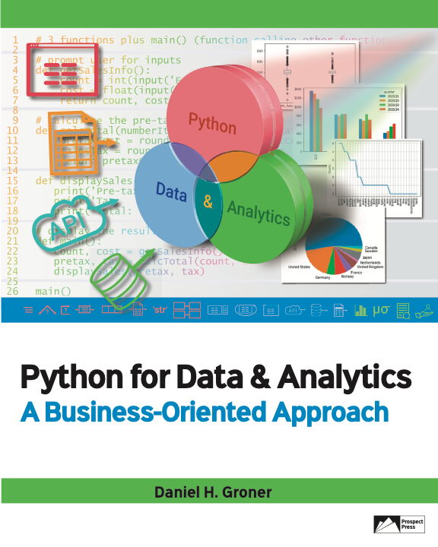
© 2023 Rose River Software, LLC
All rights reserved. This material may not be copied or distributed without permission from Prospect Press

