Slide 1

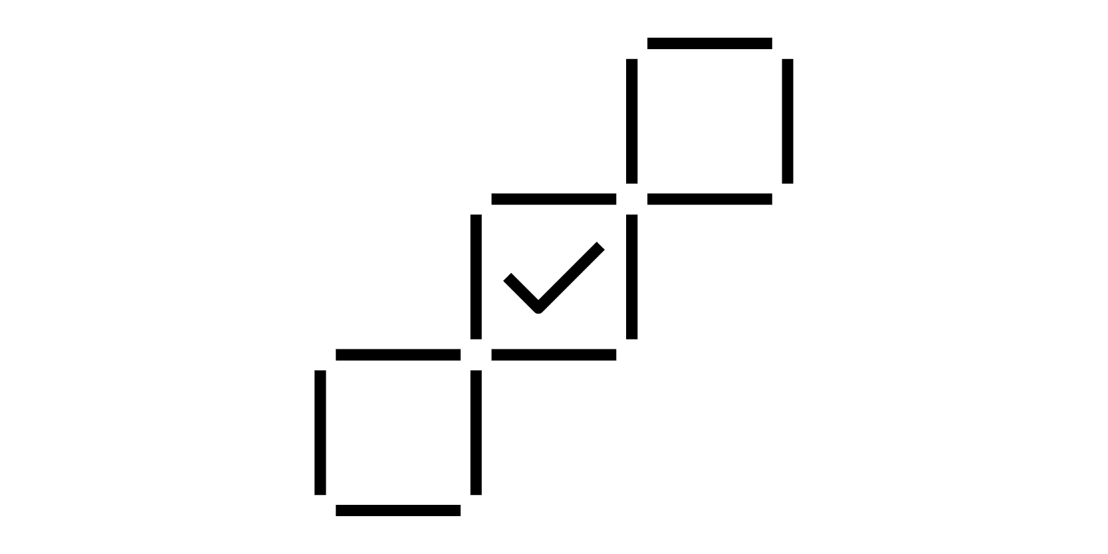
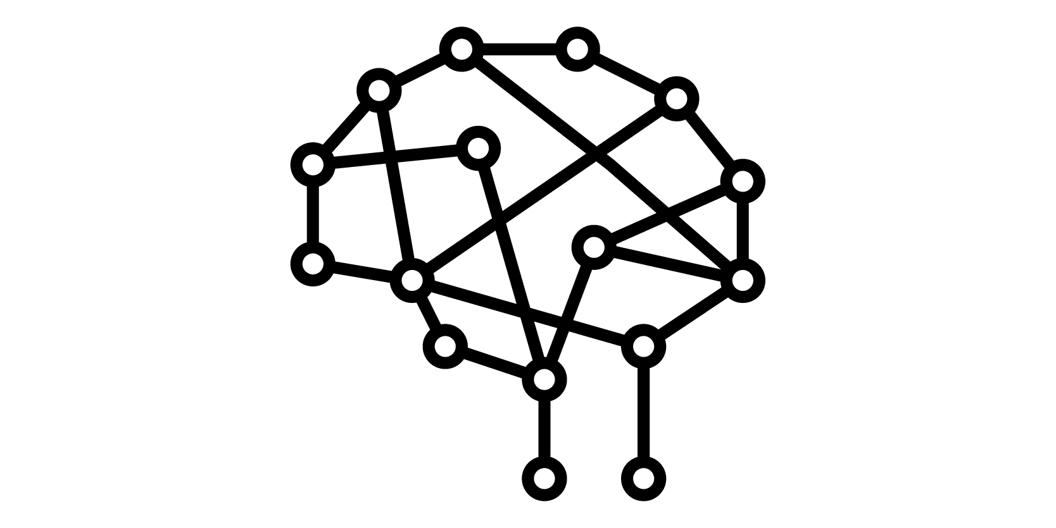
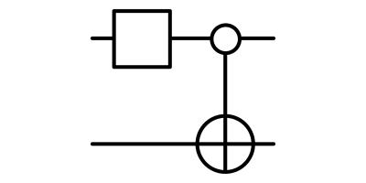
Project Idea - Quantum Othello with Q-Reinforcement Learning
Games are an interesting test bed for artificial intelligence research, as they provide a self-contained environment with fixed rules. DeepBlue, Watson and AlphaGo are only a few examples of algorithms that were put through their paces in games before applying them to different problems.
Othello is a perfect information, zero-sum, two-player strategy game played on an 8x8 board, and has already been used in classical artificial intelligence research. The board stages are highly volatile, each new move can change a large area of the board. Despite its simple rules, the game of Othello is not trivial, containing of approximately ${10}^{28}$ legal positions. The game tree itself has approximately ${10}^{58}$ nodes.
We propose the implementation of a Quantum Othello game using quantum computing together with classical machine learning techniques to create a (self-improving) computer opponent players can compete against.
Othello is also seen as a Markov Decision Problem in reinforcement learning. In addition, the mixed application of Convolutional Neural Networks result in a better accuracy predicting moves.
The Quantum opponent creates winning strategies using a Variational Quantum Circuit for Deep Reinforcement Learning. The implementation will utilise PyTorch to train a Deep Q-Learning neural network with a Quantum Computing based hidden layer.

Slide 2

Impact
Convolutional Neural Networks in combination with quantum mechanics are novel to this approach where the game state and action space is large.
q [0]
Provide an analysis of encoding the state of a complex game in a format suitable for usage in current Quantum Machine Learning environments.
q [1]
+
Demonstration of a Quantum Machine Learning technique for Reinforcement Learning implemented in an accessible format within a game
q [2]
This project will also provide a starting point for the Qiskit community to advance the implementation of Quantum Machine Learning Agents using Reinforcement Learning.
.
q [3]
In the near-term we will create a playable game and associated Quantum ML Agent.
In the long-term the Quantum ML agent can be improved for better performance and efficiency..
q [4]
+
In the long-term the Quantum ML Agent can be improved for better performance and efficiency. The game can also serve as a testing framework for other QML approaches.
q [5]
The proposal brings interest in the fields of Quantum Machine Learning and in Quantum Games since we are making an AI opponent to play against.
.
q [6]

Slide 3
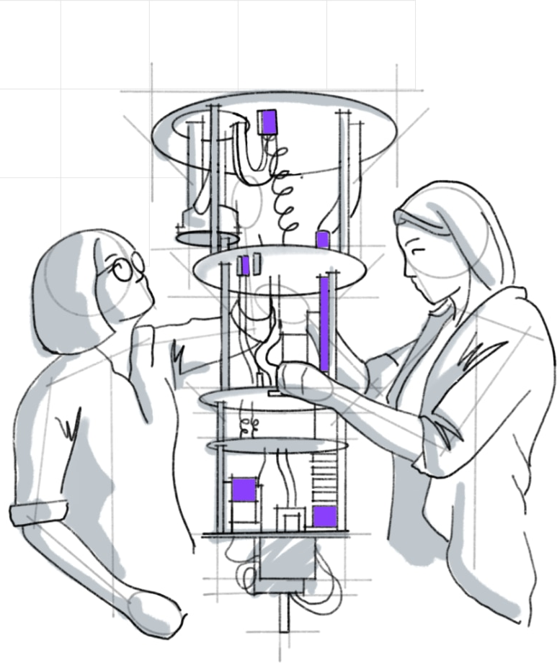

Implementation
Timeline, Skills and Qiskit Libraries
Team Beat-the-Quantum-Machine: Enda Cahill, Barbora Hrdá, Nouhaila Innan, David Peral, Divyanshu Singh
7th of May - 14th of May
Implementation of the Othello mechanics and rules.
Designing and implementing the user interface.
Building initial ML Agent
State and Action Encoding research
Skills:
Game Development: Barbora, Divyanshu,
UI: Team
ML: David, Enda, Nouhaila
15th of May - 28 of May
Implementation of the Quantum Layer.
Refine State Encoding approach
Compare results of different approaches
Skills:
QML: David, Enda, Nouhaila
Qiskit: Barbora, Divyanshu
28th of May - 4th of June
Iterative testing, and final adjustments
Finalizing project report
Buffer time
Skills:
Testing: Team
Project Report Writing: Team
4th of June
Handing in:
Working Prototype
Project Report
Project Video
Libraries / Modules / Game Engines:
Qiskit-Aqua for the implementation of Machine Learning algorithm
Qiskit-Aer for access to the backends
PyTorch
PyGame
For more information, see also: https://github.com/HayleySummer/Qiskit_Hackathon_Europe or Discord Channel: #team-beat-the-quantum-machine

