Slide 1
Beat the Quantum Machine
Qiskit Hackathon Europe: Research Study Groups
Enda Cahill, Barbora Hrdá, Nouhaila Innan, David Peral, Divyanshu Singh

Slide 2

Project Idea

Slide 3
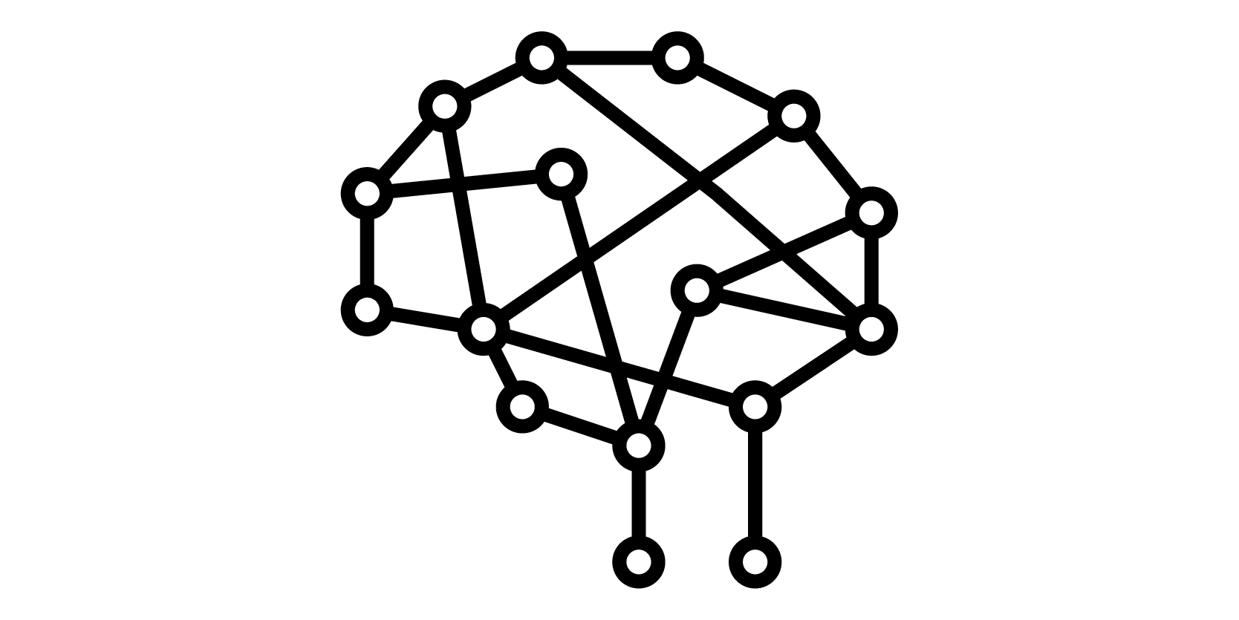
Impact
Demonstration of a quantum technique for (reinforcement learning?) implemented in an accessible format within a game
Convolutional Neuronal Networks in combination with quantum mechanics are novel to this approach, as they were only applied to image recognition.
Explore the opportunities for mapping the state of a complex game into the current Qiskit environment.
The proposal brings interest in the fields of quantum machine learning as we applied QCNNs, quantum algorithms because we used the Grover´s algorithm and in quantum games since we are making an AI to play against the user.
Near-term we are trying to create a playable game with limited and reduced rules. This rules could be based on quantum or hybrid algorithms.
Long-term: we will be able to finish a complete game with at least the same amount of rules we have in the classical algorithm and with better performance and efficiency.

Slide 4
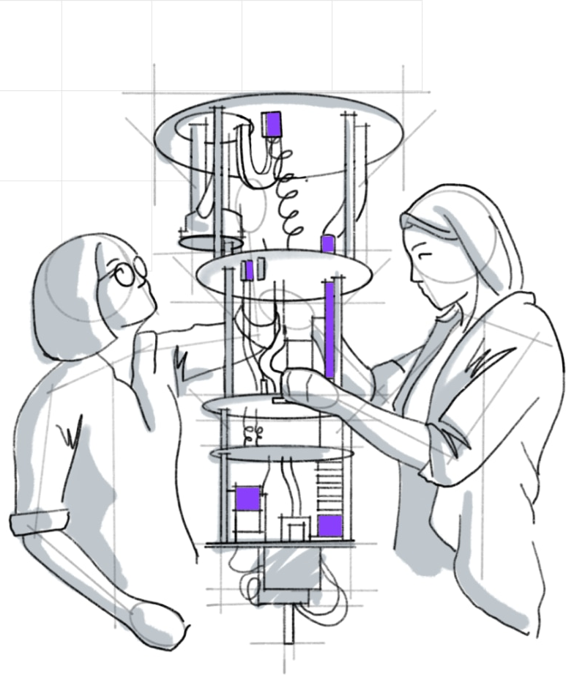

Implementation
Timeline, Skills and Qiskit Libraries
7th of May - 14th of May
Implementation of the Othello mechanics and rules.
Designing and implementing the user interface.
Skills:
Game Development: Barbora, Divyanshu,…
UI: Team
15th of May - 28 of May
Implementation of the classical (AND/OR)? quantum algorithm.
Skills:
MQL: David, Enda, Nouhaila
Qiskit: Barbora, Divyanshu
28th of May - 4th of June
Iterative testing, and final adjustments
Finalizing project report
Buffer time
Skills:
Testing -> Team
Writing -> Team
4th of June
Handing in:
Working Prototype
Project Report
Project Video
Qiskit libraries/modules:
Qiskit-Aer for getting the backend
Qiskit-Ignis for noise mitigation
Qiskit-Aqua or Qiskit-machine-learning for the implementation of Machine Learning algorithm
Qisikit-algorithm-Grover (If we use Grover's approach )

Slide 5

References
[1] Paweł Liskowski, Wojciech Ja´skowski, Krzysztof Krawiec (2017) "Learning to Play Othello with Deep Neural Networks." In: IEEE TRANSACTIONS ON COMPUTATIONAL INTELLIGENCE AND AI IN GAMES
[2] Nees Jan van Eck, Michiel van Wezel (2005): Reinforcement Learning and its Application to Othello. In: Econometric Institute Report EI 2005-47
[3] Hlynur Davíð, H. (2017). Predicting expert moves in the game of Othello using fully convolutional neural networks (Dissertation). Retrieved from http://urn.kb.se/resolve?urn=urn:nbn:se:kth:diva-210914

