Slide 1
Beat the Quantum Machine
Qiskit Hackathon Europe: Research Study Groups
Enda Cahill, Barbora Hrdá, Nouhaila Innan, David Peral, Divyanshu Singh

Slide 2
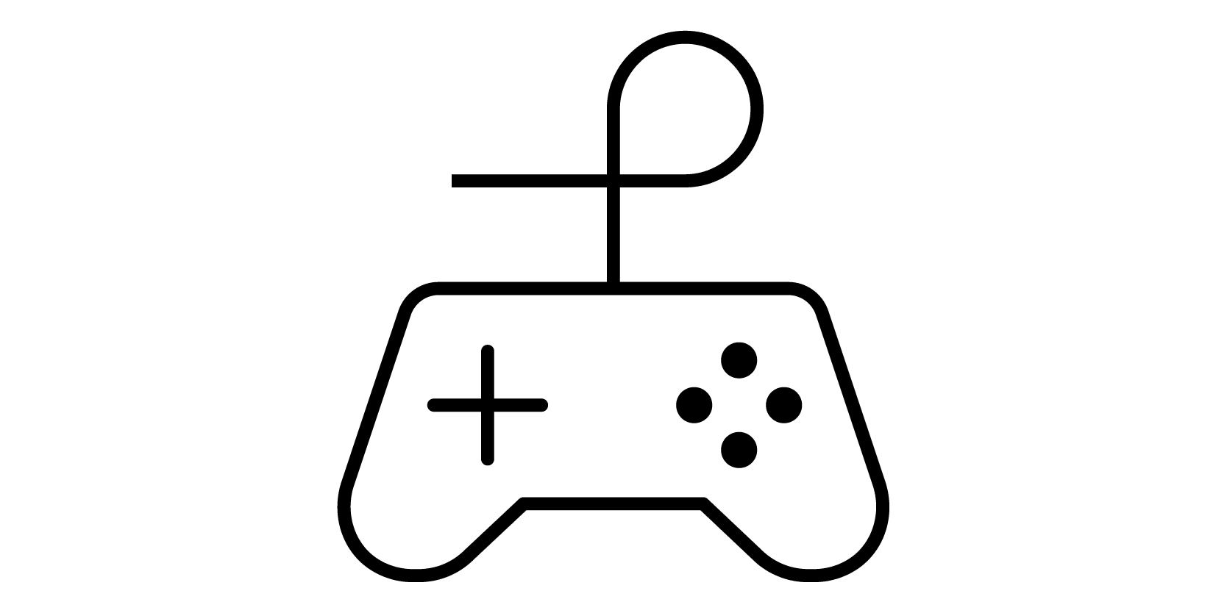
Project Idea
Games provide an interesting test bed for artificial intelligence research, as they provide a self-contained environment with fixed rules. DeepBlue, Watson and AlphaGo are only a few examples of algorithms that were put through their paces in games before applying them to different problems.
Othello (also called Reversi) is a perfect information, zero-sum, two-player strategy game played on an 8x8 board, and has already been used in classical artificial intelligence research. The board stages are highly volatile, because each new move can change a large area of the board. Despite its simple rules, the game of Othello is not trivial, containing a number of legal positions of approximately 10 x28. The game tree itself has approximately 10 x58 nodes.[1]
Othello is seen as a Markov Decision Problem in literature, marking an important section of reinforcement learning [2]. In addition, the mixed aplication of Convolutional Neural Nets result in a better accuracy predicting moves [3].
We propose the implementation of a Quantum Othello game using quantum computing together with classical machine learning techniques to create a (self-improving) computer opponent players can compete against.
The Quantum opponent creates winning strategies using a Variational Quantum Circuit for Deep Reinforcement Learning. The implementation will utilise PyTorch to train a Deep Q-Learning neural network with a Quantum Computing based hidden layer.

Slide 3
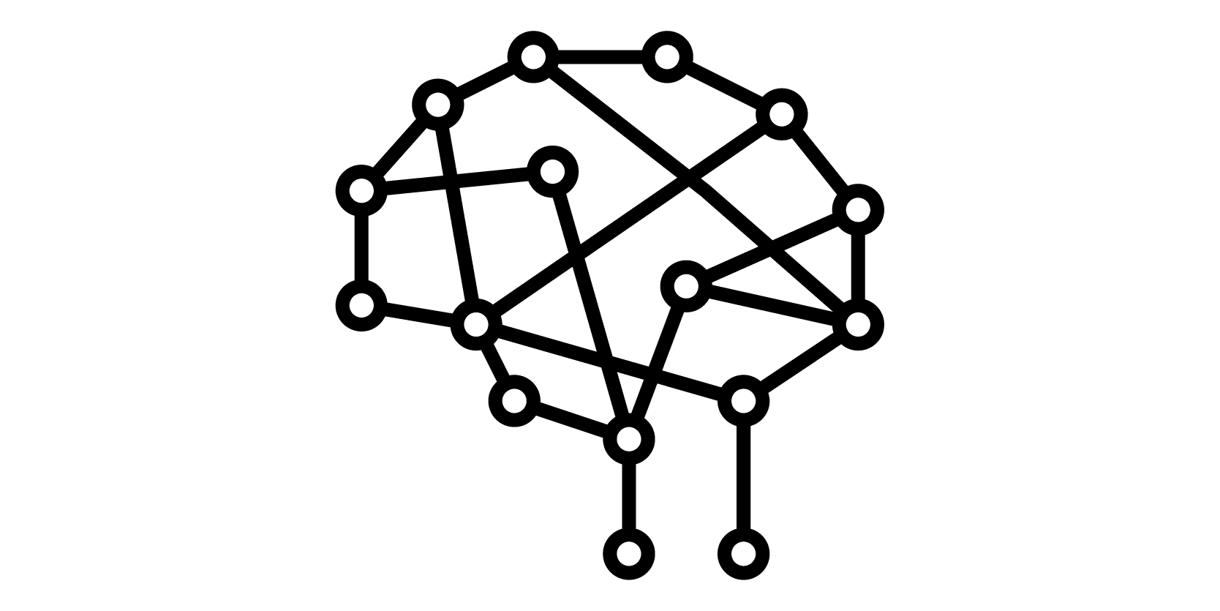
Impact (Version 2)
Demonstration of a quantum machine learning technique for reinforcement learning implemented in an accessible format within a game
Provide an analysis of encoding the state of a complex game in a format suitable for use in current Quantum ML environments.
Convolutional Neural Networks in combination with quantum mechanics are novel to this approach where the game state and action space is large.
The proposal brings interest in the fields of quantum machine learning and in quantum games since we are making an AI to play against the user.
In the near-term we will create a playable game and associated Quantum ML Agent.
In the long-term the Quantum ML agent can be improved for better performance and efficiency. This work will also provide a starting point for others to advance the implementation of Quantum Machine Learning Agents using Reinforcement Learning.

Slide 4
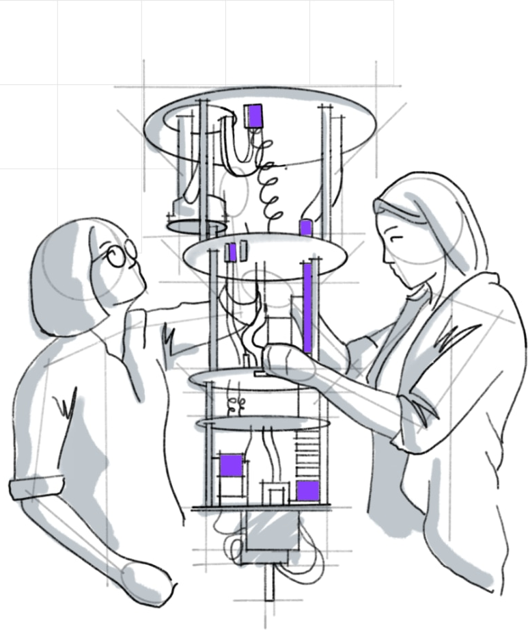

Implementation (Version 2)
Timeline, Skills and Qiskit Libraries
7th of May - 14th of May
Implementation of the Othello mechanics and rules.
Designing and implementing the user interface.
Building initial ML Agent
State and Action Encoding research
Skills:
Game Development: Barbora, Divyanshu,
UI: Team
ML: David, Enda, Nouhaila
15th of May - 28 of May
Implementation of the Quantum Layer.
Refine State Encoding approach
Compare results of different approaches
Skills:
QML: David, Enda, Nouhaila
Qiskit: Barbora, Divyanshu
28th of May - 4th of June
Iterative testing, and final adjustments
Finalizing project report
Buffer time
Skills:
Testing -> Team
Writing -> Team
4th of June
Handing in:
Working Prototype
Project Report
Project Video
Qiskit libraries/modules:
Qiskit-Aer for getting the backend
Qiskit-Aqua for the implementation of Machine Learning algorithm

Slide 5
Impact
Demonstration of a quantum technique for (reinforcement learning?) implemented in an accessible format within a game
Convolutional Neuronal Networks in combination with quantum mechanics are novel to this approach, as they were only applied to image recognition.
Explore the opportunities for mapping the state of a complex game into the current Qiskit environment.
The proposal brings interest in the fields of quantum machine learning as we applied QCNNs, quantum algorithms because we used the Grover´s algorithm and in quantum games since we are making an AI to play against the user.
Near-term we are trying to create a playable game with limited and reduced rules. This rules could be based on quantum or hybrid algorithms.
Long-term: we will be able to finish a complete game with at least the same amount of rules we have in the classical algorithm and with better performance and efficiency.

Slide 6
Implementation
Timeline, Skills and Qiskit Libraries
7th of May - 14th of May
Implementation of the Othello mechanics and rules.
Designing and implementing the user interface.
Skills:
Game Development: Barbora, Divyanshu,…
UI: Team
15th of May - 28 of May
Implementation of the classical (AND/OR)? quantum algorithm.
Skills:
MQL: David, Enda, Nouhaila
Qiskit: Barbora, Divyanshu
28th of May - 4th of June
Iterative testing, and final adjustments
Finalizing project report
Buffer time
Skills:
Testing -> Team
Writing -> Team
4th of June
Handing in:
Working Prototype
Project Report
Project Video
Qiskit libraries/modules:
Qiskit-Aer for getting the backend
Qiskit-Ignis for noise mitigation
Qiskit-Aqua or Qiskit-machine-learning for the implementation of Machine Learning algorithm
Qisikit-algorithm-Grover (If we use Grover's approach )

Slide 7

References
[1] Paweł Liskowski, Wojciech Ja´skowski, Krzysztof Krawiec (2017) "Learning to Play Othello with Deep Neural Networks." In: IEEE TRANSACTIONS ON COMPUTATIONAL INTELLIGENCE AND AI IN GAMES
[2] Nees Jan van Eck, Michiel van Wezel (2005): Reinforcement Learning and its Application to Othello. In: Econometric Institute Report EI 2005-47
[3] Hlynur Davíð, H. (2017). Predicting expert moves in the game of Othello using fully convolutional neural networks (Dissertation). Retrieved from http://urn.kb.se/resolve?urn=urn:nbn:se:kth:diva-210914

