Slide 1

Camila + Liron

Slide 2
PROBLEM
- Ever wanted to convert a few images into a short video in the palm of your hands?
- Without forgetting:
Background music
Voice-over functionality
Easy to share over Social Media
- For FREE (mostly…)!

Slide 3
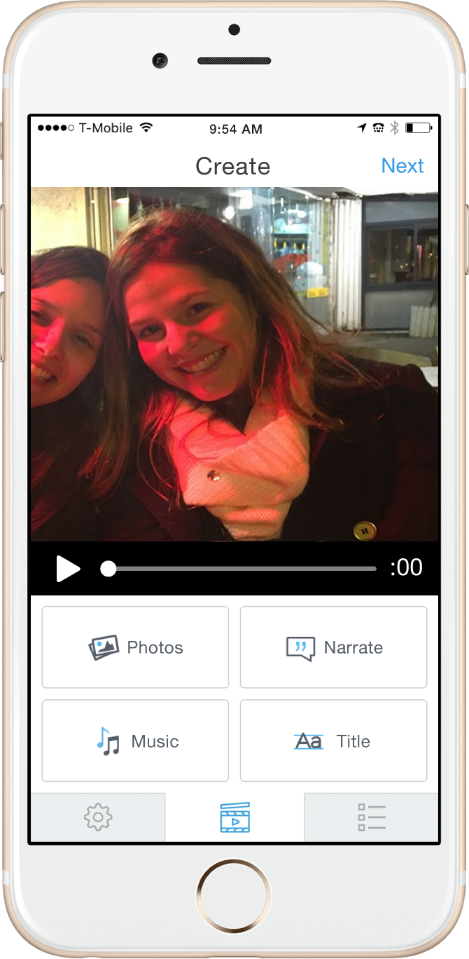
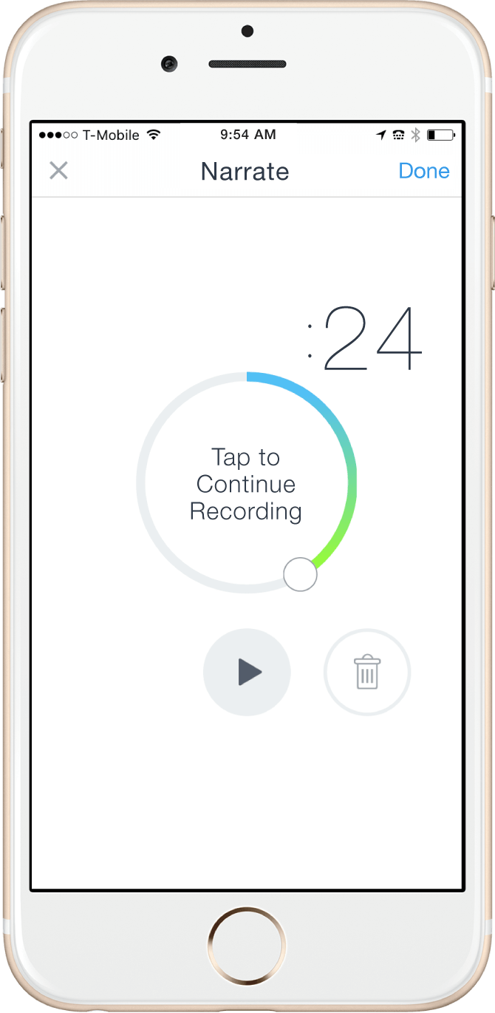
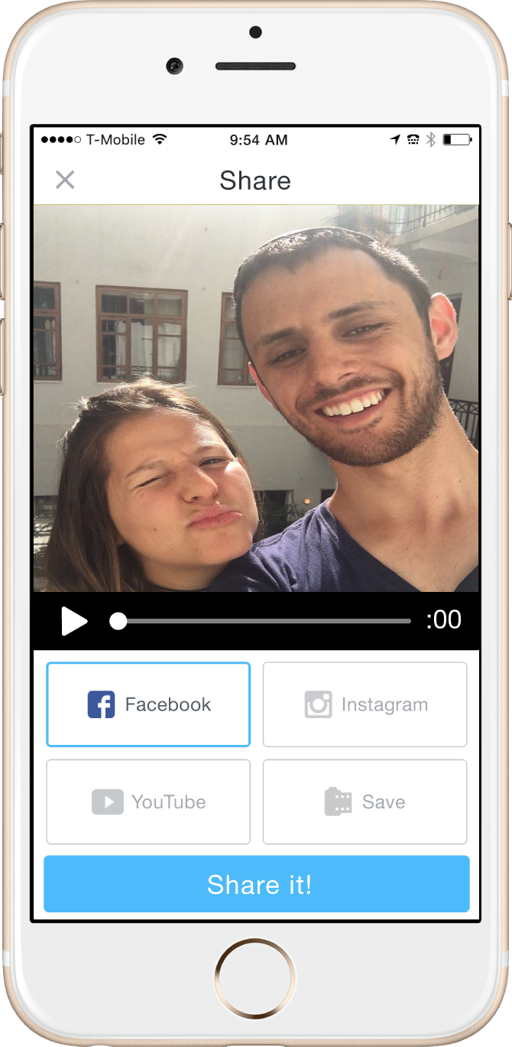
Solution
1
2
3

Slide 4
Market information
Challenges:
Users’ photos are often located on other apps
Loyalty must come by providing a service that the big apps (Facebook, Instagram, Tumblr etc.) don’t provide
Monetization
Accepted model: in-app purchases (see next slide)
Opportunities
Android market

Slide 5

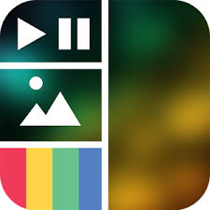
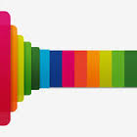
Competitor analysis
Competitor | Competitive Advantages | Disadvantages | Main Monetization
 | Largest Market Share (80ML Users) | Greedy (Costs to download movies!) | Everything costs
VidStitch | Optimized for Instagram | No Android | $0.99 to include videos
PicFlow | Free On Android | Free version is watermarked, no music | $0.99 Multiple videos, music, remove watermark

Slide 6
Our competitive edge
Android Compatibility (Still to come!)
Provide more free features than our competitors.
Target non-Instagram users.

