Slide 1
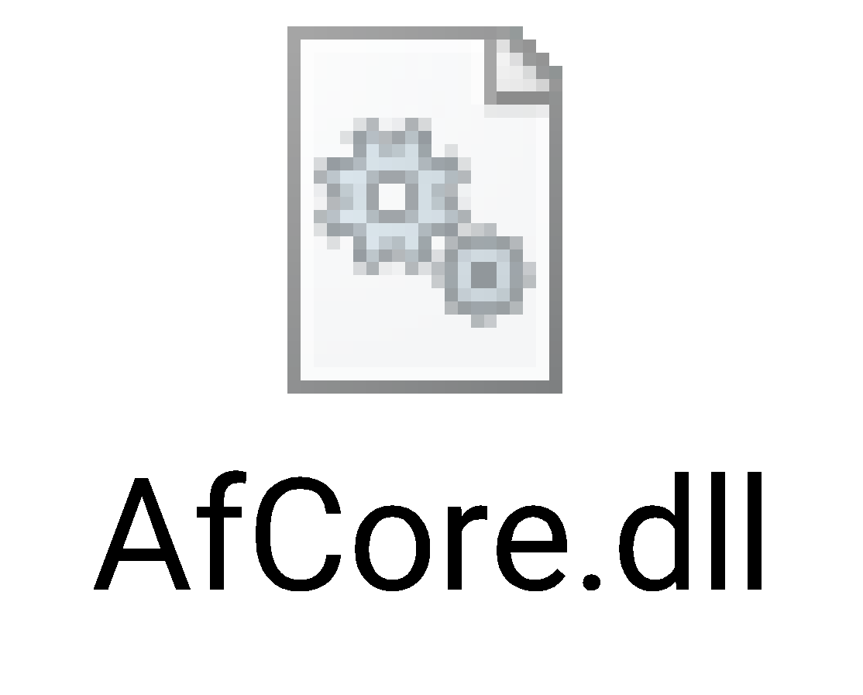

Introduction to RStudio Environment
Basic Features
Compiled by Haymanot Berelie
October 14, 2022
Dangila, Ethiopia

Slide 2

OVERVIEW OF RSTUDIO
Why Rstudio?

Slide 3
Introduction to RStudio
RStudio is a powerful and productive user interface for R or Integrated Development Environment (IDE) for R and makes using R easier.
Organize your code, output, and plots.
Auto-complete code and highlight syntax.
Help view data and objects.
Enable easy integration of R code into documents.
User-friendly interfaces.
Open source, but paid option as well (not worth it for typical users)
Same install process

Slide 4
BENEFITS OF RSTUDIO
Easier transition from Stata to R
Multiple window views at once – Results, Code, Working Environment, and Graphs
If something on your computer crashes while you’re working, R will have your code waiting for you when you re-open RStudio.
Auto suggesting the function And re-type everything all over again when a mistake make in typing code into the console.

Slide 5
GETTING STARTED WITH RSTUDIO
Once you have installed RStudio, there will be an icon on your desktop.
Double click it and RStudio will start up.
Start the R system, the main window (RGui) with a sub window (R Console) will appear. In the `Console' window the cursor is waiting for you to type in some R commands.
R does have a few pull-down menus,

Slide 6
The menu bar
The menu bar in RStudio contains 11 pull down menus, which are:
File: The file menu contains options for new file, new project, opening, saving, and printing R documents, importing dataset, compile pdf, as well as the option for exiting the session or project (clicking on the x in the R window or typing the command q() on the console).
New file: open new r script, python scripts ,shell, Markdown, notebooks, html file, latex or sweave document…
New project: for handling the analysis of new data and keep everything together.
Open: data, project in the new sessions, script, and other documentation

Slide 7
CONT’D..
saves everything; command, output and most recommended. Save history
saves commands and objects and save image # just saves the objects in the workspace .
Import dataset: importing external data from xx to RStudio
Load Workspace and Load History are options to open previously saved work.
2. Edit: The edit menu contains the standard functionality of undo, redo, cut, copy, paste, ,find and replace, check spelling, word count, Clear output and /or console.
3. Code: The code menu contains options for insert chunk, jump to, go to file/function, show document outlines/diagnostics/diagnostic project, extract variable/function, comment/uncomment/reindent/run lines, and source.

Slide 8
CONT’D…
4. View: in this drop down menu we can modify the size of panes, taps, positions … etc. The view menu contains options for show/hide panes, zoom, switch to/next/previous/first and last tabs, move focus to xx , show history/files/packages…etc.
5. Plots: The plot menu contains options for show, save, and remove plots
6. Session: The session menu contains options for new and quit sessions, interrupt, terminate, restart R, setwd(), load, save, and clear workspace.

Slide 9
CONT’D…
7. Build: The build menu contains options for configure build tools
8. Debug: The debug menu contains options for toggle and clear all breakpoints, execute next line, step into function, finish function continue/stop/helping debugging.
9. profile: The profile menu contains options for start/stop/open/help profiling, profile selected lines.

Slide 10
CONT’D…
10. Tools: The view menu contains options for install and update packages, version control, shell, terminal, jobs, add-in, memory, help and modify keyboard shortcut, project and global options…etc.
11. Helps: The help menu contains options for R help, about RStudio, community forum, and docs, markdown and roxygen quick reference, accessibility, cheat sheets, and diagnostics.

Slide 11
RSTUDIO LAYOUT OR PANES
Console
Here is where R actually evaluates code and get an immediate response.
type the code into the Source, and then send the code to the Console
We can type code directly into the console
Source
The source pane is where you create and edit ``R Scripts" - your collections of code
Equivalent of Do file editor in Stata
Not open by default

Slide 12
CONT’D…
Environment
This pane includes by default environment/history/connection/tutorial tabs.
Shows the names of all the data objects
shows a history of all the code previously evaluated .
clickable actions like “Import Dataset"
File/Plot/Packages/Viewer/Etc.…
Show list, install , update, and remove packages
access to the file directory and shows all your plots
Help tabs for R functions.

Slide 13

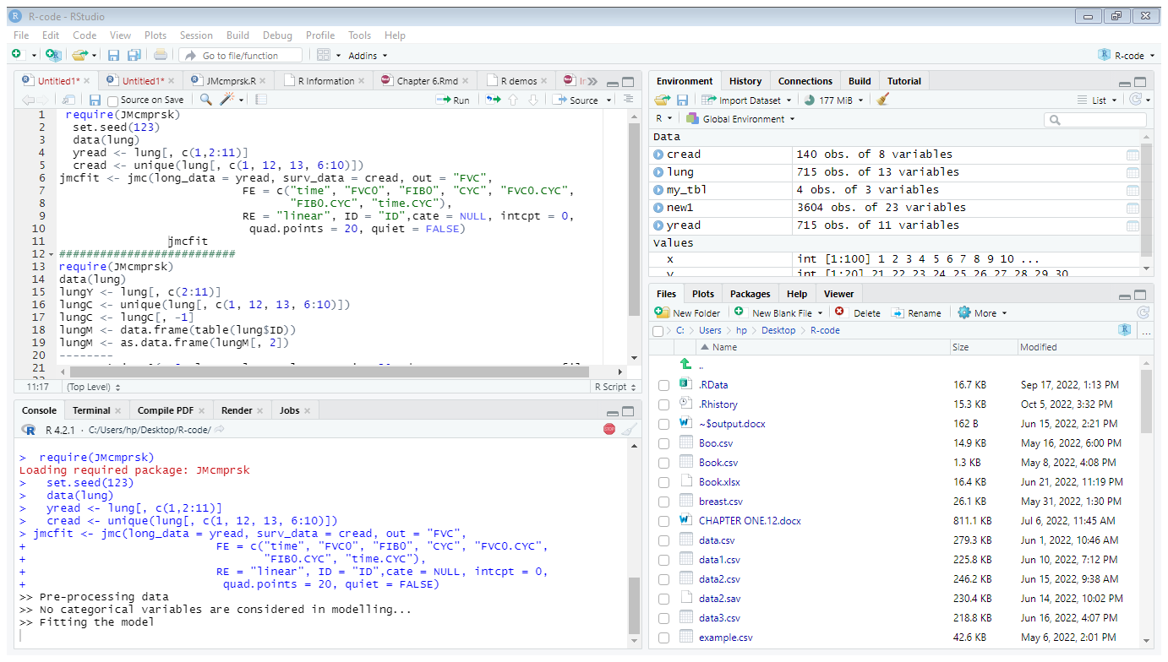
4 PRIMARY WINDOWS
Environment/History/tutorial/…
SOURCE
Click it to send code to evaluate
This is to view object in workspace and command history
Write the code here and
hit the run tab to evaluate the code
File/Plots/Packages/...
CONSOLE
Here also view file in the file directory, plots, packages, and R helps
This is where the code from the source is evaluated by R

Slide 14
WORKSPACE AND RSTUDIO PROJECT MANAGEMENT
getwd() # shows the working directory
lits.d() # lists the working directory
setwd() # sets the working directory
choose.dir() # will prompt you to choose your directory (interactive)
setwd(“D:/RTraining/”) # this changes the wd Observe the forward slash or use double backslash.
Setwd(“D:\\RTraining\\”) # same like above
dir() # lists files in the working directory
list.files() # lists files in the working directory

Slide 15
TO CREATE AN R PROJECT, GO TO:
File > New Project and then choose: New Directory> Name for the directory > Click on Create Project.
Or in the top right corner press the create project tab > New Project and then choose: New Directory> Name for the directory > Click on Create Project
Or in the top left corner press the project(none) icon > New Project and then choose: New Directory> Name for the directory > Click on Create Project
can also create via this syntax
> install.packages(“prodigenr”) # to install this package
>Library(prodigenr) # to call the package
> setup_project(“ the path of the work directory")
For more complex project it may be useful to create sub-directories to contain data, scripts and other documents separately. Can also type the below function into the Console, but we won't do that in this session.

Slide 16
DATA PERMANENCY AND REMOVING OBJECTS
The entities that R creates and manipulates are known as objects. These may be variables, arrays of numbers, character strings, functions, or more general structures built from such components.
During an R session, objects are created and stored by name (we discuss this process in the next section). The R command
to display the names of (most of) the objects which are currently stored within R.
objects()
ls()
To remove objects the function rm is available:
rm()
To remove all the objects in R type:
> rm(list=ls(all=T))

Slide 17
DATA STRUCTURE AND TYPES
Basic data type in R
Basic data structures in R
Vector
Factor
List
Matrix
data frame
Logical
Numeric
Integer
Character
Complex
Raw

Slide 18
examines features of vectors and other objects
functions
purpose
class()
typeof()
mode()
length()
attribute()
Str()
What kinds of object is it(high level)
What is the object’s data type(low-level)
What is the object’s data type(often the same as typeof())
How long is it?
Does it have any metadata
What is structure of the object?

Slide 19
CONT’D…
Data type can be converted from one to other using as.something() and can be checked using is.something() code.
Vectors and assignment
Assignment can be made using any of the following operators.
a <- 7 # keyboard shortcut for the operator <- “alt + -”
a=7
assign(“a”,7)
7->a

Slide 20
VECTORS
Vectors are the simplest type of object in R. They can easily be created with c, the combined
function.
There are 3 main types of vectors:
Numeric vectors
Character vectors
Logical vectors
Numeric Vector: Is a single entity consisting of an ordered collection of numbers.
Example: x<-c(10, 6, 3, 6, 22)

Slide 21
CHARACTER AND LOGICAL VECTOR
Character strings are entered using either matching double(“ ") or single(' ') quotes, but are printed using double quotes(or sometimes without quotes).
To set up a character/string vector z consisting of 3 place names use:
Example: > z<-c("Canberra","Sydney","Newcastle")
Or
>z<-c('Canberra','Sydney', 'Newcastle’)
Logical Vectors
A logical vector is a vector whose elements are TRUE, FALSE or NA.
> cat(is.na(z)) or print(is.na(z))
[1] FALSE FALSE FALSE TRUE

Slide 22
MATRICES
Matrices a generalization of a vector with the same data type. A matrix can be generated in two ways.
1 Using the function dim
>x <- c(1:8)
> dim(x) <- c(2,4)
2 Using the function matrix:
x <- matrix(c(1:8),2,4,byrow=F)
Use the function cbind(rbind) to create a matrix by binding two or more vectors as column(row) vectors

Slide 23
ARRAYS
Arrays are generalizations of vectors and matrices
That means, vectors in the mathematical sense are one-dimensional arrays where as matrices are two-dimensional arrays; higher dimensions are also possible.
There are two methods of creating arrays in R
Method 1: Using vectors
A vector can be used by R as an array only if it has a dimension vector as its dim attribute.
Example: array with dimension vector c(3,5,100) and a vector of 1500 elements.
> z=c(1:1500)
> dim(z) <- c(3,5,100)

Slide 24
CONT’D…
Method 2: Using the function array()
Example: array with dimension vector c(3,5,100) and a vector of 1500 elements.
z=array(1:1500, dim= c(3,5,100))
Or
>h<-c(1:1500)
>z<- h ; dim(z) <- c(3,5,100)

Slide 25
LIST
Lists: are collections of arbitrary objects. That is, the elements of a list can be objects of any type and structure.
Lists are created with the list() function:
L<-list(object-1,object-2,…,object-m)
Example:
>L <- list( c(1,5,3), matrix(1:6, nrow=3), c("Hello","world") )
The elements of the list are accessed with the [[ ]]operator.
Examples: Consider the previous example
> L[[1]] # First element of L

Slide 26
DATA FRAMES
Data frames: regarded as an extension to matrices.
➢Data frames can have columns of different data types and are the most convenient data structure for data analysis in R.
Data frames are lists with the constraint that all elements are vectors of the same length.
➢The command data.frame() creates a data frame:
dat<-data.frame(object-1,object-2,…,object-m)
Example:
> name= c("Eden","Solomon","Zelalem","Kidist")
> age=c(18,22,25,27)
> sex=c("F","M","M","F")

Slide 27
CONT’D…
> stud=data.frame(name,age,sex)
> Stud
To display the column names:
> names(stud) #OR colnames(stud)
To display the row names:
>rownames(stud)
to change the column names:
>names(stud)<-c("name","age","sex")
to change the row names:
>row.names(stud)<-("Wrt","Ato","Ato2","Wro")

Slide 28
FACTORS
Factors provide compact ways to handle categorical data
An R factor might be viewed simply as a vector with a bit more information added. That extra information consists of a record of the distinct values in that vector, calledlevels. Here’s an example:
> x <- c(5,12,13,12)
> xf <- factor(x) # The distinct values in xf—5, 12, and 13—are the levels here.
[1]5 12 13 12
Levels: 5 12 13
Common Functions Used with Factors
tapply(): tapply(x, xff, mean)
split() # , which splits a vector into groups and then applies a speciﬁed function on each group
by()

Slide 29
READING(IMPORTING) DATA
Large data objects will usually be read as values from external files rather than entered during an R session at
the keyboard. In R you can import text files with the function read.table
Syntax: read.table(“file name", arguments)
Example:
> getwd()
[1] "C:/Users/hp/Desktop/R-code"
> myfile<- "C:/Users/hp/Desktop/R-code/Data.txt"
> mydf <-read.table(myfile, skip=3,sep=",",
+ header=TRUE)

Slide 30
OTHER FUNCTIONS
read.csv # to read ―comma separated values‖ files period as a decimal
read.delim # to read- tab delimited files period as a decimal
read.mtp is functions to read Minitab files
read.spss # to reads a file stored by the SPSS save or export commands.
read.csv2 # to reads a file separated by semicolon (;) and decimal by comma (,)
read.delim2 # to reads file separated by tab (\t) and decimal by period (.)
To see the built-in dataset currently available use the following command:
>data()

Slide 31
WRITING(EXPORT) DATA
The data (usually a matrix) x are written to file file. If x is a two-dimensional matrix you need to transpose it to get the columns in file the same as those in the internal representation.
# To write a CSV file for input to Excel one might use
write.csv(,file = "filename.csv")
write.table(x, file = "foo.csv", sep = ",", col.names = NA, qmethod = "double")
# Writes a matrix or data frame to a file or the console, using column labels and a layout respecting columns.
write.matrix(x, file = "", sep = " ", blocksize)
To save your output from a session in R can be saved using the sink command:
> sink(“Rintro”) # if you want to save output as word use .doc/docx file extensions
To turn off the sink command:
> sink()

