Slide 1
Chapter One
Data Communication and Computer Networking Basics

Slide 2
Objectives
At the end of this Chapter Students should be able to:
Understand the concept of Network, Data communication
Know the components of data communication
Identify the various application of Networks
Understand the classification of Network

Slide 3
Cont’d…
Discuss the different shape of a network with their respective cons and prons.
Describe the use of Network protocol and their significance
Know the Network reference model both OSI as well as TCP/IP models

Slide 4
Introduction
Old paradigm: a single powerful computer serving all the needs of an organization
New paradigm† - Computer networks: a large number of separate (autonomous) but internetworked (being able to exchange information) computers doing the job
Merging of computer and communications technologies – no geographical barrier
Connection: copper wire, fiber optics, microwaves, infrared, communication satellites, …
Plus new applications: distributed processing (grid and cluster computing, pervasive computing, …), WWW, …

Slide 5
Introduction
Data communications and networking
Change the way we do business and the way we live
Business decisions have to be made more quickly
Decision depends on immediate access to accurate information
Business today rely on computer networks and internetworks
Before get hooked up, we need to know:
How networks operate
What types of technologies are available
Which design best fills which set of needs

Slide 6
Introduction
Development of the PC changes a lot in business, industry, science and education.
Similar revolution is occurring in data communication and networking
Technologies advances are making it possible for communications links to carry more and faster signals
Services are evolving to allow the use of this expanded capacity
For example telephone services extended to have:
Conference calling
Call waiting
Voice mail
Caller ID

Slide 7

1.1 Data Communications
Communication:
Means sharing information
Local (face to face) or remote (over distance)
Telecommunication
Telephone, telegraph and television
Means communication at a distance
Tele is Greek for far

Slide 8
Data Communications
Data:
Refers to information
Presented in any form
Agreed upon by the parties ( creating & using)
Data communication : is the exchange of data between two devices via some form of transmission medium (wire cable).

Slide 9
Data Communications
Communication system made up of a combination of hardware and software
Effectiveness of data communication system depends on:
Delivery : The system must deliver data to correct destination. Data received by the indented user only
Accuracy: The system must deliver data accurately (no change).
Data changed & uncorrected is unusable

Slide 10
Data Communications
Timeliness: The system must deliver data in timely manner
Data arrived late are useless
In the same order (video and audio) & without delay (Real time transmission)
Jitter: Variation in the packet arrival time (uneven quality in the video is the result)

Slide 11
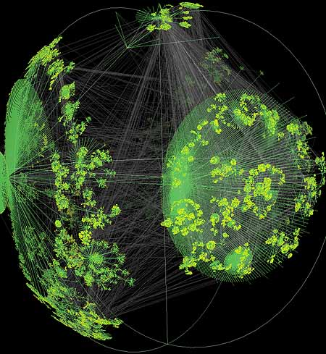
Data Communications

Slide 12
1-1 DATA COMMUNICATIONS
Definition:
The term telecommunication means communication at a distance.
The word data refers to information presented in whatever form is agreed upon by the parties creating and using the data.
Data communications are the exchange of data between two devices via some form of transmission medium such as a wire cable.
Topics discussed in this section:
Components of a data communications system
Data Flow

Slide 13
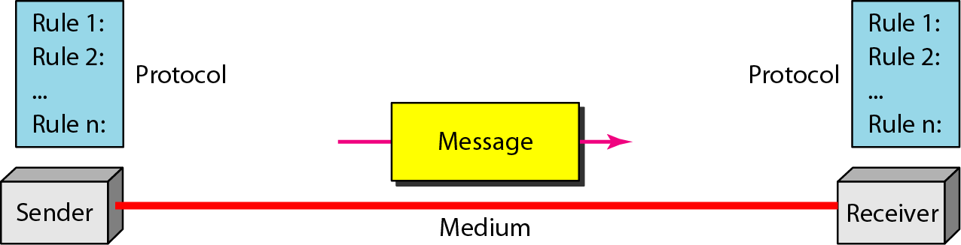
Figure 1.1 Components of a data communication system
A data communication system is made up of five components

Slide 14
Components
Message: the information (data) to be communicated
Consist of text, numbers, pictures, audio, or video
Sender: the device that sends the data message
Computer, workstation, telephone handset, video camera, …
Receiver: the device that receives the message
Computer, workstation, telephone handset, television, ….

Slide 15
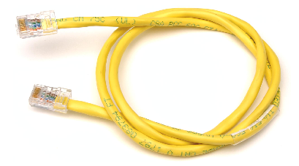


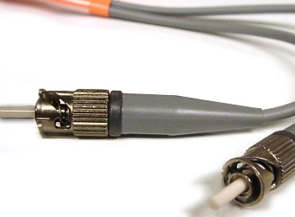
Components
Medium: The physical path by which a message travels from sender to receiver
twisted pair, coaxial cable, fiber-optic, radio waves

Slide 16
Components
Protocol: a set of rules that govern data communications
An agreement between the communicating devices
Devices may be connected but not communicating (no protocol)
Arabic speaker with Japanese speaker

Slide 17
Data Representation
Text
Numbers
Images
Audio
Video

Slide 18
Data Representation
Text:
Sequence of bits (0s or 1s)
Different sets of patterns to represent text symbols (each set is called: code)
ASCII: 7 bits (128 symbols)
common coding system today is:
Unicode uses: 32 bits to represent a symbol or character in any language
Unicode
(4,294,967,296)

Slide 19
Data Representation
Numbers:
Represented by bit patterns
The number is directly converted to a binary number

Slide 20
Data Representation
Images:
Represented by bit patterns
A matrix of
Resolution: size of the pixels
High resolution: more memory is needed
Each pixel is assigned a bit pattern
1-bit pattern (black and white dots image)
2-bit pattern (4 levels of gray)
RGB (color images)
pixels

Slide 21
Data Representation
Audio:
Continuous not discrete
Change to digital signal
Video:
Recording or broadcasting of a picture or movie
Change to digital signal

Slide 22
Data Flow
Communication between two devices can be:
Simplex
Half-Duplex
Full-Duplex

Slide 23
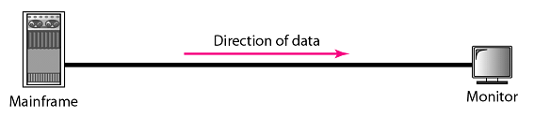
Data Flow
Simplex (one way street)
The communication is unidirectional
Only one device on a link can transmit; the other can only receive
Use the entire capacity of the channel to send data
Example: Keyboards, Monitors
Data

Slide 24

Data Flow
Half-Duplex (one-lane with two-directional traffic)
Each station can both transmit and receive, but not at the same time
When one device is sending, the other can only receive, and vice versa
The entire capacity of a channel is taken over by the transmitting device
Example: Walkie-talkies
Data
Data

Slide 25

Data Flow
Full-Duplex (Duplex) (two-way street)
Both stations can transmit and receive at same time
Signals going in either direction sharing the capacity of the link
Sharing can occur in two ways:
Link has two physically separate transmission paths
One for sending and the other for receiving
The capacity of the channel is divided between signals travelling in both directions
Example: Telephone network
Data
Data

Slide 26

Exercise
What mode of data flow the following exhibits shows?
Answer: Full-Duplex
Data
Data

Slide 27
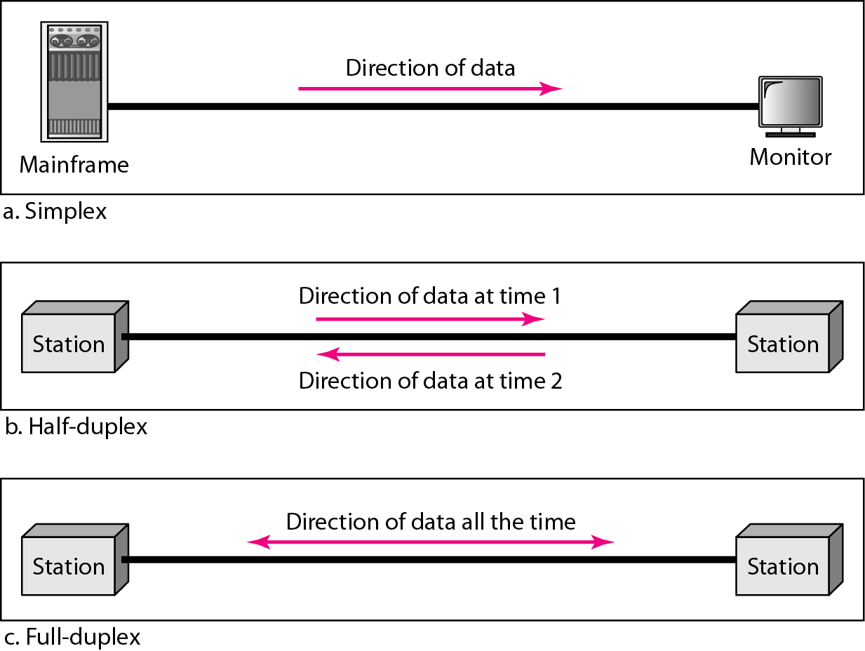
Figure 1.2 Data flow (simplex, half-duplex, and full-duplex)

Slide 28
Networks
Network : A set of devices (nodes) connected by communication links
Node : computer, printer, …
Distributed Processing :
Most networks used it
Task is divided among multiple computers instead of one single large computer

Slide 29
Networks
Network Criteria
Network must meet a certain number of criteria
The most important of the network criterions are:
Performance
Reliability
Security

Slide 30
Networks
Performance
Transit time: A mount of time required for a message to travel from one device to another
Response time: Elapsed time between an inquiry and a response

Slide 31
Networks
Performance
Performance depends on :
1- Number of users: large number slow response time.
2- Type of transmission medium: fiber-optic cabling faster than others cables.
3- Capabilities of the connected hardware: affect both the speed and capacity of transmission.
4- Efficiency of the software: process data at the sender and receiver and intermediate affects network performance.

Slide 32
Networks
Performance
Performance is evaluated by two contradictory networking metrics:
Throughput (high): a measure of how fast we can actually send data through a network
Delay (low)

Slide 33
Networks
Reliability
Reliability is measured by:
Frequency of failure
Recovery time of a network after a failure
Network’s robustness in a catastrophe: protect by good back up network system

Slide 34
Networks
Security
Protecting data from unauthorized access
Protecting data from damage and development
Implementing policies and procedures for recovery from breaches and data losses (Recovery plan)

Slide 35
Networks
Physical Structures:
Type of connection
Network: Two or more devices connected through links
Link: Communication pathway that transfers data from one device two another
Two devices must be connected in some way to the same link at the same time. Two possible types:
Point-to-Point
Multipoint

Slide 36

Networks
Point-to-Point
Dedicated link between two devices
Entire capacity of the link is reserved for transmission between those two devices
Use an actual length of wire or cable

Slide 37
Networks
Point-to-Point
Other options, such as microwave or satellite is possible
Example: Television remote control

Slide 38
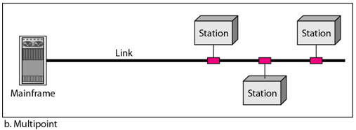
Networks
Multipoint (multidrop)
More than two devices share a single link
Capacity is shared
Channel is shared either spatially or temporally
Spatially shared: if devices use link at same time
Timeshare: if users must take turns

Slide 39
Digital Transmission of Digital Data
Computers produce binary data
Standards needed to ensure both sender and receiver understands this data
Coding: language that computers use to represent letters, numbers, and symbols in a message
Signaling (aka, encoding): language that computers use to represent bits (0 or 1) in electrical voltage
Bits in a message can be send in
A single wire one after another (Serial transmission)
Multiple wires simultaneously (Parallel transmission)

Slide 40
TRANSMISSION IMPAIRMENT
Signals travel through transmission media, which are not perfect.
The imperfection causes signal impairment.
This means that the signal at the beginning of the medium is not the same as the signal at the end of the medium.
What is sent is not what is received.
Three causes of impairment are attenuation, distortion, and noise.

Slide 41
PROTOCOLS
A protocol is synonymous with rule. It consists of a set of rules that govern data communications. It determines what is communicated, how it is communicated and when it is communicated. The key elements of a protocol are syntax, semantics and timing

Slide 42
Elements of a Protocol
Syntax
Structure or format of the data
Indicates how to read the bits - field delineation
Semantics
Interprets the meaning of the bits
Knows which fields define what action
Timing
When data should be sent and what
Speed at which data should be sent or speed at which it is being received.

Slide 43
Standards
Importance
Provide a “fixed” way for hardware and/or software systems (different companies) to communicate
Help promote competition and decrease the price
Types of Standards
Formal standards
Developed by an industry or government standards-making body
De-facto standards
Emerge in the marketplace and widely used
Lack official backing by a standards-making body

Slide 44
Standardization Processes
Specification
Developing the nomenclature and identifying the problems to be addressed
Identification of choices
Identifying solutions to the problems and choose the “optimum” solution
Acceptance
Defining the solution, getting it recognized by industry so that a uniform solution is accepted

Slide 45
Major Standards Bodies
ISO (International Organization for Standardization)
Technical recommendations for data communication interfaces
Composed of each country’s national standards orgs.
Based in Geneva, Switzerland (www.iso.ch)
ITU-T (International Telecommunications Union –Telecom Group
Technical recommendations about telephone, telegraph and data communications interfaces
Composed of representatives from each country in UN
Based in Geneva, Switzerland (www.itu.int)

Slide 46
Major Standards Bodies (Cont.)
ANSI (American National Standards Institute)
Coordinating organization for US (not a standards- making body)
www.ansi.org
IEEE (Institute of Electrical and Electronic Engineers)
Professional society; also develops mostly LAN standards
standards.ieee.org
IETF (Internet Engineering Task Force)
Develops Internet standards
No official membership (anyone welcomes)
www.ietf.org

Slide 47
Some Data Comm. Standards
Layer
Common Standards
5. Application layer
HTTP, HTML (Web)
MPEG, H.323 (audio/video)
IMAP, POP (e-mail)
4. Transport layer
TCP (Internet)
SPX (Novell LANs)
3. Network layer
IP (Internet)
IPX (Novell LANs)
2. Data link layer
Ethernet (LAN)
Frame Relay (WAN)
PPP (dial-up via modem for MAN)
1. Physical layer
RS-232c cable (LAN)
Category 5 twisted pair (LAN)
V.92 (56 kbps modem)

Slide 48
Switching Networks
Long distance transmission is typically done over a network of switched nodes
Nodes not concerned with content of data
End devices are stations
Computer, terminal, phone, etc.
A collection of nodes and connections is a communications network
Data routed by being switched from node to node

Slide 49
Nodes
Nodes may connect to other nodes only, or to stations and other nodes
Node to node links usually multiplexed
Network is usually partially connected
Some redundant connections are desirable for reliability
Two different switching technologies
Circuit switching
Packet switching

Slide 50
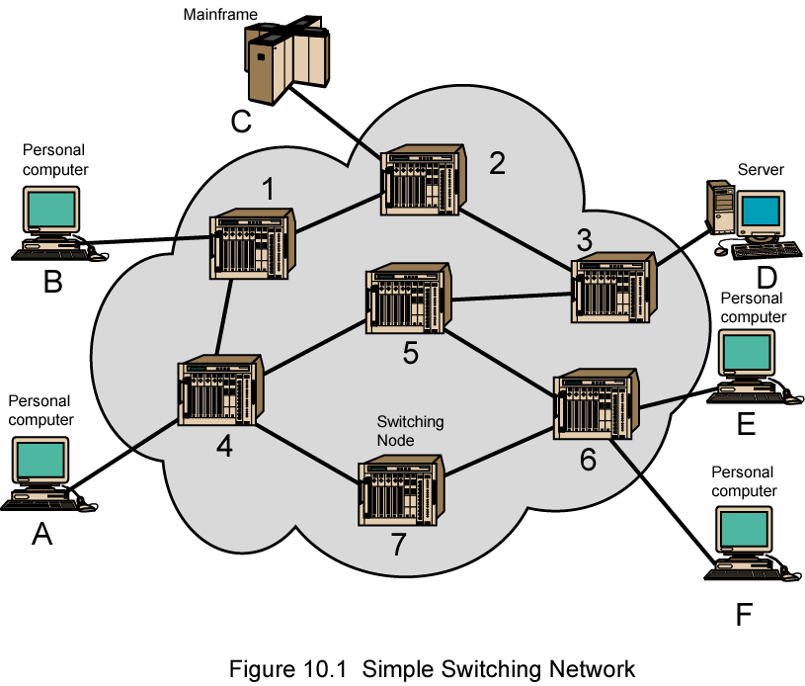
Simple Switched Network

Slide 51
Circuit Switching
Dedicated communication path between two stations
Three phases
Establish
Transfer
Disconnect
Must have switching capacity and channel capacity to establish connection
Must have intelligence to work out routing

Slide 52
Circuit Switching - Applications
Inefficient
Channel capacity dedicated for duration of connection
If no data, capacity wasted
Set up (connection) takes time
Once connected, transfer is transparent
Developed for voice traffic (phone)

Slide 53
Packet Switching Principles
Circuit switching designed for voice
Resources dedicated to a particular call
Much of the time a data connection is idle
Data rate is fixed
Both ends must operate at the same rate

Slide 54
Basic Operation
Data transmitted in small packets
Typically 1000 octets
Longer messages split into series of packets
Each packet contains a portion of user data plus some control info
Control info
Routing (addressing) info
Packets are received, stored briefly (buffered) and past on to the next node
Store and forward

Slide 55
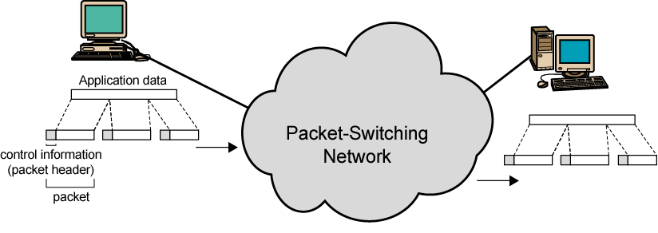
Use of Packets

Slide 56
Advantages
Line efficiency
Single node to node link can be shared by many packets over time
Packets queued and transmitted as fast as possible
Data rate conversion
Each station connects to the local node at its own speed
Nodes buffer data if required to equalize rates
Packets are accepted even when network is busy
Delivery may slow down
Priorities can be used

Slide 57
Switching Technique
Station breaks long message into packets
Packets sent one at a time to the network
Packets handled in two ways
Datagram
Virtual circuit

Slide 58
Datagram
Each packet treated independently
Packets can take any practical route
Packets may arrive out of order
Packets may go missing
Up to receiver to re-order packets and recover from missing packets

Slide 59
Virtual Circuit
Preplanned route established before any packets sent
Call request and call accept packets establish connection (handshake)
Each packet contains a virtual circuit identifier instead of destination address
No routing decisions required for each packet
Clear request to drop circuit
Not a dedicated path

Slide 60
Virtual Circuits v Datagram
Virtual circuits
Network can provide sequencing and error control
Packets are forwarded more quickly
No routing decisions to make
Less reliable
Loss of a node looses all circuits through that node
Datagram
No call setup phase
Better if few packets
More flexible
Routing can be used to avoid congested parts of the network

Slide 61
Circuit v Packet Switching
Performance
Propagation delay
Transmission time
Node delay

Slide 62
1-2 NETWORKS
A network is a set of devices (often referred to as nodes) connected by communication links. A node can be a computer, printer, or any other device capable of sending and/or receiving data generated by other nodes on the network. A link can be a cable, air, optical fiber, or any medium which can transport a signal carrying information.
Topics discussed in this section:
Network Criteria
Physical Structures
Categories of Networks

Slide 63
Network Criteria
Performance
Depends on Network Elements
Measured in terms of Delay and Throughput
Reliability
Failure rate of network components
Measured in terms of availability/robustness
Security
Data protection against corruption/loss of data due to:
Errors
Malicious users

Slide 64
The Uses of a Network
Simultaneous access to data
Data files are shared
Access can be limited
Shared files stored on a server
Software can be shared
Site licenses
Network versions
Application servers
Notes:
Teaching Tip
Figure 9A.2 on page 342 visually describes the sharing process. It can be helpful to have students open a shared file that you control. Make a change then have the students open it again. Alternatively, share a document and allow your students to write in it. Then demonstrate how the shared document changes.
Spend time discussing why application servers need to be so powerful.

Slide 65
The Uses of a Network
Shared peripheral device
Printers and faxes are common shares
Reduces the cost per user
Devices can be connected to the network
Print servers control network printing
Manage the print queue
Notes:
Teaching tip
Figure 9A.4 on page 344 shows a print queue. It can be helpful to demonstrate your classroom queue.

Slide 66
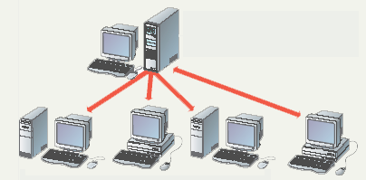
Sharing Data
File server contains documents used by other computers.

Slide 67
The Uses of a Network
Personal communication
Email
Instantaneous communication
Conferencing
Tele conferencing
Videoconferencing
Audio-conferencing
Data-conferencing
Voice over IP
Phone communication over network wires
Notes:
Teaching tip
It is fun if you can setup a teleconference in your classroom. Students get to learn how to join or create the conference. Additionally, they learn how to participate. Finally, students have fun, especially with shared whiteboards.

Slide 68
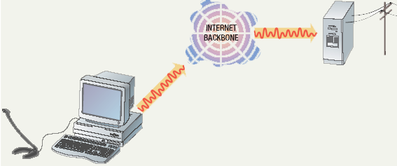
Voice Over IP

Slide 69
The Uses of a Network
Easier data backup
Backup copies data to removable media
Server data backed up in one step
Notes:
Insider information
The text describes needing special software to back up data from user drives. However, the backup utility that comes with Windows 2000 and XP is capable of performing this chore.

Slide 70
Categories of Networks
Network Category depends on its size
Two primary categories
LAN: Covers area < 2miles
WAN: Can be worldwide
MAN: Between LAN & WAN, span 10s of miles

Slide 71
Local Area Network (LAN)
Privately owned
Links devices in the same office, building, or campus
Simple LAN: 2 PCs & 1 printer in home or office
Size is limited to a few kilometers
Allow resources to be shared (hardware, software, or data)

Slide 72
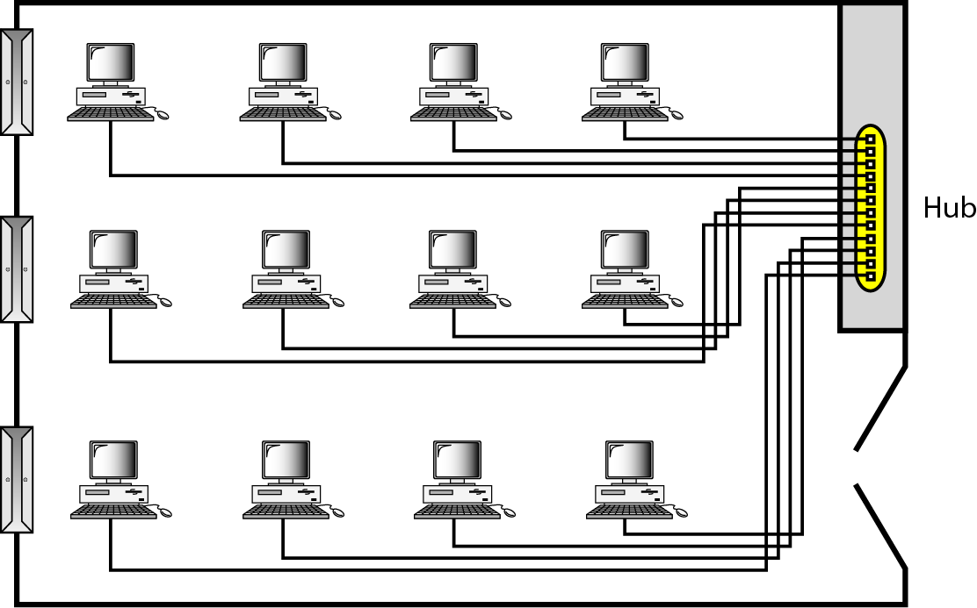
Local Area Network (LAN)
An isolated LAN connecting 12 computers to a hub in a closet

Slide 73
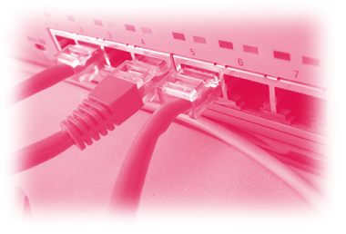
Local Area Network (LAN)
LAN is distinguished by:
Size (# users of OS, or licensing restrictions)
Transmission medium (only one type)
Topology (bus, ring, star)
Data Rates (speed):
Early: 4 to 16 Mbps
Today: 100 to 1000 Mbps

Slide 74
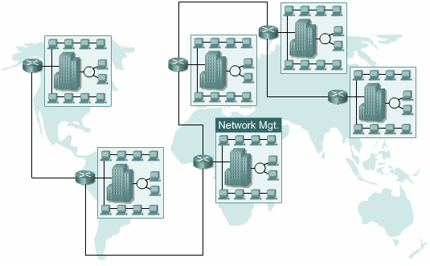
Wide Area Networks (WAN)
Provides long-distance transmission of data over large geographic areas (country, continent, world)

Slide 75
Wide Area Networks (WAN)
Switched WAN
Backbone of the Internet
Dialup line point-to-point WAN
Leased line from a telephone company

Slide 76
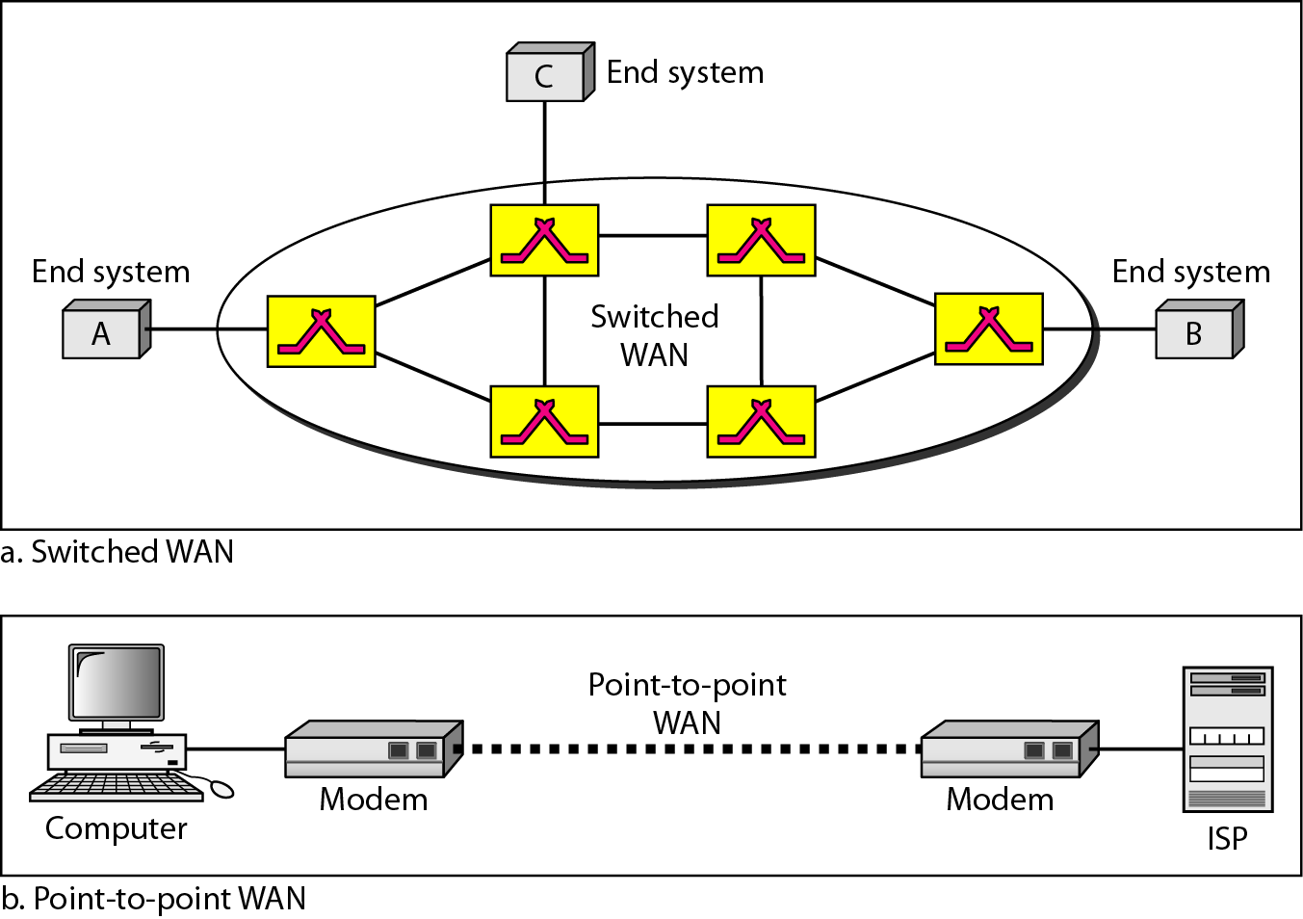
Wide Area Networks (WAN)

Slide 77
Metropolitan Area Networks (MAN)
Size between LAN and WAN
Inside a town or a city
Example: the part of the telephone company network that can provide a high-speed DSL to the customer

Slide 78
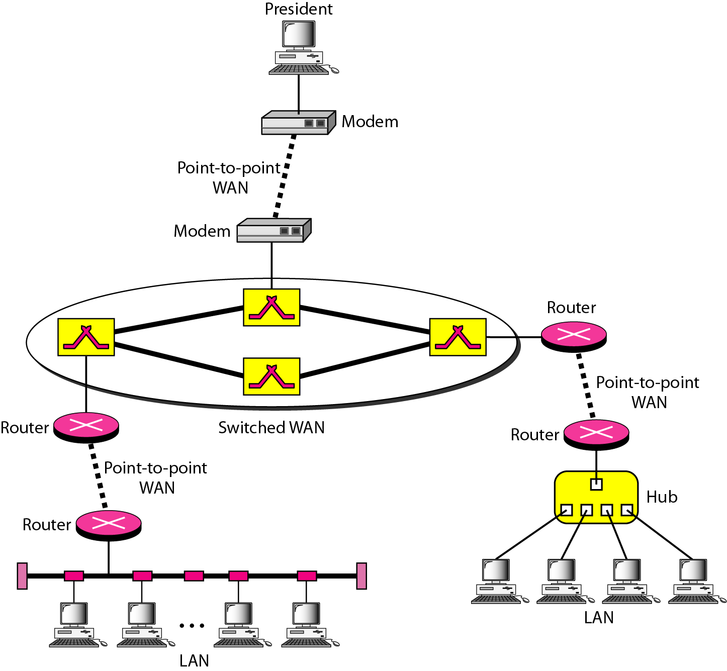
Interconnection of Networks: Internetworks
Two or more networks connected together

Slide 79
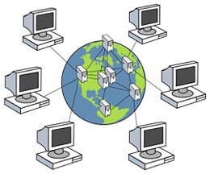
The Internet
Internet has revolutionized many aspects of our daily lives.
It has affected the way we do business as well as the way we spend our leisure time.
Internet is a communication system that has brought a wealth of information to our fingertips and organized it for our use
An internet is 2 or more networks that can communicate with each other
The Internet is a collaboration of more than hundreds of thousands of interconnected networks

Slide 80
The Internet
An internet (small i) is two or more networks
Notable internet is called the Internet (hundreds of thousands interconnected networks)
Private individuals + government agencies + school + research facilities +
Corporations + libraries in more than 100 countries
This communication system came in 1969
Mid-1960 (ARPA) Advanced Research Projects Agency in (DOD) was interested to connect mainframes in research organizations
1967, ARPA presented its ideas for ARPANET
Host computer connecting to (IMP) interface message processor.
Each IMP communicate with other IMP
1969, four nodes (universities) connected via IMPs to form a network
Software (NCP) Network Control Protocol provided communication between the hosts.
1972, Vint Cerf and Bob Kahn invented (TCP) Transmission Control Protocol
Later TCP was split to (TCP) Transmission Control Protocol and (IP) Internetworking Protocol

Slide 81
The Internet
Internet Today
Made of many LANs and WANs
Every day new networks area added and removed
Internet services Providers (ISPs) offer services to the end users
International service providers
National service providers
Regional service providers
Local service providers
Data
rate

Slide 82
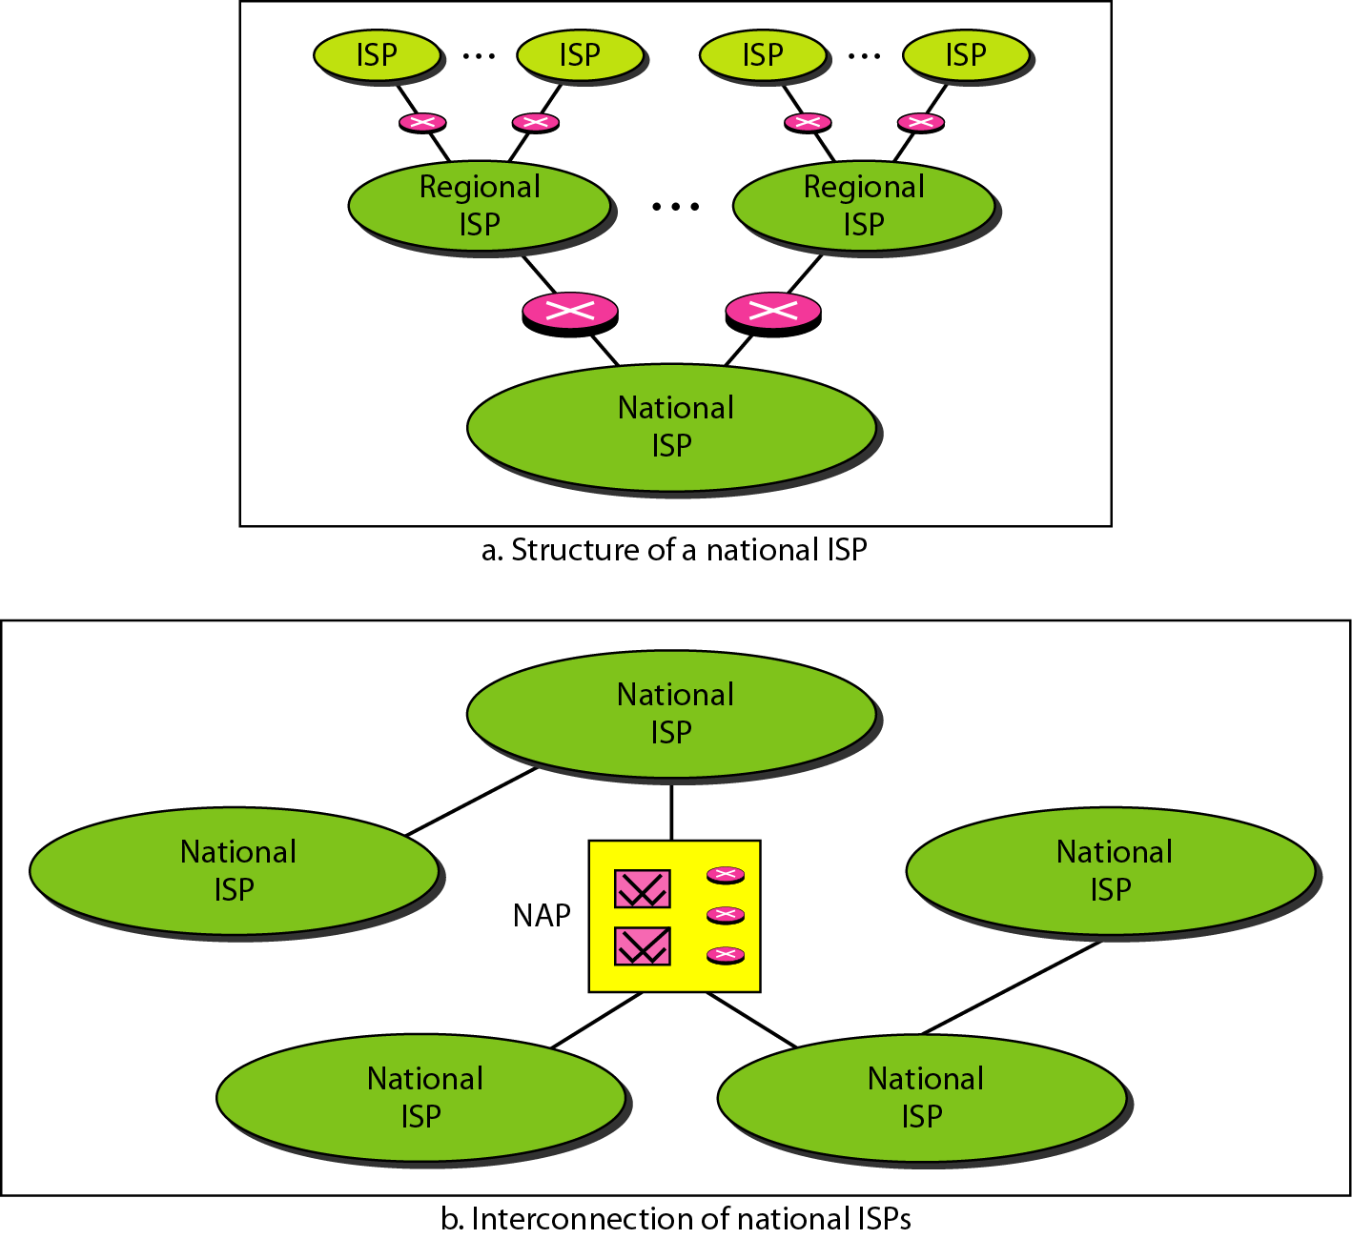
The Internet
Hierarchical organization of the Internet

Slide 83
Common Network Types
Local Area Network (LAN)
Contains printers, servers and computers
Systems are close to each other
Contained in one office or building
Organizations often have several LANS
Notes:
Teaching tip
Use a real world example to describe an organization with interconnected LANs.

Slide 84
Common Network Types
Wide Area Networks (WAN)
Two or more LANs connected
Over a large geographic area
Typically use public or leased lines
Phone lines
Satellite
The Internet is a WAN
Notes:
Teaching tip
Blockbuster Video uses a WAN to connect it’s stores nationwide. Customers from Pittsburgh may rent videos in Hilton Head. Late fees will even be displayed!

Slide 85
Hybrid Network Types
Campus Area Networks (CAN)
A LAN in one large geographic area
Resources related to the same organization
Each department shares the LAN

Slide 86
Hybrid Network Types
Metropolitan Area Network (MAN)
Large network that connects different organizations
Shares regional resources
A network provider sells time
Notes:
Teaching tip
An example of a regional resource is a supercomputer. For example, Pittsburgh has the Pittsburgh Super Computing center (www.psc.edu). The various colleges in Pittsburgh connect to the center through a MAN in Pittsburgh.

Slide 87
Hybrid Network Types
Home Area Network (HAN)
Small scale network
Connects computers and entertainment appliances
Found mainly in the home

Slide 88
Hybrid Network Types
Personal Area Network (PAN)
Very small scale network
Range is less than 2 meters
Cell phones, PDAs, MP3 players
Notes:
Insider information
PAN is very new. Few devices support PAN. High end cell phones include Bluetooth technology. Once the technology matures, Bluetooth will allow the creation of a PAN.

Slide 89
How Networks Are Structured
Server based network
Node is any network device
Servers control what the node accesses
Users gain access by logging in
Server is the most important computer
Notes:
Teaching tip
Spend a few minutes here discussing password policies. Describe why it is important not to give out a password. Also describe why longer, more complicated passwords are important.

Slide 90
How Networks Are Structured
Client/Server network
Nodes and servers share data roles
Nodes are called clients
Servers are used to control access
Database software
Access to data controlled by server
Server is the most important computer

Slide 91
How Networks Are Structured
Peer to peer networks (P2PN)
All nodes are equal
Nodes access resources on other nodes
Each node controls its own resources
Most modern OS allow P2PN
Distributing computing is a form
Kazaa
Notes:
Teaching tip
Discuss how users managing their own security settings can be bad.

Slide 92
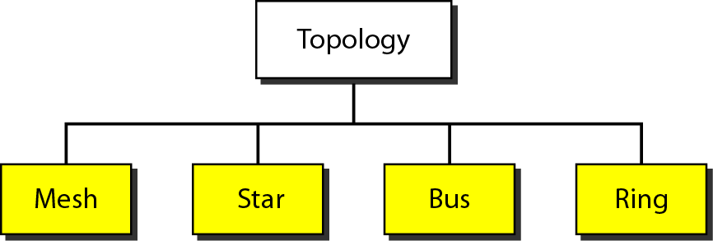
Physical Topology

Slide 93
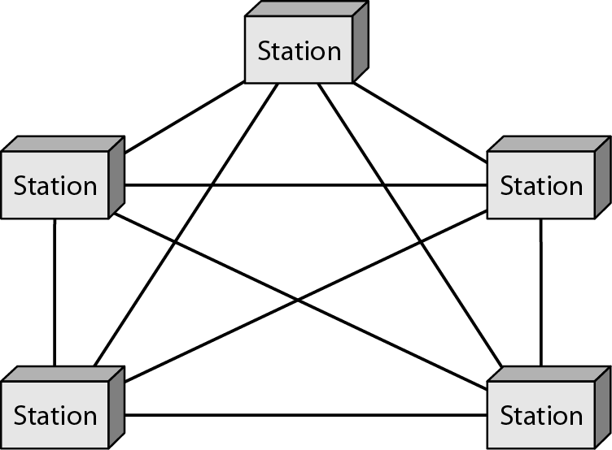
Physical Topology
Mesh
Every link is dedicated point-to-point link
The term dedicated means that the link carries traffic only between the two devices it connects

Slide 94
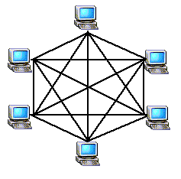
Physical Topology
Mesh
To link n devices fully connected mesh has: n ( n - 1) / 2 physical channels (Full-Duplex)
Every Device on the network must have n - 1 ports

Slide 95

Physical Topology
Mesh
Example:
8 devices in mesh has links: n(n-1) / 2
number of links = 8 (8-1)/2 = 28
number of ports per device = n – 1 = 8 –1 = 7

Slide 96
Physical Topology
Mesh
Advantages
Each connection carry its own data load (no traffic problems)
A mesh topology is robust
Privacy or security
Fault identification and fault isolation

Slide 97
Physical Topology
Mesh:
Disadvantages
Big amount of cabling
Big number of I/O ports
Installation and reconnection are difficult
Sheer bulk of the wiring can be greater than the available space
Hardware connect to each I/O could be expensive
Mesh topology is implemented in a limited fashion; e.g., as backbone of hybrid network

Slide 98
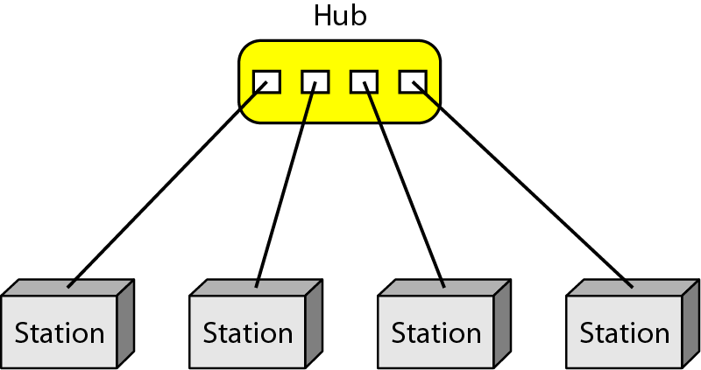
Physical Topology
Star:
Dedicated point-to-point to a central controller (Hub)
No direct traffic between devices
The control acts as an exchange

Slide 99

Physical Topology
Star
Advantages
Less expensive than mesh (1 Link + 1 port per device)
Easy to install and reconfigure
Less cabling
Additions, moves, and deletions required one connection
Robustness : one fail does not affect others
Easy fault identification and fault isolation

Slide 100
Physical Topology
Star
Disadvantages
Dependency of the whole topology on one single point (hub)
More cabling than other topologies ( ring or bus)
Used in LAN

Slide 101
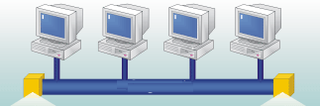
Physical Topology
Bus
It is multipoint
One long cable acts as a backbone
Used in the design of early LANS, and Ethernet LANs

Slide 102
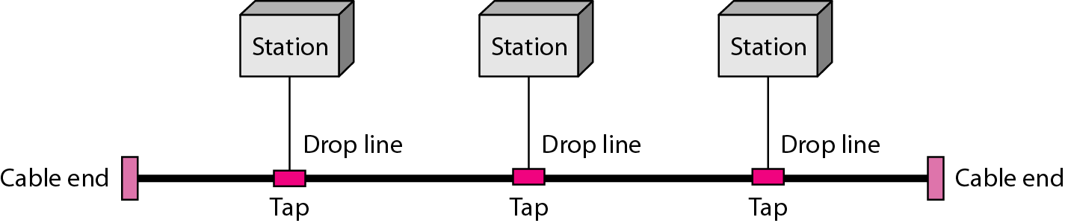
Physical Topology
Bus
Nodes connect to cable by drop lines and taps
Signal travels along the backbone and some of its energy is transformed to heat
Limit of number of taps and the distance between taps

Slide 103

Physical Topology
Bus
Advantages
Ease of installation
Less cables than mesh, star topologies
Disadvantages
Difficult reconnection and fault isolation ( limit of taps)
Adding new device requires modification of backbone
Fault or break stops all transmission
The damaged area reflects signals back in the direction of the origin, creating noise in both directions

Slide 104
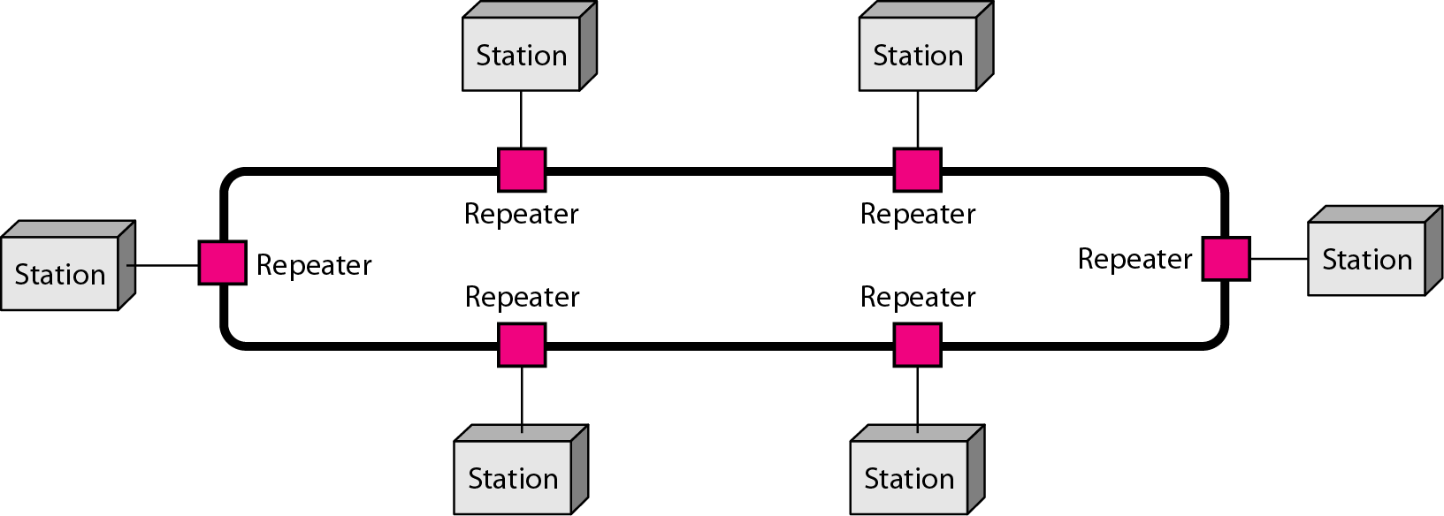
Physical Topology
Ring
Each device has dedicated point-to-point connection with only the two devices on either side of it
A signal is passed along the ring in one direction from device to device until it reaches its destination
Each devices incorporates a Repeater

Slide 105

Physical Topology
Ring
Advantages
Easy of install and reconfigure
Connect to immediate neighbors
Move two connections for any moving (Add/Delete)
Easy of fault isolation
Disadvantage
Unidirectional
One broken device can disable the entire network. This weakness can be solved by using a dual ring or a switch capable of closing off the break

Slide 106
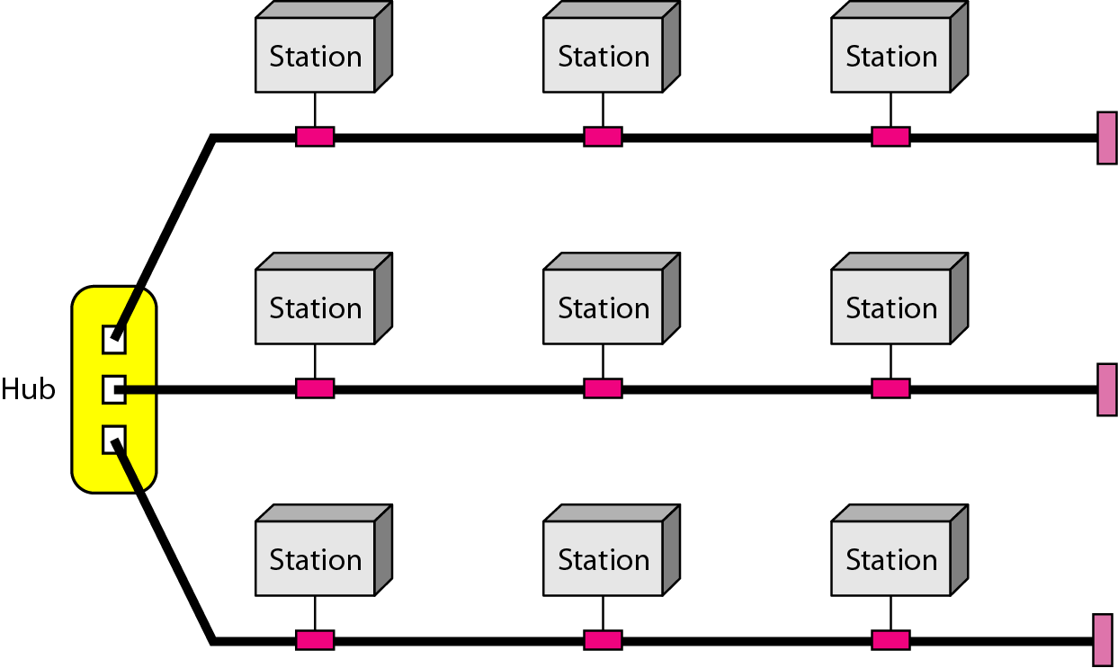
Physical Topology
Hybrid Topology
Example: having a main star topology with each branch connecting several stations in a bus topology

Slide 107
Network Topologies
Topology
Logical layout of wires and equipment
Choice affects
Network performance
Network size
Network collision detection
Several different types
Notes:
Teaching tip
Discuss how your network topology handles collisions. If your students are technical, contrast this with an inferior topology.

Slide 108
Network Topologies
Packets
Pieces of data transmitted over a network
Packets are created by sending node
Data is reassembled by receiving node
Packet header
Sending and receiving address
Packet payload
Number and size of data
Actual data
Packet error control
Notes:
Teaching tip
For technical students take the time to draw the packet structure on the board. The typical structure is destination address | sending address | packet number | total packets | data size | payload | error control.

Slide 109
Network Topologies
Bus topology
Also called linear bus
One wire connects all nodes
Terminator ends the wires
Advantages
Easy to setup
Small amount of wire
Disadvantages
Slow
Easy to crash
Notes:
Teaching tip
Pages 352 and 353 have diagrams of each network topology

Slide 110
Network Topologies
Star topology
All nodes connect to a hub
Packets sent to hub
Hub sends packet to destination
Advantages
Easy to setup
One cable can not crash network
Disadvantages
One hub crashing downs entire network
Uses lots of cable
Most common topology

Slide 111
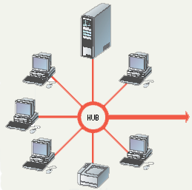
Star Topology

Slide 112
Network Topologies
Ring topology
Nodes connected in a circle
Tokens used to transmit data
Nodes must wait for token to send
Advantages
Time to send data is known
No data collisions
Disadvantages
Slow
Lots of cable

Slide 113
Network Topologies
Mesh topology
All computers connected together
Internet is a mesh network
Advantage
Data will always be delivered
Disadvantages
Lots of cable
Hard to setup

Slide 114
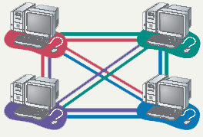
Mesh Topology

Slide 115
Network Media
Links that connect nodes
Choice impacts
Speed
Security
Size

Slide 116
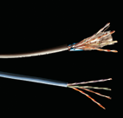
Wire Based Media
Twisted-pair cabling
Most common LAN cable
Called Cat5 or 100BaseT
Four pairs of copper cable twisted
May be shielded from interference
Speeds range from 1 Mbps to 1,000 Mbps
Notes:
Insider information
Interference is usually electrical. Magnets, solar flares or electronic devices generate interference.

Slide 117
Wire Based Media
Coaxial cable
Similar to cable TV wire
One wire runs through cable
Shielded from interference
Speeds up to 10 Mbps
Nearly obsolete

Slide 118
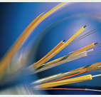
Wire Based Media
Fiber-optic cable
Data is transmitted with light pulses
Glass strand instead of cable
Immune to interference
Very secure
Hard to work with
Speeds up to 100 Gbps
Notes:
Teaching tip
Remind students that bps is bits per second. Gbps then is billion bits per second.

Slide 119
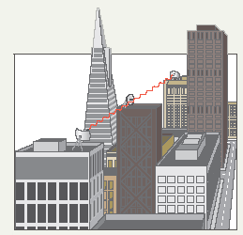
Wireless Media
Data transmitted through the air
LANs use radio waves
WANs use microwave signals
Easy to setup
Difficult to secure
Notes:
Teaching tip
Now is the time to briefly discuss 802.11 standards. A full discussion of 802.11 is covered in the next section.

Slide 120

Network Hardware
Network interface cards
Network adapter
Connects node to the media
Unique Machine Access Code (MAC)
Notes:
Insider Information
The Xerox Corporation controls the assignment of Ethernet addresses to NIC manufacturers.

Slide 121
Network Hardware
Network linking devices
Connect nodes in the network
Cable runs from node to device
Crossover cable connects two computers

Slide 122
Network Hardware
Hubs
Center of a star network
All nodes receive transmitted packets
Slow and insecure

Slide 123
Network Hardware
Switches
Replacement for hubs
Only intended node receives transmission
Fast and secure
Notes:
Insider information
Twisted pair networks cannot achieve higher than 10 Mbps using a hub. Switches are necessary to achieve 100 Mbps or higher.

Slide 124
Network Hardware
Bridge
Connects two or more LANs together
Packets sent to remote LAN cross
Other packets do not cross
Segments the network on MAC addresses

Slide 125

Network Hardware
Router
Connects two or more LANs together
Packets sent to remote LAN cross
Network is segmented by IP address
Connect internal networks to the Internet
Need configured before installation
Notes:
Discussion point
Ask who in the class has high speed Internet. Then determine if anyone is sharing this to the rest of the house or dorm. If they are, see if they can describe the setup. Most likely, the sharing is done with a router.

Slide 126
Network Hardware
Gateway
Connects two dissimilar networks
Connects coax to twisted pair
Most gateways contained in other devices

Slide 127
Network Cabling
Cabling specifications
Bandwidth measures cable speed
Typically measured in Mbps
Maximum cable length
Connector describes the type of plug

Slide 128

Network Cabling
Ethernet
Very popular cabling technology
10 Base T, 10Base2, 10Base5
Maximum bandwidth 10 Mbps
Maximum distances100 to 500 meters

Slide 129
Network Cabling
Fast Ethernet
Newer version of Ethernet
Bandwidth is 100 Mbps
Uses Cat5 or greater cable
Sometimes called 100Base T
Requires a switch
Notes:
Teaching tip
Point out that the speed of the cable is the number before the word Base.

Slide 130
Network Cabling
Gigabit Ethernet
High bandwidth version of Ethernet
1 to 10 Gbps
Cat 5 or fiber optic cable
Video applications

Slide 131
Network Cabling
Token ring
Uses shielded twisted pair cabling
Bandwidth between 10 and 25 Mbps
Uses a multiple access unit (MAU)
Popular in manufacturing and finance

Slide 132
Network Protocols
Language of the network
Rules of communication
Error resolution
Defines collision and collision recovery
Size of packet
Naming rules for computers

Slide 133
Network Protocols
TCP/IP
Transmission Control Protocol/Internet Protocol
Most popular protocol
Machines assigned a name of 4 numbers
IP address
209.8.166.179 is the White House’s web site
Dynamic Host Configuration Protocol
Simplifies assignment of IP addresses
Required for Internet access
Notes:
Teaching tip
Have students determine IP addresses for the computer. On 2000/XP enter ipconfig /all. Windows 98 and back enter winipcfg.

Slide 134
Network Protocols
IPX/SPX
Internet Packet Exchange/Sequenced Packet Exchange
Older protocol
Associated with Novell Netware
Replaced by TCP/IP

Slide 135
Network Protocols
NetBEUI
Network BIOS Extended User Interface
Used by Windows to name computers
Transmission details handled by TCP/IP
Notes:
Discussion Point
Have students tell you what BIOS stands for.

Slide 136
Network Protocols
Token ring
Popular in manufacturing and finance
Nodes communicate when they have the token

Slide 137
Network Models
We use the concept of layers in our daily life. As an example, let us consider two friends who communicate through postal mail. The process of sending a letter to a friend would be complex if there were no services available from the post office.
Topics discussed in this section:
Sender, Receiver, and Carrier Hierarchy

Slide 138
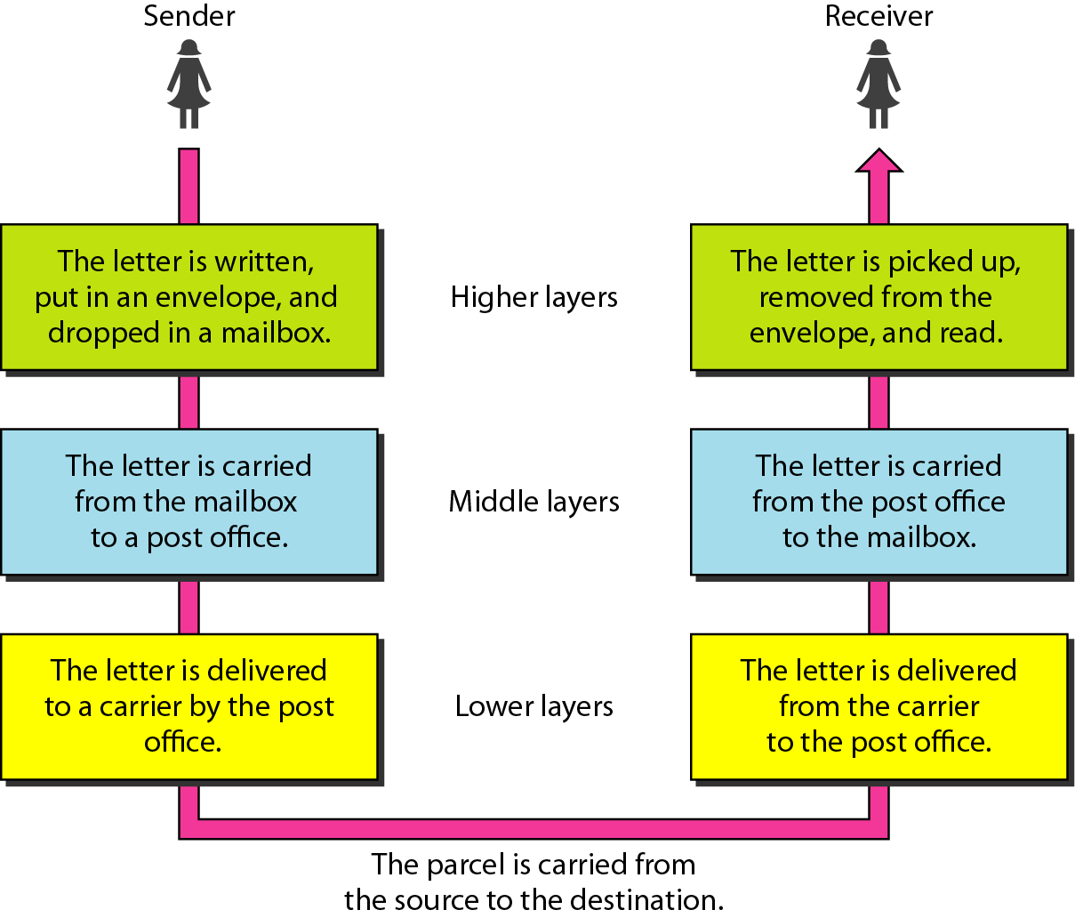
Figure 2.1 Tasks involved in sending a letter

Slide 139
2-2 THE OSI MODEL
Established in 1947, the International Standards Organization (ISO) is a multinational body dedicated to worldwide agreement on international standards. An ISO standard that covers all aspects of network communications is the Open Systems Interconnection (OSI) model. It was first introduced in the late 1970s.
Topics discussed in this section:
Layered Architecture Peer-to-Peer Processes
Encapsulation

Slide 140

Note
ISO is the organization. OSI is the model.

Slide 141
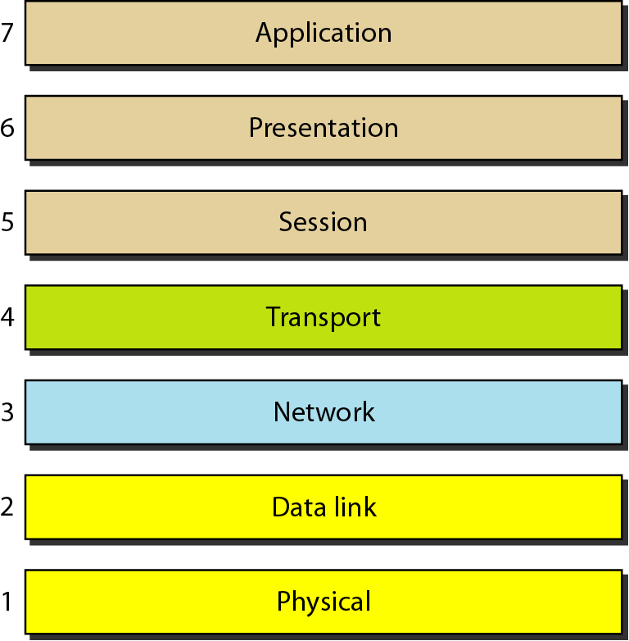
Figure 2.2 Seven layers of the OSI model

Slide 142
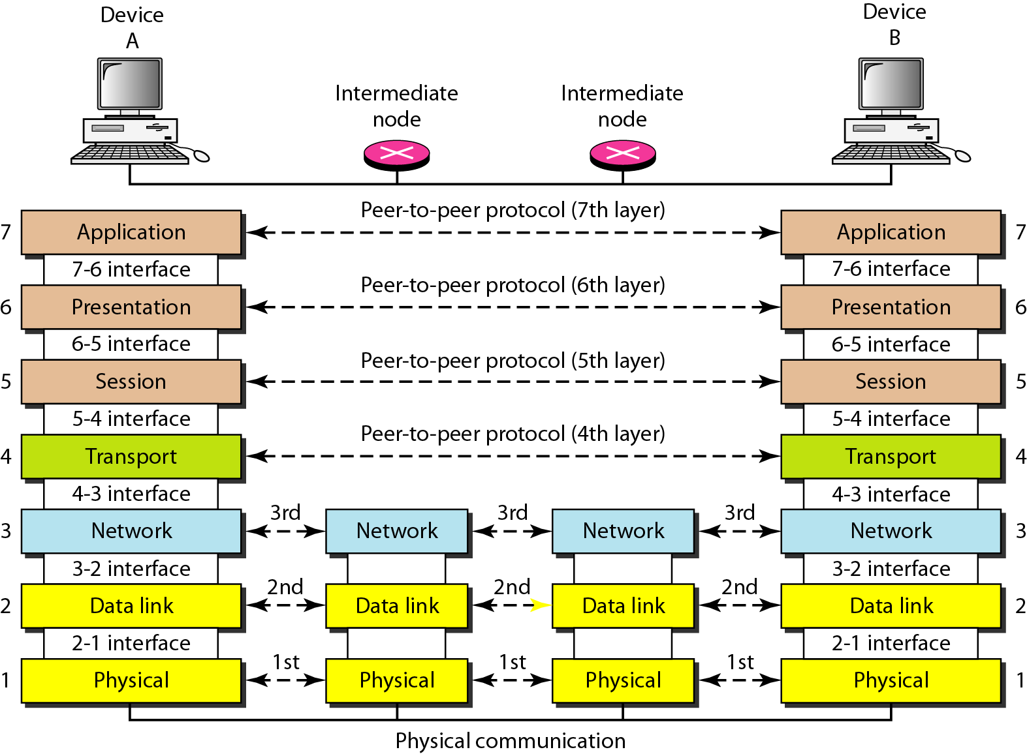
Figure 2.3 The interaction between layers in the OSI model

Slide 143
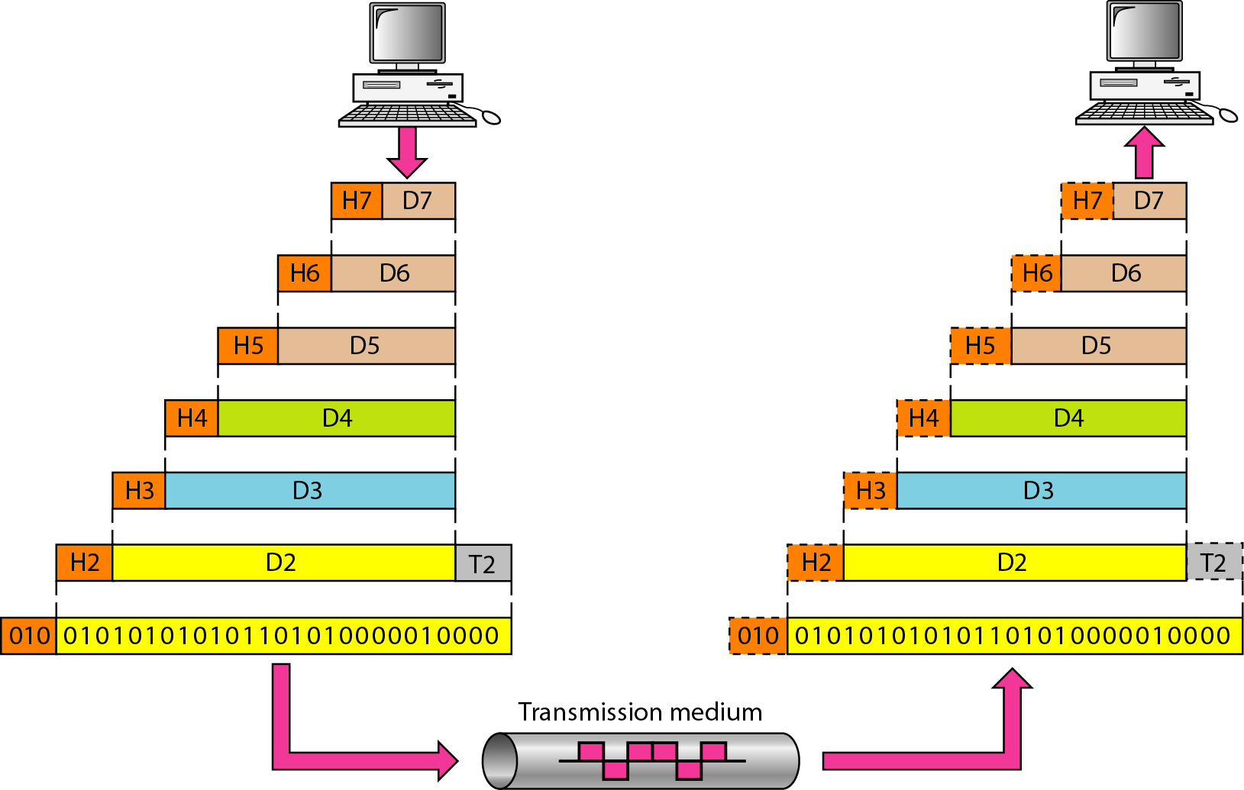
Figure 2.4 An exchange using the OSI model

Slide 144
2-3 LAYERS IN THE OSI MODEL
In this section we briefly describe the functions of each layer in the OSI model.
Topics discussed in this section:
Physical Layer Data Link Layer
Network Layer
Transport Layer
Session Layer
Presentation Layer
Application Layer

Slide 145
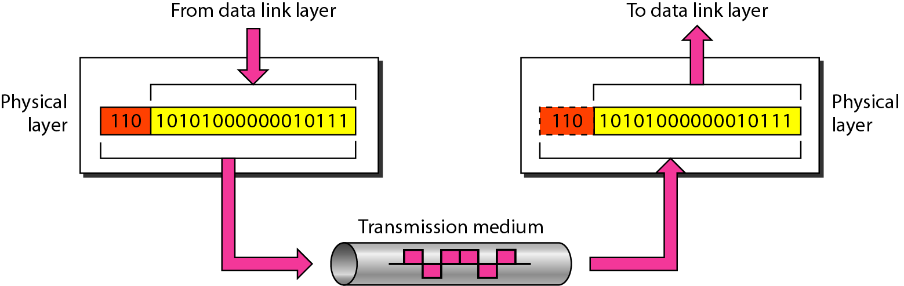
Figure 2.5 Physical layer

Slide 146
Note
The physical layer is responsible for movements of
individual bits from one hop (node) to the next.

Slide 147
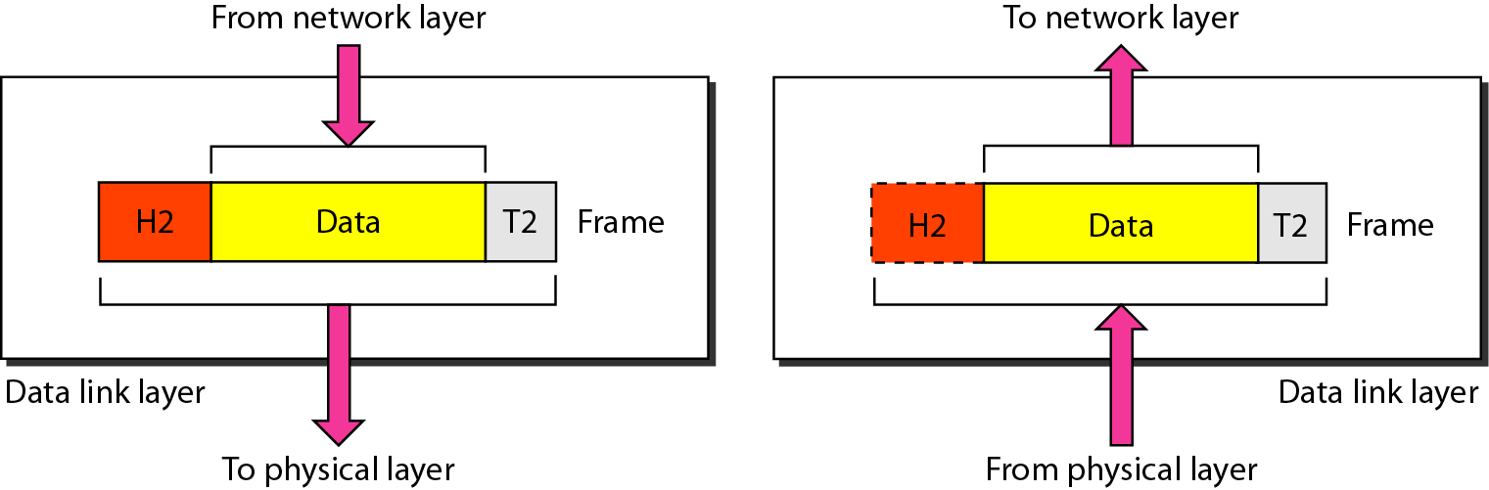
Figure 2.6 Data link layer

Slide 148
Note
The data link layer is responsible for moving frames from one hop (node) to the next.

Slide 149
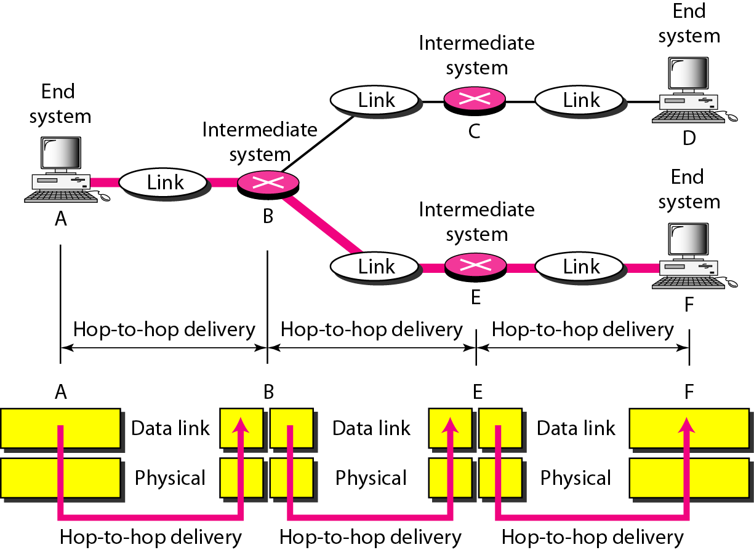
Figure 2.7 Hop-to-hop delivery

Slide 150
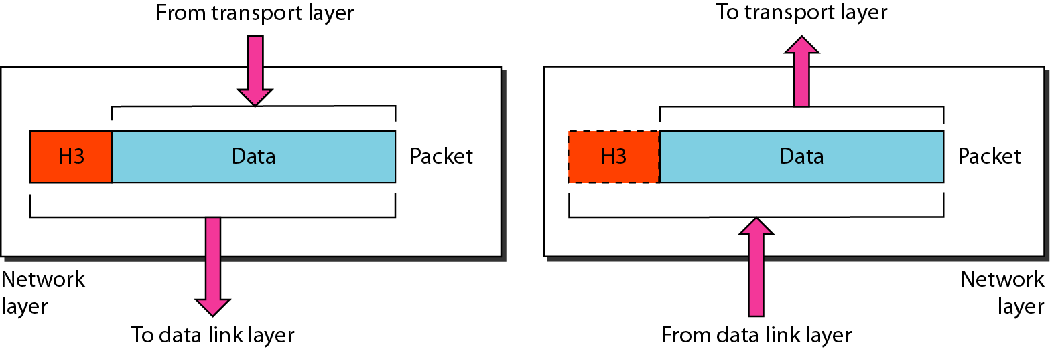
Figure 2.8 Network layer

Slide 151
Note
The network layer is responsible for the delivery of individual packets from
the source host to the destination host.

Slide 152
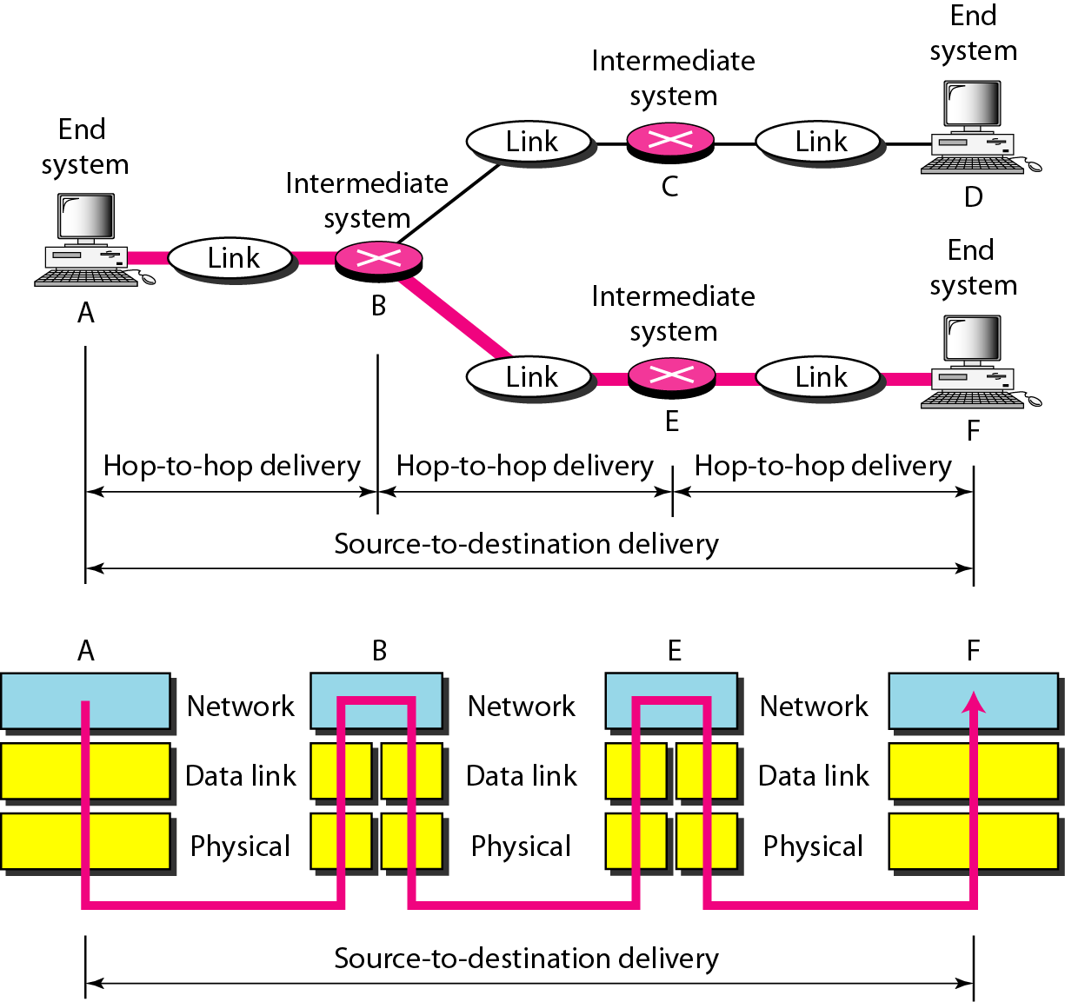
Figure 2.9 Source-to-destination delivery

Slide 153
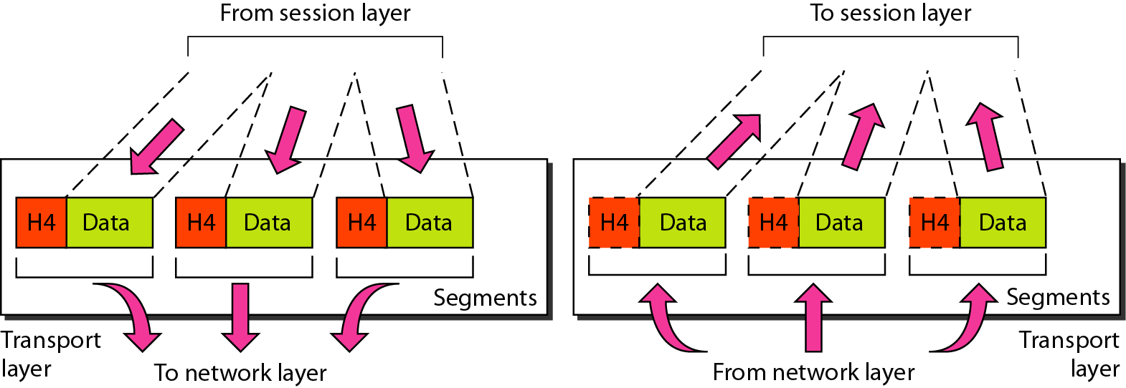
Figure 2.10 Transport layer

Slide 154
Note
The transport layer is responsible for the delivery of a message from one process to another.

Slide 155
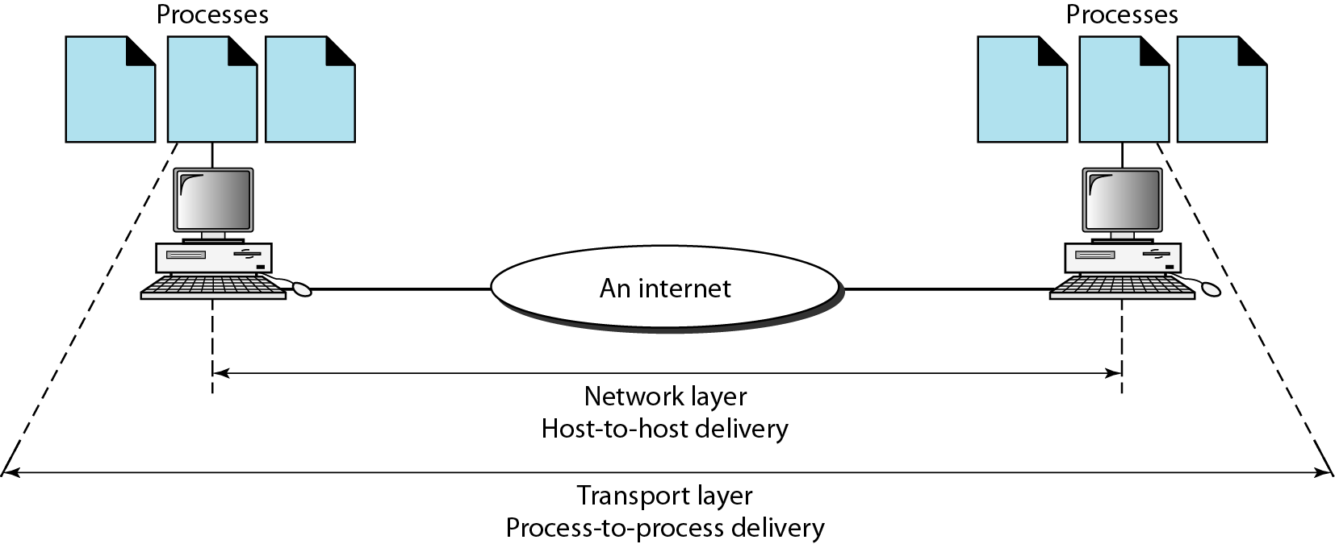
Figure 2.11 Reliable process-to-process delivery of a message

Slide 156
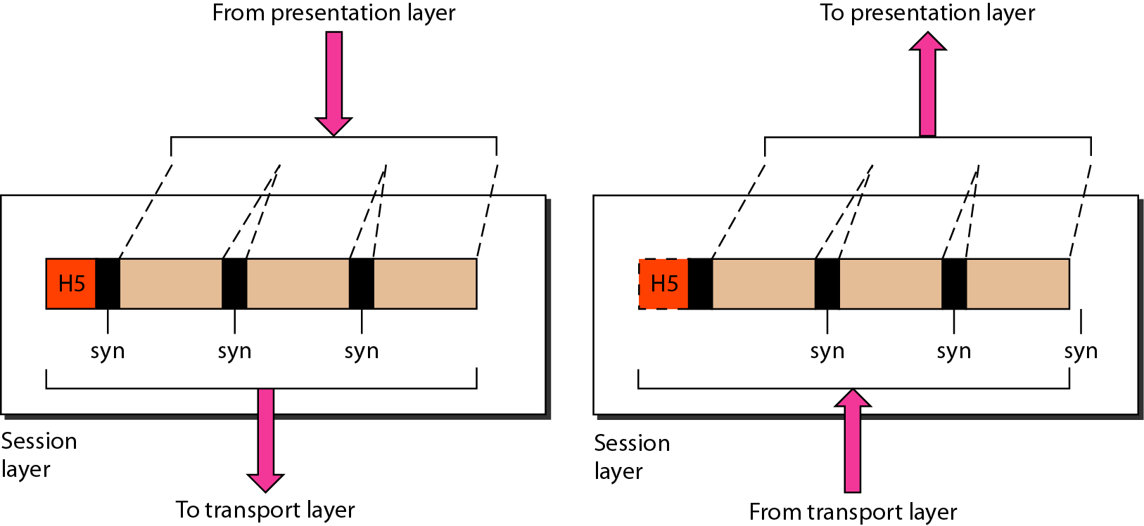
Figure 2.12 Session layer

Slide 157
Note
The session layer is responsible for dialog control and synchronization.

Slide 158
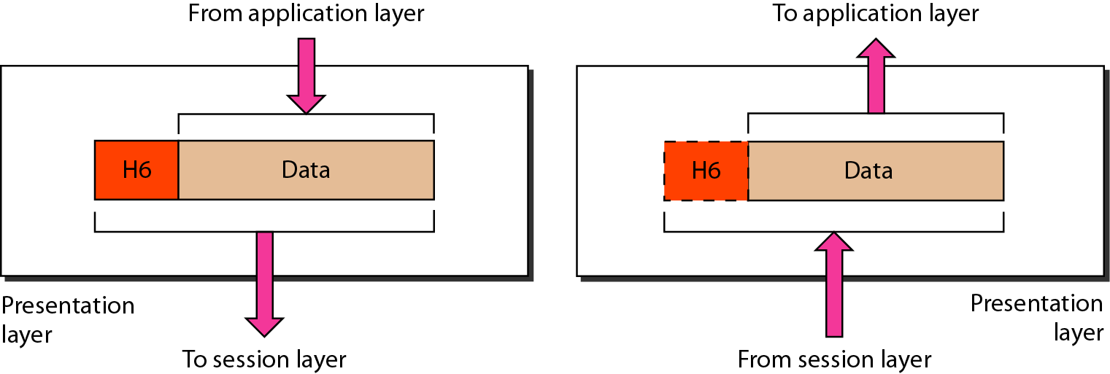
Figure 2.13 Presentation layer

Slide 159
Note
The presentation layer is responsible for translation, compression, and encryption.

Slide 160
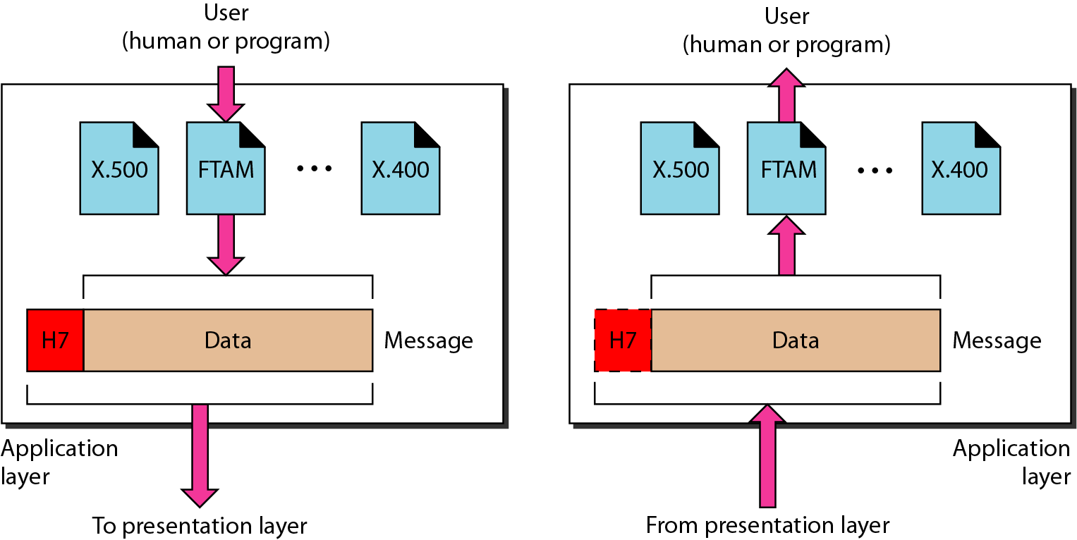
Figure 2.14 Application layer

Slide 161
Note
The application layer is responsible for providing services to the user.

Slide 162
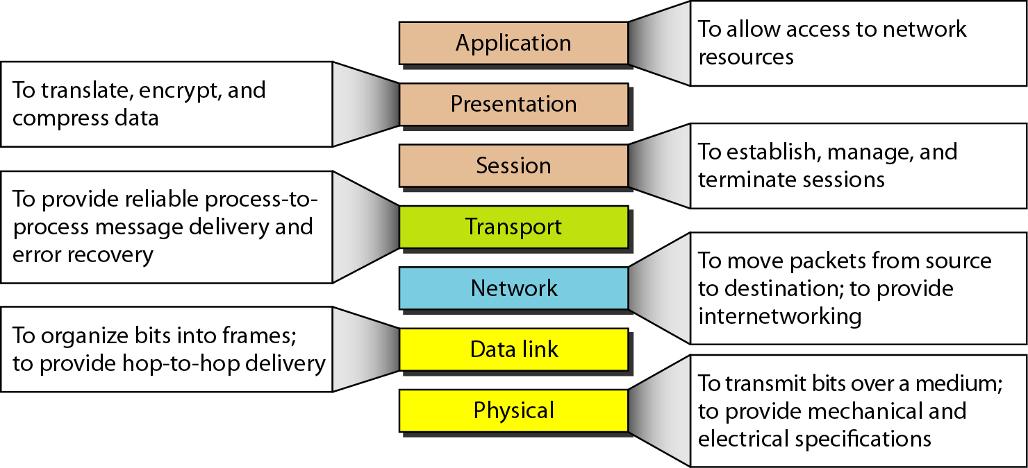
Figure 2.15 Summary of layers

Slide 163
2-4 TCP/IP PROTOCOL SUITE
The layers in the TCP/IP protocol suite do not exactly match those in the OSI model. The original TCP/IP protocol suite was defined as having four layers: host-to-network, internet, transport, and application. However, when TCP/IP is compared to OSI, we can say that the TCP/IP protocol suite is made of five layers: physical, data link, network, transport, and application.
Topics discussed in this section:
Physical and Data Link Layers Network Layer Transport Layer
Application Layer

Slide 164
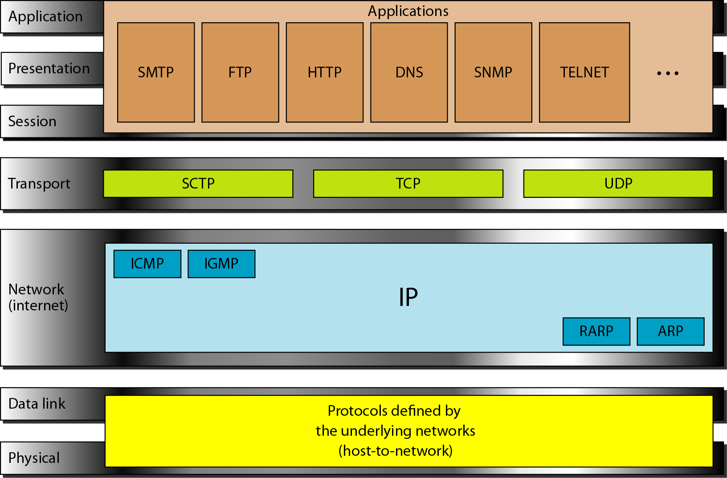
Figure 2.16 TCP/IP and OSI model

Slide 165
2-5 ADDRESSING
Four levels of addresses are used in an internet employing the TCP/IP protocols: physical, logical, port, and specific.
Topics discussed in this section:
Physical Addresses Logical Addresses Port Addresses Specific Addresses

Slide 166
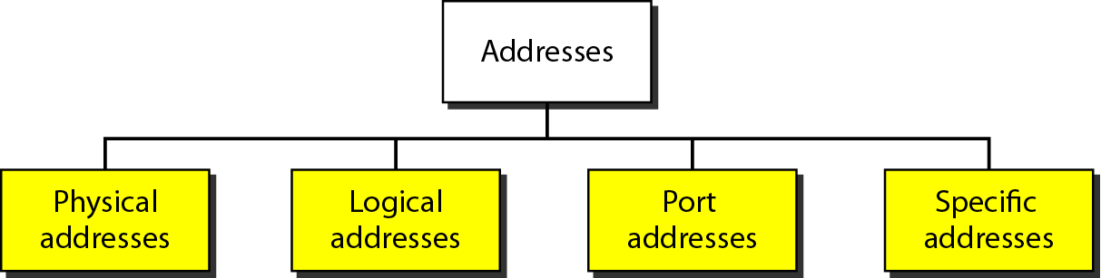
Figure 2.17 Addresses in TCP/IP

Slide 167
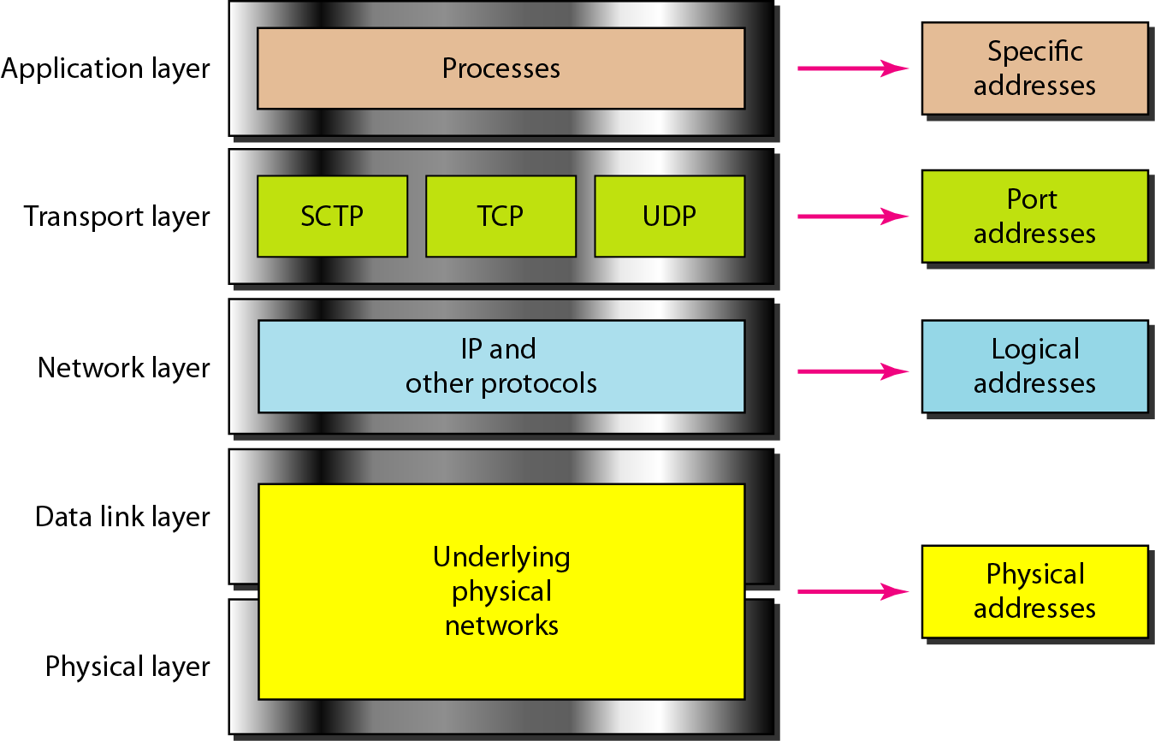
Figure 2.18 Relationship of layers and addresses in TCP/IP

Slide 168
Example 2.1
In Figure 2.19 a node with physical address 10 sends a frame to a node with physical address 87. The two nodes are connected by a link (bus topology LAN). As the figure shows, the computer with physical address 10 is the sender, and the computer with physical address 87 is the receiver.

Slide 169
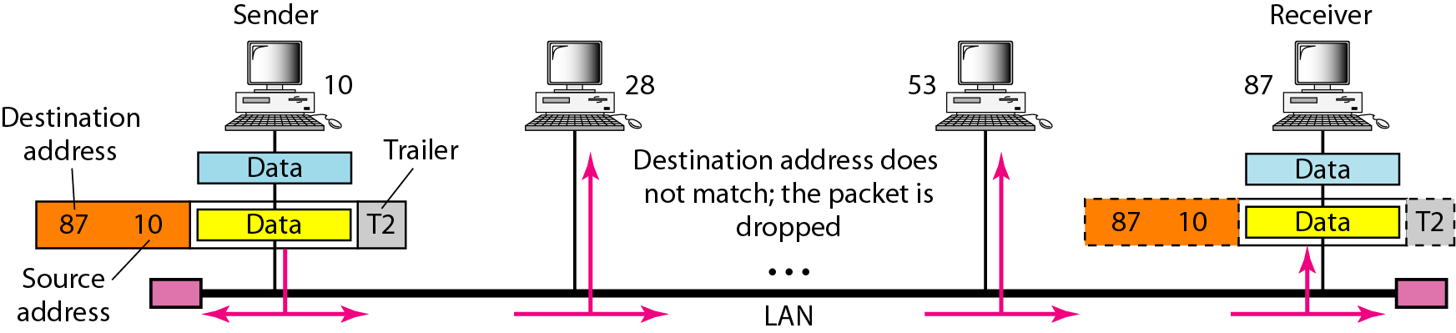
Figure 2.19 Physical addresses

Slide 170
Example 2.2
Most local-area networks use a 48-bit (6-byte) physical address written as 12 hexadecimal digits; every byte (2 hexadecimal digits) is separated by a colon, as shown below:
07:01:02:01:2C:4B
A 6-byte (12 hexadecimal digits) physical address.

Slide 171
Example 2.3
Figure 2.20 shows a part of an internet with two routers connecting three LANs. Each device (computer or router) has a pair of addresses (logical and physical) for each connection. In this case, each computer is connected to only one link and therefore has only one pair of addresses. Each router, however, is connected to three networks (only two are shown in the figure). So each router has three pairs of addresses, one for each connection.

Slide 172

Figure 2.20 IP addresses

Slide 173
Example 2.4
Figure 2.21 shows two computers communicating via the Internet. The sending computer is running three processes at this time with port addresses a, b, and c. The receiving computer is running two processes at this time with port addresses j and k. Process a in the sending computer needs to communicate with process j in the receiving computer. Note that although physical addresses change from hop to hop, logical and port addresses remain the same from the source to destination.

Slide 174

Figure 2.21 Port addresses

Slide 175
Note
The physical addresses will change from hop to hop,
but the logical addresses usually remain the same.

Slide 176
Example 2.5
A port address is a 16-bit address represented by one decimal number as shown.
753
A 16-bit port address represented as one single number.

Slide 177
Transmission Media
The transmission medium is the physical path by which a message travels from sender to receiver.
Computers and telecommunication devices use signals to represent data.
These signals are transmitted from a device to another in the form of electromagnetic energy.
Examples of Electromagnetic energy include power, radio waves, infrared light, visible light, ultraviolet light, and X and gamma rays.
All these electromagnetic signals constitute the electromagnetic spectrum

Slide 178

Not all portion of the spectrum are currently usable for telecommunications
Each portion of the spectrum requires a particular transmission medium

Slide 179
Signals of low frequency (like voice signals) are generally transmitted as current over metal cables. It is not possible to transmit visible light over metal cables, for this class of signals is necessary to use a different media, for example fiber-optic cable.

Slide 180
Classes of transmission media

Slide 181
Transmission Media
Guided media, which are those that provide a conduit from one device to another.
Examples: twisted-pair, coaxial cable, optical fiber.
Unguided media (or wireless communication) transport electromagnetic waves without using a physical conductor. Instead, signals are broadcast through air (or, in a few cases, water), and thus are available to anyone who has a device capable of receiving them.

Slide 182
Guided Media
There are three categories of guided media:
Twisted-pair cable
Coaxial cable
Fiber-optic cable

Slide 183

Twisted-pair cable
Twisted pair consists of two conductors (normally copper), each with its own plastic insulation, twisted together.
Twisted-pair cable comes in two forms: unshielded and shielded
The twisting helps to reduce the interference (noise) and crosstalk.

Slide 184


Slide 185

UTP and STP

Slide 186

Frequency range for twisted-pair cable

Slide 187

Unshielded Twisted-pair (UTP) cable
Any medium can transmit only a fixed range of frequencies!
UTP cable is the most common type of telecommunication medium in use today.
The range is suitable for transmitting both data and video.
Advantages of UTP are its cost and ease of use. UTP is cheap, flexible, and easy to install.

Slide 188
The Electronic Industries Association (EIA) has developed standards to grade UTP.
Category 1. The basic twisted-pair cabling used in telephone systems. This level of quality is fine for voice but inadequate for data transmission.
Category 2. This category is suitable for voice and data transmission of up to 2Mbps.
Category 3.This category is suitable for data transmission of up to 10 Mbps. It is now the standard cable for most telephone systems.
Category 4. This category is suitable for data transmission of up to 20 Mbps.
Category 5. This category is suitable for data transmission of up to 100 Mbps.

Slide 189
Table 7.1 Categories of unshielded twisted-pair cables
Category | Bandwidth | Data Rate | Digital/Analog | Use
1 | very low | < 100 kbps | Analog | Telephone
2 | < 2 MHz | 2 Mbps | Analog/digital | T-1 lines
3 | 16 MHz | 10 Mbps | Digital | LANs
4 | 20 MHz | 20 Mbps | Digital | LANs
5 | 100 MHz | 100 Mbps | Digital | LANs
6 (draft) | 200 MHz | 200 Mbps | Digital | LANs
7 (draft) | 600 MHz | 600 Mbps | Digital | LANs

Slide 190
UTP connectors
The most common UTP connector is RJ45 (RJ stands for Registered Jack).

Slide 191
Shielded Twisted (STP) Cable
STP cable has a metal foil or braided-mesh covering that enhances each pair of insulated conductors.
The metal casing prevents the penetration of electromagnetic noise.
Materials and manufacturing requirements make STP more expensive than UTP but less susceptible to noise.

Slide 192
Applications
Twisted-pair cables are used in telephones lines to provide voice and data channels.
The DSL lines that are used by the telephone companies to provide high data rate connections also use the high-bandwidth capability of unshielded twisted-pair cables.
Local area networks, such as 10Base-T and 100Base-T, also used UTP cables.

Slide 193
Coaxial Cable (or coax)
Coaxial cable carries signals of higher frequency ranges than twisted-pair cable.
Coaxial Cable standards:
RG-8, RG-9, RG-11 are
used in thick Ethernet
RG-58 Used in thin Ethernet
RG-59 Used for TV

Slide 194
BNC connectors
To connect coaxial cable to devices, it is necessary to use
coaxial connectors. The most common type of connector is the Bayone-Neill-Concelman, or BNC, connectors. There are three
types: the BNC connector, the BNC T connector, the BNC terminator.
Applications include cable TV networks, and some traditional Ethernet LANs like 10Base-2, or 10-Base5.

Slide 195
Optical Fiber
Metal cables transmit signals in the form of electric current.
Optical fiber is made of glass or plastic and transmits signals in the form of light.
Light, a form of electromagnetic energy, travels at 300,000 Kilometers/second ( 186,000 miles/second), in a vacuum.
The speed of the light depends on the density of the medium through which it is traveling ( the higher density, the slower the speed).

Slide 196
The Nature of the Light
Light travels in a straight line as long as it is moving through a single uniform substance.
If a ray of light traveling through one substance suddenly enters another (less or more dense) substance, its speed changes abruptly, causing the ray to change direction. This change is called refraction.

Slide 197
Refraction

Slide 198
Critical angle
If the angle of incidence increases, so does the angle of refraction.
The critical angle is defined to be an angle of incidence for which the angle of refraction is 90 degrees.

Slide 199
Reflection
When the angle of incidence becomes greater than the critical angle, a new phenomenon occurs called reflection.
Light no longer passes into the less dense medium at all.

Slide 200

Critical Angle

Slide 201
Optical fibers use reflection to guide light through a channel.
A glass or core is surrounded by a cladding of less dense glass or plastic. The difference in density of the two materials must be such that a beam of light moving through the core is reflected off the cladding instead of being into it.
Information is encoded onto a beam of light as a series of on-off flashes that represent 1 and 0 bits.

Slide 202
Fiber construction

Slide 203
Types of Optical Fiber
There are two basic types of fiber: multimode fiber and single-mode fiber.
Multimode fiber is best designed for short transmission distances, and is suited for use in LAN systems and video surveillance.
Single-mode fiber is best designed for longer transmission distances, making it suitable for long-distance telephony and multichannel television broadcast systems.

Slide 204
Propagation Modes (Types of Optical Fiber )
Current technology supports two modes for propagating light along optical channels, each requiring fiber with different physical characteristics: Multimode
and Single Mode.
Multimode, in turn, can be implemented in two forms: step-index or graded index.

Slide 205
Multimode: In this case multiple beams from a light source move through the core in different paths.
In multimode step-index fiber, the density of the core remains constant from the center to the edges. A beam of light moves through this constant density in a straight line until it reaches the interface of the core and cladding. At the interface there is an abrupt change to a lower density that alters the angle of the beam’s motion.
In a multimode graded-index fiber the density is highest at the center of the core and decreases gradually to its lowest at the edge.

Slide 206
Propagation Modes

Slide 207
Single mode uses step-index fiber and a highly focused source of light that limits beams to a small range of angles, all close to the horizontal.
Fiber Sizes
Optical fibers are defined by the ratio of the diameter of their core to the diameter of their cladding, both expressed in microns (micrometers)
Type | Core | Cladding | Mode
50/125 | 50 | 125 | Multimode, graded-index
62.5/125 | 62.5 | 125 | Multimode, graded-index
100/125 | 100 | 125 | Multimode, graded-index
7/125 | 7 | 125 | Single-mode

Slide 208
Light sources for optical fibers
The purpose of fiber-optic cable is to contain and direct a beam of light from source to target.
The sending device must be equipped with a light source and the receiving device with photosensitive cell (called a photodiode) capable of translating the received light into an electrical signal.
The light source can be either a light-emitting diode (LED) or an injection laser diode.

Slide 209
Fiber-optic cable connectors
The subscriber channel (SC) connector is used in cable TV. It uses a push/pull locking system. The straight-tip (ST) connector is used for connecting cable to networking devices. MT-RJ is a new connector with the same size as RJ45.

Slide 210
Advantages of Optical Fiber
The major advantages offered by fiber-optic cable over twisted-pair and coaxial cable are noise resistance, less signal attenuation, and higher bandwidth.
Noise Resistance: Because fiber-optic transmission uses light rather than electricity, noise is not a factor. External light, the only possible interference, is blocked from the channel by the outer jacket.

Slide 211
Advantages of Optical Fiber
Less signal attenuation
Fiber-optic transmission distance is significantly greater than that of other guided media. A signal can run for miles without requiring regeneration.
Higher bandwidth
Currently, data rates and bandwidth utilization over fiber-optic cable are limited not by the medium but by the signal generation and reception technology available.

Slide 212
Disadvantages of Optical Fiber
The main disadvantages of fiber optics are cost, installation/maintenance, and fragility.
Cost. Fiber-optic cable is expensive. Also, a laser light source can cost thousands of dollars, compared to hundreds of dollars for electrical signal generators.
Installation/maintenance
Fragility. Glass fiber is more easily broken than wire, making it less useful for applications where hardware portability is required.

Slide 213
Unguided Media
Unguided media, or wireless communication, transport electromagnetic waves without using a physical conductor. Instead the signals are broadcast though air or water, and thus are available to anyone who has a device capable of receiving them.
The section of the electromagnetic spectrum defined as radio communication is divided into eight ranges, called bands, each regulated by government authorities.

Slide 215
Propagation of Radio Waves
Radio technology considers the earth as surrounded by two layers of atmosphere: the troposphere and the ionosphere.
The troposphere is the portion of the atmosphere extending outward approximately 30 miles from the earth's surface.
The troposphere contains what we generally think of as air. Clouds, wind, temperature variations, and weather in general occur in the troposphere.
The ionosphere is the layer of the atmosphere above the troposphere but below space.

Slide 216
Propagation methods

Slide 217
Ground propagation. In ground propagation, radio waves travel through the lowest portion of the atmosphere, hugging the earth. These low-frequency signals emanate in all directions from the transmitting antenna and follow the curvature of the planet. The distance depends on the power in the signal.
In Sky propagation, higher-frequency radio waves radiate upward into the ionosphere where they are reflected back to earth. This type of transmission allows for greater distances with lower power output.
In Line-of-Sight Propagation, very high frequency signals are transmitted in straight lines directly from antenna to antenna.

Slide 218
Bands
Band | Range | Propagation | Application
VLF | 3–30 KHz | Ground | Long-range radio navigation
LF | 30–300 KHz | Ground | Radio beacons and navigational locators
MF | 300 KHz–3 MHz | Sky | AM radio
HF | 3–30 MHz | Sky | Citizens band (CB), ship/aircraft communication
VHF | 30–300 MHz | Sky and line-of-sight | VHF TV, FM radio
UHF | 300 MHz–3 GHz | Line-of-sight | UHF TV, cellular phones, paging, satellite
SHF | 3–30 GHz | Line-of-sight | Satellite communication
EHF | 30–300 GHz | Line-of-sight | Long-range radio navigation

Slide 219
Propagation of Specific Signals
VLF Very Low Frequency waves are propagated as surface waves, usually through the air but some times through seawater. VLF waves do not suffer much attenuation in transmission but are susceptible to the high levels of atmospheric noise ( heat and electricity) active at low altitudes.
VLF waves are use mostly for long-range radio navigation and for submarine communication.

Slide 220


LF low frequency waves are also propagated as surface waves. LF waves are used for long-range radio navigation and for radio beacons or navigational locators.
MF Middle frequency signals are propagated in the troposphere. Uses for MF transmissions include AM radio, maritime radio, and emergency frequencies.

Slide 221

HF high frequency signals use ionospheric propagation. These frequencies move into the ionosphere, where they are reflected back to earth. Uses for HF signals include amateur radio, citizen’s band (CB) radio, military communication, long-distance aircraft and ship communication, telephone, telegraph, and fax.

Slide 222


VHF Most very high frequency waves use line-of-sight propagation. Uses for VHF include VHF television, FM radio, and aircraft navigational aid.
UHF Ultrahigh frequency waves always use line-of-sight propagation. Uses for UHF includes UHF television, mobile telephone, cellular radio, and microwave links.

Slide 223


SHF Superhigh frequency waves are transmitted using mostly line-of-sight and some space propagation. Uses for SHF include terrestrial and satellite microwave and radar communication.
EHF Extremely high frequency waves use space propagation. Uses for EHF are predominantly scientific and include radar, satellite and experimental communications.

