Slide 1
Chapter 3
Linked List Data Structure and its applications

Slide 2
Lists - Introduction
Some applications require processing data in a strict chronological order.
Example:
Processing objects in the order that they arrived.
OR
Processing objects in the reverse of the order that they arrived.
For all these situations, a simple list structure is appropriate.

Slide 3
Lists – Definition
A list is a finite, ordered sequence of data items called elements.
Important concept: List elements have a position.
[1st element in the list, 2nd element, and so on.]
Notation: <a₀, a₁, …, a_{n-1}>
[“Ordered”: the positions are ordered, NOT the values.]
Each list element has a data type (all same data type, but not necessarily).
Notes:
Students should already be familiar with lists.
Chapter objective: Use algorithm analysis in a familiar context to compare implementations.

Slide 4
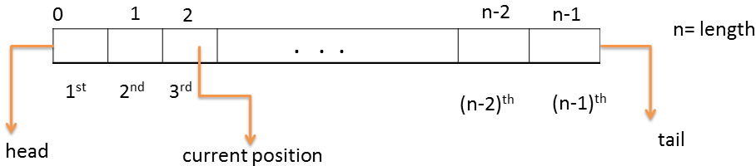
Cont’d
The empty list contains no elements.
The length of the list is the number of elements currently stored.
The beginning of the list is called the head, the end of the list is called the tail.

Slide 5
Cont’d
Sorted lists have their elements positioned in ascending or descending order of value, while unsorted lists have no necessary relationship between element values and positions.
What operations should we implement?
[Design the basic operations first]

Slide 6
List Implementation Concepts
Our list implementation will support the concept of a current position.
Basic operations:
Add, find and delete element anywhere, next, previous, clear (reinitialize), test for empty.

Slide 7
Types of Data Structures to implement list
There are two broad types of data structure based on their memory allocation:
Static Data Structures
Dynamic Data Structures

Slide 8
Static Data Structures
Are data structures that are defined & allocated before execution, thus the size cannot be changed during time of execution.
Example: Array implementation of ADTs.
Dynamic Data Structure
Are data structure that can grow and shrink in size or permits discarding of unwanted memory during execution time.
Example: Linked list implementation of ADTs.

Slide 9
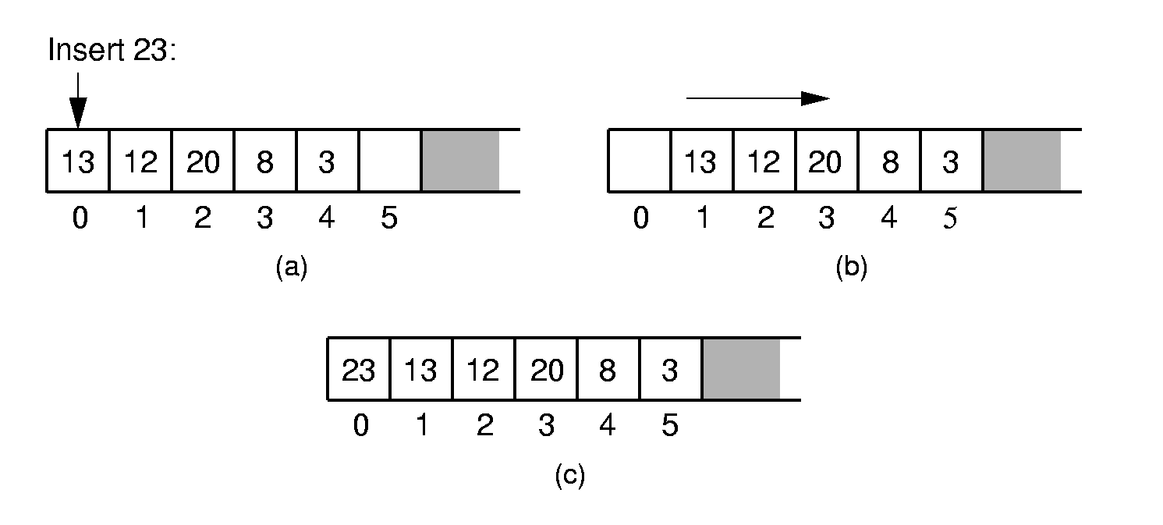
Array-Based List Implementation
[There are two standard approaches to implementing lists, the array-based list and the linked list.]
Array-Based List Insert:
[Push items up/down. Cost: Θ(n).]
Inserting an element at the head of an array-based list requires shifting all existing elements in the array by one position toward the tail.

Slide 10
Array-Based List Class (1)
//Array-based list
class AList : public List{
private:
int maxSize; // Maximum size of list
int listSize; // Actual elem count
int curr; // Position of curr
datatype listArray; // Array holding list
public:
AList(int size = DefaultListSize){// Constructor
maxSize = size;
listSize = curr = 0;
listArray = new datatype[maxSize];
}
~AList() { delete [] listArray; } // Destructor

Slide 11
Array-Based List Class (2)
void clear() { //Reinitialize the list
delete [] listArray;
listSize = curr = 0;
listArray = new datatype[maxSize];
}
void setStart() { curr = 0; }
void setEnd() { curr = listSize; }
void prev() { if (curr != 0) curr--; }
void next() { if (curr <= listSize)
curr++; }
int length() { return listSize; }
bool setPos(int pos) {
if ((pos >= 0) && (pos <= listSize))
curr = pos;
return (pos >= 0) && (pos <= listSize);
}

Slide 12
Array-Based List Class (3)
//get current value
bool getValue(){
if (listSize == 0)return false;
else{
it = listArray[curr];
return true;}
}
// Insert at current position
bool insert(datatype item) {
if (listSize == maxSize) return false;
for(int i=listSize; i>curr; i--)
// Shift Elems up to make room
listArray[i] = listArray[i-1];
listArray[curr] = item;
listSize++; // Increment list size
return true;
}

Slide 13
Array-Based List Class (4)
// Append element to end of the list
bool append(datatype item) {
if (listSize == maxSize) return false;
listArray[listSize++] = item;
return true;
}
// Remove and return curr element
bool remove() {
if (length() == 0) return false;
it = listArray[curr]; // Copy element
for(int i=curr; i<listSize-1; i++)
// Shift them down
listArray[i] = listArray[i+1];
listSize--; // Decrement size
return true;
}
…………
}

Slide 14
Revision to Structure
Is a collection of data items and the data items can be of different data type.
The data item of structure is called member of the structure.
Declaration of structure
Structure is defined using the struct keyword.
struct name {
data type1 member 1;
data type2 member 2
.
.
data type n member n;
};

Slide 15
Example :
struct student {
char name[20];
int age;
char Dept[20];
};
The struct keyword creates a new user defined data type that is used to declare variable of an aggregated data type.

Slide 16
Accessing Members of Structure Variables
The Dot operator (.): to access data members of
structure variables.
The Arrow operator (->): to access data members of
pointer variables pointing to the structure.
Example:
struct student stud;
struct student *studptr;
cout<<stud.name;
OR
cout<<studptr->name;

Slide 17
Self-Referential Structures
Structures can hold pointers to instances of themselves.
Example:
struct student{
char name[20];
int age;
char Dept[20];
struct student *next;
};

Slide 18
Linked List- Based List Implementation
The second approach for implementing lists makes use of pointers and is called a linked list.
The linked list uses dynamic memory allocation, i.e. it allocates memory for new list elements as needed
Is self-referential structure.
Is a collection of elements called nodes, each of which stores two types of fields. Data items and a pointer to next node.
The data field: holds the actual elements on the list.
The pointer field: contains the address of the next
node in the list.

Slide 19
A linked list can be represented by a diagram like this one:
node
A
data
pointer
A
B
C
∅
Start
Start (Head): Special pointer that points to the first
node of a linked list, so that we can keep track of the linked list.
The last node should point to NULL to show that
it is the last link in the chain (in the linked list).

Slide 20
Types of Lists
There are two basic types of linked list
Singly Linked list
Doubly linked list

Slide 21
Singly Linked List
Each node has only one link part.
Each link part contains the address of the next node in the list.
Link part of the last node contains NULL value (special value) which signifies the end of the node.

Slide 22
Schematic Representation
Here is a singly-linked list (SLL):
start
a
b
c
d
Each node contains a value(data) and a pointer to the next node in the list.
Start is the header pointer which points at the first node in the list.

Slide 23
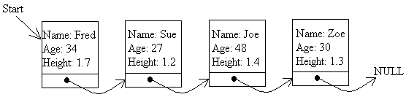
Example
This linked list has four nodes in it, each with a
link to the next node in the series (in the linked
list).

Slide 24
Basic Operations on a List
Creating a List
Inserting an element in a list
Deleting an element from a list
Searching a list

Slide 25
Defining(Creating) the data structure for linked lists
struct student
{
char name[20];
int age;
char Dept[20];
student *next;
student *prev;//Double linked list
};
struct student *start = NULL;

Slide 26
Inserting a node in a SLL
First, we declare the space for a pointer item and assign a pointer (*p) to it. This is done using the new statement as follow
struct student
{
char name[20];
int age;
char Dept[20];
student *next;
};
struct student *start = NULL;
struct student *p;
p= new student;

Slide 27
Inserting a node in a SLL
Having declared the node, we ask the user to fill in the details of the student i.e. the name, age and department or others…
cout<<“Enter the name of the student:n”;
cin>>p->name;
cout<<“Enter the age of the student:\n”;
cin>>p->age
cout<<“Enter the dept of the student:\n”;
cin>>p->Dept;
p->next= NULL;//if the node is to be
//inserted at the end

Slide 28
Inserting a node in a SLL
There are 3 cases here:-
Insertion at the beginning
Insertion at the end
Insertion after a particular node

Slide 29
Insertion at the beginning
There are two steps to be followed:-
Make the next pointer of the node point towards the first node of the list.
Make the start pointer point towards this new node.
If the list is empty simply make the start pointer point towards the new node;

Slide 30
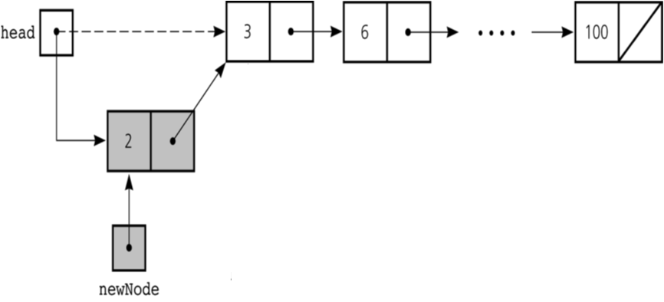
Cont…

Slide 31
void insert_beg(student *p)
{
student *temp;
if(start==NULL) //if the list is empty
{
start=p;
cout<<”Node inserted at the beginning”;
}
else
{
temp=start;
start=p;
p->next=temp; //making new node point at
} //the first node of the list
}

Slide 32
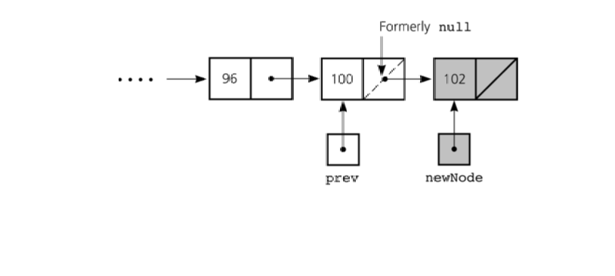
Inserting at the end
Here we simply need to make the next pointer of the last node point to the new node.
To do this we need to declare a second pointer, q, to step through the list until it finds the last node

Slide 33
void insert_end(student *p)
{
student *q=start;
if(start==NULL)
{
start=p;
cout<<”Node inserted at the end…!\n”;
}
else
{// the loop terminate when q points to the last node
while(q->next!=NULL)
q=q->next;
q->next=p; // the new node is made the last node
}
}

Slide 34
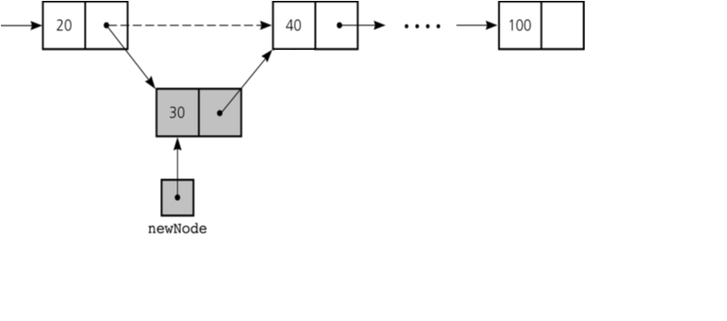
Inserting after an element
Here we again need to do 2 steps :-
Make the next pointer of the node to be inserted point to the next node of the node after which you want to insert the node.
Make the next pointer of the node after which the node is to be inserted, point to the node to be inserted.
or
Create a Node
Set the node data Values
Break pointer connection
Re-connect the pointers

Slide 35
void insert_after(int c, student *p){
student *q;
q=start;
for(int i=2;i<c; i++)
q=q->next;
if(q==NULL)
cout<<”Less than “<<c<<” nodes…!”;
p->next=q->next;
q->next=p;
cout<<”Node inserted successfully”;
}

Slide 36
Displaying the list of nodes
Having added one or more nodes, we need to display the list of nodes on the screen using the following steps
Steps
Set a temporary pointer to point to the same thing as the start pointer
If the pointer points to NULL, display the message “End of list” and stop
Otherwise, display the details of the node pointed by the start node
Make the temporary pointer point to the same thing as the next pointer of the node it is currently indicating
Jump back to step 2

Slide 37
void display()
{
student *q=start;
do
{ if(q==NULL)
cout<<“End of List\n”;
else
{ // Display details for what q points to
cout<<“Name:”<<q->name<<endl;
cout<<“Age:”<<q->age<<endl;
cout<<“Department:”<<q->Dept<<endl;
// Move to next node (if present)
q=q->next;
}
}while(q!=NULL);
}

Slide 38
Navigating/Traversing through the list
To Move Forward:
Set a pointer to point to the same thing as the start pointer.
If the pointer points to NULL, display the message “list is empty" and stop.
Otherwise, move to the next node by making the pointer point to the same thing as the next pointer of the node it is currently indicating(using current pointer).

Slide 39
To Move to Backward: (single linked list)
Set a pointer to p point to the same thing as the start pointer.
If the pointer p points to NULL, display the message “list is empty" and stop. Otherwise move forward until you find the last node.
Set an other new pointer q(which will later point to the node that is previous to p) and assign the same value as start pointer and move forward until you find the node before the one we are considering at the last node.
Set the p pointer equal to the other new pointer q (previous pointer)
Jump to step one

Slide 40
Deleting a node in SLL
Here also we have three cases:-
Deleting the first node
Deleting the last node
Deleting the intermediate node

Slide 41
Deleting the first node
Here we apply following steps:-
Set a temporary pointer temp pointing to the same thing as the start pointer
If the start pointer points to NULL display the message “List is Empty” and
Else make the start pointer point towards the 2nd node.
Deleting the temp node using delete keyword.
start
one
two
three

Slide 42
void del_first(){
if(start==NULL)
cout<<”\n Error……List is empty\n”;
else
{
student * temp=start;
start=temp->next;
delete temp;
cout<<”\n First node deleted!”;
}
}

Slide 43
Deleting the last node
Here we apply the following steps:-
Set a temporary pointer q and temp
Move forward q and temp so that temp points to the last node and q points to the second last node(previous to temp)
Make the second last node’s next pointer point to NULL
Deleting the temp node via delete keyword
start
node1
node2
node3
node4
q
temp

Slide 44
void del_last()
{
if(start==NULL)
cout<<”\n Error….List is empty”;
else
{
student *q=start;
while(q->next->next!=NULL)
q=q->next;
student *temp=q->next;
q->next=NULL;
delete temp;
cout<<”\n Deleted successfully…”;
}
}

Slide 45
Deleting a particular node
Here we make the next pointer of the node previous to the node being deleted, point to the successor node of the node to be deleted and then delete the node using delete keyword.
node1
node2
node3
To be deleted

Slide 46
void del(int c)
{
node *q=start;
for(int i=1;i<c-1; i++)
{
q=q->next;
if(q==NULL)
cout<<”\n Node not found\n”;
}
if(i==c-1)
{
node *p=q->next; //node to be deleted
q->next=p->next;//disconnecting the node p
delete p;
cout<<“Deleted Successfully”;
}
}

Slide 47
Arrays Vs Linked Lists
Arrays | Linked list
Fixed size: Resizing is expensive | Dynamic size
Insertions and Deletions of first element are inefficient: Elements are usually shifted | Insertions and Deletions are efficient: No shifting
Random access i.e., efficient indexing | No random access → Not suitable for operations requiring accessing elements by index such as sorting
No memory waste if the array is full or almost full; otherwise may result in much memory waste. | Since memory is allocated dynamically(acc. to our need) there is no waste of memory.
Sequential access is faster [Reason: Elements in contiguous memory locations] | Sequential access is slow [Reason: Elements not in contiguous memory locations]

Slide 48
COMPLEXITY OF VARIOUS OPERATIONS IN ARRAYS AND SLL
Operation | ID-Array Complexity | Singly-linked list Complexity
Insert at beginning | O(n) | O(1)
Insert at end | O(1) | O(1) if the list has tail reference O(n) if the list has no tail reference
Insert at middle | O(n) | O(n)
Delete at beginning | O(n) | O(1)
Delete at end | O(1) | O(n)
Delete at middle | O(n): O(1) access followed by O(n) shift | O(n): O(n) search, followed by O(1) delete
Search | O(n) linear search O(log n) Binary search | O(n)
Indexing: What is the element at a given position k? | O(1) | O(n)

Slide 49
Doubly linked lists
Each node points not only to Successor node (Next node), but also to Predecessor node (Previous node).
There are two NULL: at the first and last nodes in the linked list.
Advantage: given a node, it is easy to visit its predecessor (previous) node. It is convenient to traverse linked lists Forwards and Backwards.
It is not necessary to have start pointer, we can have any pointer(current) pointing to one of the node in the list
∅
A
B
C
∅
Head (Start)

Slide 50
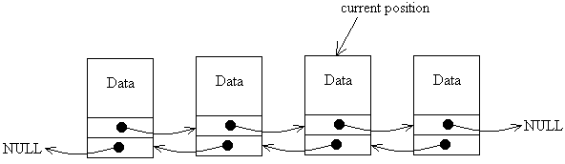
Doubly linked lists….
Here, there is no pointer to the start of the list, there is simply a pointer to some position in the list that can be moved left or right.
The reason we needed a start pointer in the ordinary linked list is because, having moved on from one node to another, we can’t easily move back, so without the start pointer, we would lose track of all the nodes in the list that we have already passed. With the doubly linked list, we can move the current pointer backwards and forwards at will.

Slide 51
DLL’s compared to SLL’s
Advantages:
Can be traversed in either direction (may be essential for some programs).
Some operations, such as deletion and inserting before a node, become easier.
Disadvantages:
Requires more space.
List manipulations are slower (because more links must be changed).
Greater chance of having bugs (because more links must be manipulated).

Slide 52
Structure of DLL
struct student
{
char name[20];
int age;
student *next;
student *previous;//holds the address of previous node
};
Previous
.Data
.Next

Slide 53


Inserting at beginning

Slide 54
void insert_beg(student *p)
{
if(start==NULL)
{
start=p;
cout<<"Node inserted successfully at the beginning";
}
else
{
student * temp=start;
start=p;
temp->previous=p; //making 1st node’s previous point to the new node
p->next=temp; //making next of the new node point to the 1st node
cout<<"\nNode inserted successfully at the beginning\n";
}
}

Slide 55
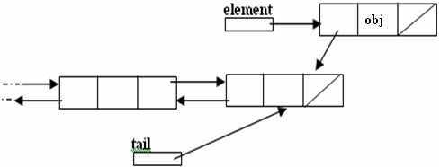
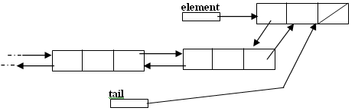
Inserting at the end

Slide 56
void insert_end(student *p)
{
if(start==NULL)
{
start=p;
cout<<"\nNode inserted successfully at the end";
}
else
{
student *temp=start;
while(temp->next!=NULL)
{
temp=temp->next;
}
temp->next=p;
p->previous=temp;
cout<<"\nNode inserted successfully at the end\n";
}
}

Slide 57
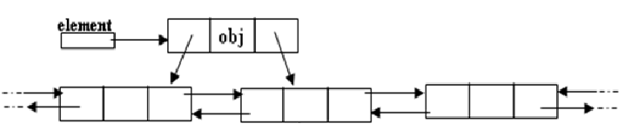
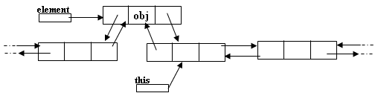
Inserting after a node
Making next and previous pointer of the node to be inserted point accordingly
Adjusting the next and previous pointers of the nodes between which the new node accordingly

Slide 58
void insert_after(int c, node *p)
{
temp=start;
for(int i=1;i<c-1;i++)
{
temp=temp->next;
}
p->next=temp->next;
temp->next->previous=p;
temp->next=p;
p->previous=temp;
cout<<"\nInserted successfully";
}

Slide 59
Navigating through DDL(To Move to Backward:)
Set a pointer to point to the same thing as the current pointer.
If the pointer points to NULL, display the message “list is empty" and stop.
Otherwise, move back to the previous node by making the pointer point to the same thing as the previous pointer of the node it is currently indicating.

Slide 60
Deleting a node
Node deletion from a DLL involves changing two links
In this example, we will delete node b
myDLL
a
b
c
Deletion of the first node or the last node is a special case

Slide 61
void del_at(int c)
{
node *s=start;
{
for(int i=1;i<c-1;i++)
{
s=s->next;
}
node *p=s->next;
s->next=p->next;
p->next->previous=s;
delete p;
cout<<"\nNode number "<<c<<" deleted successfully";
}
}
}

Slide 62
APPLICATIONS OF LINKED LIST
Applications that have an MRU (Most Recently Used) list (a linked list of file names).
The cache in your browser that allows you to hit the BACK button (a linked list of URLs).
Undo functionality in Photoshop or Word (a linked list of state).
A stack, hash table, and binary tree can be implemented using a doubly linked list.

Slide 63
Variations of Linked Lists
Circular linked lists
The last node points to the first node of the list.
How do we know when we have finished traversing the list?
(Hint: check if the pointer of the current node is equal to the Start (head) pointer).
A
B
C
Start

Slide 64
Exercises
1. Write a C++ program using single and double linked list data structure that keeps track of student record. Each student has Name and ID. The program should include the following operations.
Add a new student data from the keyboard(front, middle, last)
Delete node ( the first, last, middle)
Display the whole list of students (first to end and end to first)
Search a specific node

