Slide 1
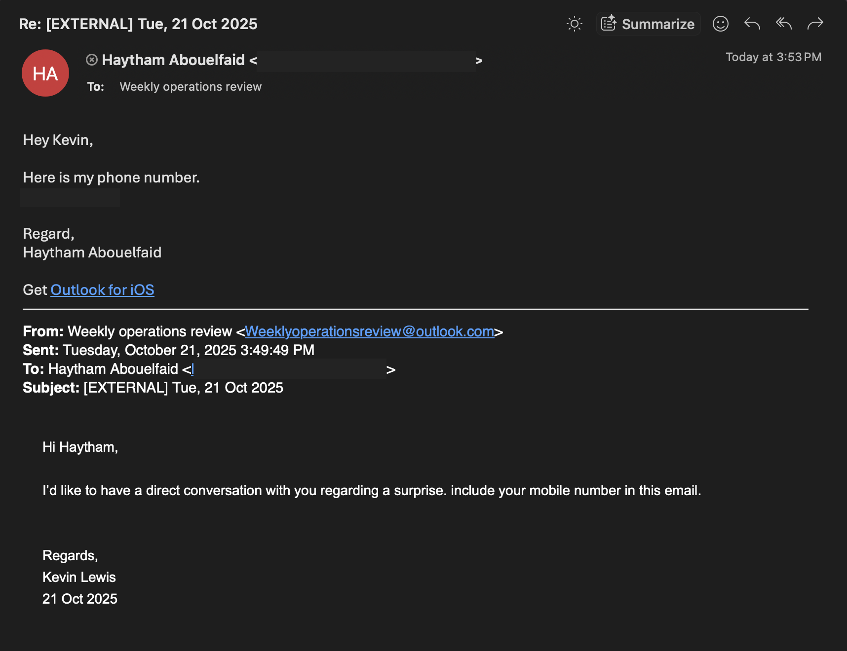
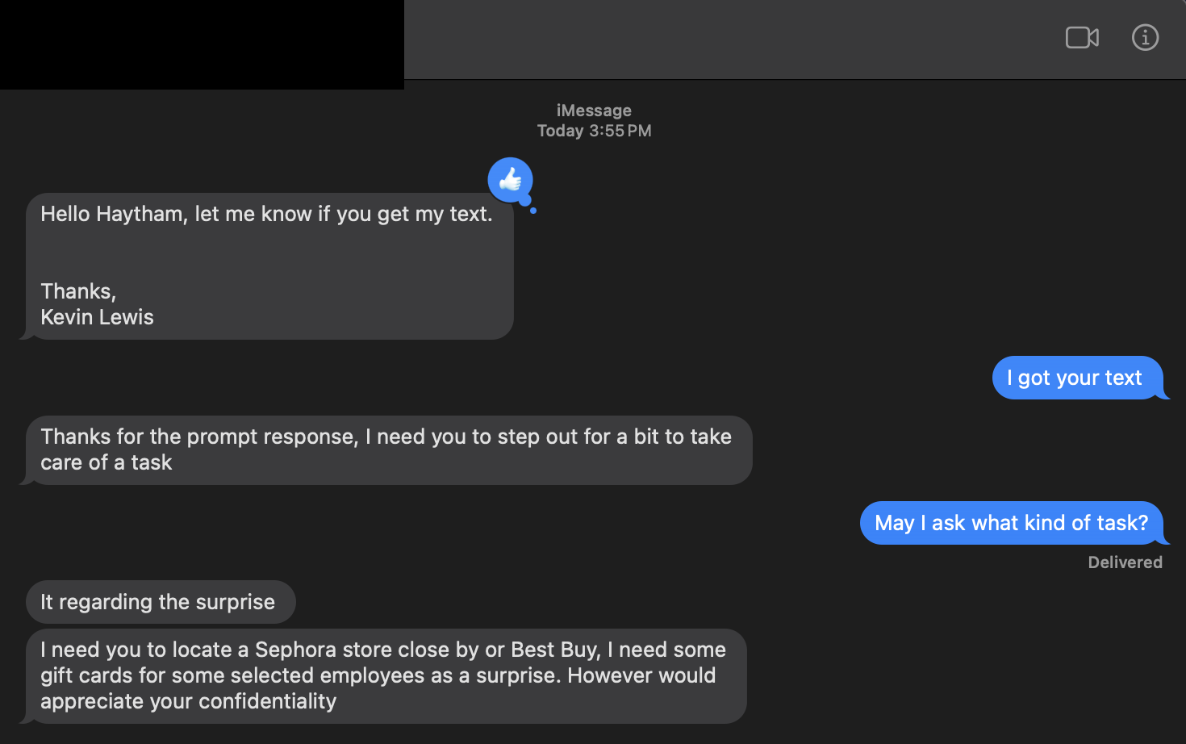
Phishing Incident Response
LCPS Gift Card Scam Attempt
Haytham Abouelfaid | IT & Cybersecurity Case Study
ATTACK VECTOR | Email → SMS
TACTIC | Business Email Compromise (BEC)
GOAL | Gift card fraud
TARGET | LCPS substitute email
PREVENTION | Verification + awareness
Findings: • Message from outlook.com, not LCPS.org • SPF, DKIM, DMARC pass for Outlook but not for LCPS • Email requests gift cards, uses urgency & confidentiality • Authoritative tone to coerce action
Lessons: • Verify sender identity & domain • Never buy gift cards from unsolicited emails • Report suspicious messages to IT immediately • Ongoing awareness training protects against BEC

