Slide 1
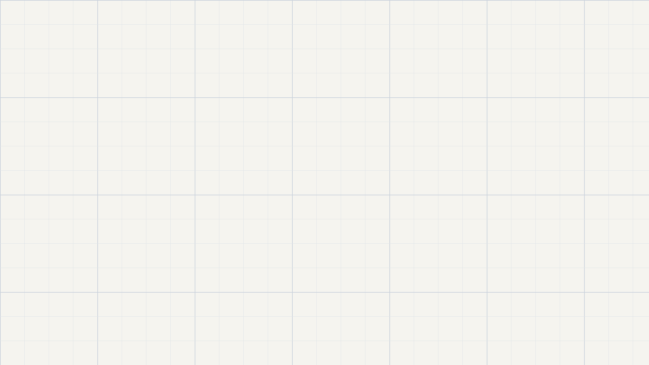
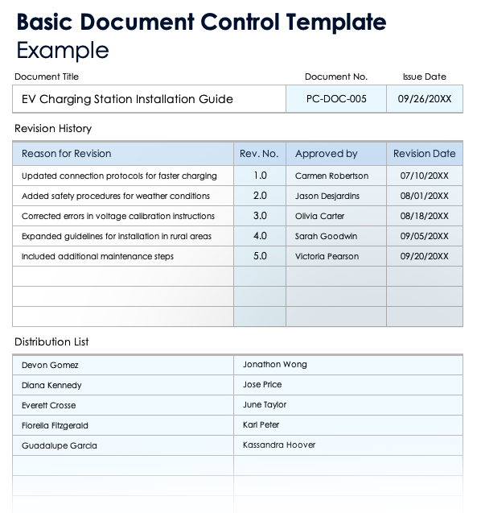

template <typename T>
T max(T x, T y)
{
if (x >= y) {
return x;
}
else return y;
}
Notes:
A no-name brand cereal?
Templatised C++ functions?
Or a blank document template?
Prof. Marshall always says

Slide 2
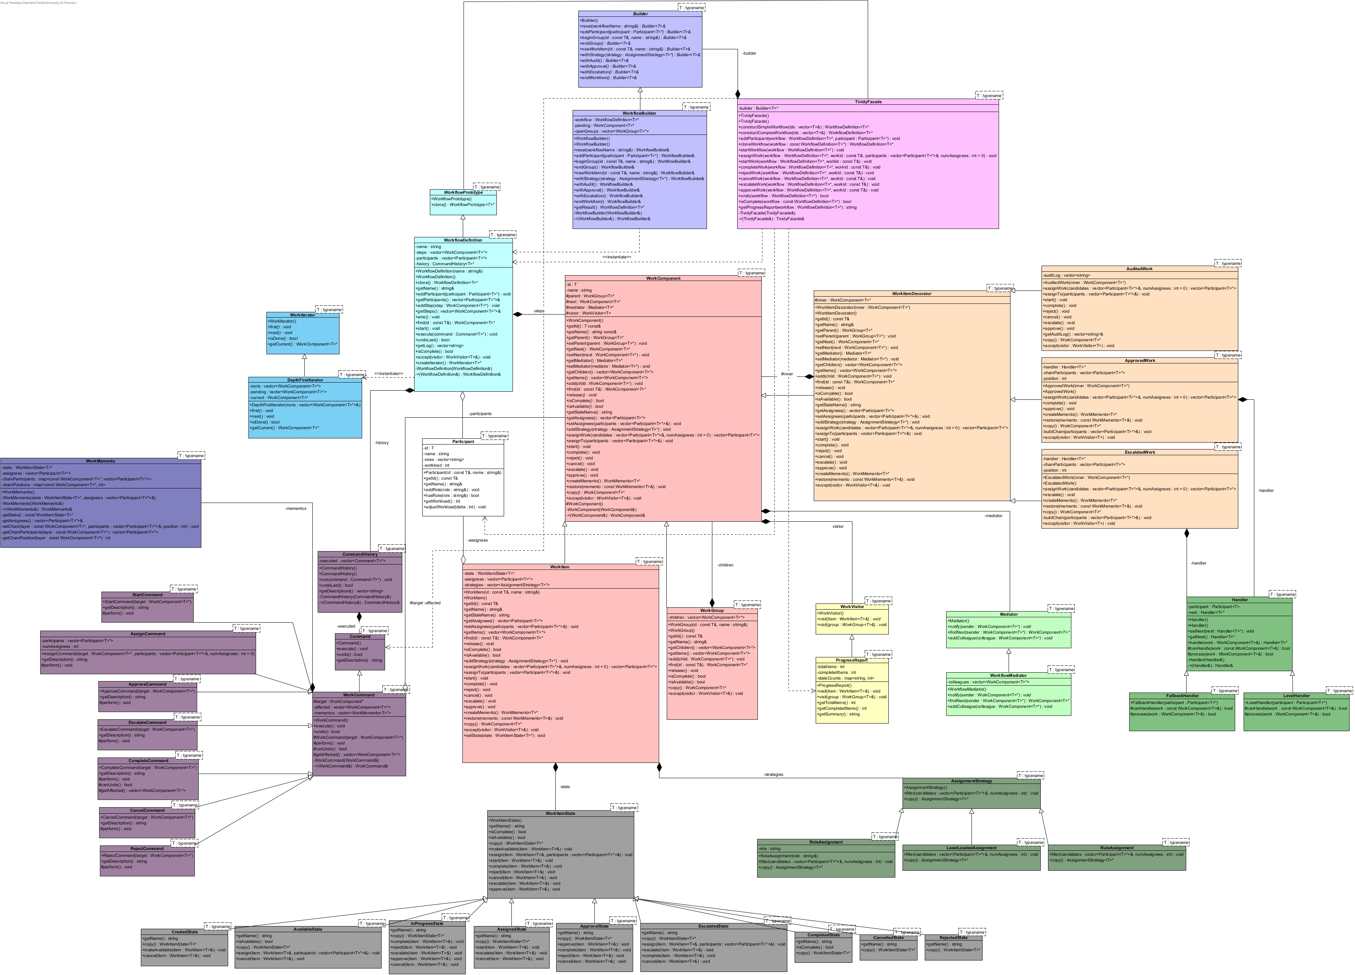
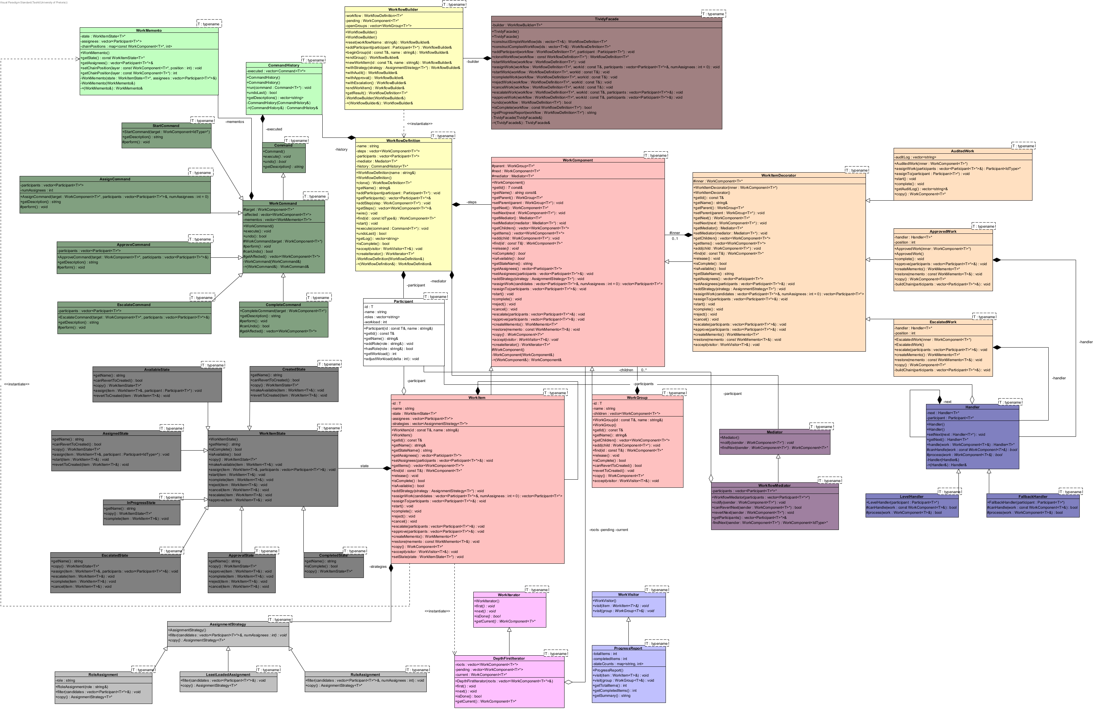
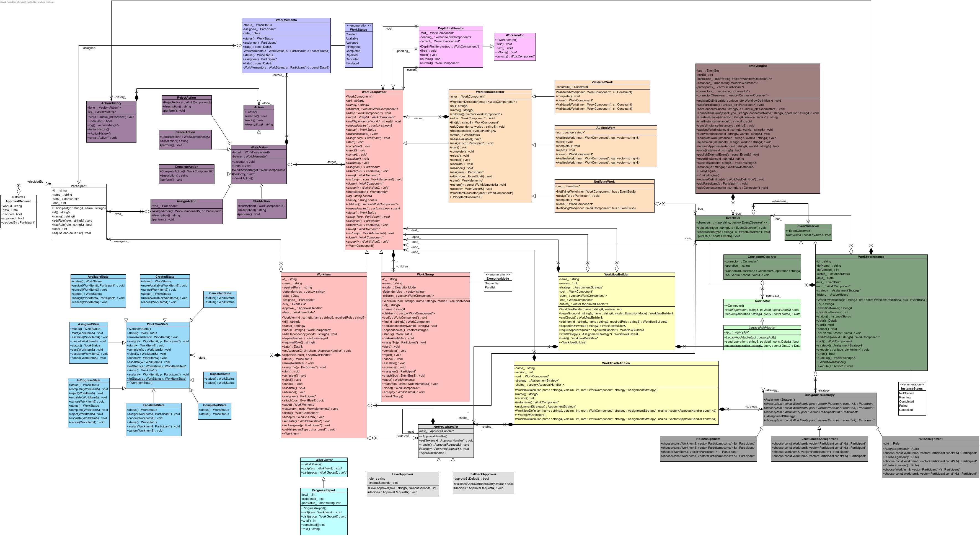
“Go play with it.”
— PROF. MARSHALL
class_diagram_v3
class_diagram_v2
class_diagram_v1
Notes:
three entirely different versions
before finally landing…

Slide 3
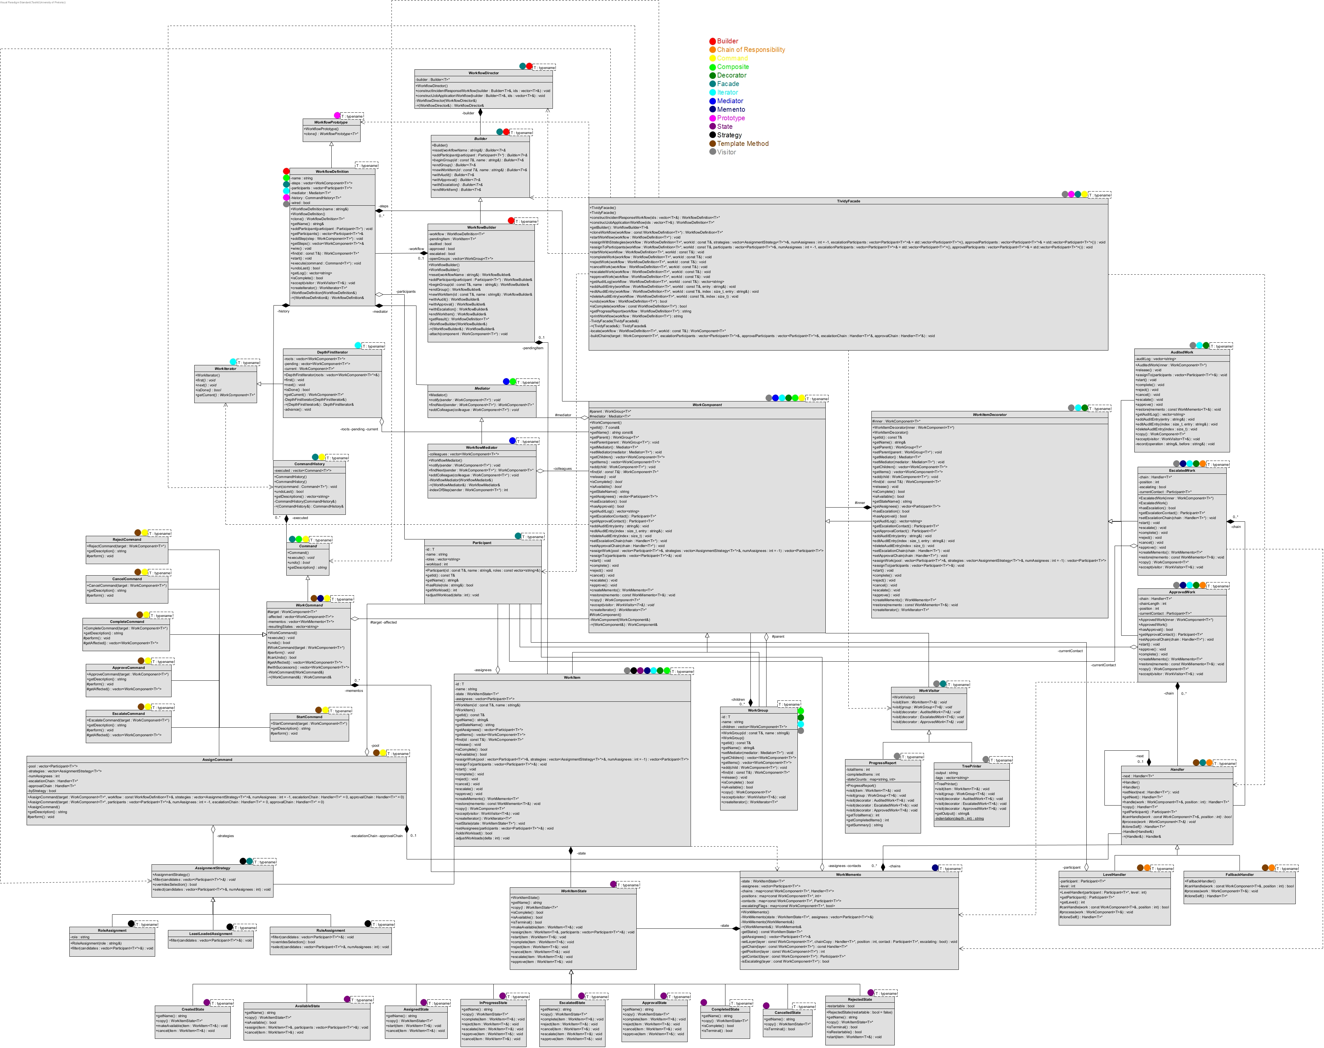
class_diagram_final
Notes:
our team is proud to present TIVIDY

Slide 4


A Generic Workflow Management System
TIVIDY
The Power Rangers
GITHUB REPO QR CODE
Notes:
Once a WorkflowDefinition is constructed

Slide 5
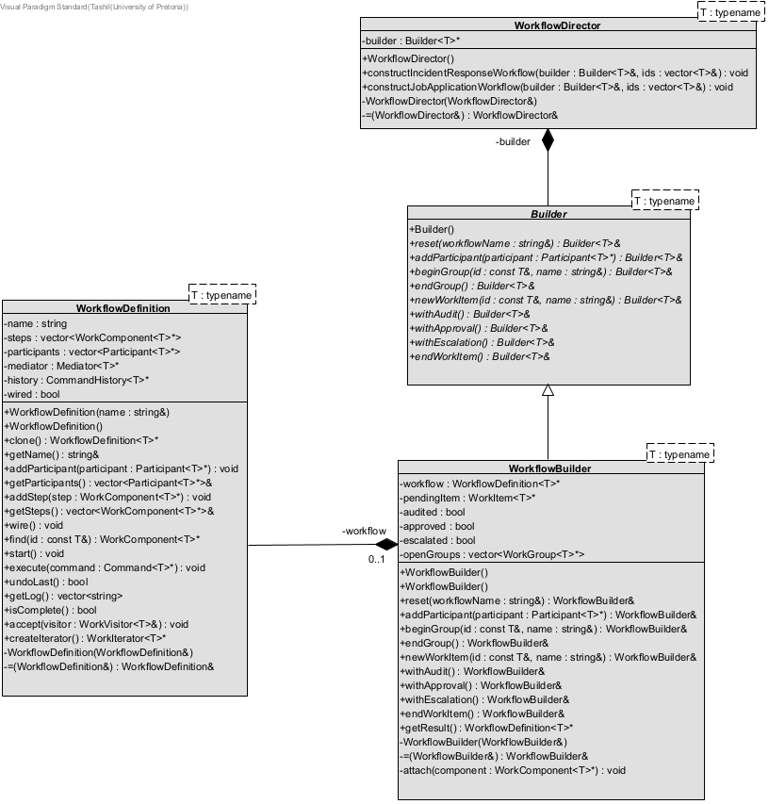
Builder
PATTERN 01 / 14 — CREATIONAL
Director tells the Builder which pieces to add, and in what order, to build a complex workflow step by step.
NB: certain participants may have been omitted for visual purposes
TIVIDY — A Generic Workflow Management System
SHEET 05 / 27
Notes:
Once a WorkflowDefinition is constructed

Slide 6
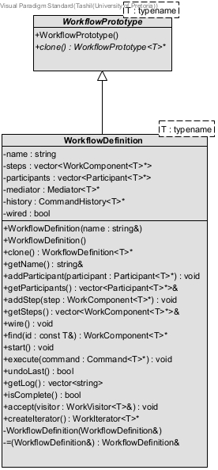
Prototype
PATTERN 02 / 14 — CREATIONAL
Clone a finished WorkflowDefinition with a deep copy, rather than rebuilding a complex object each time.
NB: certain participants may have been omitted for visual purposes
TIVIDY — A Generic Workflow Management System
SHEET 06 / 27
Notes:
We’re performing a deep copy, so working on one instance won't touch the definition.

Slide 7
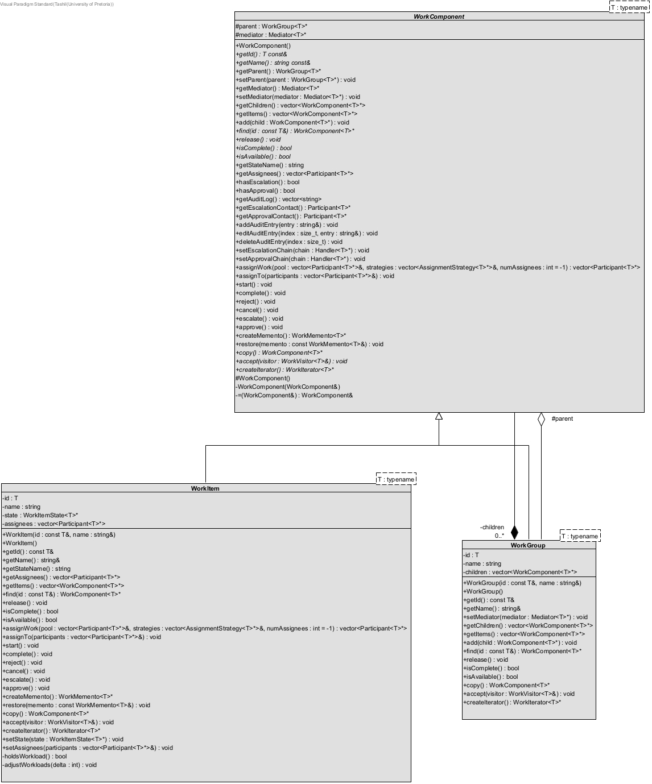
Composite
PATTERN 03 / 14 — STRUCTURAL
A WorkItem is one task. A WorkGroup is a step that holds other items or groups
NB: certain participants may have been omitted for visual purposes
TIVIDY — A Generic Workflow Management System
SHEET 07 / 27
Notes:
The Mediator.

Slide 8
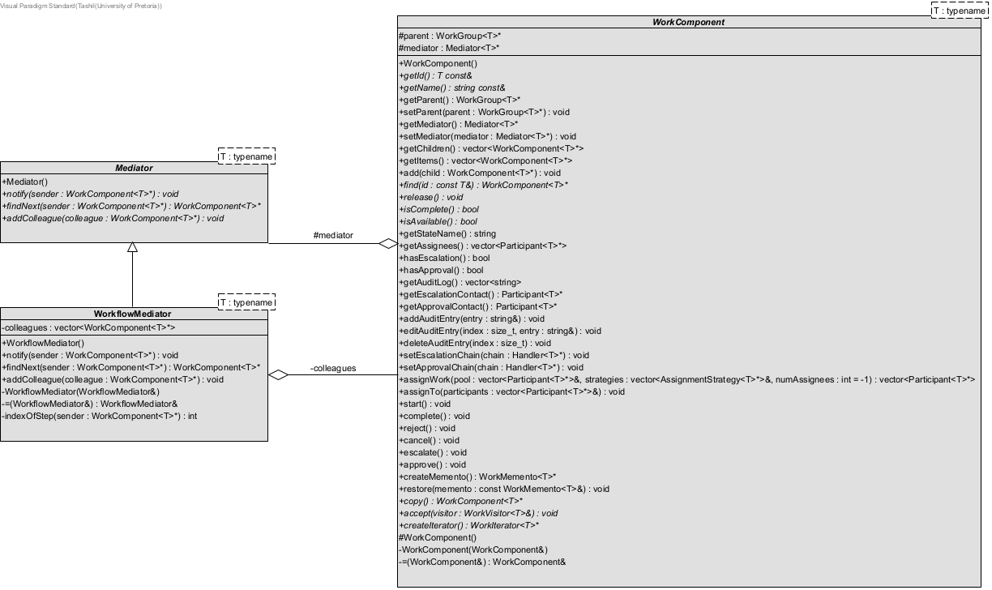
Mediator
PATTERN 04 / 14 — BEHAVIOURAL
The Mediator decides when the next component is released.
NB: certain participants may have been omitted for visual purposes
TIVIDY — A Generic Workflow Management System
SHEET 08 / 27
Notes:
If we look at the Sequence Diagram

Slide 9
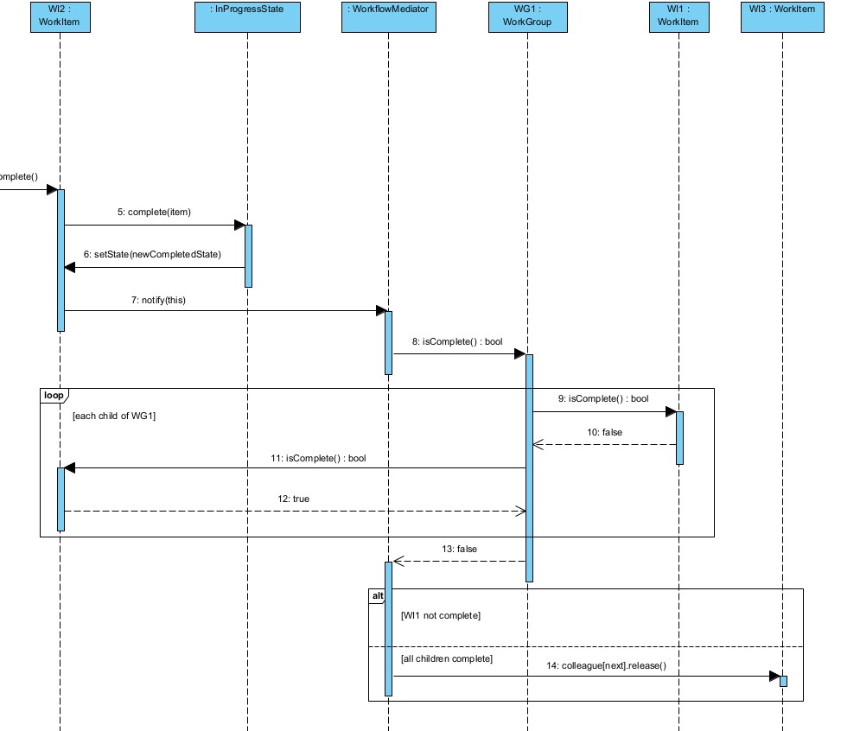
Mediator
PATTERN 04 / 14 — BEHAVIOURAL
The Mediator decides when the next component is released.
NB: entire diagram may not be shown for visual purposes
TIVIDY — A Generic Workflow Management System
SHEET 09 / 27
Notes:
A WorkItem owns its State

Slide 10
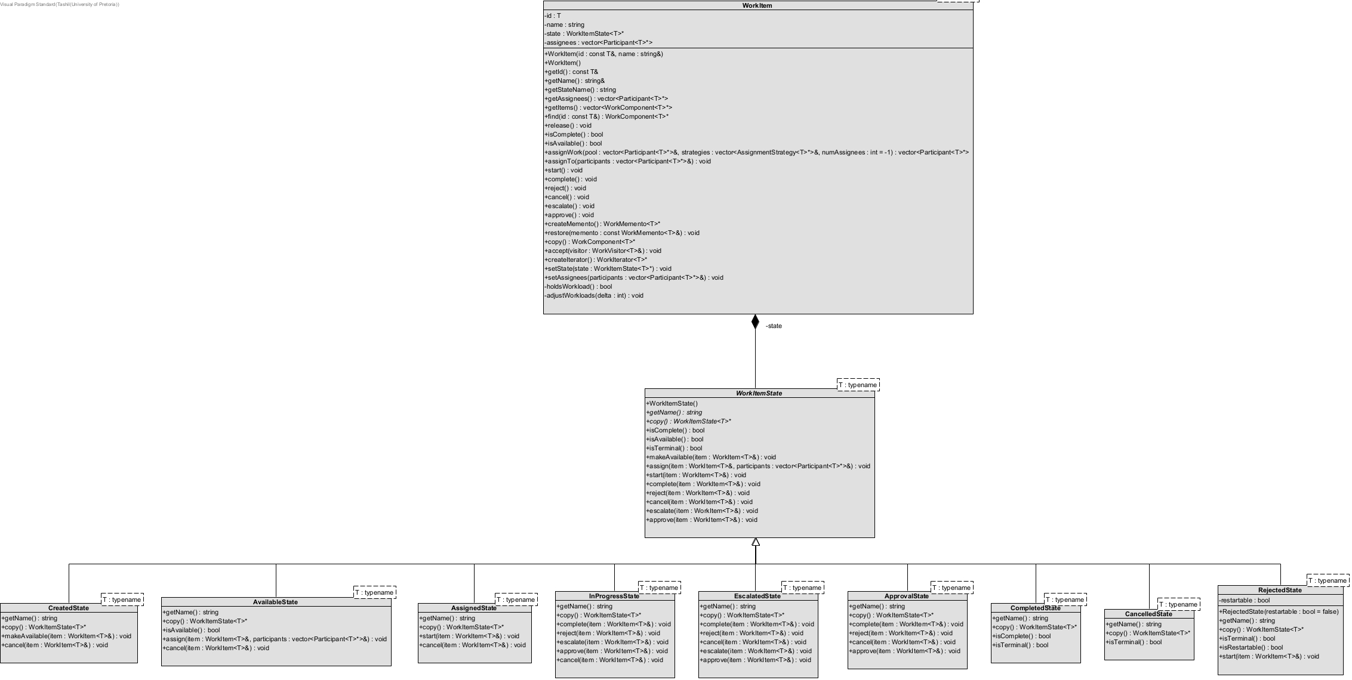
State
PATTERN 05 / 14 — BEHAVIOURAL
State decides which operations are legal at any moment.
NB: certain participants may have been omitted for visual purposes
TIVIDY — A Generic Workflow Management System
SHEET 10 / 27
Notes:
An interesting transition

Slide 11
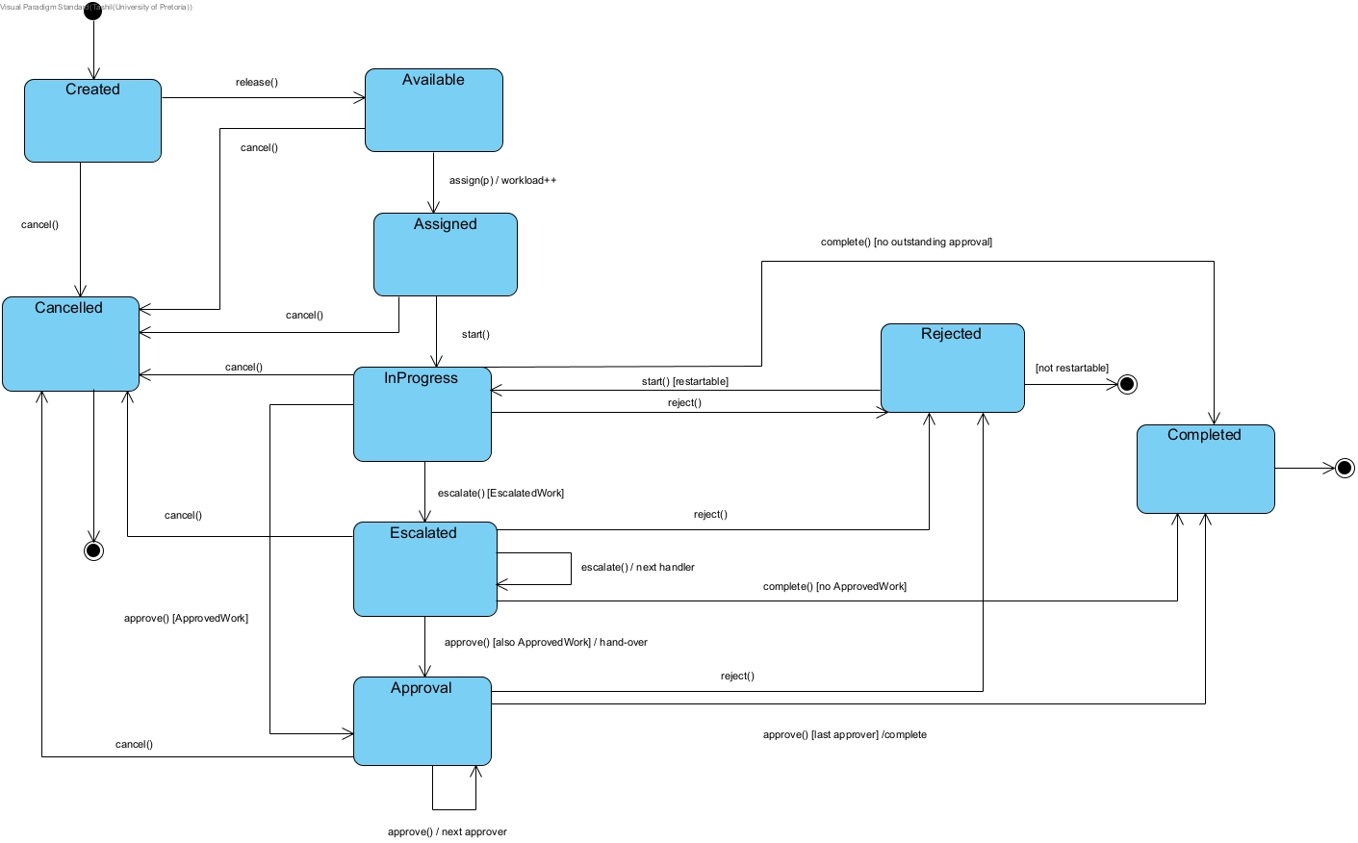
State
PATTERN 05 / 14 — BEHAVIOURAL
State decides which operations are legal at any moment.
NB: entire diagram may not be shown for visual purposes
TIVIDY — A Generic Workflow Management System
SHEET 11 / 27
Notes:
We use Strategy

Slide 12
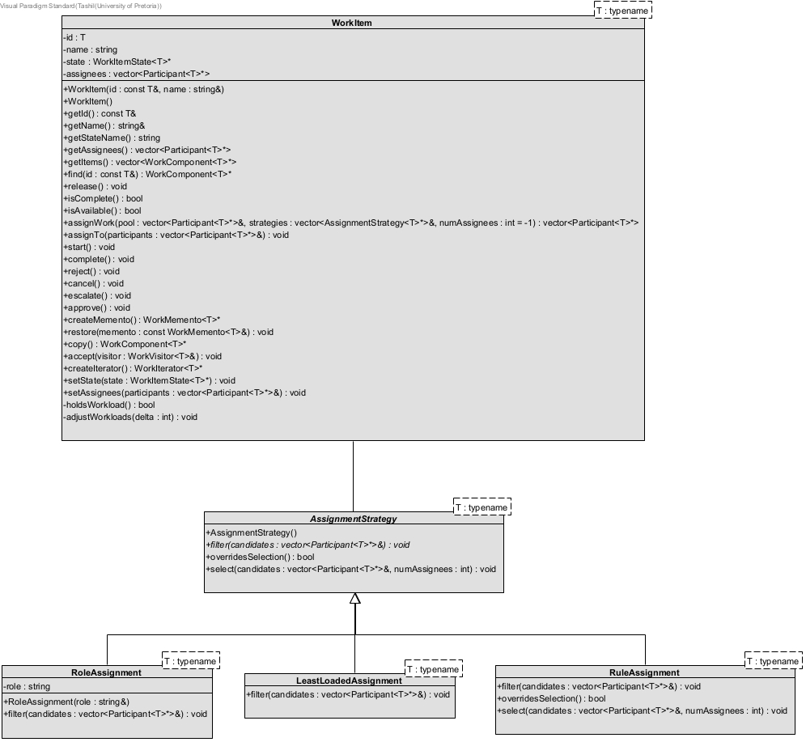
Strategy
PATTERN 06 / 14 — BEHAVIOURAL
Assignment algorithms are interchangeable. Each one narrows the pool; with none passed in, assignment is manual.
NB: certain participants may have been omitted for visual purposes
TIVIDY — A Generic Workflow Management System
SHEET 12 / 27
Notes:
Well, our system also accommodates for manual assignment.

Slide 13
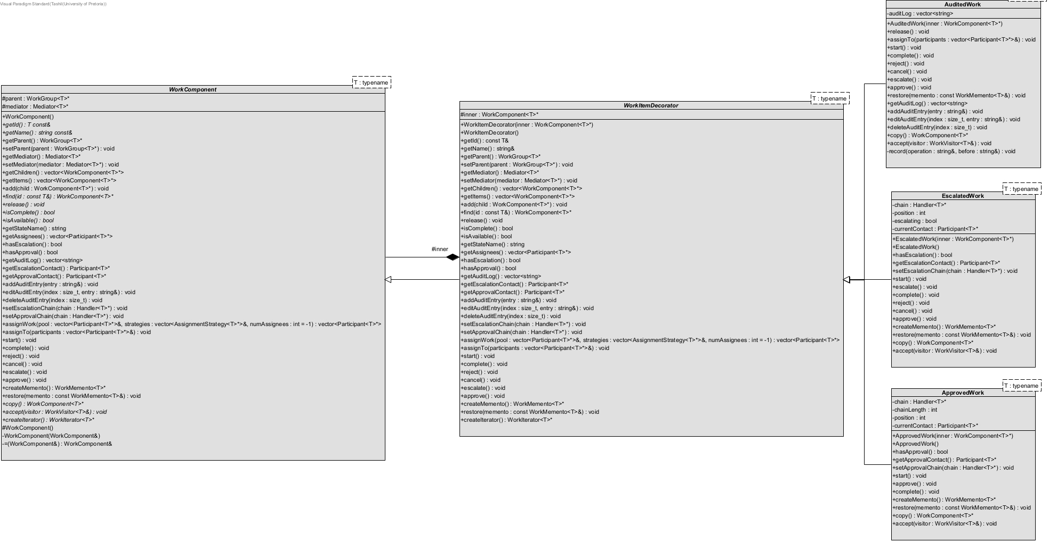
Decorator
PATTERN 07 / 14 — STRUCTURAL
Adds extra behaviour such as audit history, escalation or approval, without a subclass for every combination.
NB: certain participants may have been omitted for visual purposes
TIVIDY — A Generic Workflow Management System
SHEET 13 / 27
Notes:
tie directly into Chain of Responsibility.

Slide 14
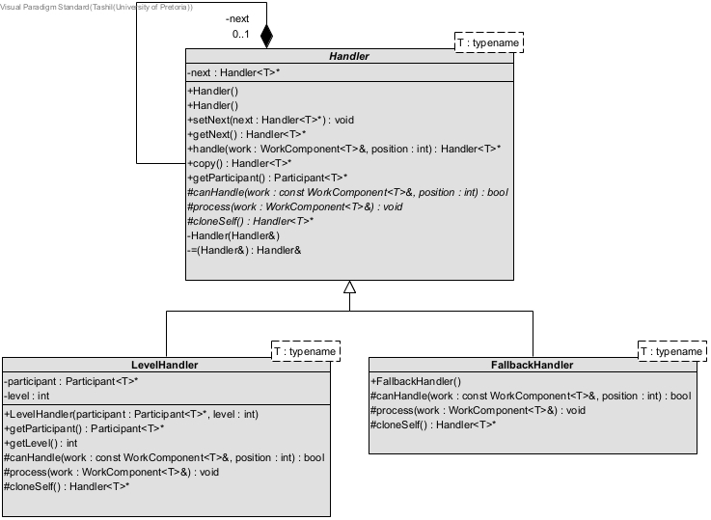
Chain of Responsibility
PATTERN 08 / 14 — BEHAVIOURAL
Handlers are linked. A request moves one link at a time until one handles it, and the FallbackHandler always does.
NB: certain participants may have been omitted for visual purposes
TIVIDY — A Generic Workflow Management System
SHEET 14 / 27
Notes:
with the FallbackHandler always handling a request

Slide 15
Template Method
PATTERN 09 / 14 — BEHAVIOURAL
The skeleton is fixed: check if the handler can process the request, and either run
it or pass it along
NB: certain participants may have been omitted for visual purposes
TIVIDY — A Generic Workflow Management System
SHEET 15 / 27
Notes:
handle acts as a Template Method here

Slide 16
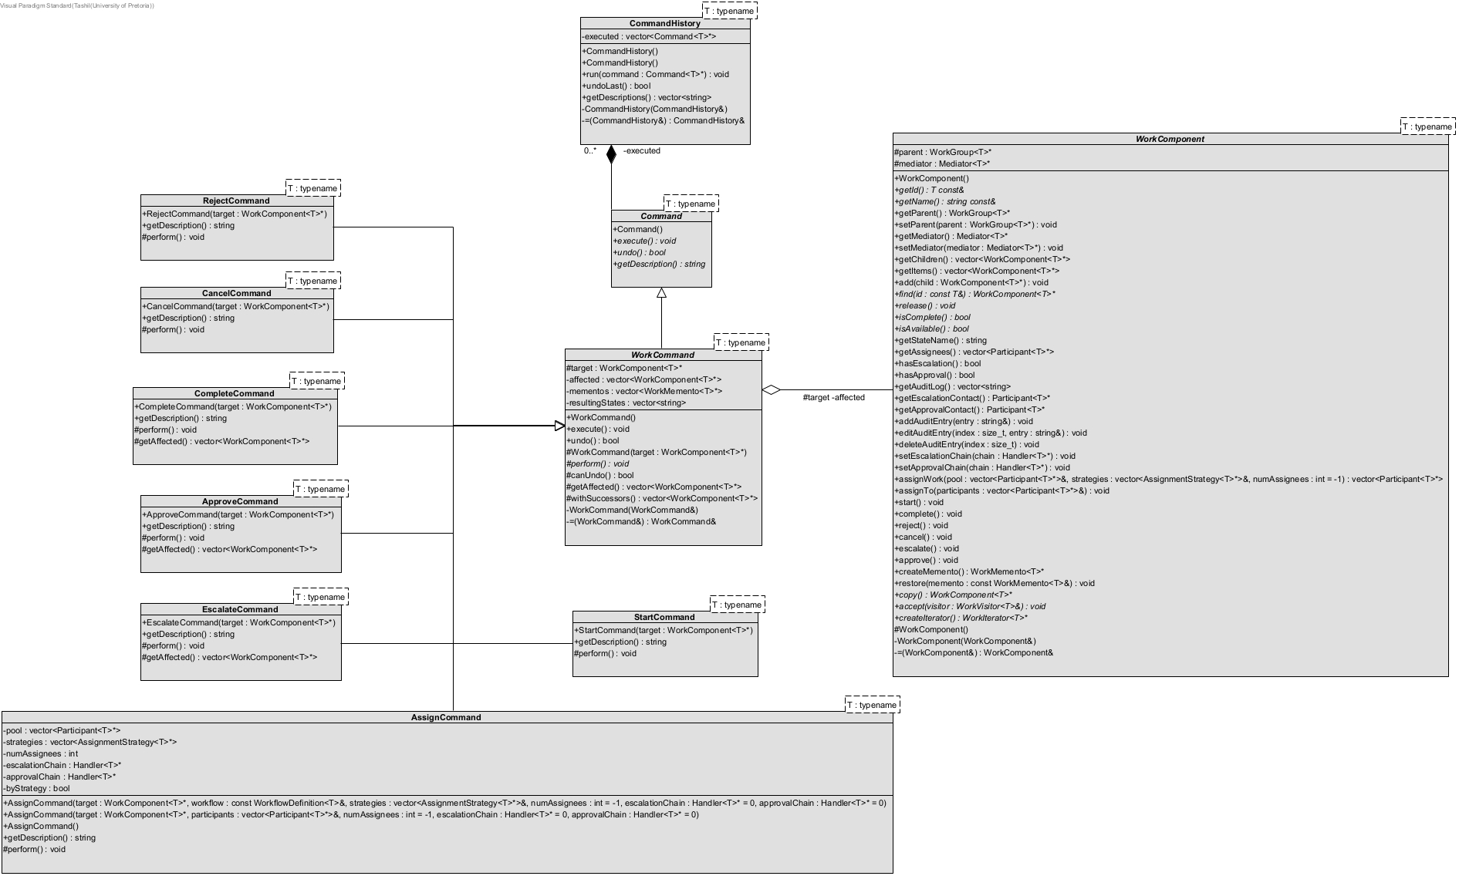
Command
PATTERN 10 / 14 — BEHAVIOURAL
Each action is encapsulated as an object, so everything can be tracked and undone.
NB: certain participants may have been omitted for visual purposes
TIVIDY — A Generic Workflow Management System
SHEET 16 / 27
Notes:
we use Memento

Slide 17
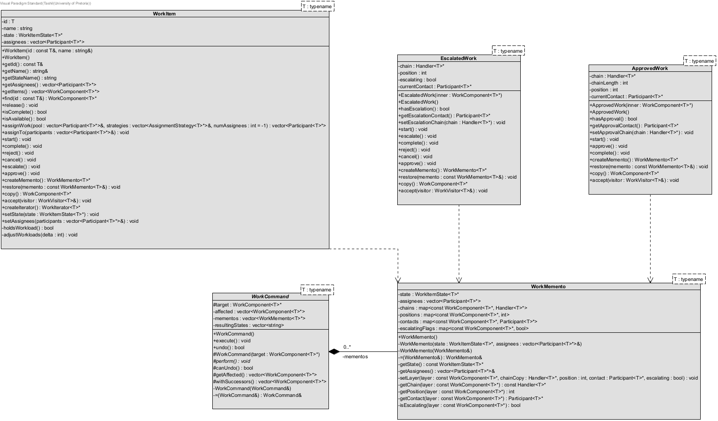
Memento
PATTERN 11 / 14 — BEHAVIOURAL
Memento restores the exact previous state without breaking encapsulation. Undo runs newest first.
NB: certain participants may have been omitted for visual purposes
TIVIDY — A Generic Workflow Management System
SHEET 17 / 27
Notes:
execute and undo in WorkCommand are Template Methods.

Slide 18
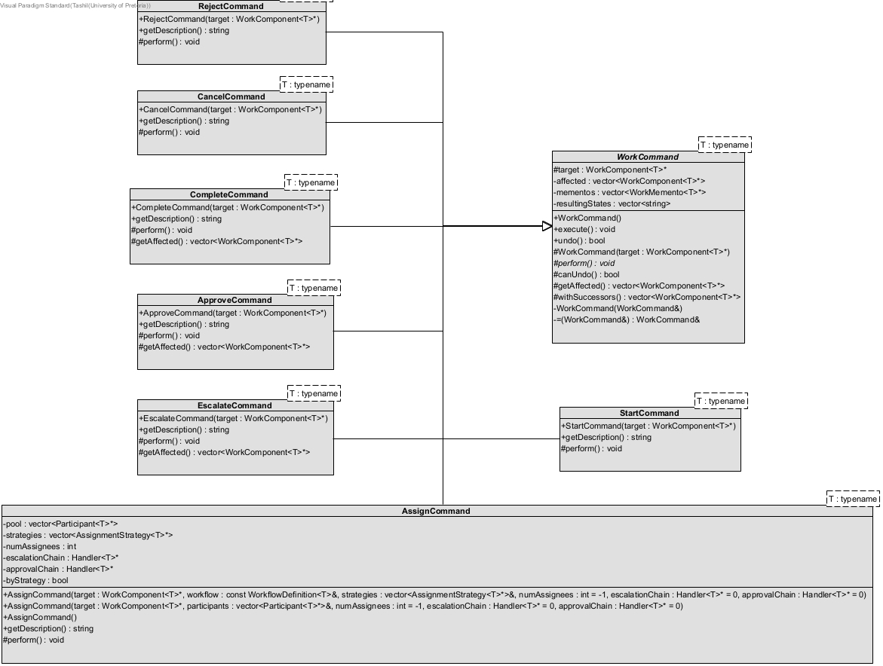
Template Method
PATTERN 09 / 14 — BEHAVIOURAL
The skeleton is fixed: snapshot, perform, record. Each ConcreteCommand supplies perform.
NB: certain participants may have been omitted for visual purposes
TIVIDY — A Generic Workflow Management System
SHEET 18 / 27
Notes:
To walk the workflow tree

Slide 19
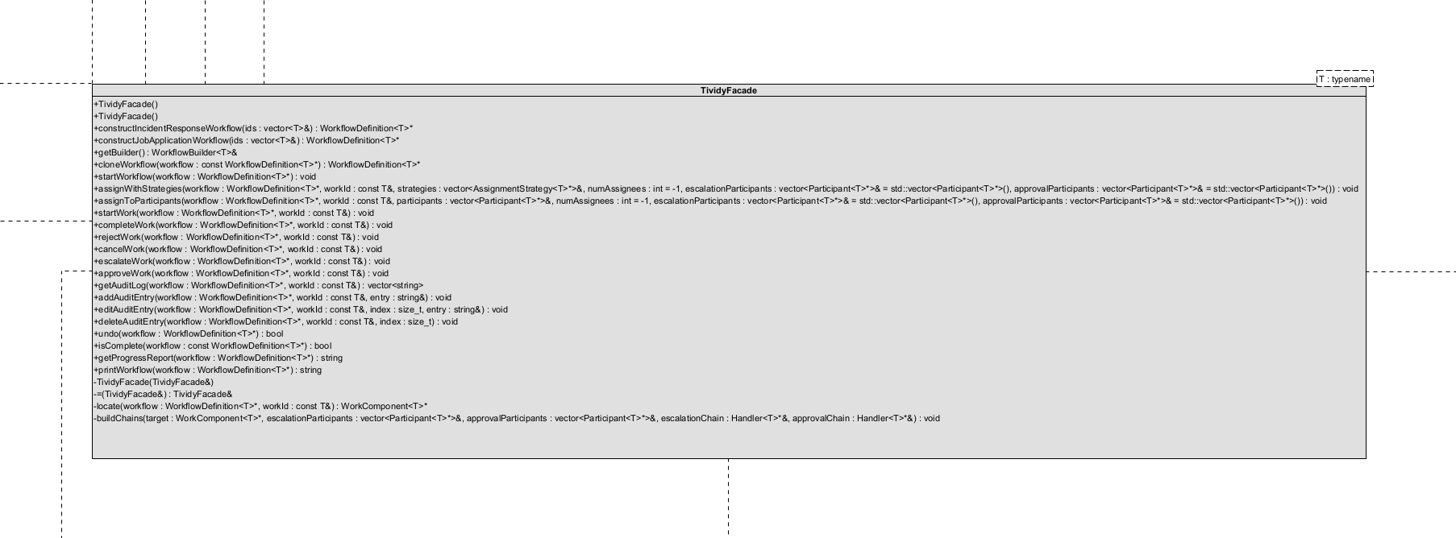
Façade
PATTERN 12 / 14 — STRUCTURAL
One unified, high-level interface over the complex subsystem classes, so the client gets a much simpler way in.
NB: certain participants may have been omitted for visual purposes
TIVIDY — A Generic Workflow Management System
SHEET 19 / 27
Notes:
To walk the workflow tree

Slide 20
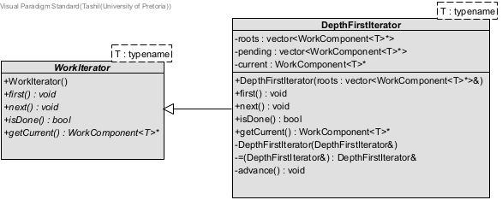
Iterator
PATTERN 13 / 14 — BEHAVIOURAL
A DepthFirstIterator walks the workflow tree without exposing how its elements are stored.
NB: certain participants may have been omitted for visual purposes
TIVIDY — A Generic Workflow Management System
SHEET 20 / 27
Notes:
Mark’s favourite pattern, Visitor.

Slide 21
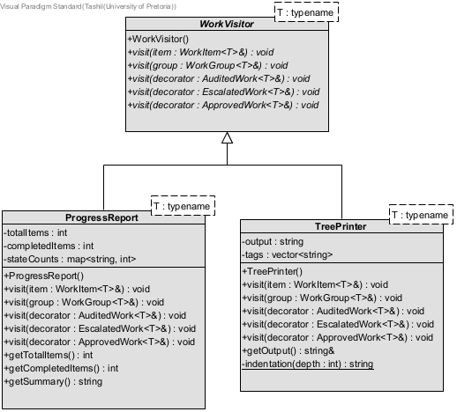
Visitor
PATTERN 14 / 14 — BEHAVIOURAL
Reports live in visitors, not in the work classes. ProgressReport counts the states; TreePrinter draws the tree.
NB: certain participants may have been omitted for visual purposes
TIVIDY — A Generic Workflow Management System
SHEET 21 / 27
Notes:
ORATILE flips the switch. BLACKOUT. The lights cut. The projector screen is plain black.
RAYHAAN
Wait, did the laptop just die?

Slide 22
Notes:
You know what

Slide 23

Notes:
And so

Slide 24

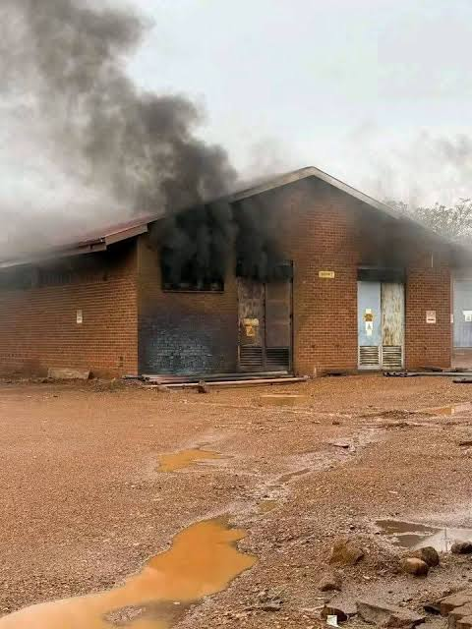
Lights out.
CONCRETE SCENARIO 01 — INCIDENT RESPONSE WORKFLOW
On 29th September 2026, during heavy rain, an explosion at the Waltloo substation caused a 132 kV trip at Njala. A transformer was found faulty, and the City ran three-hour load rotations while it was being repaired.

Slide 25

Tyto Insights
CONCRETE SCENARIO 02 — JOB APPLICATION WORKFLOW
A data consultancy based in Pretoria, founded by our very own University of Pretoria computer science graduates Mark Botros and Inge Odendaal.
01
02
03
Initial Screening
Interviews
Final Decision
Application Review
Reference Check
Behavioural Interview
Technical Interview
Approved?
Rejected?

Slide 26
TividyEngine
Scenario
1..*

Slide 27
Any questions?
GITHUB REPO QR CODE

