Slide 1
Student Grade Prediction Using Linear Regression
Syed Muhammad Hayyan Hasan

Slide 2
Libraries Used & Data set
Libraries: Pandas, matplotlib.pyplot, seaborn, sklearn.model_selection, sklearn.linear_model, sklearn.metrics
Dataset Name: Student Performance Data Set
Provided by: UCI Machine Learning Repository
Main Goal: Predicting Final Grades(G3) using Linear Regression and Machine Learning
Important features used: First Period Grades(G1), (Second Period Grades)G2, failures, absences

Slide 3
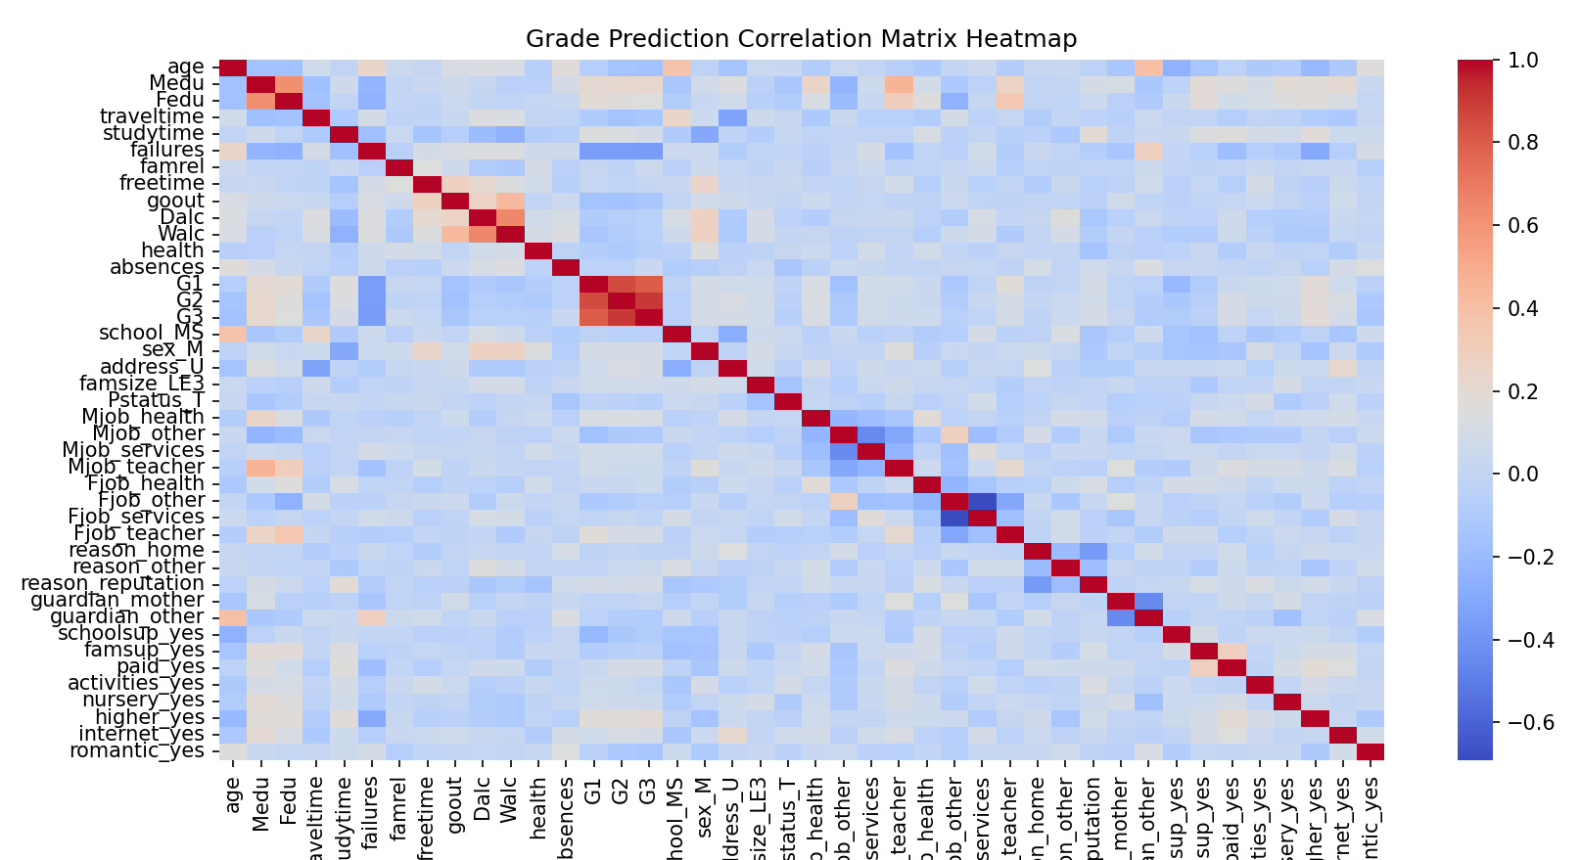
Correlation Heatmap
There seems to be a correlation between several features and the final grades (G3).

Slide 4
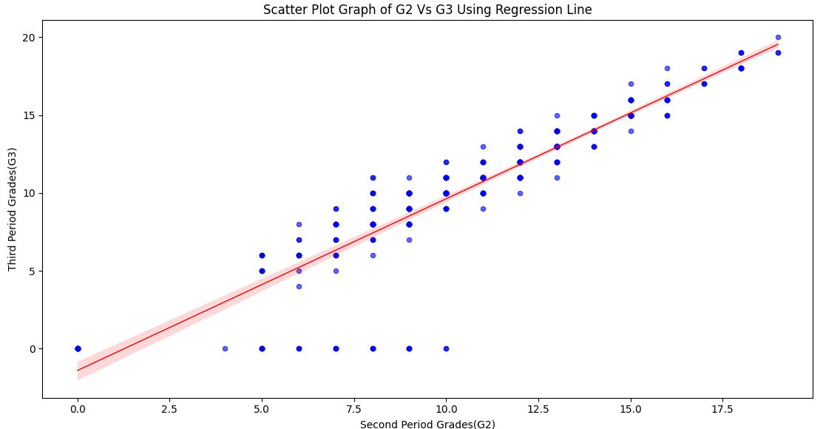
Visual Analysis (G2 Vs G3)
The scatter plot shows a strong positive correlation between second period grades (G2) and final grades (G3).

Slide 5
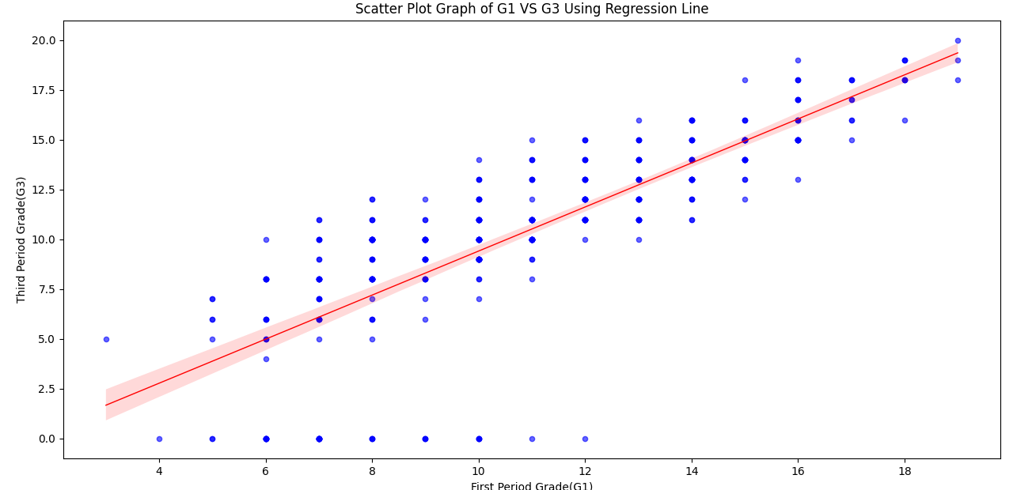
Visual Analysis (G1 Vs G3)
The scatter plot indicates a moderate positive correlation between first period grades (G1) and final grades (G3).

Slide 6
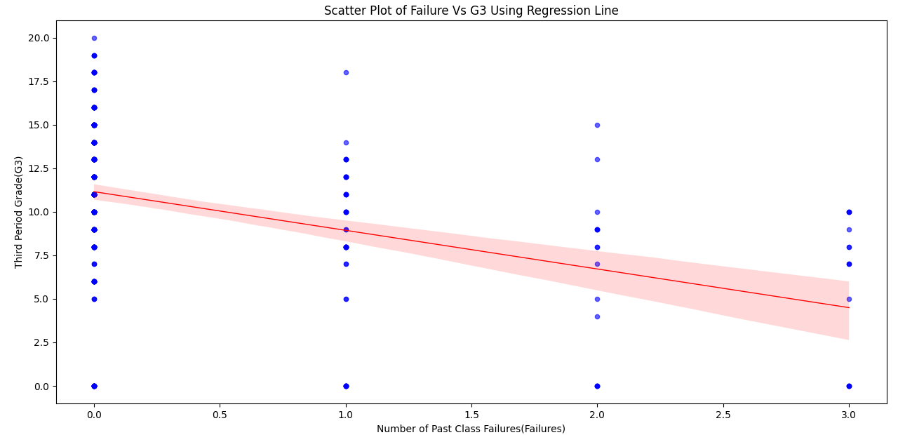
Visual Analysis (Failures Vs g3)
Failures vs G3: Slight negative correlation
The Data was cleaner than anticipated, hence it seems inorganic

Slide 7
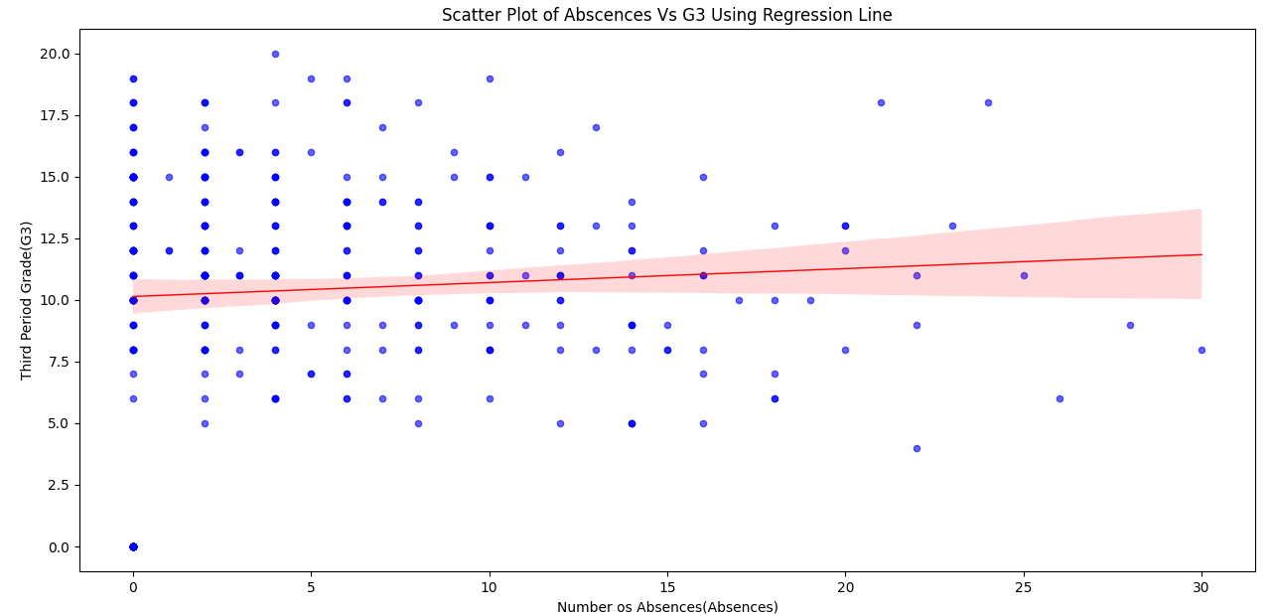
Visual Analysis (Scatter Plots)
Had to limit the analysis to 30 as it was too inconclusive after it

Slide 8
Model Building & Results
Used Linear Regression model
Train-test split: 80/20 with random_state = 2
Evaluation metrics:
- Mean Squared Error (MSE): 2.87
- R² Score: 0.849

Slide 9
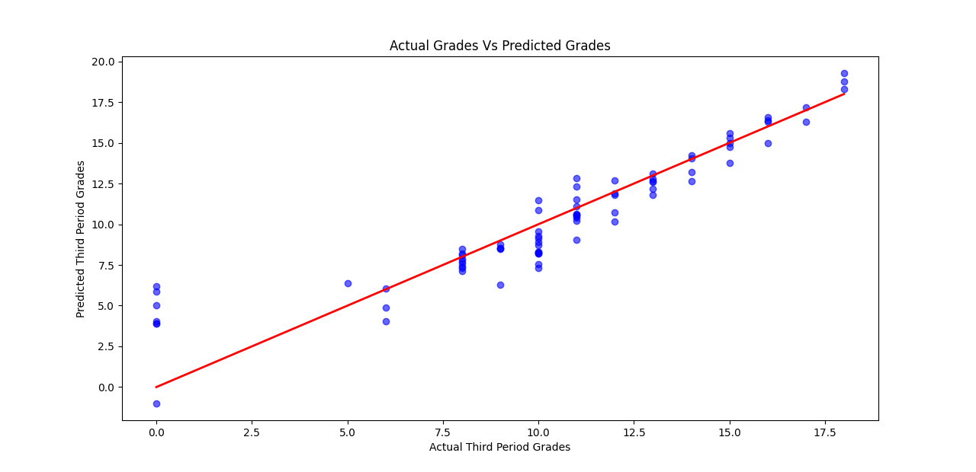
actual vs predicted G3

Slide 10
Project Problems & Fixes
String columns caused correlation issue ➝ Fixed using One-Hot Encoding
Heatmap used for overwhelming correlation data
Failure vs G3 looked artificial ➝ due to clean data
Absences vs G3 too scattered ➝ limited plot to 30 absences

Slide 11
Conclusion
Successfully built a Linear Regression model to predict final grades (G3) using G1, G2, absences, and failures.
Identified G1 and G2 as the most impactful predictors through correlation analysis and visualizations.
Some features (absences, failures) had weaker impact
Achieved a strong R² score of 0.85, indicating high model accuracy and reliability.
Gained hands-on experience in data preprocessing, exploratory analysis, model training, and performance evaluation using Python and relevant libraries.

