Slide 1
Temperature
Fan
Control

Slide 2
Group Member
Patsawut Phongchoo
1911310454
Kanitin Lim-Usunno
1911310504
Tanarat Phetroeksakul
1911310553

Slide 3
Overview

Slide 4
Model design
Temp sensor get temperature in 16 bit value
Change to int
Show value in 7 segment
If value greater than 40 degrees Celsius
DC Fan working

Slide 5
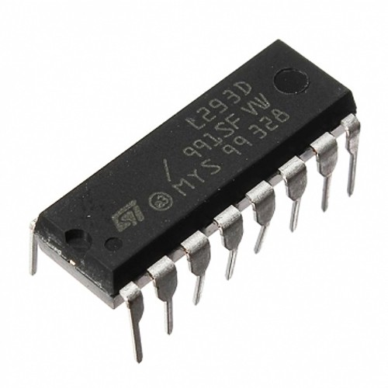
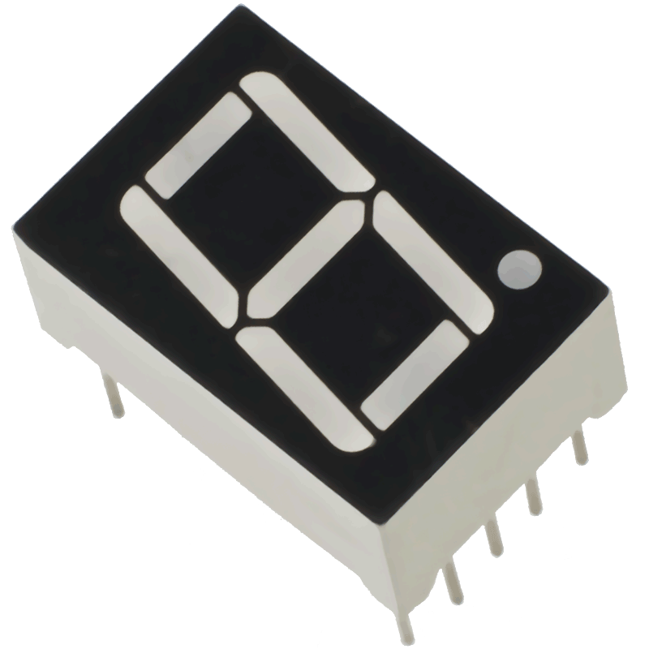
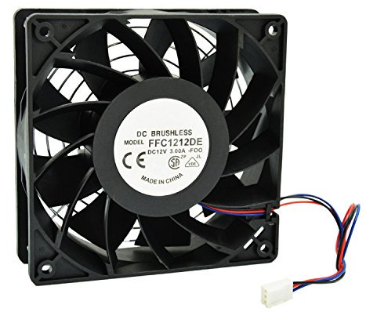
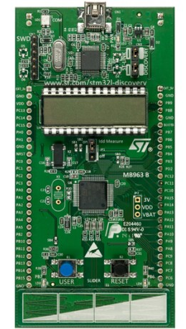
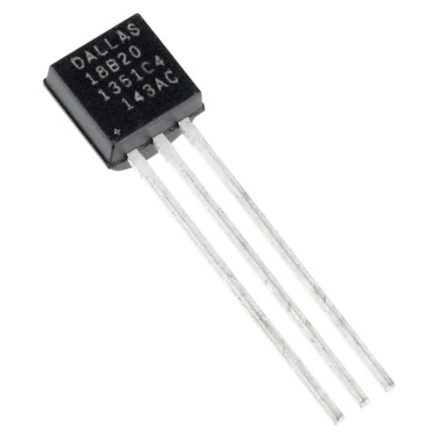
Devices Used
L293D
7 Segment
DC Fan 5V
STM32L152RB
DALLAS DS18B20

Slide 6
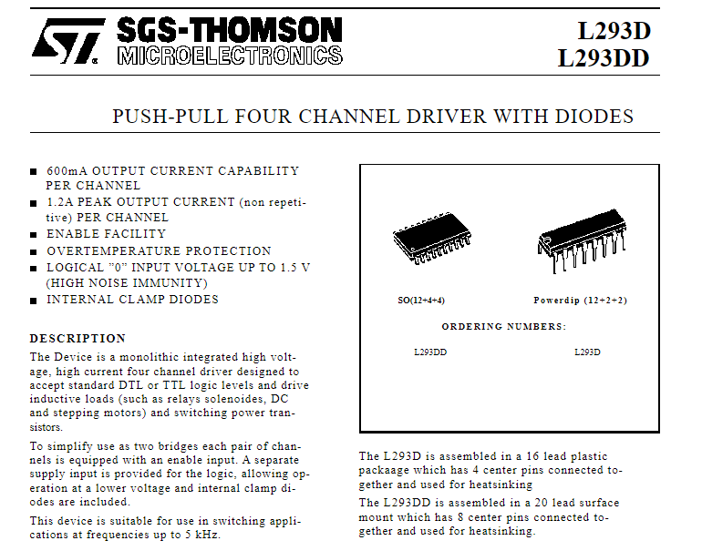
L293D

Slide 7
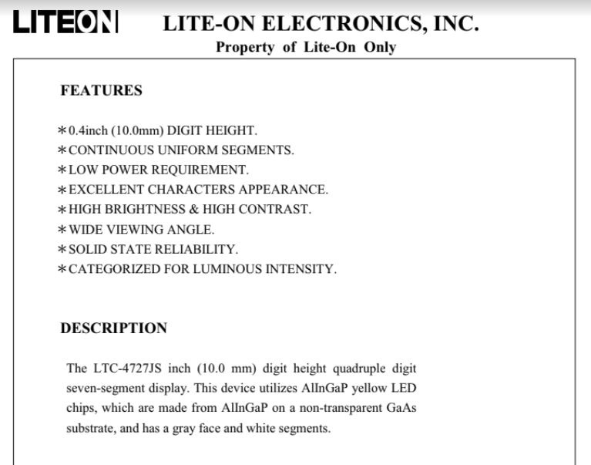
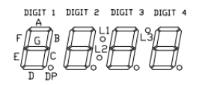
7 Segment

Slide 8
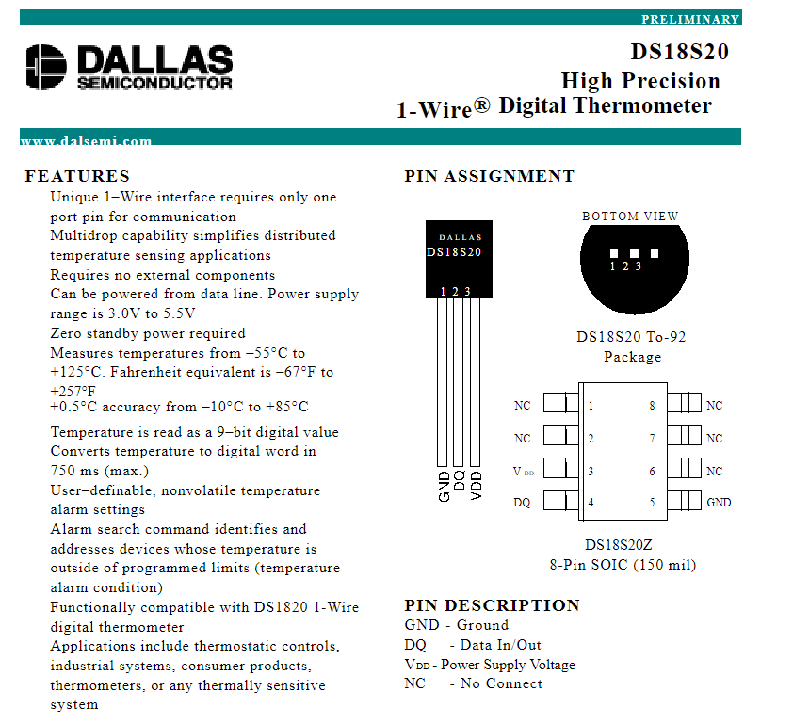
DALLAS DS18B20

Slide 9
Model design
System information
MCU : STM32L152RB
Sensor : DALLAS DS18B20
7 segment : 2-digit
Software : Keil/Language:C

Slide 10
Model design
Behavior
Show value
Range : 2 digits
Unit : Celsius
Measure temperature
operating length
-55 - 125 degrees Celsius
Indicate status
≥30 degrees Celsius
Function
Measure temperature
Temperature sensor
Show value
7 segment
Motor
DC fan 5v

Slide 11




Model design
Port/pin | 0 | 1 | 2 | 3 | 4 | 5 | 6 | 7 | 8 | 9 | 10 | 11 | 12 | 13 | 14 | 15
A
B
C
D
H
7 segment
L293D
DALLAS DS18B20
Not use

Slide 12
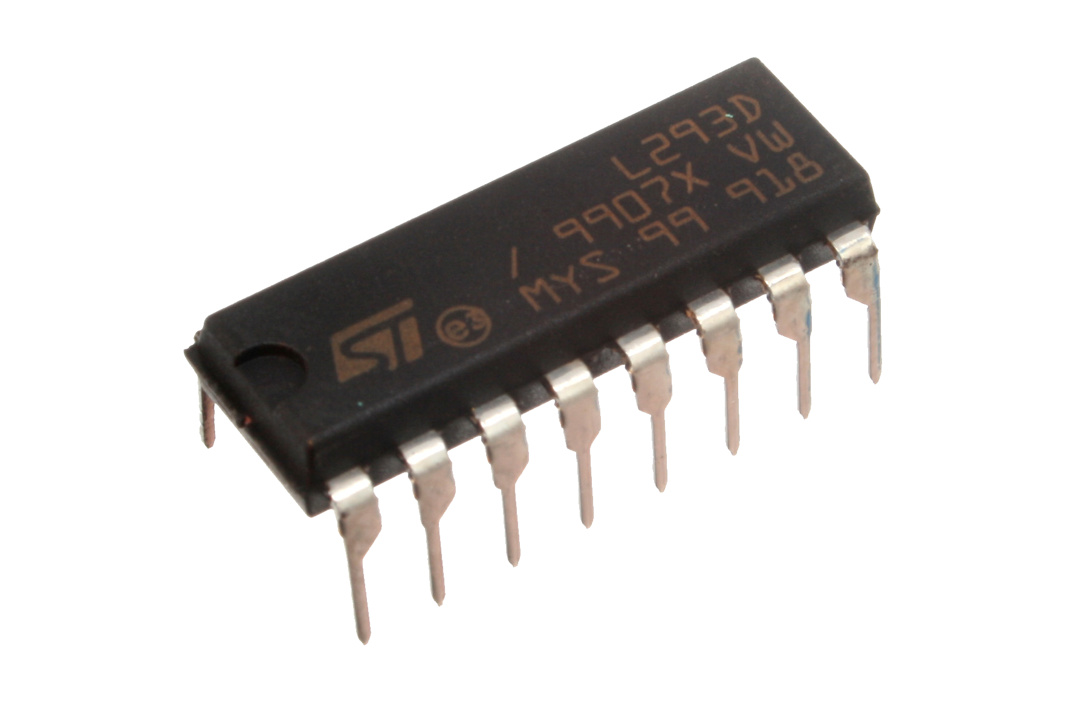
Model design
PB 2 10 11 12 13 14 15
PC 1 2
7 segment
sensor
L293d
PB 4 5 7
PB 6
DS18B20

Slide 13
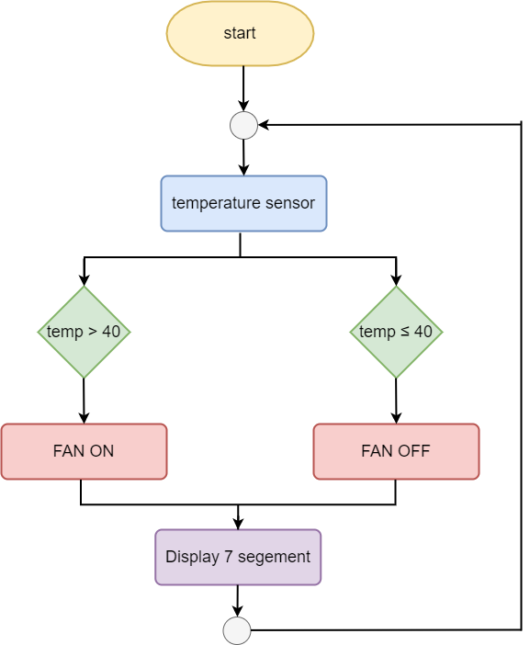
System flowchart

Slide 14
Gantchart

Slide 15
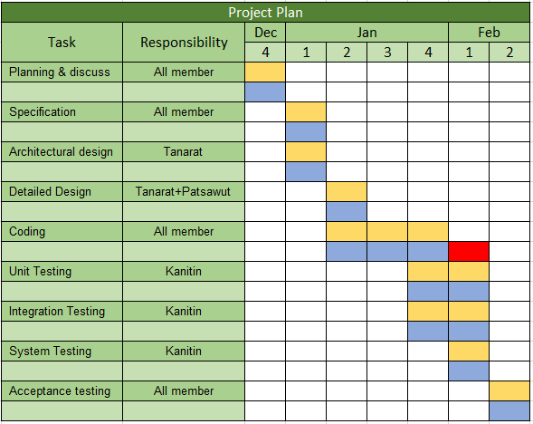


Slide 16
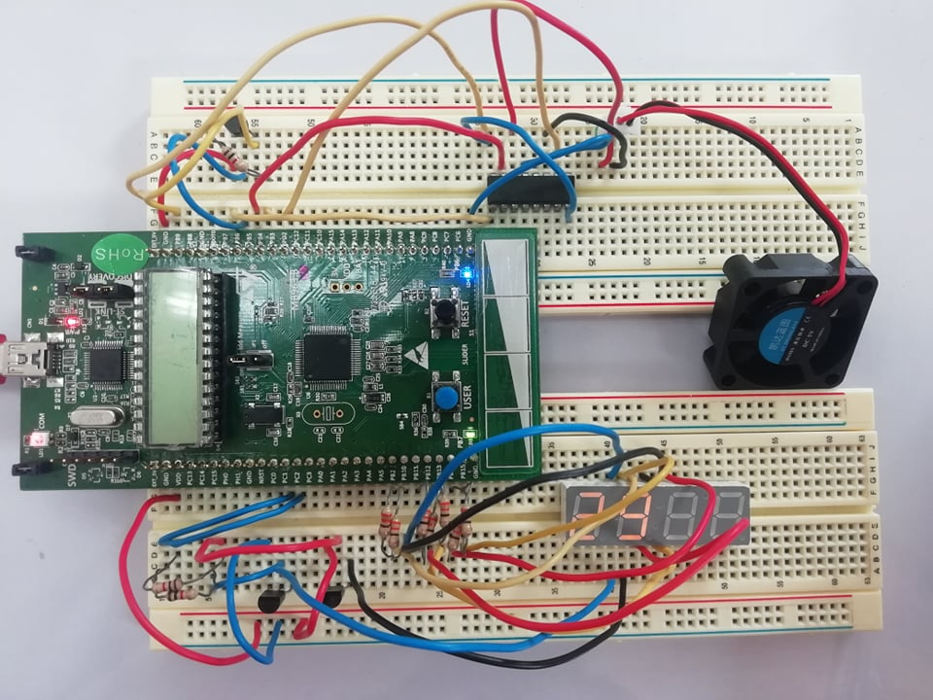
Circuit

Slide 17
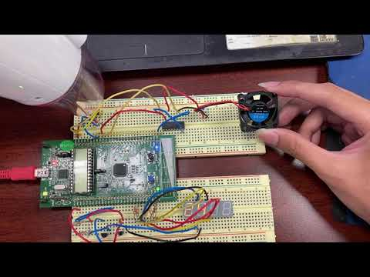
Example VDO

Slide 18
Problem And solution

Slide 19
Hardware Component lists
Component list | Qty. | มีแล้ว | รอเบิก | รอซื้อ | แหล่งซื้อ | ราคา/ชิ้น | ราคารวม
STM32L152RB Board | 1 | /
L293D | 1 | /
DS18B20 | 1 | /
7 Segment | 1 | /
DC Fan 5V | 1 | / |  |  | shopee | 43 | 43
Pin Header for DC Fan | 1 | / |  |  | shopee | 31 | 31
Wire | -
 |  |  |  |  |  |  | 74

Slide 20
Thank you

