Slide 1
LAB 11 POINTERS
2024/12/3

Slide 2
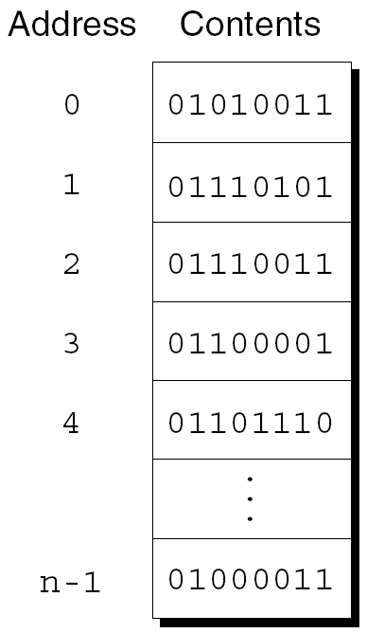
Addresses
Essentially, the computer's memory is made up of bytes. Each byte has a number, an address, associated with it.
Each byte has a unique address

Slide 3
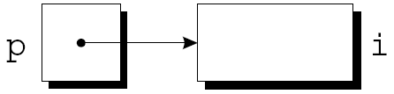
Pointer Variables
Addresses can be stored in pointer variables
When we store the address of a variable i in the pointer variable p, we say that p “points to” i
A graphical representation

Slide 4
Declaring Pointer Variables
When a pointer variable is declared, its name must be preceded by an asterisk *
int *p; /*points only to integers */
p is a pointer variable capable of pointing to objects of type int
Pointer variables can appear in declarations along with other variables
int i, j, a[10], b[20], *p, *q;

Slide 5
Address and Indirection Operators
& (address) operator : Find the address of a variable
* (indirection) operator : Gain access to the object that a pointer points to
Ex. address
int i=5;
cout<<“value of i: ”<<i<<endl;
cout<<“adress of i: ”<<&i;
Output: value of i : 5
address of i : 0x6dfefc

Slide 6
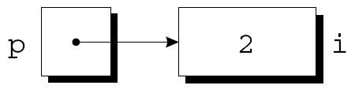
The Indirection Operator
Once a pointer variable points to an object, we can use the * (indirection) operator to access what’s stored in the object
Ex.
int i = 2; Output: i = 2
int *p = &i;
cout <<“ i = ” << *p;
*p has the same value as i
Changing the value of *p changes the value of i

Slide 7
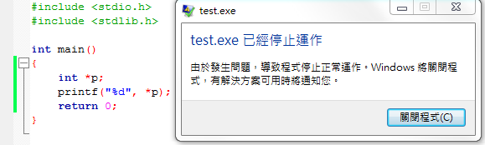
The Indirection Operator
Applying the indirection operator to an uninitialized pointer variable causes undefined behavior
int *p;
cout << *p; /*** WRONG ***/

Slide 8
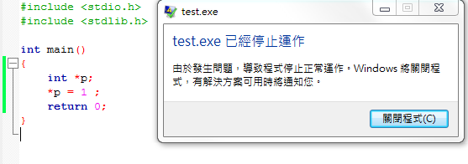
The Indirection Operator
Assigning a value to *p is particularly dangerous
int *p;
*p = 1; /*** WRONG ***/
pointer p is not initialized,
it points to unspecified memory location

Slide 9
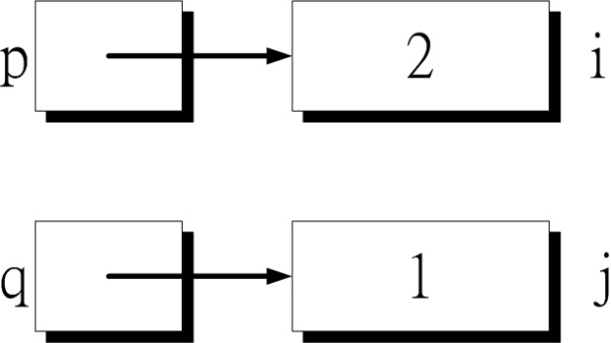
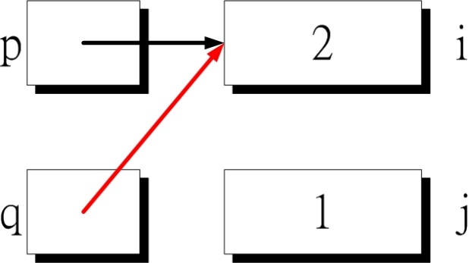
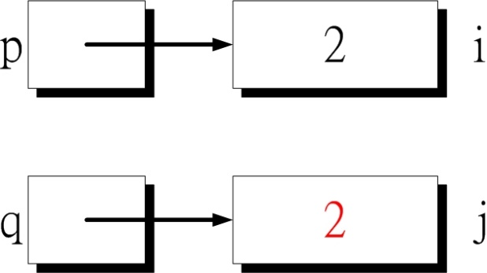
Pointer Assignment
Difference between q = p; and *q = *p;
The first statement is a pointer assignment, but the second is not
q = p
*q = *p

Slide 10
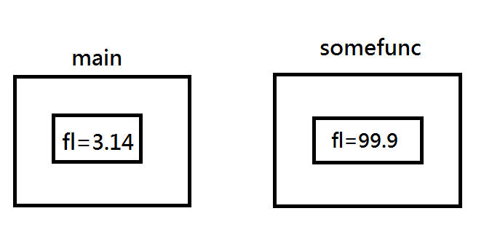
Pass by value
1: #include <stdio.h>
2: void somefunc(float fl)
3: {
4: fl=99.9;
5: }
6: int main()
7: {
8: float fl=3.14;
9: somefunc(fl);
10: cout<<fl;
11: return 0;
12: }
Result？
fl = 3.14

Slide 11
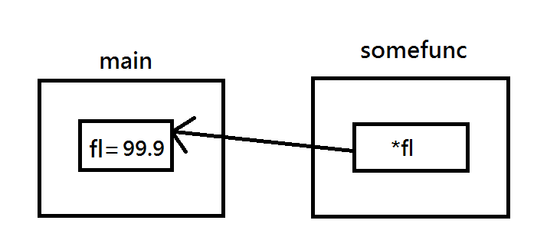
Pass by pointer
1 #include <stdio.h>
2
3 void somefunc(float* fl)
4 {
5 *fl = 99.9;
6 }
7
8 int main()
9 {
10 float fl=3.14;
11 somefunc(&fl);
12 cout<<fl;
13 return 0;
14
15 }
Result？
fl = 99.9

Slide 12
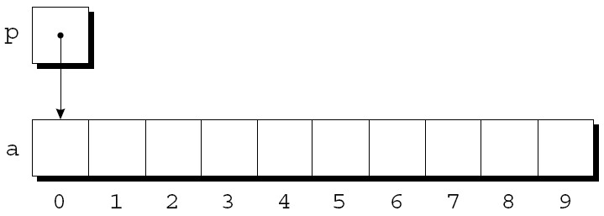
Pointers and Arrays (1/2)
Pointers can point to array elements
int a[10], *p;
p = &a[0];
A graphical representation

Slide 13
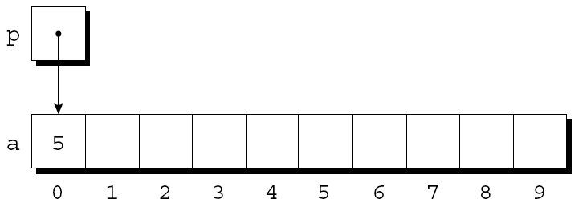
Pointers and Arrays (2/2)
We can now access a[0] through p; for example, we can store the value 5 in a[0] by writing
int *p = &a[0];
*p = 5;
An updated picture

Slide 14
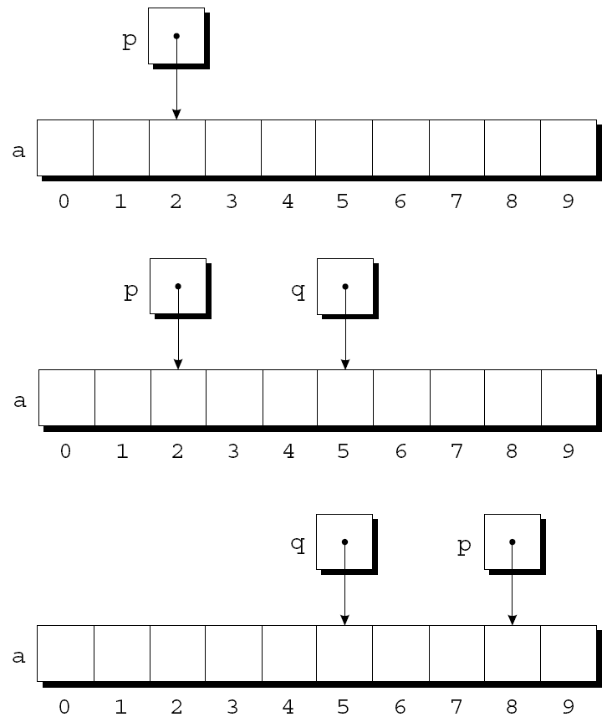
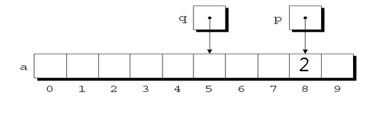
Adding an Integer to a Pointer
Example of pointer addition : int *p,*q;
p = &a[2];
q = p + 3;
p += 6;
*p=2;

Slide 15
Combining * and ++ Operators
Because the postfix version of ++ takes precedence over *, the compiler sees this as
*p++ = j is equal to *(p++) = j;
Think: *p++ increment p later
*++p increment p first
Ex. int *p = &a[0];
*p++ = 5 or *(p++) = 5 means set a[0] = 5, then p points to a[1]
*++p = 5 or *(++p) = 5 means p points to a[1], then set a[1]=5

Slide 16
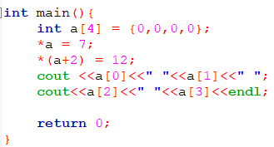
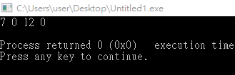
Using an Array Name as a Pointer
Suppose that a is declared as follows
int a[4];
Examples of using a as a pointer
*a = 7; /*stores 7 in a[0]*/
*(a+2) = 12; /*stores 12 in a[2]*/
In general, a + i is the same as &a[i]
Both represent a pointer to element i of a
Also, *(a+i) is equivalent to a[i]
Both represent element i itself

Slide 17
Array Arguments (1/2)
The fact that an array argument is treated as a pointer has some important consequences
For example, the following function modifies an array by storing zero into each of its elements
void store_zeros(int a[], int n)
{
int i;
for(i = 0; i < n; ++i)
a[i] = 0;
}

Slide 18
Array Arguments (2/2)
An array parameter can be declared as a pointer if desired
store_zeros could be defined as follows
void store_zeros(int *a, int n)
{
int i;
for(i = 0; i < n; ++i)
*(a+i)= 0;
}
int main()
{ int a[10];
store_zeros(&a[0],10)
…
}
The compiler treats a[i] as *(a+i)

Slide 19
Exercise(1/4)
You are asked to create a program to manage the inventory of a store. Each product in the inventory has a unique product ID, and a quantity in stock.
Steps:
1. Read in all 5 product IDs.
2. Read in all 5 stock quantities.
3. Given a command, perform the function described below
command | Function
display | Display information for all products
update | Update the quantity of a specific product. If ID not found, print error message.
query | Query the stock quantity of a specific product. If not found, print error message.
sq | Sort products by quantities (ascending order)
sid | Sort products by IDs (ascending order)
exit | Exit the program and terminate the system.
else | Print error message and skip to next command.

Slide 20
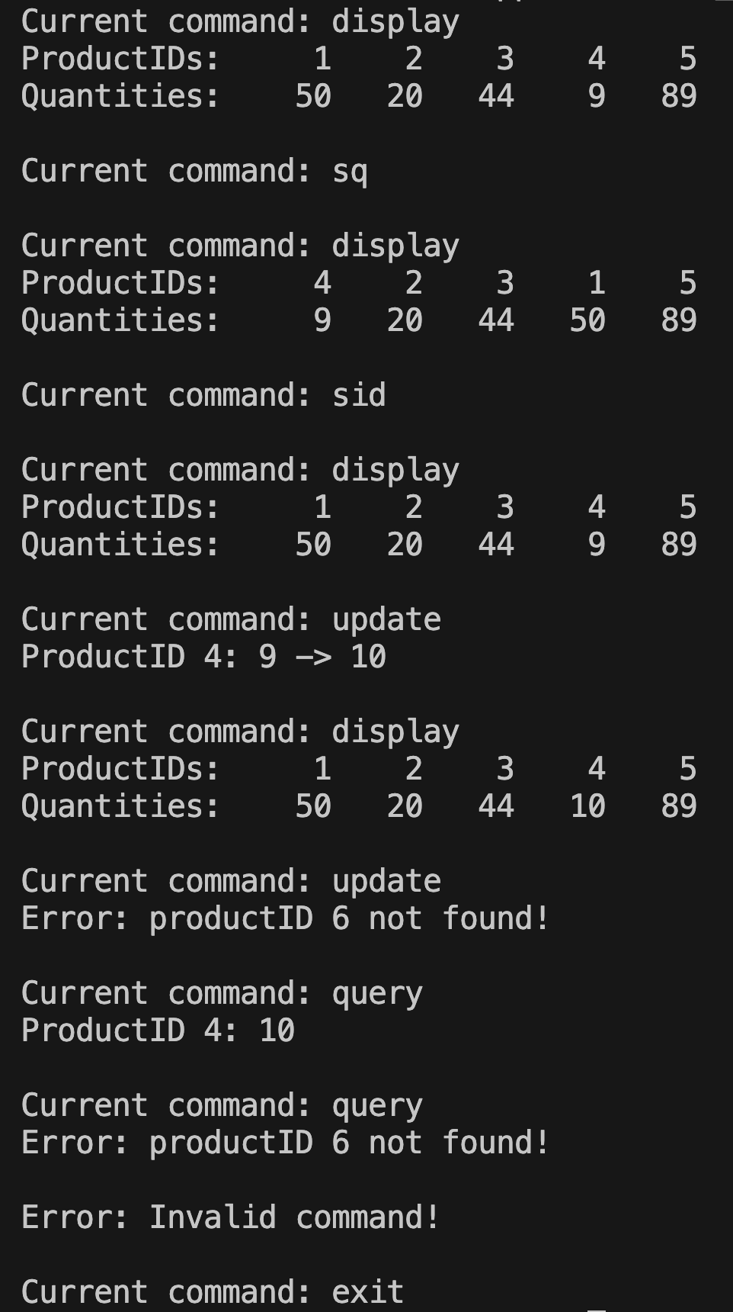
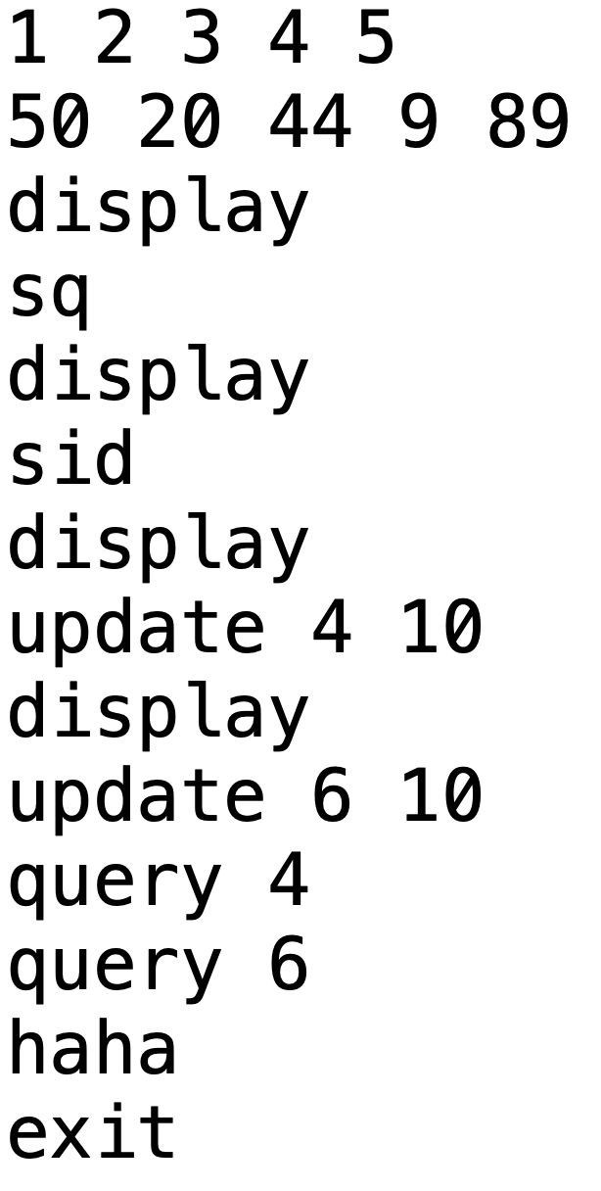
Exercise(2/4)
IDs
Quantities
Commands
update, ID, newQuantity
query, ID

Slide 21
Exercise(3/4)
Output format:
1. display
#include <iomanip>
…
cout << setw(5) << productIDs[i];
…
2. Each command ends with a newline, except for ”exit”.
3. There is one space after every ‘ : ‘.

Slide 22
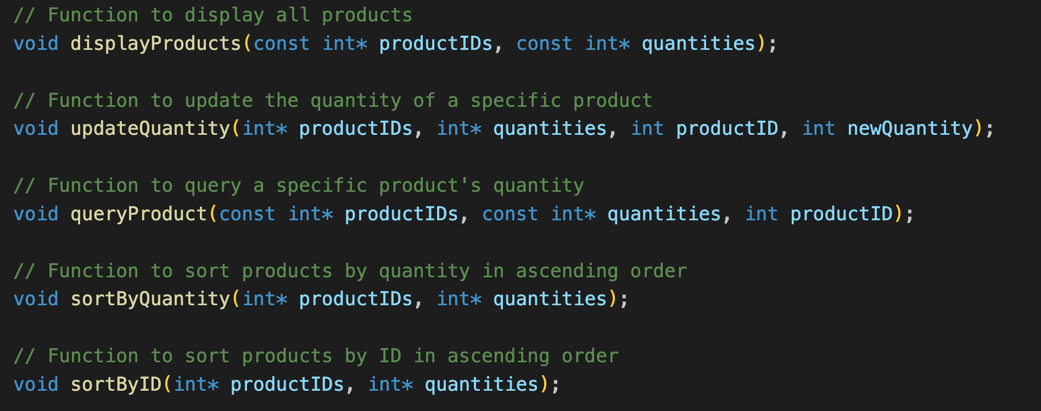
Exercise(4/4)
You may refer to the function definition shown below.
Note: You may define your own function, but you have to implement the call by pointer method !!!

Slide 23
Submission
Ask TAs for demo, and show your result of OJ.
OJ commands:
g++ <cpp_file> -o Lab11
/home/share/2024CPPDEMO Lab 11
Remember to upload your cpp to new E3
Naming rule : <your_student_ID>_Lab11.cpp
Time limit: before 9:20 p.m.

