Slide 1
Life Threatening Prediction due to the adverse effects of Covid-19 Vaccination
Krutika Agrawal
Reshma Rajan
Anoushka Roy
Hazel Abraham
Sayan Biswas
Under the Esteemed Guidance of
Vikash Chandra

Slide 2
INDUSTRY REVIEW
With the help of the application of Data Science in healthcare, it has now become possible to detect the symptoms of a disease at a very early stage. Also, with the advent of various innovative tools and technologies, doctors are able to monitor patients’ conditions from remote locations.
Benefits of Data Science in Healthcare
Data Science helps in advancing healthcare facilities and processes. It helps boost productivity in diagnosis and treatment and enhances the workflow of healthcare systems. The ultimate goals of the healthcare system are as follows:
To ease the workflow of the healthcare system
To reduce the risk of treatment failure
To provide proper treatment on time
To avoid unnecessary emergencies due to the non-availability of doctors
To reduce the waiting time of patients

Slide 3
Business Problem & Solution Approach
The purpose of the project is having a detailed understanding of the common types of adverse reactions of COVID-19 vaccine and identifying which adverse reactions lead to life threatening events.
Further understanding of the project is:
Detect new, unusual, or rare vaccine adverse events
Monitor increases in known adverse events
Identify potential patient risk factors for particular types of adverse events
Assess the safety of newly licensed vaccines
To evaluate factors potentially associated with participant-reported adverse effects after COVID-19 vaccination
Data Understanding
Data Pre-Processing
EDA
Data Mining
Model Building
Model Evaluation
Model Optimisation

Slide 4
UNDERSTANDING THE DATASET
In this project we are trying to predict the possibility of death after vaccination.
We are mainly focusing on adverse effects of Moderna and Pfizer-BioNTech vaccines
There are 49021 records and there are 51 features
Our target is ‘DIED’ column which contains the information of what is the possibility of death post vaccination.
We have taken 3 datasets:
Vaccine dataset :- Some important columns are VAX_TYPE (Administered Vaccine Type), VAX_MANU (Vaccine Manufacturer), VAX_DOSE_SERIES (Number of doses) etc.
Demographic dataset :- Some important columns are DIED ( Target Variable), HOSPDAYS (Number of days Hospitalized), NUMDAYS :Number of days (Onset date - Vax. Date), L_THREAT (Life-Threatening Illness ), CURR_ILL ( Current Illness) etc.
Symptom dataset :- Some important columns are Symptom 1, Symptom 2, Symptom 3 , Symptom 4 and Symptom 5 etc.

Slide 5

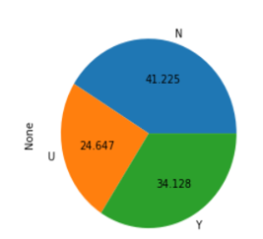
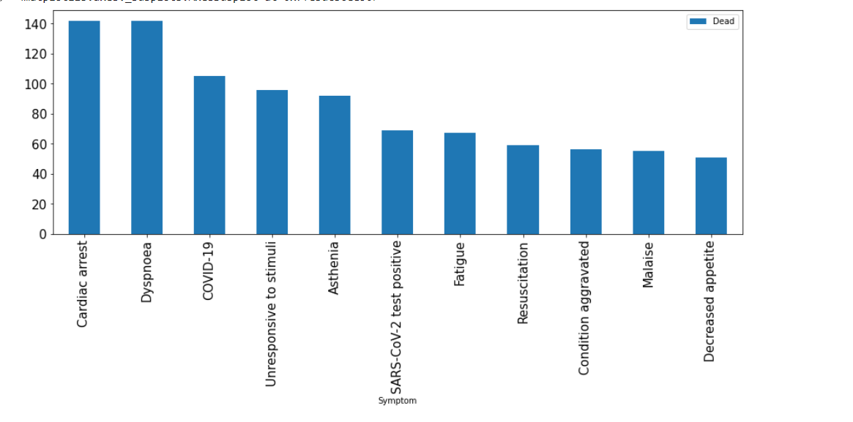
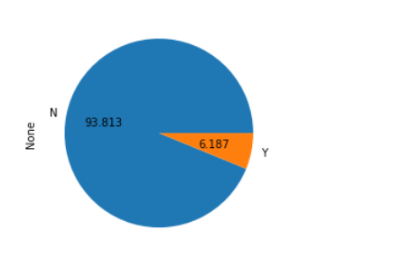

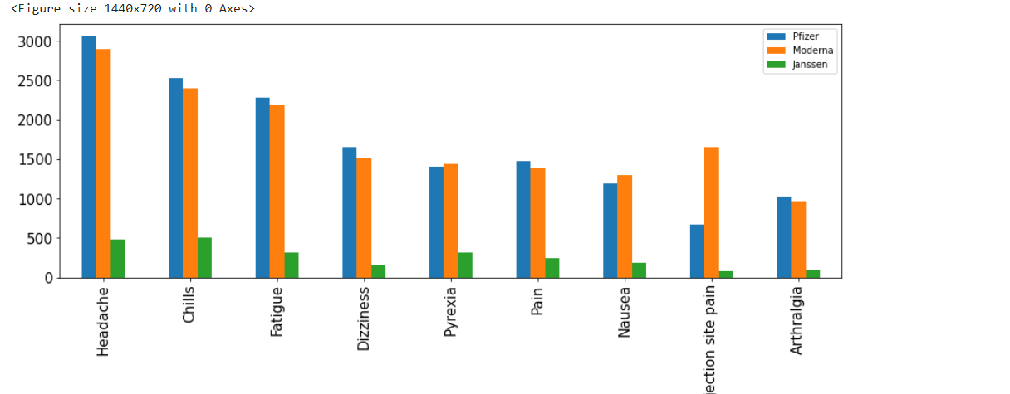
EXPLORATORY DATA ANALYSIS(EDA)
percentage of people recovered
Percentage of people died

Slide 6
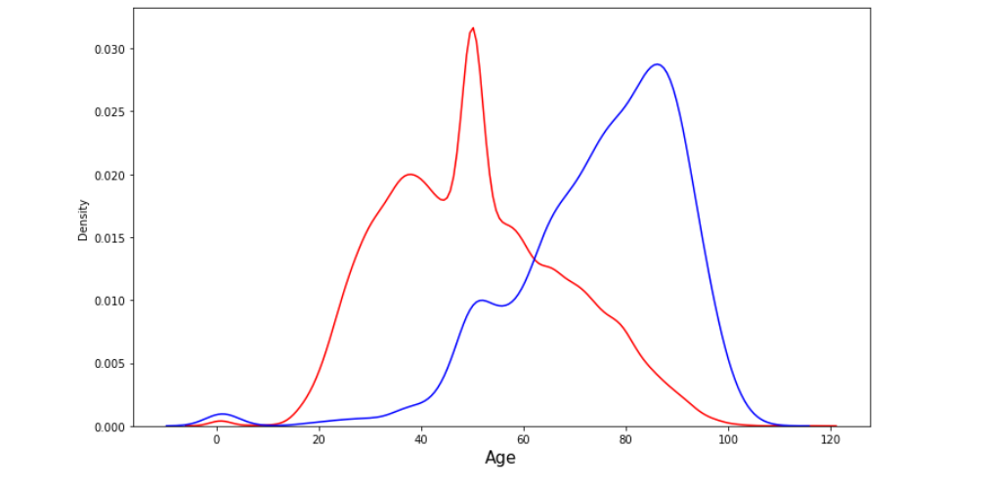
This is a plot of age distribution against death status. Red is for not dead , blue is for dead

Slide 7
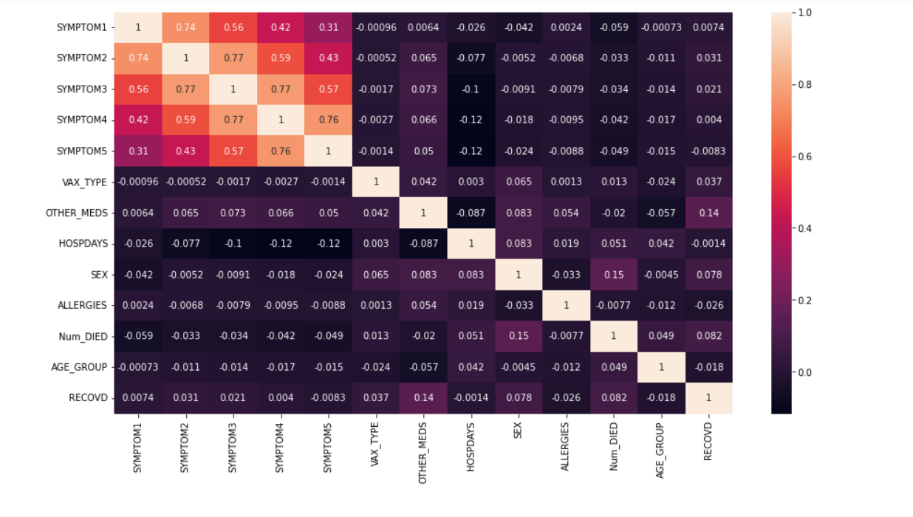
Checking for Multicollinearity
The SYMPTOM1, SYMPTOM2,SYMPTOM3,SYMPTOM4 And SYMPTOM 5 has high Positive Correlation. So there will be Presence of Multicollinearity between these features

Slide 8
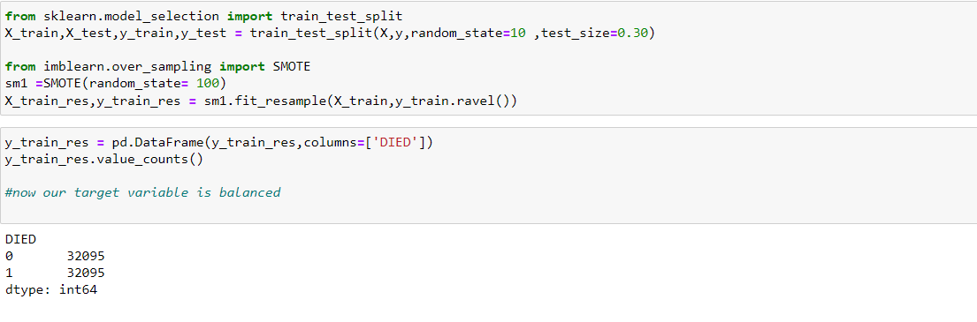
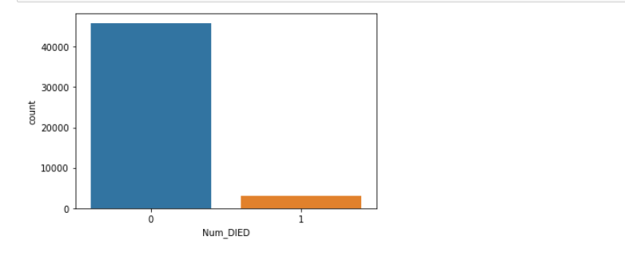
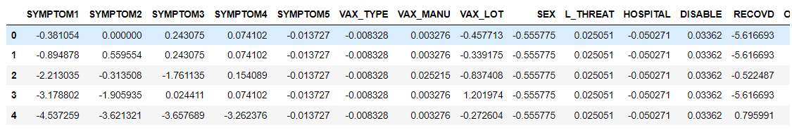
BALANCING THE TARGET VARIABLE
IMBALANCED TARGET VARIABLE
USING SMOTE
ENCODING THE CATEGORICAL FEATURES USING WEIGHT OF EVIDENCE ENCODING

Slide 9
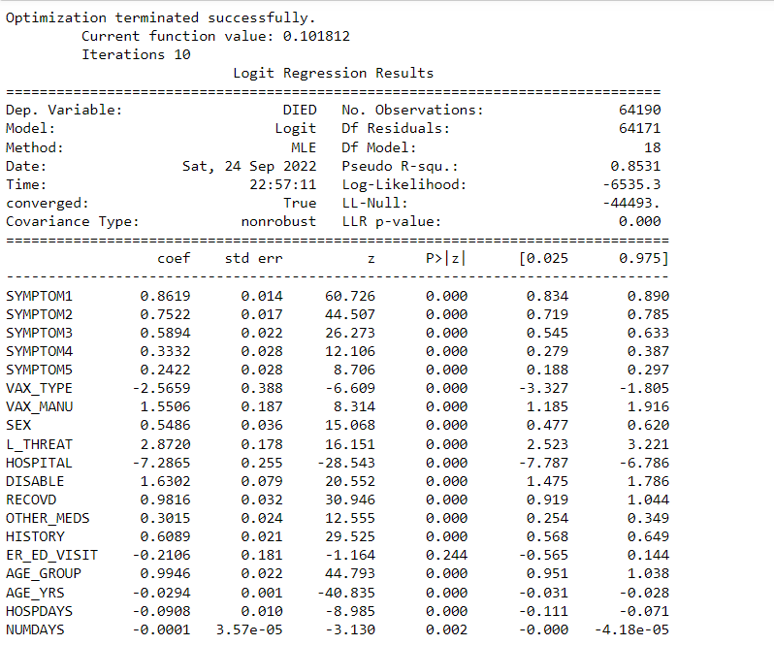
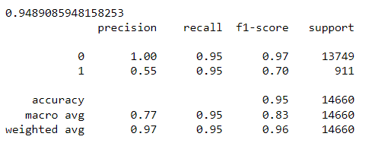
BUILDING FULL MODEL
USING LOGIT
USING LOGISTICREGRESSION

Slide 10
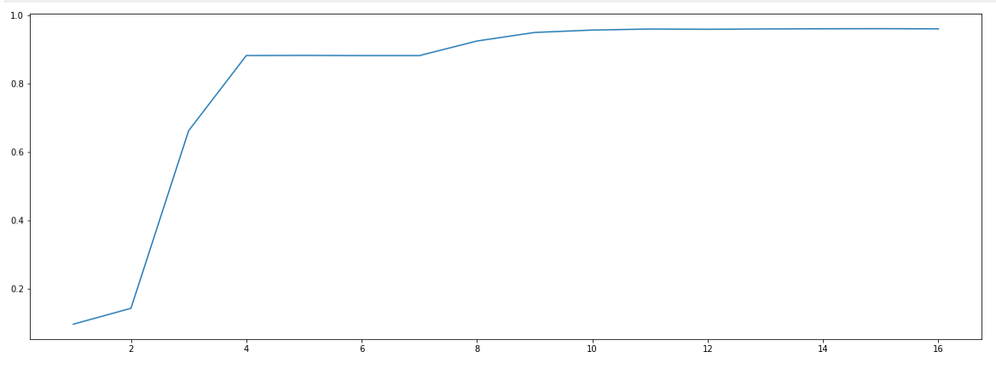
FEATURE SELECTION
In our basic model we have a lot of features present, so we performed feature selection for our further models using Recursive Feature Elimination (RFE) algorithm. We have chosen RFE as it is easy to configure and it is effective at selecting those features which are most relevant in predicting the target variable.
We have plot the model score for different values of no. of features (n) and found out that after n=11 the score of the model almost saturated, so we have chosen no. of features equals to 11.

Slide 11
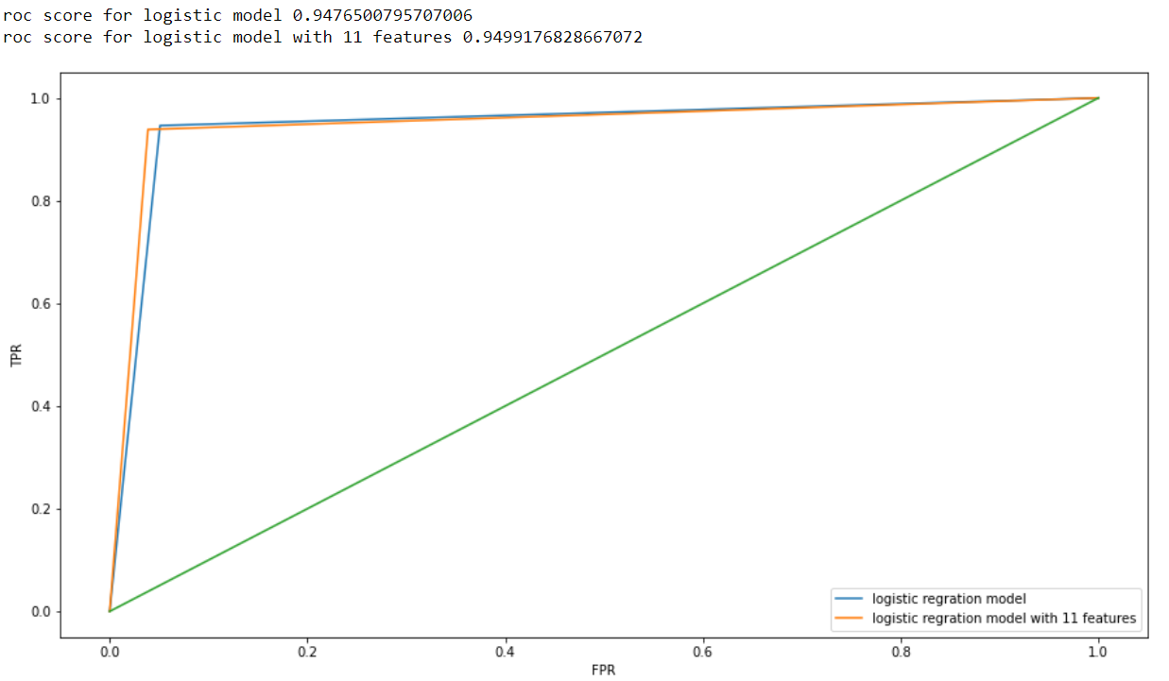
ROC CURVE BEFORE AND AFTER FEATURE SELECTION

Slide 12
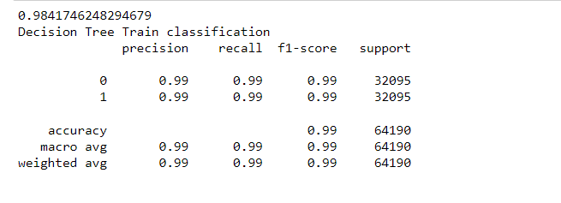
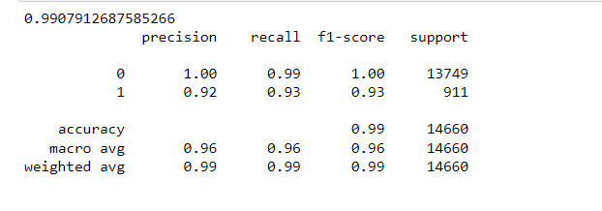
DECISION TREE RANDOM FOREST

Slide 13
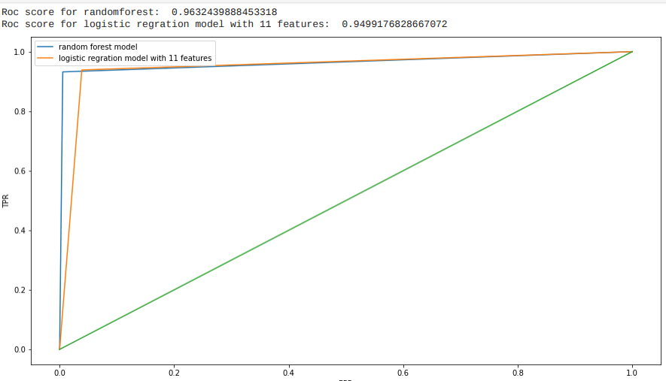
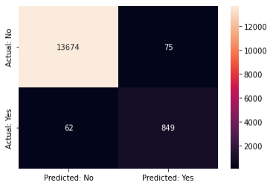
ROC AUC CURVE CONFUSION COMPARISON MATRIX
CONFUSION MATRIX FOR RANDOM FOREST

Slide 14
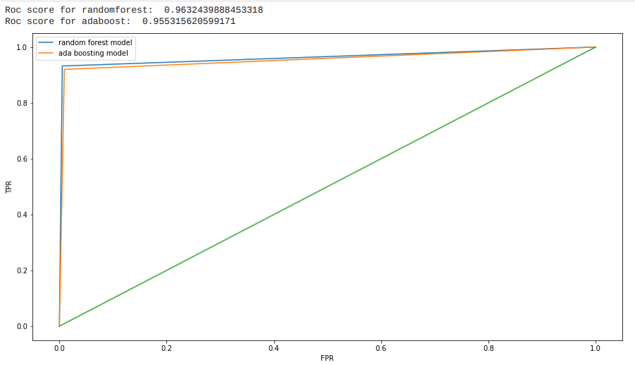
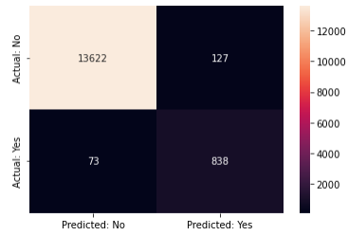
MODEL BUILDING USING IMPORTANT FEATURES USING ADABOOST
CONFUSION MATRIX FOR ADABOOST

Slide 15
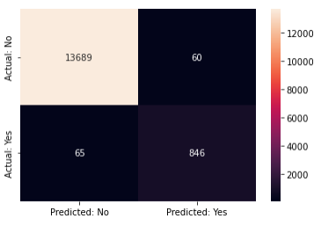
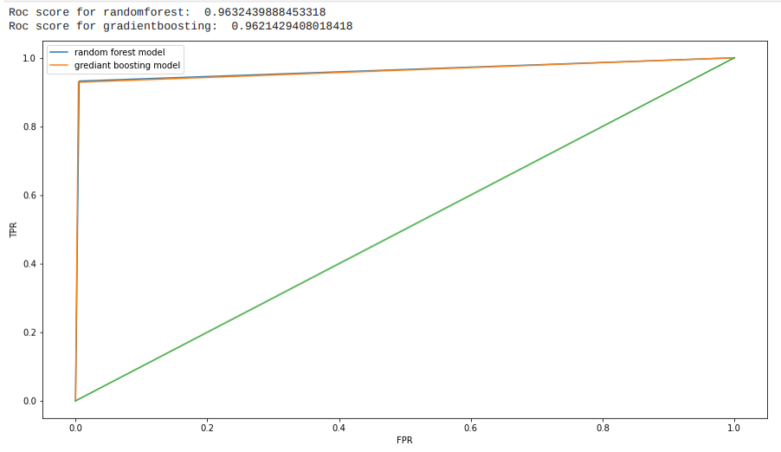
MODEL BUILDING USING IMPORTANT FEATURES USING GRADIENT BOOSTING
CONFUSION MATRIX FOR GRADIENT BOOSTING

Slide 16
MODEL SUMMARY
MODEL | Precision | F1-Score | Recall
Decision Tree (Train) | 0.99 | 0.99 | 0.99
Decision Tree (Test) | 0.91 | 0.94 | 0.96
Random Forest (Train) | 0.99 | 0.99 | 0.99
Random Forest (Test) | 0.96 | 0.95 | 0.95
Ada Boosting (Test) | 0.94 | 0.95 | 0.96
Gradient Boosting (Test) | 0.97 | 0.97 | 0.96
FROM THE ABOVE TABLE WE CAN INFER THAT RANDOM FOREST AND GRADIENT BOOSTING ALMOST GIVING SIMILAR RESULTS, BUT GRADIENT BOOSTING IS GIVING A BETTER RESULT THAN OTHERS MODEL.

Slide 17
CONCLUSION
In the healthcare sector, a huge amount of data is generated continuously and this data can be used to extract meaningful information.
Through our project we have tried to predict if someone is going to die from the side effect of the Covid-19 Vaccination. We have made a good quality model for this purpose which can predict this.
Although we have some wrong prediction while testing but that is well under the limit and most of the prediction were correct.
So through our model we can actually predict if someone's life is at risk due to the ill effect of vaccination and we can start to treat him/her accordingly before hand to save their lives

Slide 18
REFERENCES
The references can be blogs, articles or even social media news relevant to explain the importance of the projects.
https://www.kaggle.com/datasets/ayushggarg/covid19-vaccine-adversereactions?resource=download&select=2021VAERSDATA.c

Slide 19
THANK YOU

