Slide 1
Detection of COVID 19 presented by Hazem Abdelsattar

Slide 2
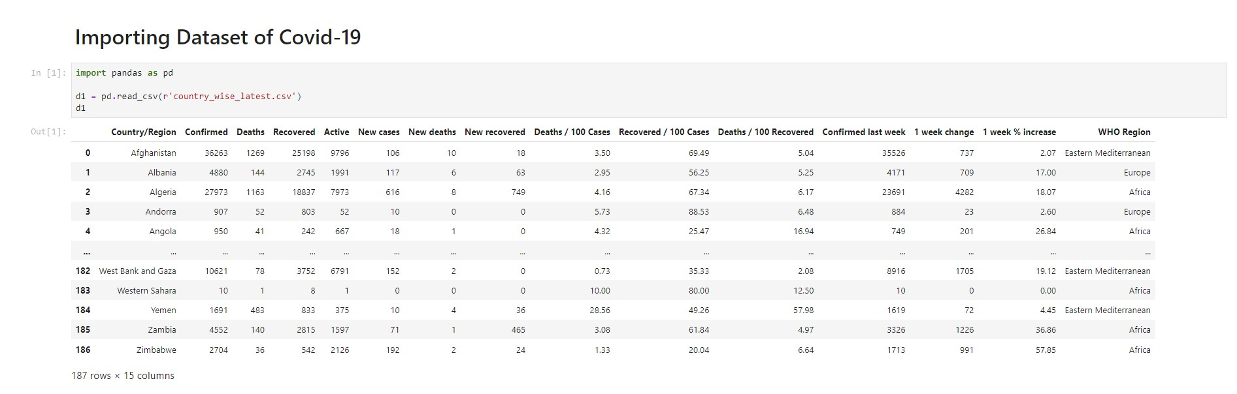
Reading The Database

Slide 3
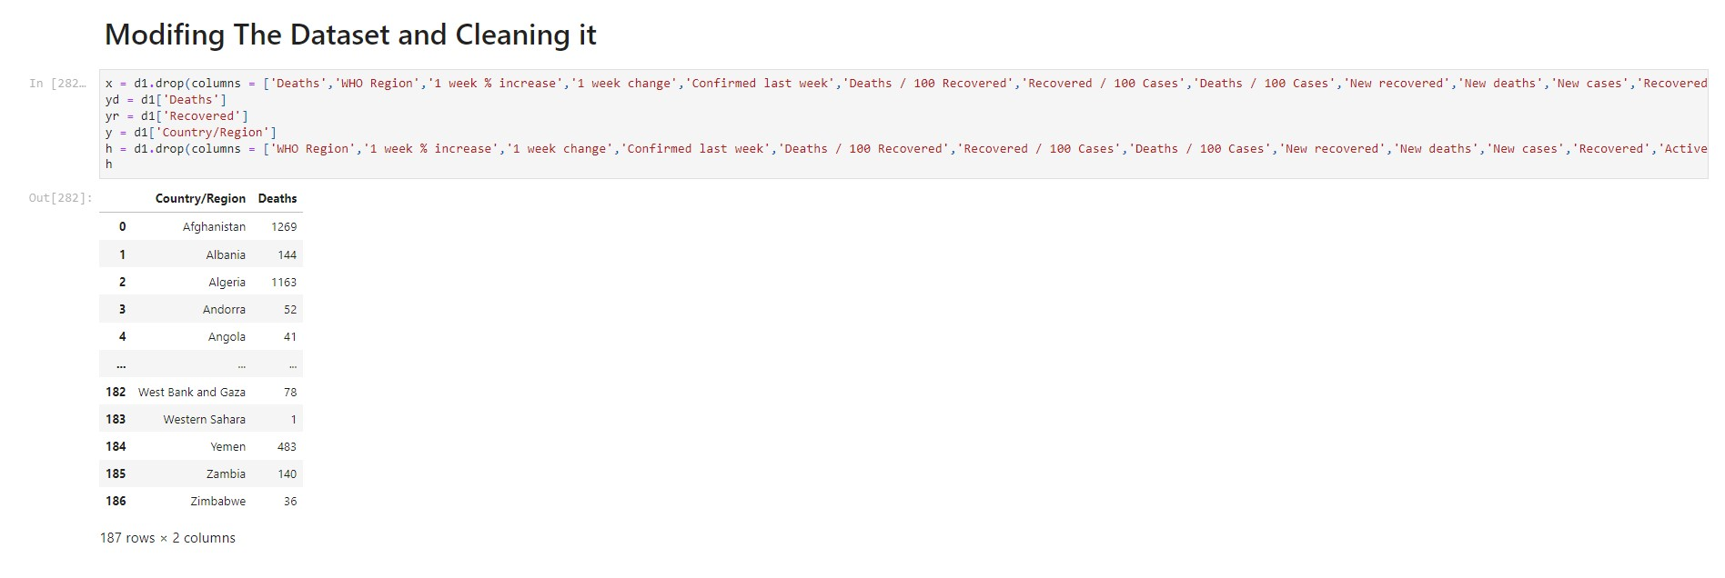
Modify it and get the attributes ready!

Slide 4
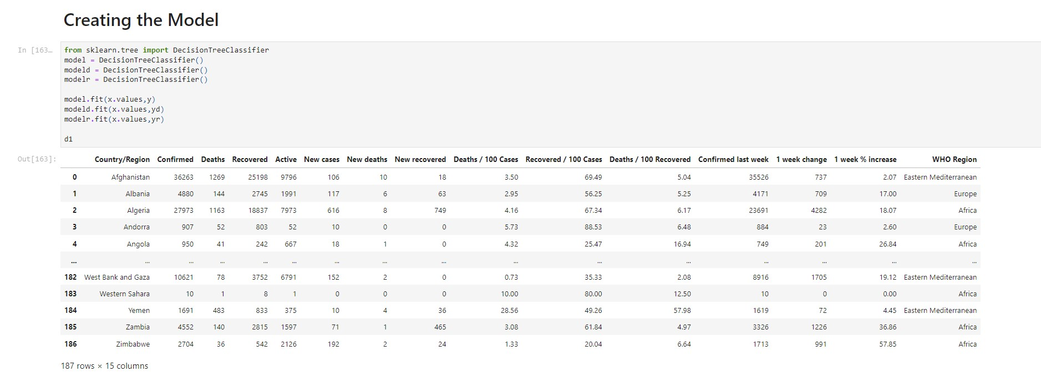
Creating The Model !

Slide 5
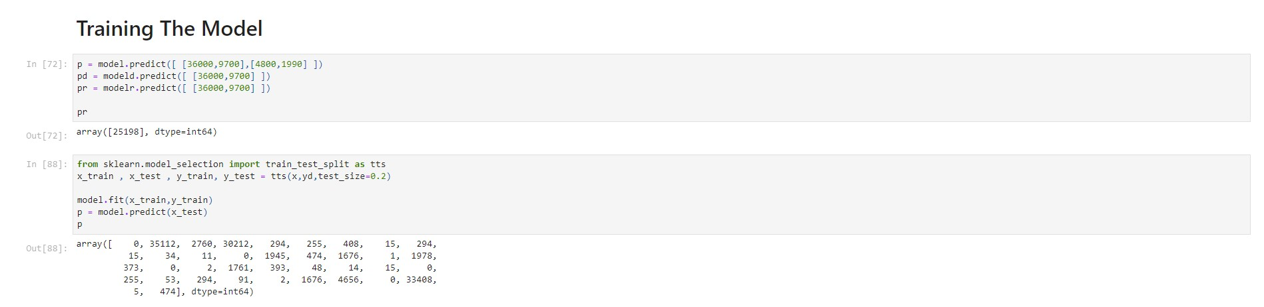
Training The Model

Slide 6
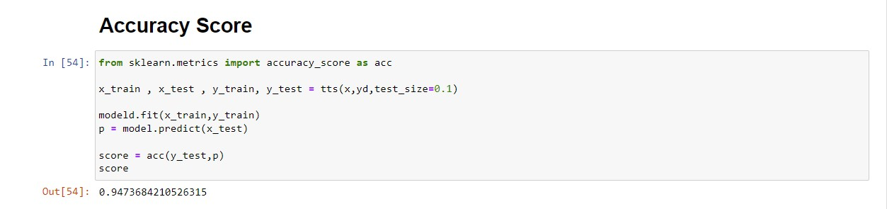
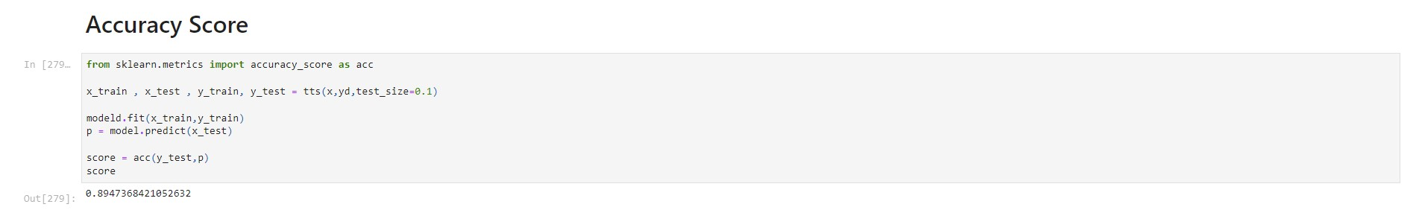
Our Accuracy Score Reached 94% !

Slide 7
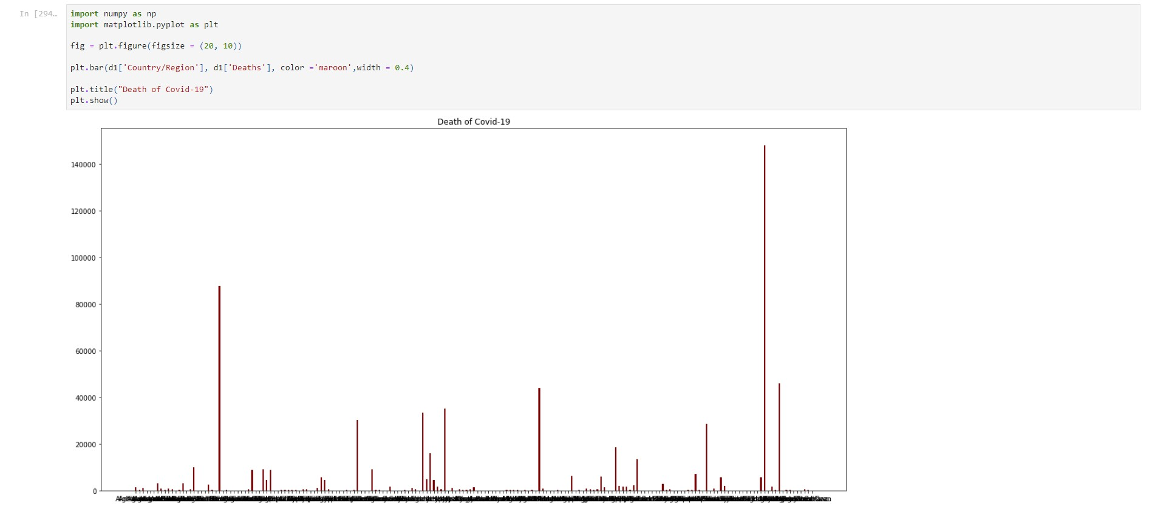
Bar Representation

Slide 8
Thank You !

