Slide 1
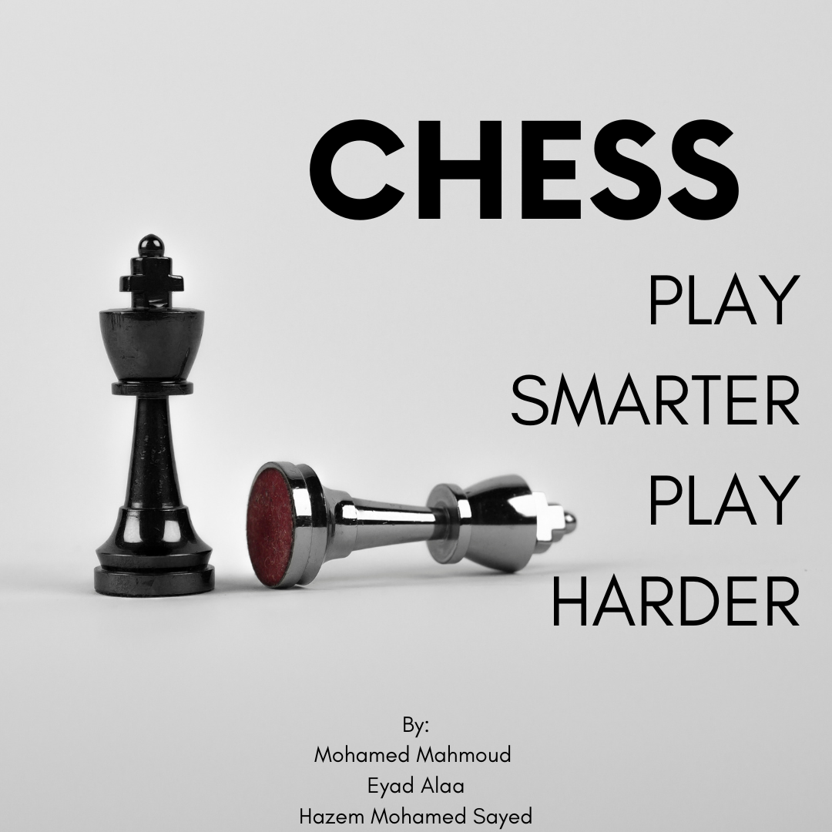

Slide 2

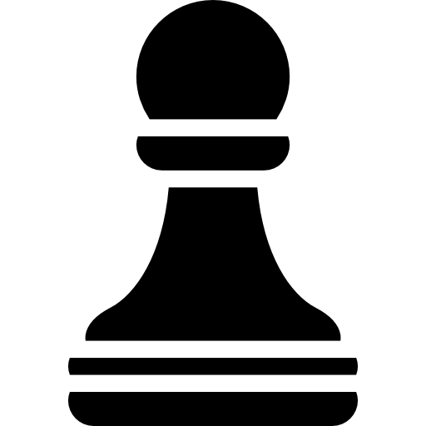

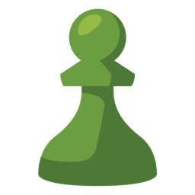
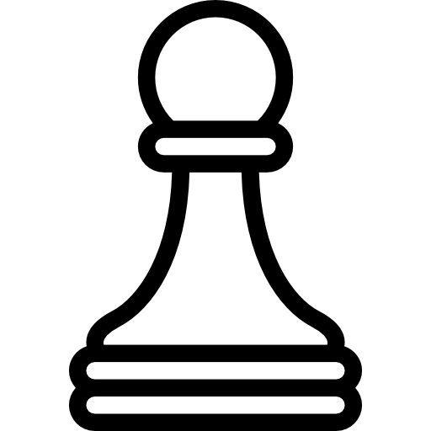

Project Overview:
Goal: Develop a functional and interactive chess game
Technologies: Python programming language, basic graphical interface libraries

Slide 3

Why Chess?
Chess is a classic and strategic board game that challenges the mind.
Enhances logical thinking, problem-solving, and strategic planning skills.

Slide 4
Objectives:
Understand the rules and mechanics of chess.
Implement the game logic for all pieces and moves.
Create a user-friendly interface to play the game.

Slide 5
Project Highlights:
Developing algorithms to validate legal moves.
Designing the graphical user interface (GUI) for the chessboard.
Implementing a user-friendly experience with intuitive controls.

Slide 6
Key Features:
Interactive chessboard with pieces.
Highlighting legal moves and capturing opponents' pieces.
Implementing castling, and promotion mechanics.

Slide 7
Tools and Libraries:
Python programming language (3.11 version)
Pygame for GUI implementation

Slide 8
Thank you for your attention!
Get ready to dive into the world of Python chess programming!

